Slide 1
Computational Proteomics and Metabolomics
Oliver Kohlbacher, Sven Nahnsen, Knut Reinert
0. Introduction and Overview

Slide 2
Systems Biology – Definition
“Systems biology is a relatively new biological study field that focuses on the systematic study of complex interactions in biological systems, thus using a new perspective (integration instead of reduction) to study them. Particularly from year 2000 onwards, the term is used widely in the biosciences, and in a variety of contexts. Because the scientific method has been used primarily toward reductionism, one of the goals of systems biology is to discover new emergent properties that may arise from the systemic view used by this discipline in order to understand better the entirety of processes that happen in a biological system.”
http://en.wikipedia.org/wiki/Systems_biology (06/06/2008)

Slide 3
Integration vs. Reductionism
Systems biology as an integrative approach takes the reductionist approach one step further
Do not only understand the components, but understand ‘emerging properties’ of a system
Key of this is the integration of different data, covering different aspects of the system
Integrated modeling of the whole system can then reveal these emerging and dynamic properties
Example:
circadian clock – the temporal (dynamic) behavior is an emerging property of the rather simple interaction of a few key players.

Slide 4
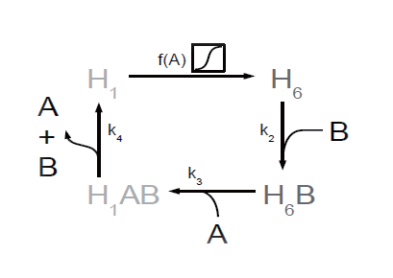
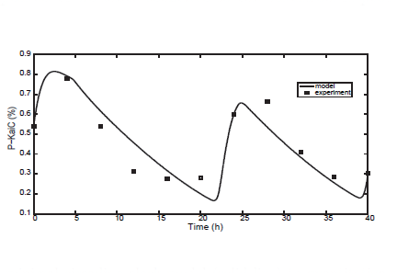
Circadian Clock in Cyanobacteria
Circadian clocks are internal oscillators implementing a 24 hour rhythm in most organisms
The model shown on the right is a simple model for cyanobacteria including three genes (KaiA, KaiB, and KaiC – A/B/C)
Their interaction, phosphorylation, hexamer formation (H₆), etc. are simple processes that can be described mathematically
Together these simple processes give rise to the oscillation shown on the right, which agrees well with experimental data
Looking at each of the processes in isolation will not reveal the osciallation
I. Axmann, S. Legewie, and H. Herzel (2007). A minimal circadian clock model. Genome Informatics. 18:54-64.
Notes:
Minimal model of the cyanobacterial circadian core clock comprising KaiA, KaiB and
KaiC proteins. (1) Depending on the available amount of free KaiA proteins, KaiC hexamers switch
between a de-(H1) and a phosphorylated (H6) state. (2) KaiB proteins bind to phosphorylated
KaiC hexamers resulting in a conformational change of the KaiBC protein complex (H6B). (3)
KaiA proteins join the KaiBC complex. Conformational change and sequestration of free KaiA by
complexation favor KaiC dephosphorylation. (4) The dephosphorylated complexes (H1AB) breakup
and release KaiA, KaiB and dephosphorylated KaiC hexamers (H1) which restarts the circle.
(Axmann et al.)

Slide 5
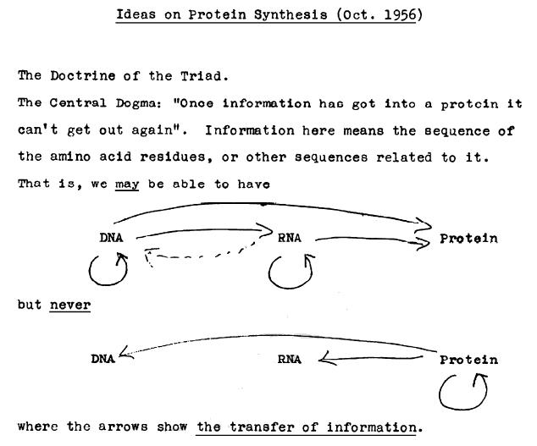
Central Dogma of Molecular Biology
First articulation by Francis Crick in 1956
Published in Nature in 1970
Origin of the “Central Dogma of Molecular Biology” (Francis Crick, 1956)
Notes:
Nobel price 1962 for double helix
TODO: correct citation is missing

Slide 6
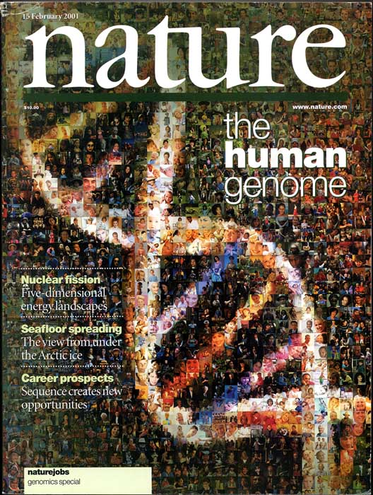
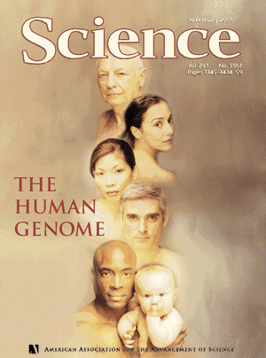
Genome sequencing
February 2001 – Publication of the first draft of the human genome
Notes:
TODO: references for covers are missing…

Slide 7
‘Postgenomics’ – The Age of Omes
-ome, comb. form
[…]
3. Cell Biol. and Molecular Biol. Forming nouns with the sense ‘all of the specified constituents of a cell, considered collectively or in total’, as plastidome n., plastome n., vacuome n.
(Oxford English Dictionary online)
Ever since the rise of genomics, the suffix "-omics" has been added to many fields to denote studies undertaken on a large or genome-wide scale. While not everyone agrees with this change of terms, we felt that the terms are sufficiently widely used to serve as pointers to our published papers in the area. (Website of ‘Nature’)
http://www.oed.com
http://www.nature.com/omics/about/index.html

Slide 8
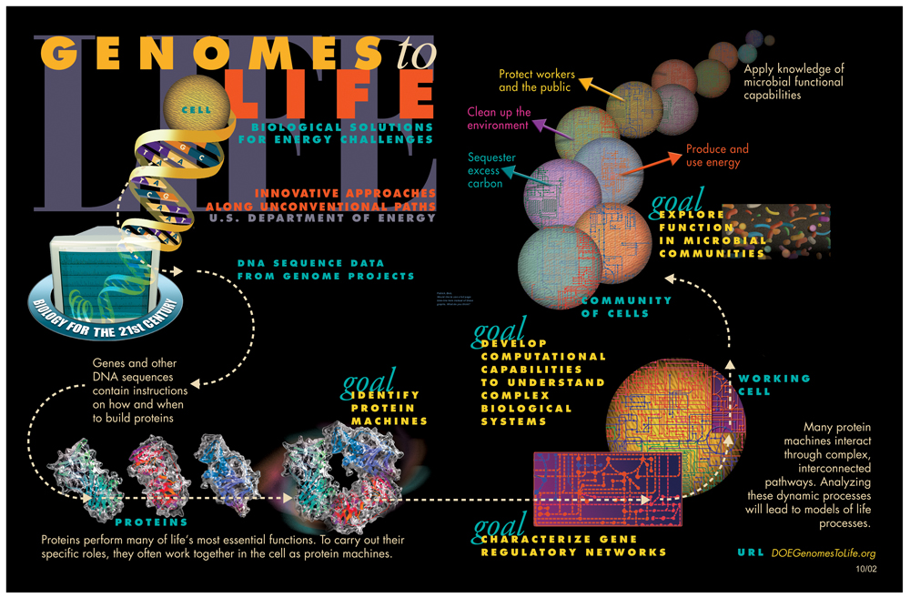
Notes:
TODO: missing image source

Slide 9
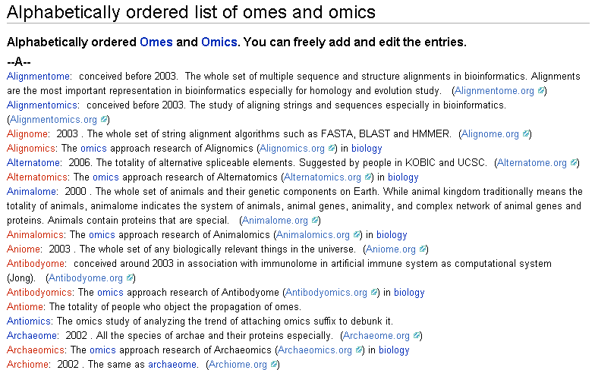
OMICS Mania
http://omics.org/index.php/Alphabetically_ordered_list_of_omes_and_omics

Slide 10
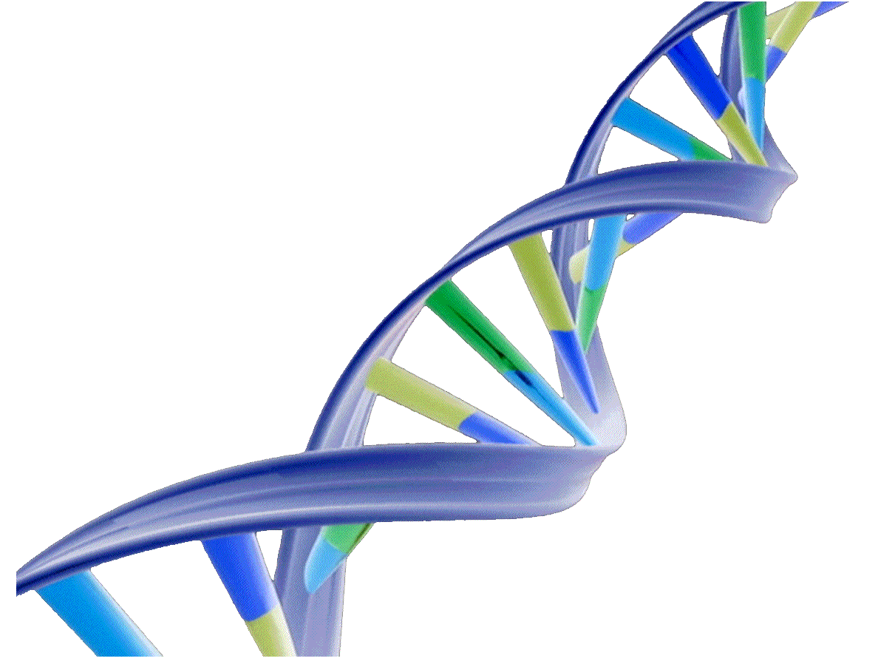
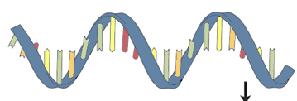
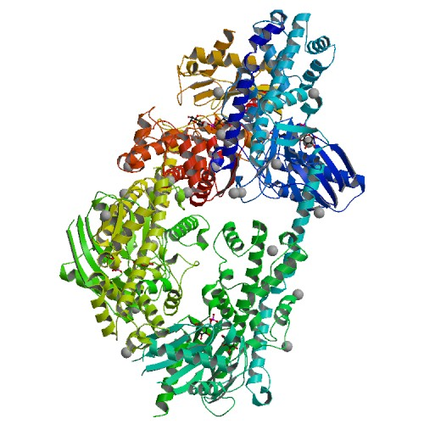
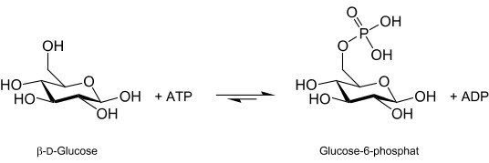
The World of Omes
DNA
Genome
Transcriptome
Proteome
Metabolome
mRNA
Protein
Metabolites
http://www.pdb.org/pdb/images/2nzt_bio_r_500.jpg
Notes:
Human hexokinase 2 (NextProt: HK2)
PDB: 2NZT
gene: ENSEMBLE http://www.ensembl.org/Homo_sapiens/Export/Output/Gene?db=core;flank3_display=0;flank5_display=0;g=ENSG00000159399;output=fasta;r=2:75061108-75120486;strand=feature;param=cdna;param=coding;param=peptide;param=utr5;param=utr3;param=exon;param=intron;genomic=unmasked;_format=Text

Slide 11
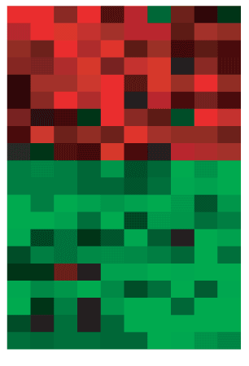
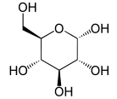
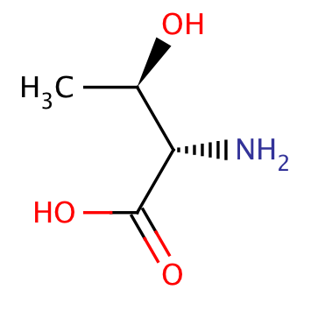
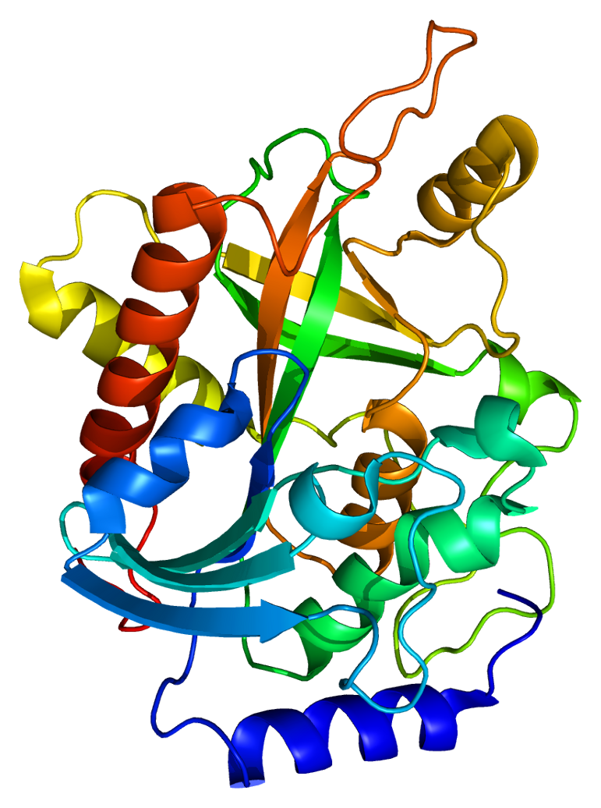
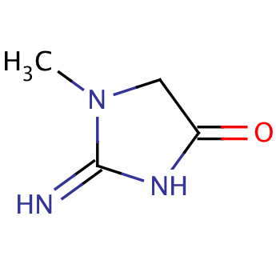
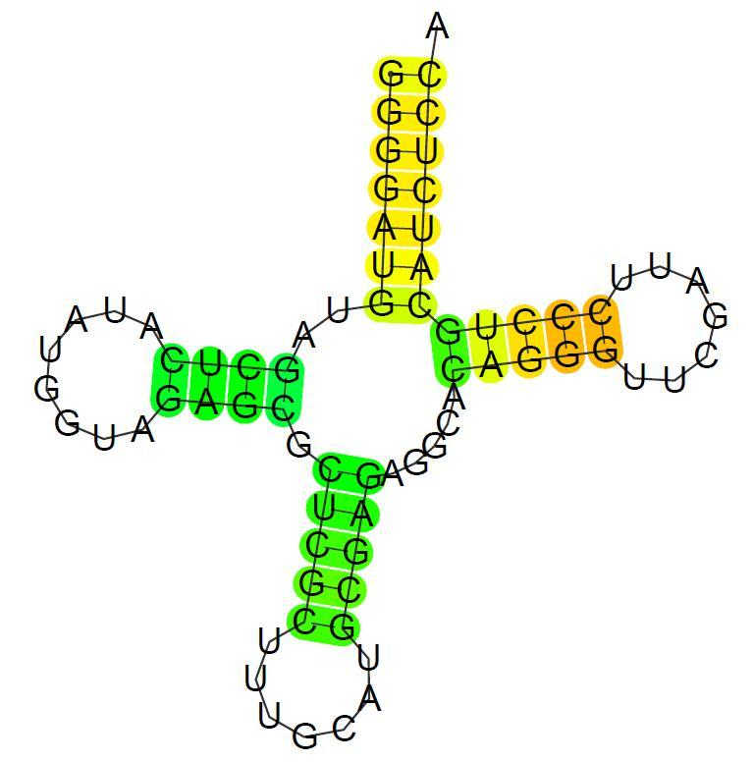
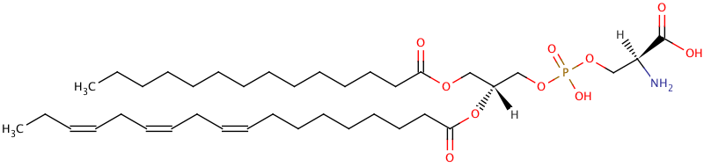
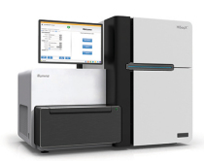
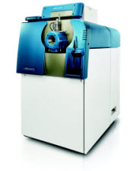
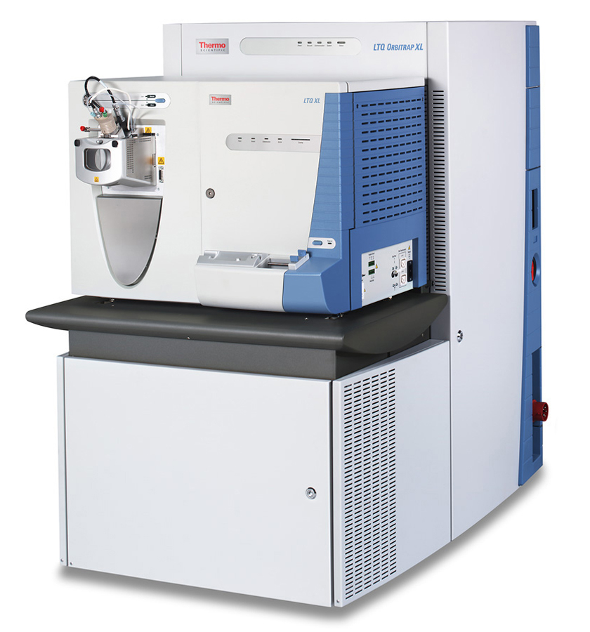
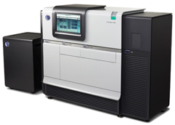
Technologies
Genome
Epigenome
Transcriptome
RNOme
Proteome
Interactome
Metabolome
Lipidome
Next-Generation Sequencing
Mass Spectrometry
Notes:
TODO missing image sources

Slide 12
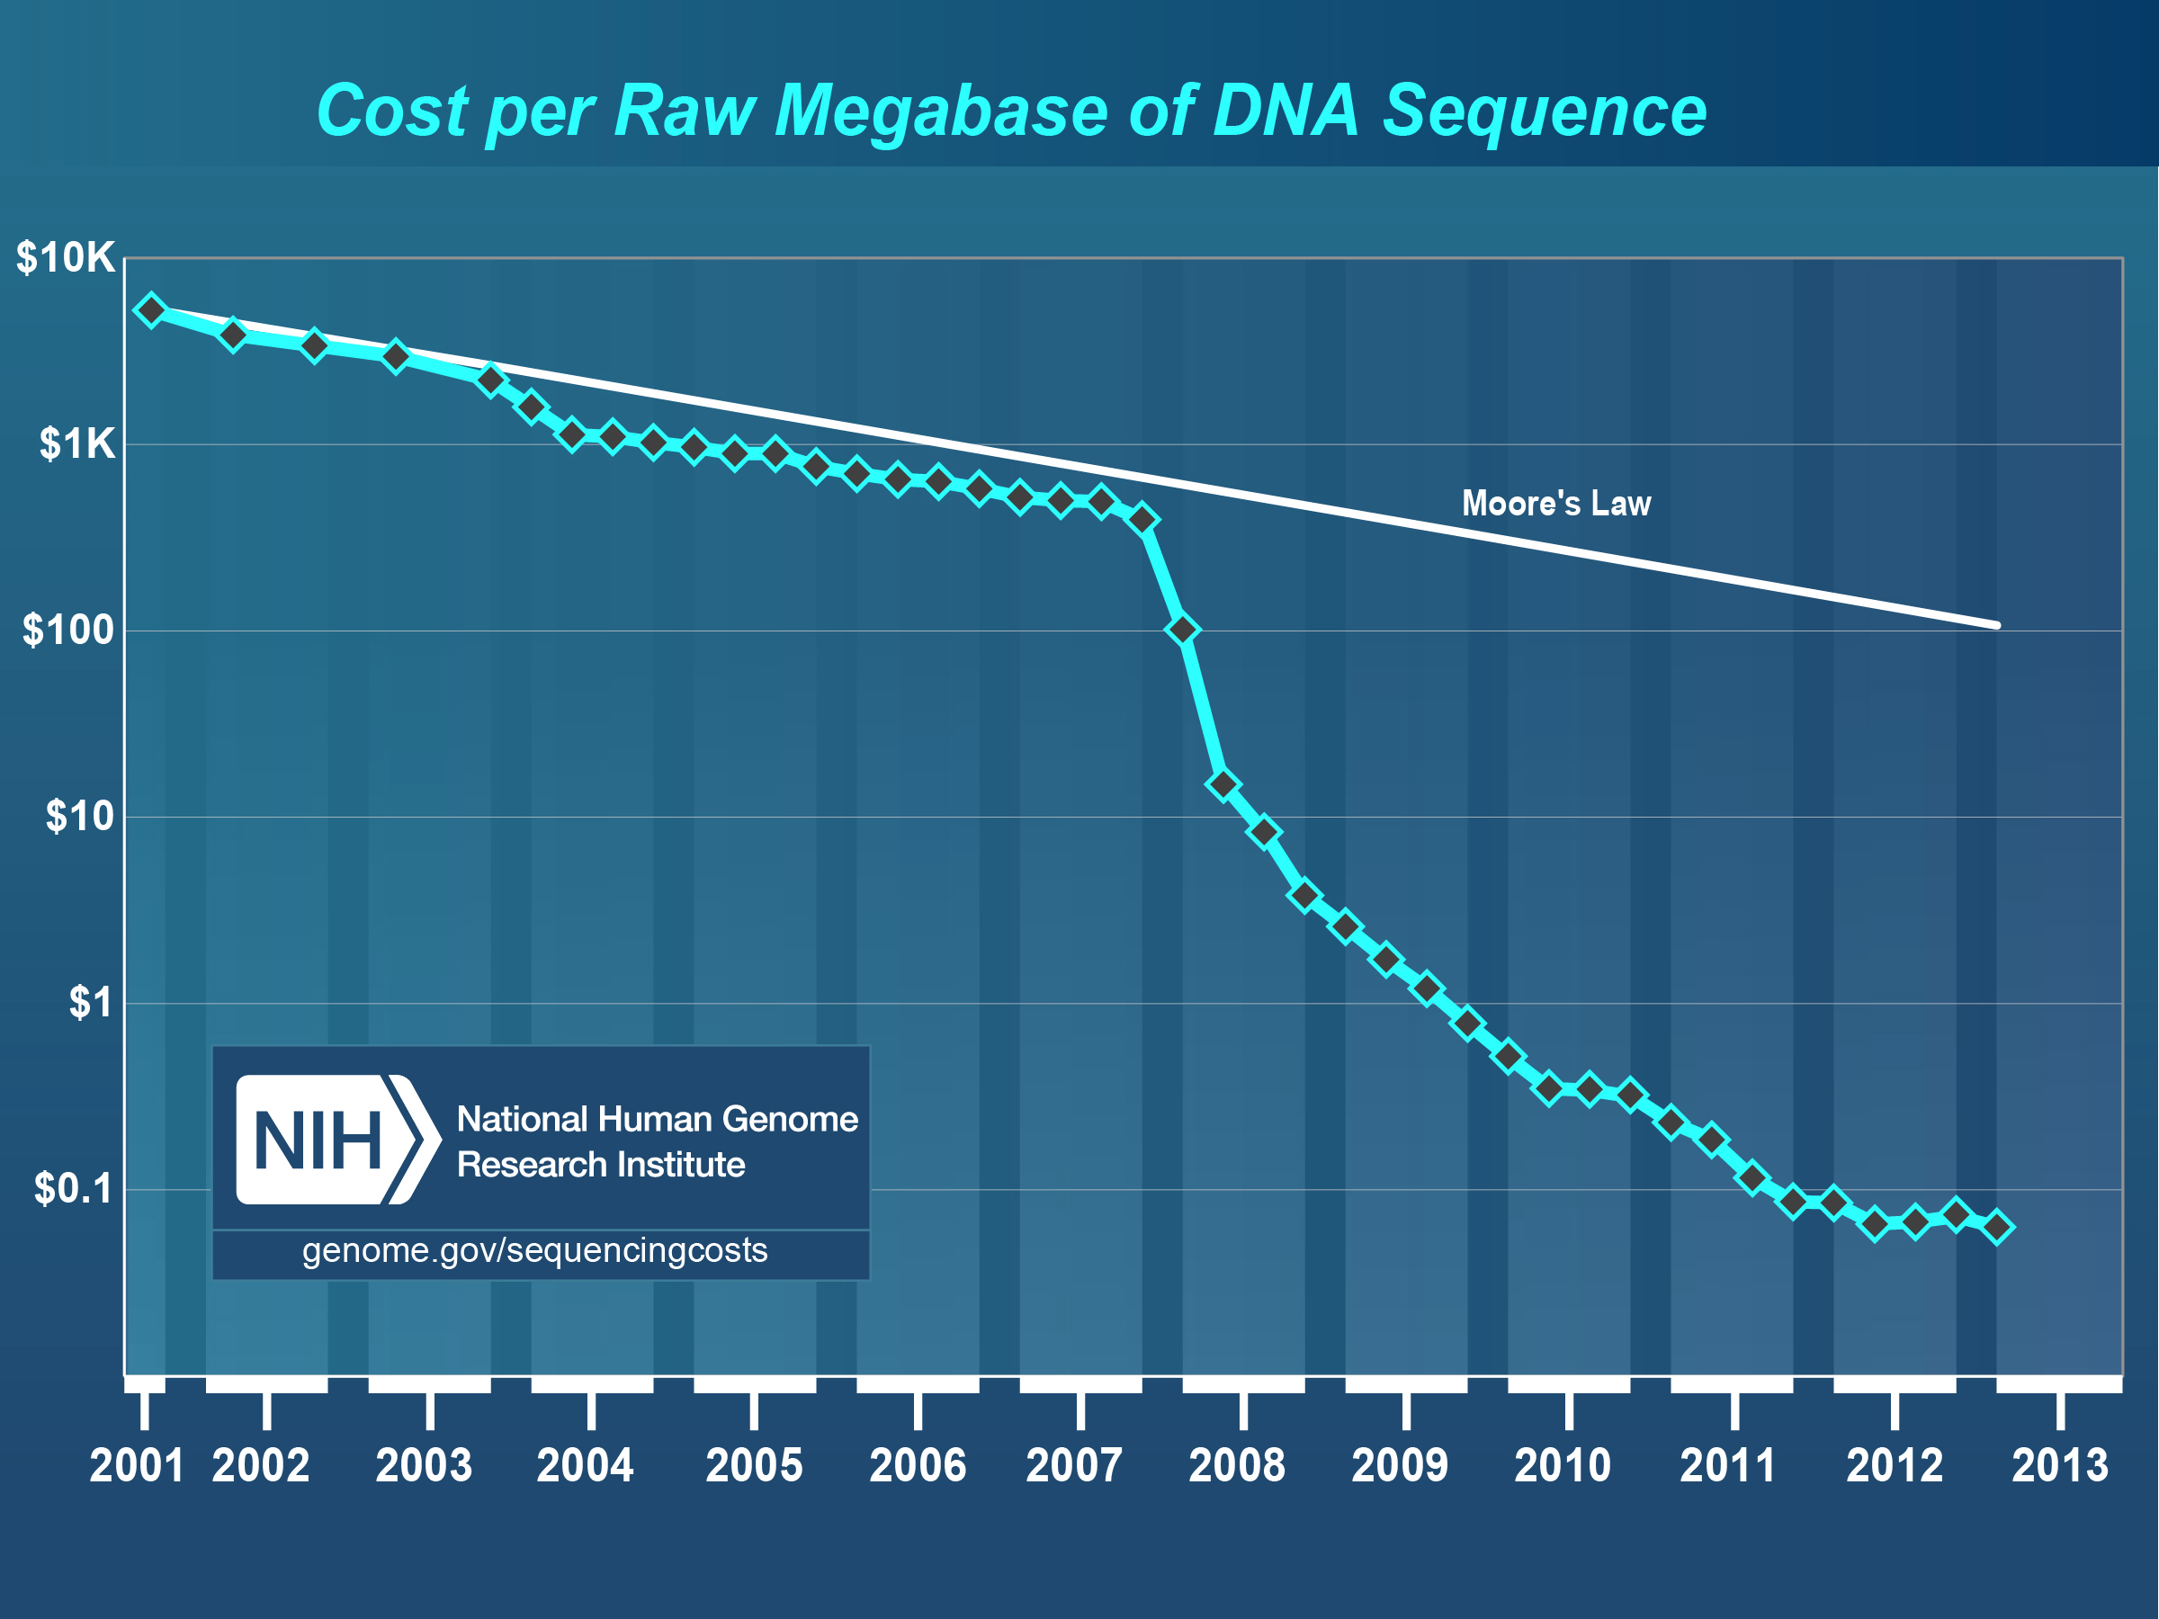

Slide 13
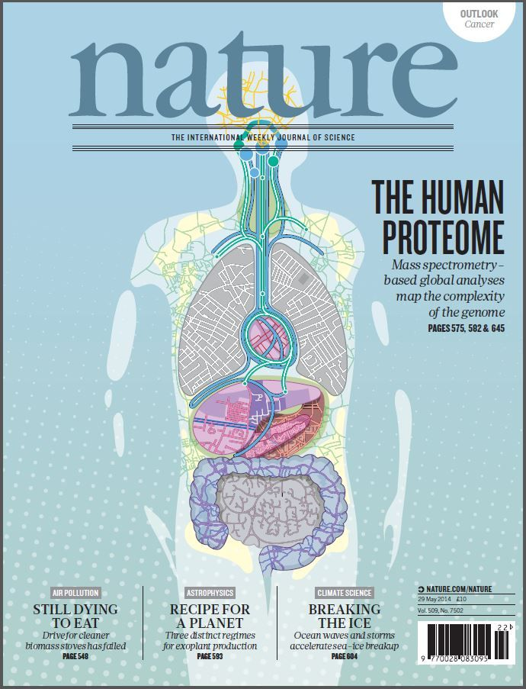
Human Proteome
Nature cover May 2014
Two draft versions of the human proteome (for various) tissues
Claim ~90% coverage of the proteome
Nature, 509 (2014) [cover]
Notes:
Image source: http://www.pinterest.com/pin/160651911682482760/

Slide 14
OMICS Data
High-throughput techniques provide data for one specific type of relationship
  Genomics: DNA sequence data
  Transcriptomics: mRNA concentration
  Proteomics: protein concentrations/sequence
  Metabolomics: metabolite concentrations
  Interactomics: protein-protein interaction data
OMICS data is reductionist, but at a very large scale
OMICS data is often voluminous, but of low quality/noisy

Slide 15
Classical Data vs. Omics Data
Classical
Omics
Low-throughput
Low-dimensional, often single facts
High accuracy, every data point supported by multiple experiments
Analysis of experiments simple (small data volume!)
High-throughput
High-dimensional, measuring many parameters in parallel
Often low accuracy, lots of noise
Often not interpretable without statistics/bioinformatics

Slide 16
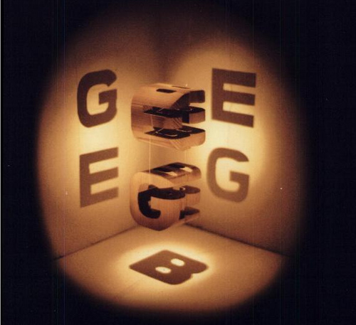
Omics is a Matter of Perspective!
Notes:
TODO: add image source

Slide 17
Omics is a Matter of Perspective
Each omics technology/level provides a cross-section of one particular type of biomolecules
Different levels thus correlate (roughly) to distinct ??????
  Genomics: what can the cell potentially do?
  Transcriptomics: what is currently being turned on?
  Proteomics: what enzymes are currently active? which signals are being transduced?
  Metabolomics: what is being produced/consumed?
Different levels thus provide a different functional perspective
Notes:
Knut: Word missing

Slide 18
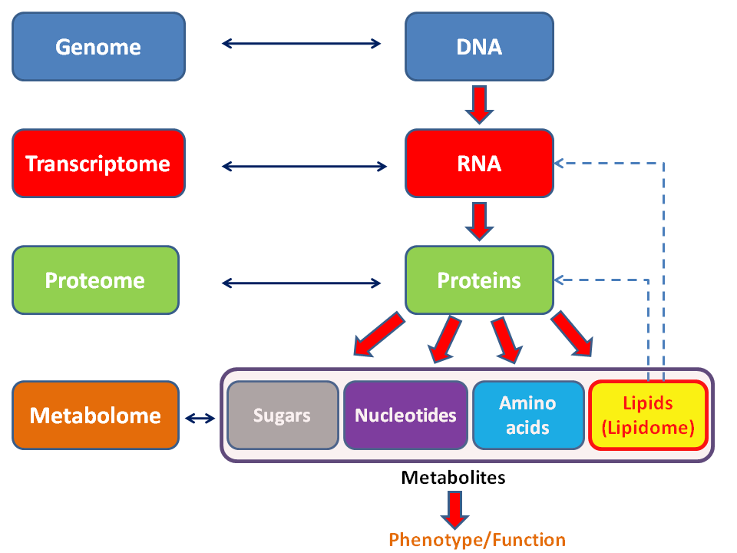
Omics Technologies
http://en.wikipedia.org/wiki/File:Metabolomics_schema.png , accessed 2014-03-10, 11:42:00 UTC
Notes:
Knut: Fits better after 10/11

Slide 19
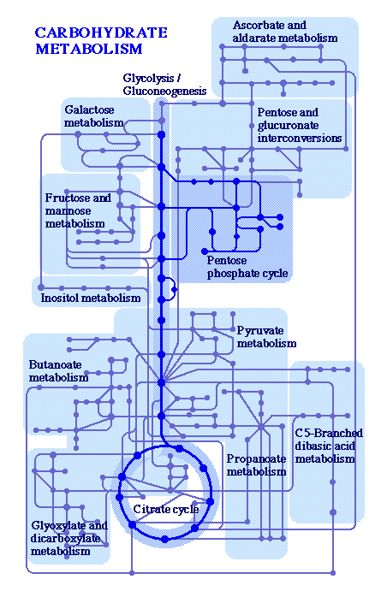
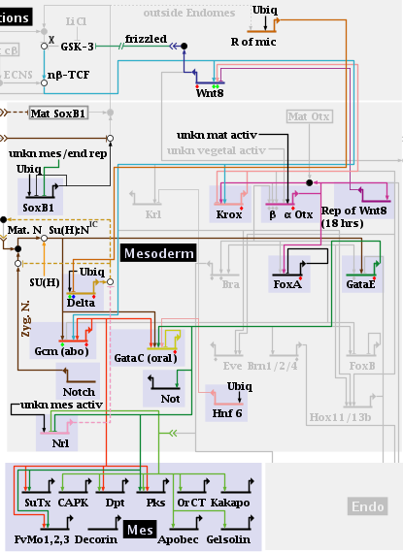
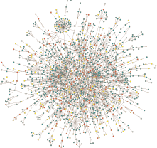
Integrative Analysis
Analyzing individual data set is trivial
Simultaneous integrated analysis of data from multiple layers/types of data is currently still the major challenge!

Slide 20
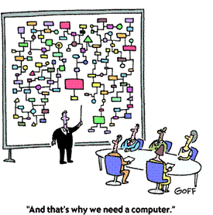
Computational Systems Biology
The complexity and also the sheer amount of data produced with high-throughput techniques makes manual analysis difficult
Systems biology thus requires a strong computational component:
Computational Systems Biology
http://www.sys-bio.org/contentimages/WhyWeNeedComputer.png

Slide 21
Challenges in Data Integration
Semantic integration of data from different sources
  Different data formats
  Ambiguities, nomenclature
Lack of data
  We do not know everything!
  High-throughput methods show only a fraction of ‘everything’ (detection limits!)
Different scales
  Time scales different, length scales different
  How to model different resolutions simultaneously?

Slide 22
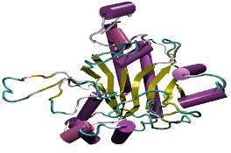
Protein
A protein or polypeptide consists of a linear chain of amino acids that build 3-dimensional structures
Amino acids are connected via peptide bonds
Peptide bonds
H
O
O
H
O
H
O
N-terminus
C-terminus
H₂N
C
C
NH
C
C
NH
C
C
NH
C
C
OH
R₁
R₂
R₃
R₄
Notes:
Knut: Maybe add slide before for the change of gears (omics -> proteomics? ) seems abrupt

Slide 23
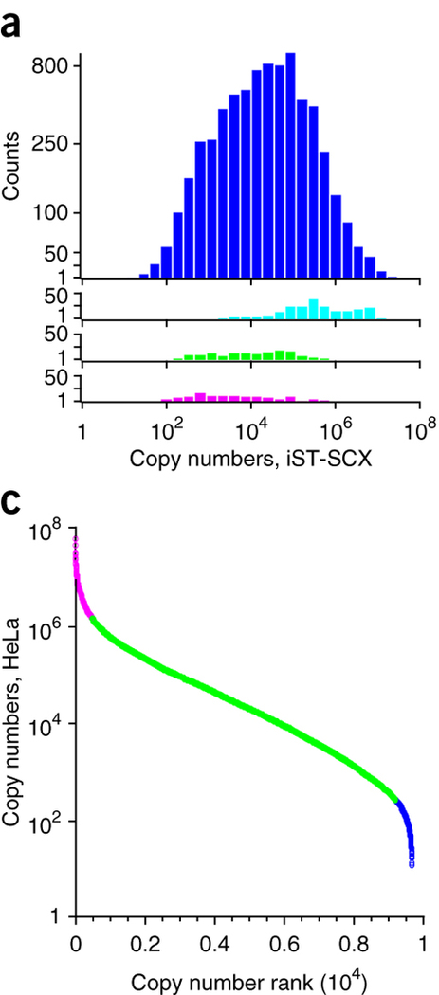
Proteomics
Proteomics: study of a proteome
Proteome: sum of all proteins in a given sample (e.g., tissue, cell, time-point)
Proteomics typically tries to
  Catalog the proteins in a sample (qualitative proteomics)
  Quantify the proteins in a sample, i.e., determine the concentrations of all proteins (quantitative proteomics)
Concentrations in a sample vary drastically – large dynamic range required (see figure on the right)
Kulak et al., Nat. Methods 11, 319–324 (2014) doi:10.1038/nmeth.2834

Slide 24
Proteomics – Typical Questions
There are some problematic issues on defining a protein
  Protein identity: unique amino acid sequence and single source of origin?
    There may be different genes encoding the identical amino acid sequence
    Different organisms may encode identical proteins
  Splice variants: A gene can give rise to different mRNAs
  Polymorphisms: many genes occur in allelic variants encoding sequence variations
  Posttranslational modifications: PTMs are very hetero-geneous and significantly alter the function of the protein

Slide 25

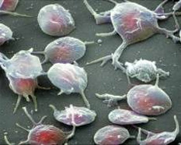
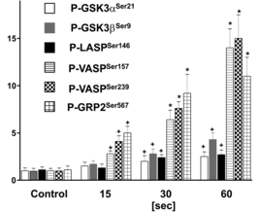
Proteomics - Examples
Understanding phenotypes:
Genome remains the same…
…proteome changes
Understanding signaling:
Platelets are non-nucleated cells – to understand their behavior (blood clotting) phosphoproteomics is required. It reveals time-resolved activation of kinases.
Activated platelets
Time course of selected phosphopeptides
(Beck et al., 2014)
http://www.iamashcash.com/wp-content/uploads/2011/03/caterpillar-to-butterfly1.jpg, accessed: 14/10/2013 6 PM
http://www.ufrgs.br/laprotox/en/what-we-do/research-lines/ureases-non-enzymatic-properties/ureases-induce-platelet-secretion-and-aggregation
Beck et al., Blood (2014), 123(5):e1-e10. doi: 10.1182/blood-2013-07-512384

Slide 26
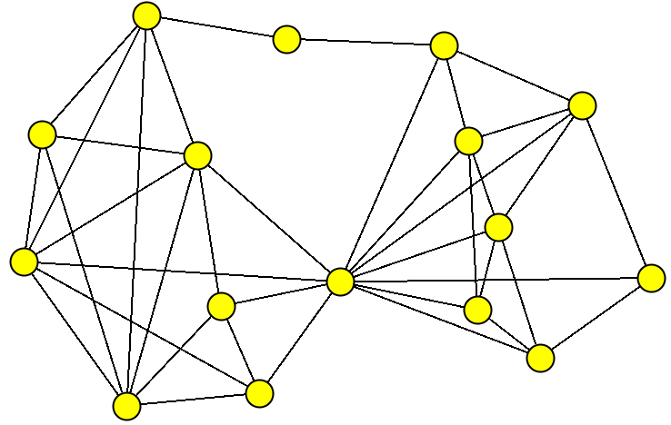
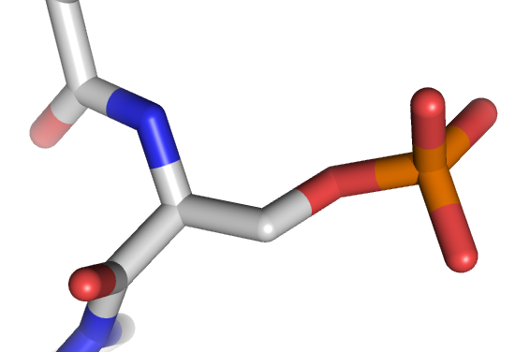
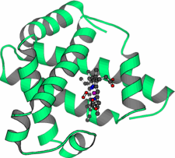
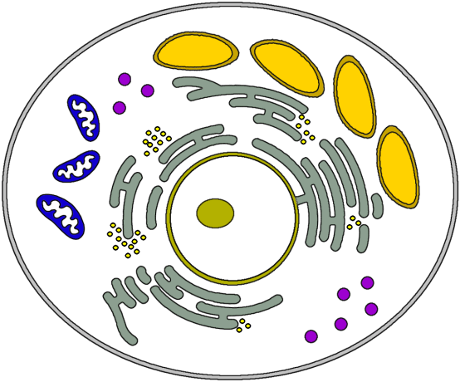
Main fields of proteomics
protein interaction
protein characterization
(identification + PTMs)
?
protein localization
protein expression

Slide 27
Applications of proteomics
protein interaction
protein characterization
(identification + PTMs)
Drug target identification
Determine content of a
protein mixture
Understanding regulation
of protein activity
?
Functional annotation
(compartment and function)
Drug target identification
Gene annotation
Therapeutic markers
Drug target identification
protein localization
protein expression

Slide 28
Metabolites
Metabolites are intermediates and products of metabolic processes – everything that biochemistry can create
Technically speaking also DNA, RNA and proteins could be considered metabolites
The term is usually restricted to small molecules
Spans a variety of substance classes (not complete):
  Amino acids
  Alcohols
  Lipids
  Sugars
  …
Chemically much more diverse than proteome!

Slide 29
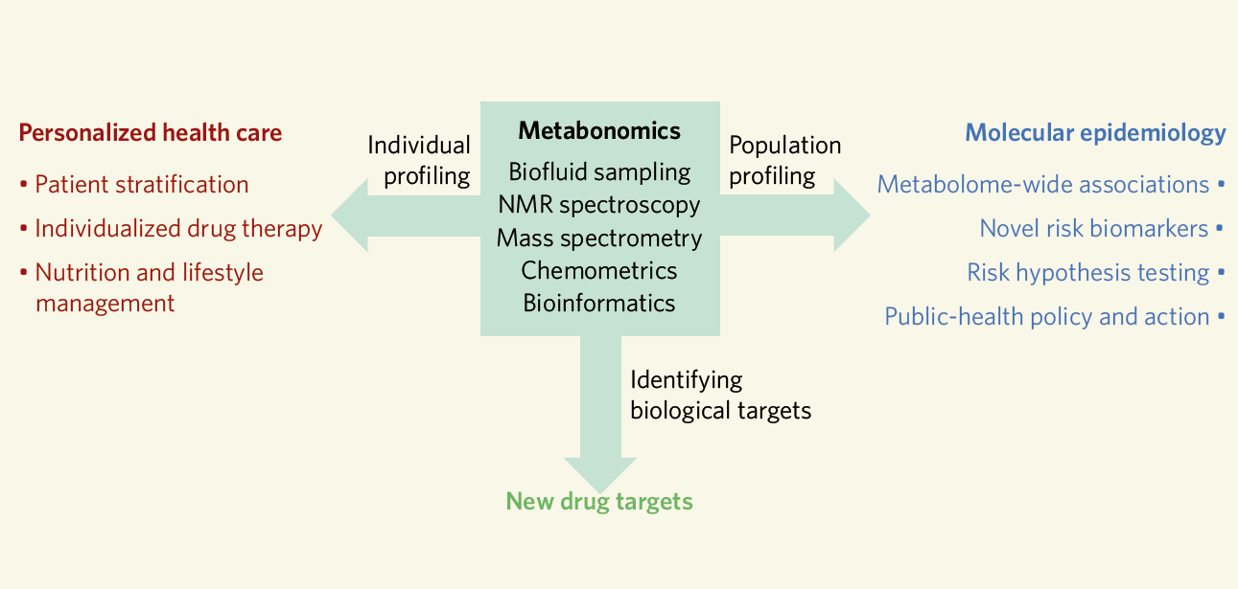
Metabolomics – The Big Picture
Nicholson and Lindon. Nature 2008, 455, 1054-1056

Slide 30
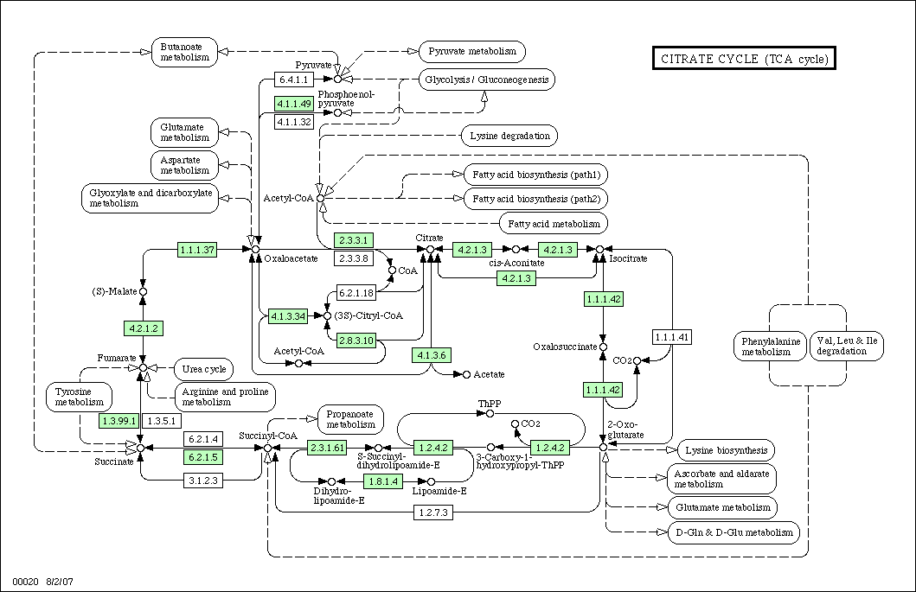
Metabolic Networks
http://www.genome.jp/dbget-bin/www_bget?pathway+ecj00020

Slide 31
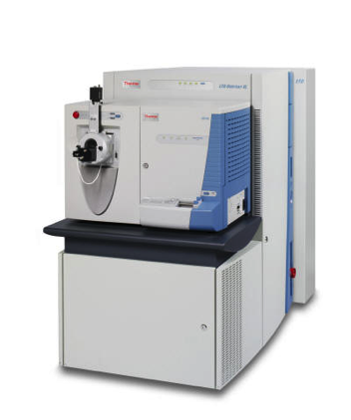
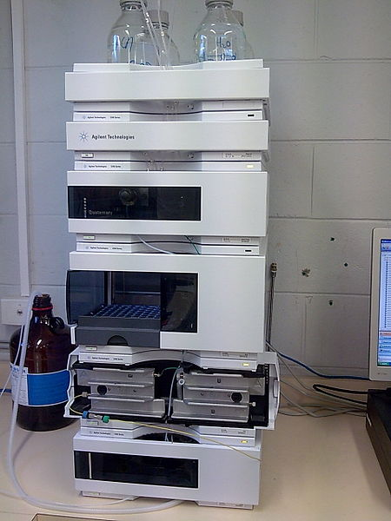
Technologies
Modern Proteomics and Metabolomics studies are based on
Chromatography coupled to Mass spectrometry (MS)
http://en.wikipedia.org/wiki/High-performance_liquid_chromatography.
Access 14/10/2013, 5 PM
www.planetorbitrap.com
Access 14/10/2013, 5 PM

Slide 32
Technologies
Chromatography (GC/LC)
  Chromatography separates proteins/peptides or metabolites
  Reduces complexity of samples
Mass spectrometry (MS)
  Identifies the biomolecules (mass spectrum often used similar to a ‘fingerprint’ of the molecule)
  Signal intensity is proportional to concentration of the molecule in the sample

Slide 33



Shotgun proteomics
Protein
extraction
Trypsin
digestion
Peptide fractionation
(e.g., isoelectric focusing)
MS spectrum
MS/MS spectrum
Computational proteomics
Mass Spectrometry (MS)
High Performace
Liquid Chromatography (HPLC)

Slide 34

At its core: HPLC-MS
I
HPLC ESI TOF
Spectrum (scan)
RT
Separation 1
separate peptides
by their retention
time on column
Ionization
electrospray,
transfers charge
to the peptides
Separation 2
MS separates by mass-to-charge
ratio (m/z)

Slide 35
Mass Spectrometry
mass
spectrometry
measure a peptide‘s mass-to-charge ratio
Intensity
m/z
Intensity
m/z

Slide 36
Proteomics: Database Search
Identification of mass spectra is easily done through database search
  Search all peptides of matching mass from a database
  Construct a theoretical mass spectrum for these peptide candidates
  Score against the experimental spectrum
Post-genomics: database search is possible because we have a genome sequence
?
?
?
Sequence DB

Slide 37
Integrative Analysis
Analyzing individual data set is trivial
Simultaneous integrated analysis of data from multiple layers/types of data is currently still the major challenge!

Slide 38
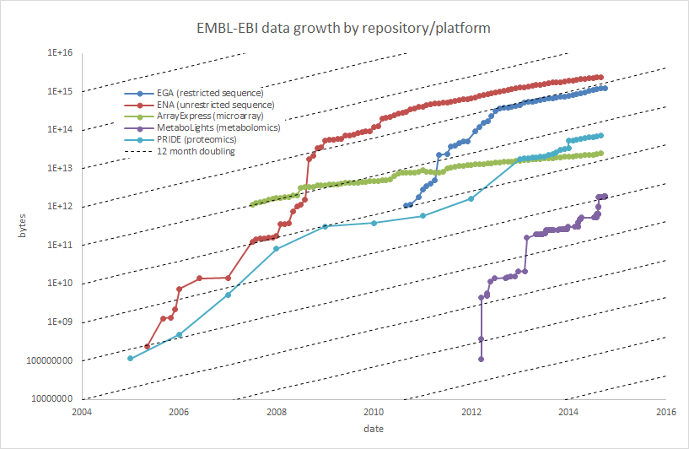
Growth of Omics Data (EBI Repositories)
Illustration: Christoph Steinbeck, EBI
Notes:
Fig: pers. Comm. Chris Steinbeck (2014-10-03)

Slide 39
Multi-Omics/Polyomics
Systems biology requires an integrative view spanning more than one omics level – this is called ‘multi-omics’ or ‘polyomics’
Data sets are
  Huge (often hundreds of GB)
  Heterogeneous
  Complex in their structure
Integrative analysis is complex (usually takes longer than data generation)
Complex analysis workflows are hard to reproduce

Slide 40
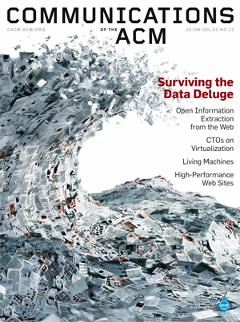
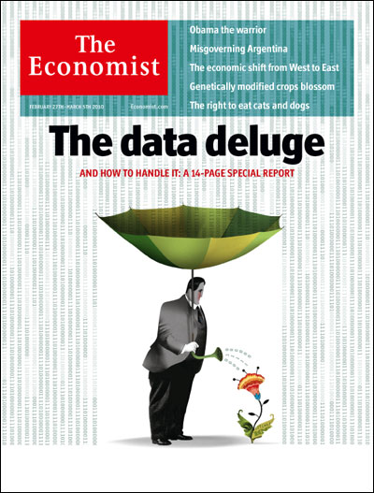
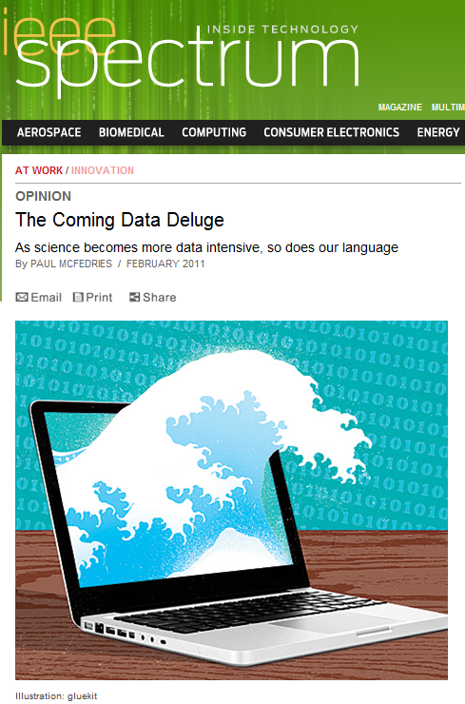
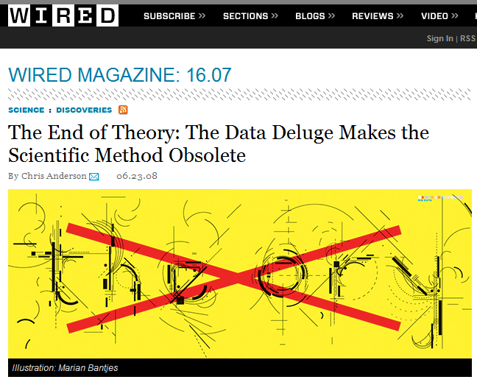
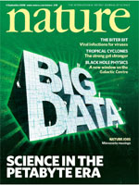
Big Data and Reproducible Science
Notes:
TODO add image sources

Slide 41
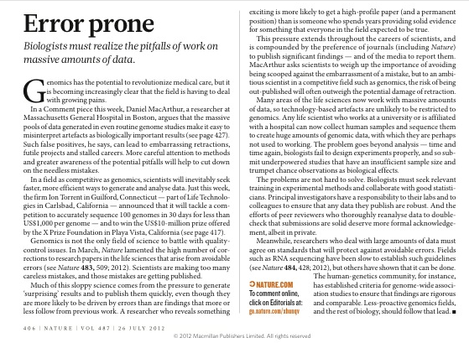
Big Data and Reproducible Science

