Slide 1
Computational Proteomics and Metabolomics
Oliver Kohlbacher, Sven Nahnsen, Knut Reinert
5. Quantification II: Label-free quantification, SILAC

Slide 2
Overview
Label-free quantification
  Definition of features
  Feature finding on centroided data
  Absolute quantification using label-free quantification
SILAC quantification
  Problem
  Application of simple feature finding and linking
  MaxQuant algorithm
  Application examples

Slide 3
Learning Unit 5A
Feature Finding for
Label-Free Quantification
Feature-finding
Definition of terms (maps, features)
Key concepts in label-free quantification
Averagine model
Feature finding on centroided data

Slide 4





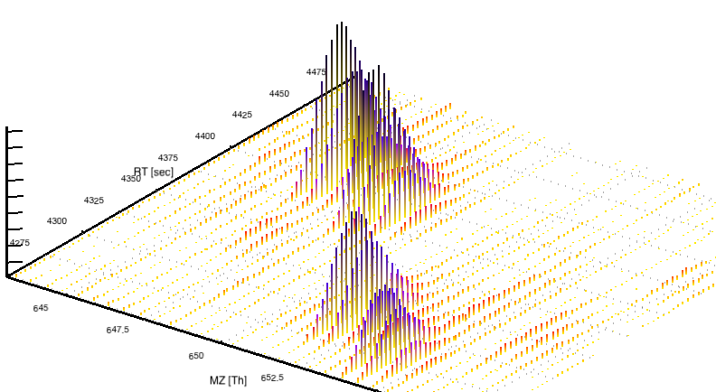


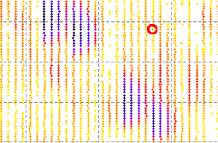












Label-Free Quantification (LFQ)
Quantification through the ion current in MS spectra
Key advantage: no labeling needed – cheap, scales well
Key disadvantage: normalization tricky – direct comparison
Based on the notion of features and maps
  LC-MS data: 2D datasets of up to hundreds of GB per sample
  Raw data: unmodified detector signal
  Centroided data: peaks called on the MS level
  Features: the stuff that matters in maps

Slide 5
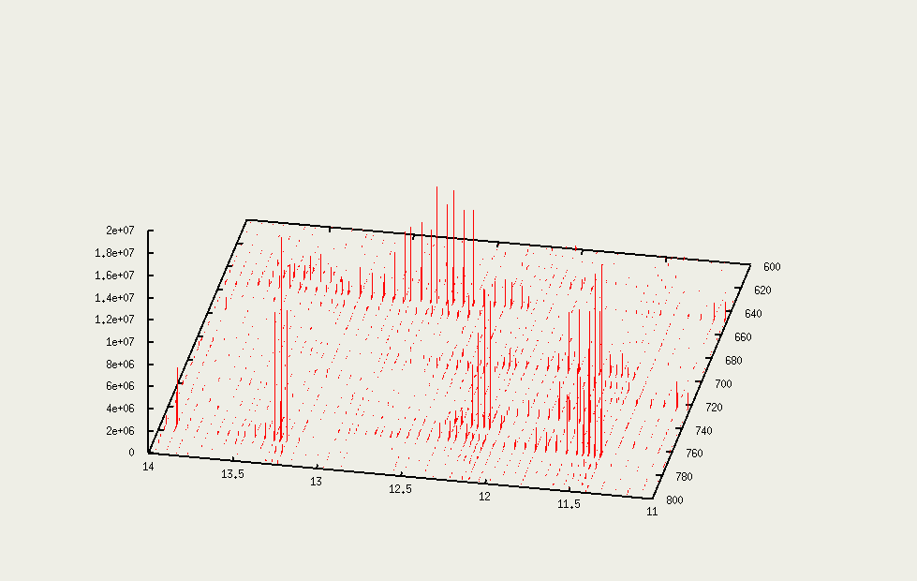
LC-MS Data (Map)
  Quantification
  (15 nmol/µl, 3x over-expressed, …)
Notes:
Show in video a map

Slide 6
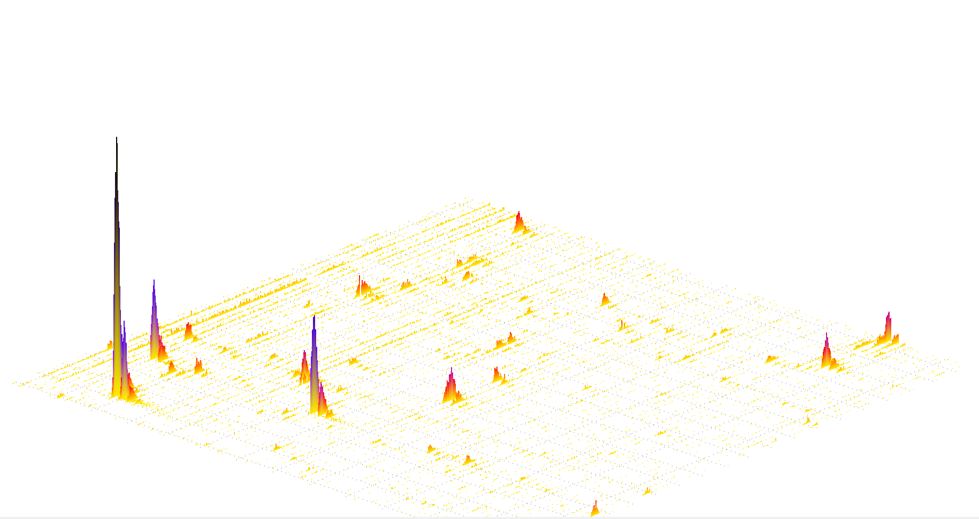
Feature Finding – Terms
Map:
Two-dimensional data set (RT, m/z) containing the MS signal from one LC-MS run.
Feature:
  The sum of all the MS signals caused by the same analyte in a specific charge state.
  Different charge states or adducts will result in distinct features. Primarily characterized by RT, m/z, charge, intensity.
Feature finding:
Finding the set of features explaining as much of the signal in a map as possible.

Slide 7
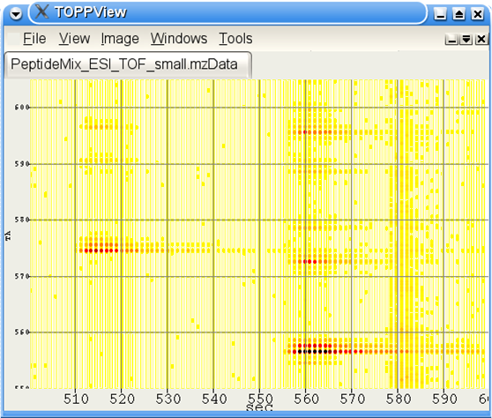
Raw Map
m/z
RT

Slide 8
Raw Map
m/z
RT

Slide 9
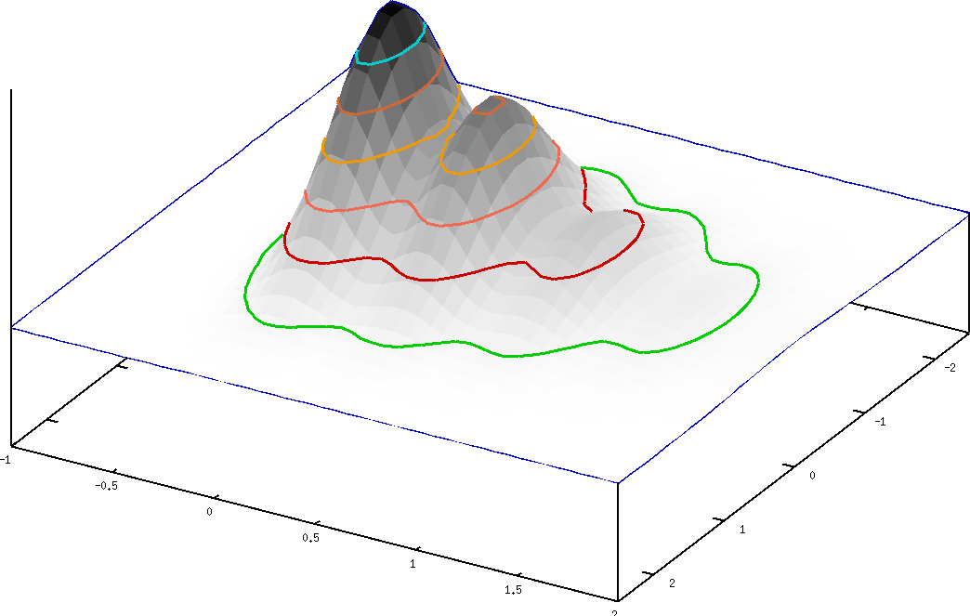
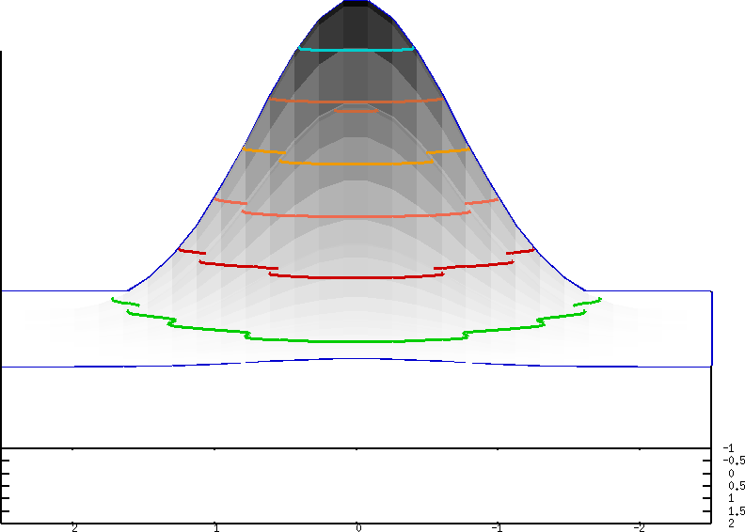
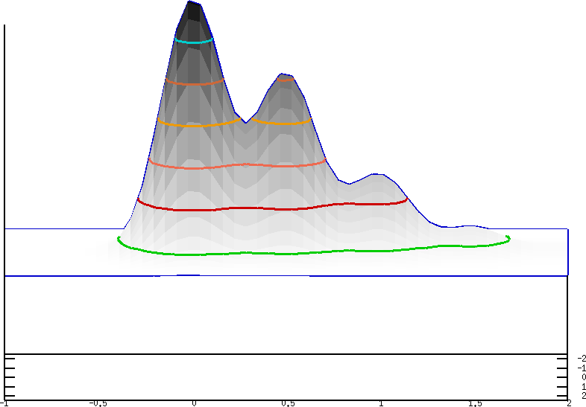
Raw Map
Feature
m/z
=
rt
+
m/z
RT

Slide 10
Raw Map
Feature
m/z
=
rt
+
m/z
RT

Slide 11
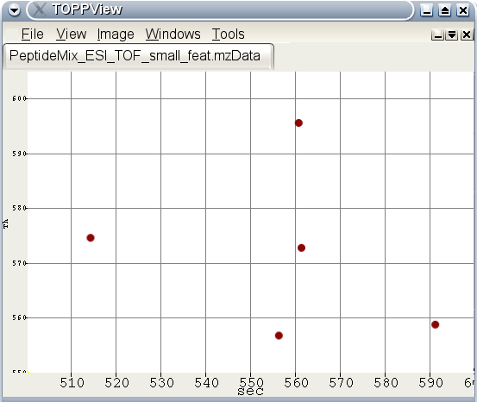
Raw Map → Feature Map

Slide 12
LFQ – Analysis Strategy
Find features in all maps

Slide 13
LFQ – Analysis Strategy
Find features in all maps
Align maps

Slide 14
LFQ – Analysis Strategy
Find features in all maps
Align maps
Link corresponding features

Slide 15
LFQ – Analysis Strategy
Find features in all maps
Align maps
Link corresponding features
Identify features
GDAFFGMSCK

Slide 16
LFQ – Analysis Strategy
Find features in all maps
Align maps
Link corresponding features
Identify features
Quantify
GDAFFGMSCK
1.0 : 1.2 : 0.5

Slide 17
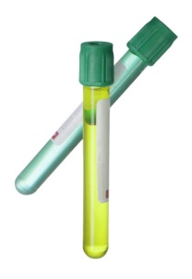
Feature Finding as Data Reduction
Sample
HPLC/MS
Raw Data
10 GB
Sig.-
Proc.
Maps
Data Reduction
Filtered
Raw Data
50 MB
1 GB
Diff.
Anal.
Annot.
Maps
Identification
Differentially
Expressed
Proteins
50 MB
1 kB

Slide 18
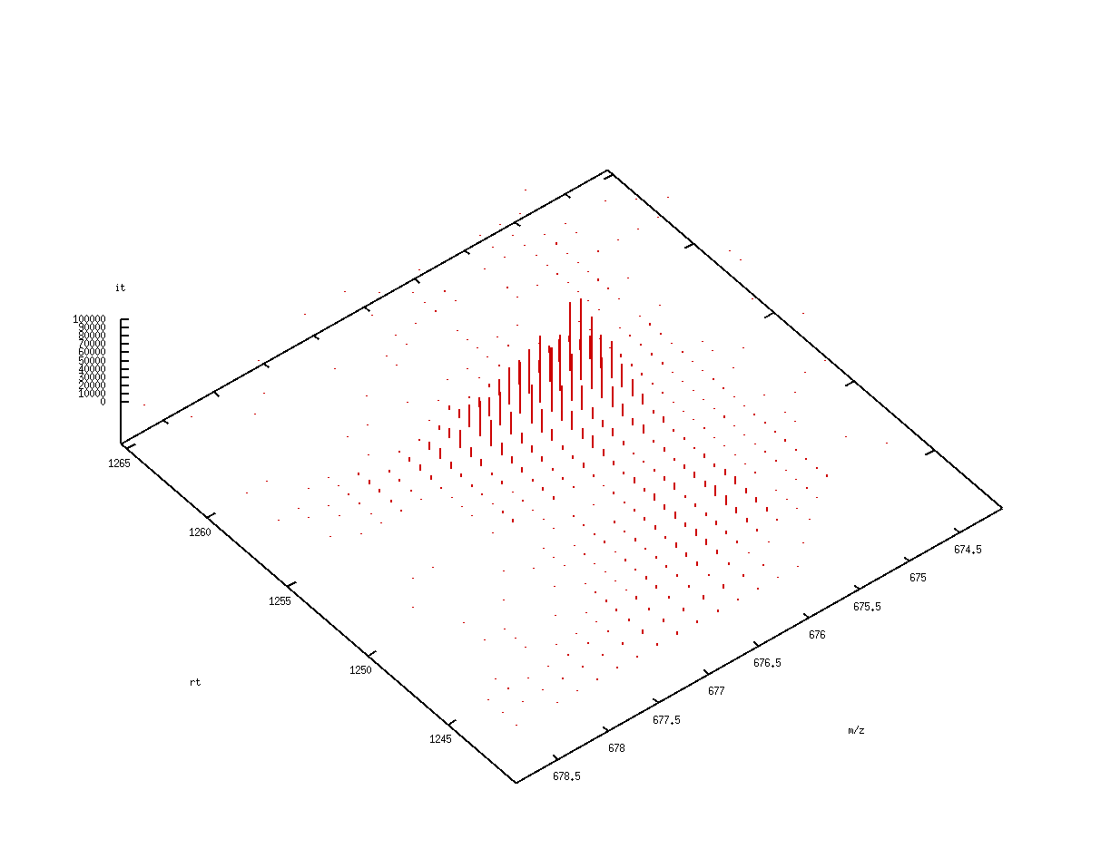
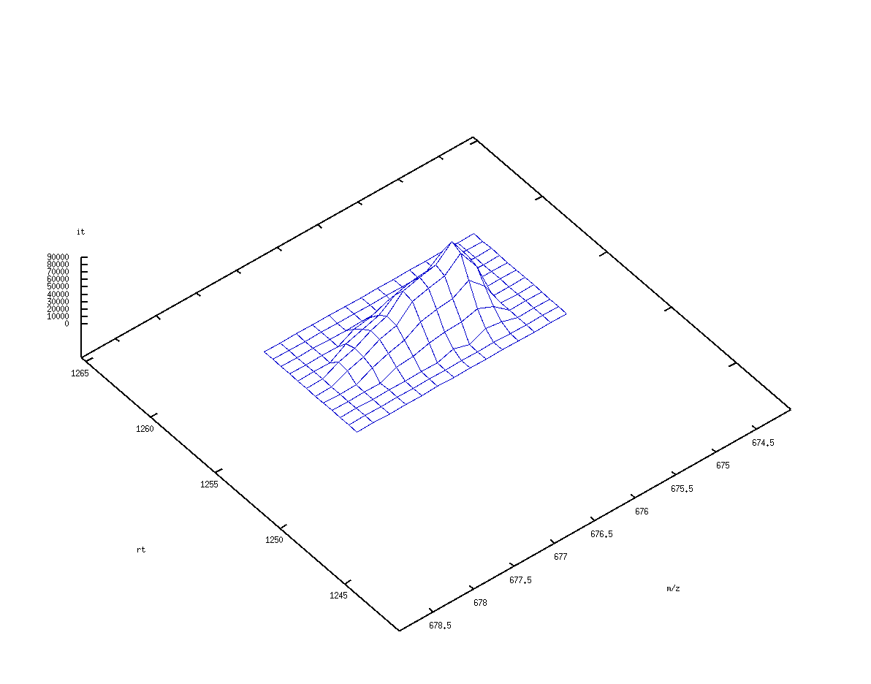
Feature Finding
Identify all peaks belonging to one peptide
Key idea:
  Identify suspicious regions
  Fit a two-dimensional model to that region

Slide 19
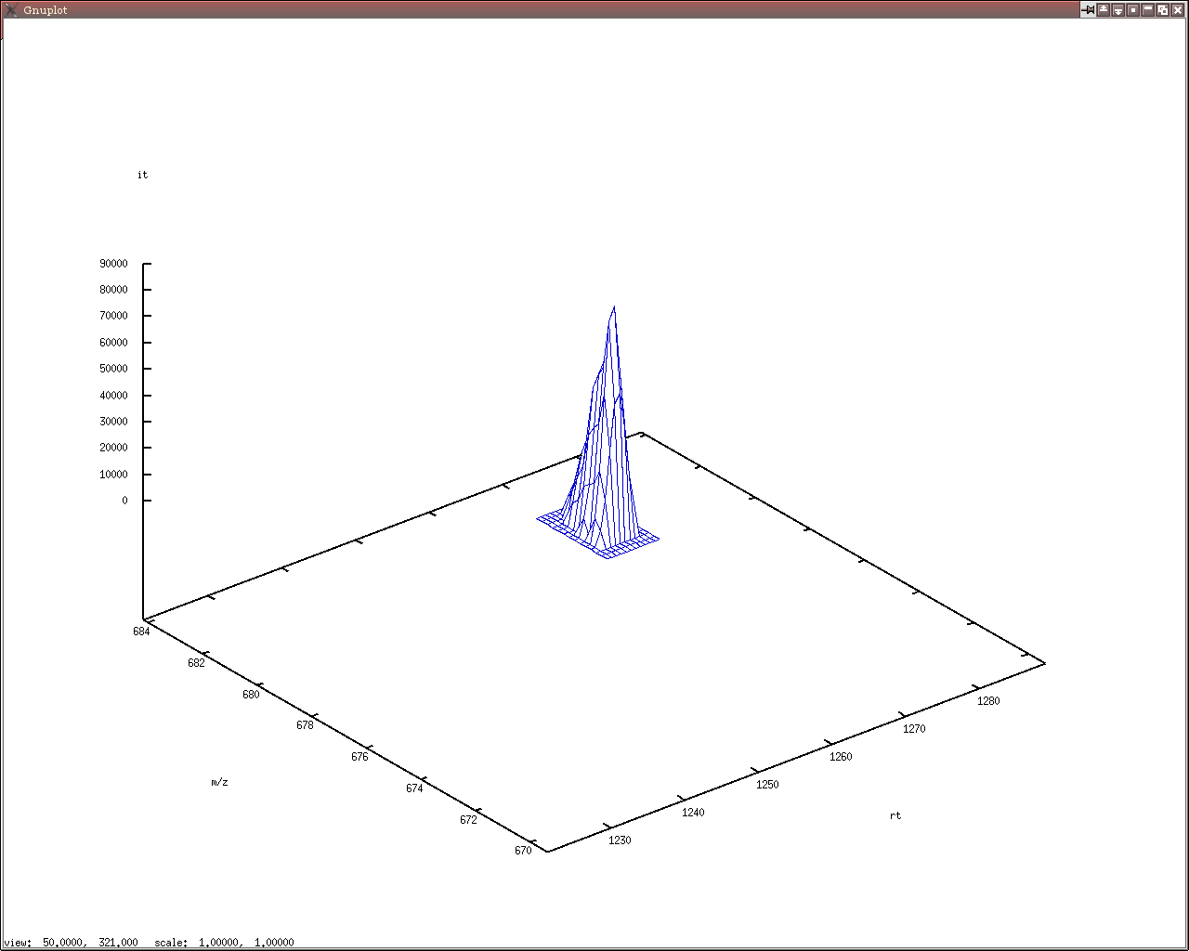
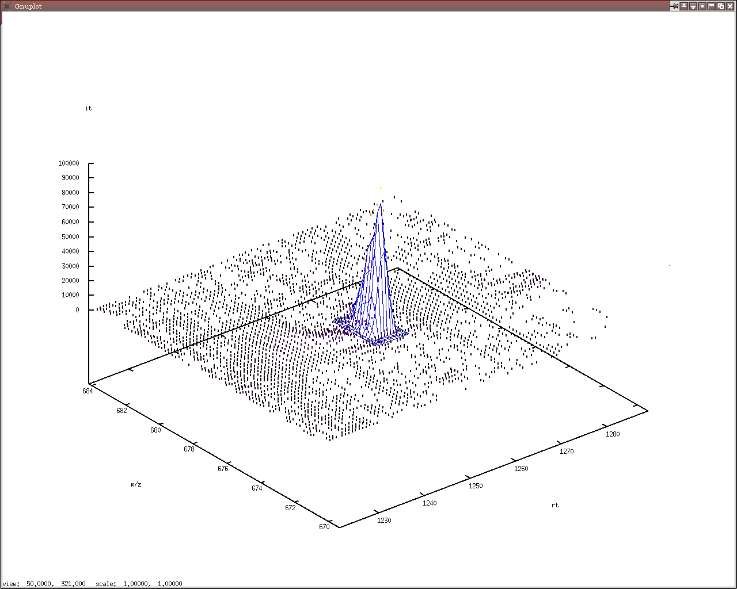
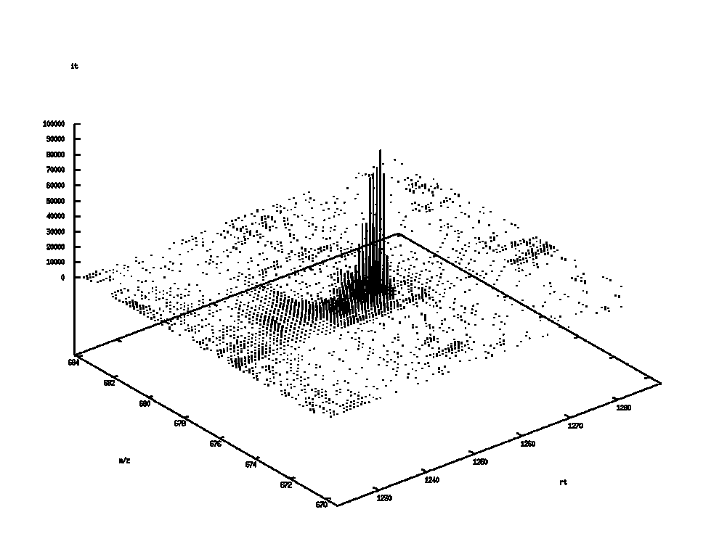
Feature Attributes
Attributes
Position (m/z, RT)
Intensity, volume
Quality
… … …

Slide 20
Feature Model
=
x
Feature model
Isotope pattern
Elution profile
m/z
rt

Slide 21
Feature Model
Physical processes leading to the shape of a feature:
  Chromatography
    Elution profiles are (ideally) shaped like a Gaussian
    Parameters: width, height, position
  Mass spectrometry
    Mass spectra of peptides are characterized by the isotope pattern
    Modeled by a binomial distribution
Both separation processes are independent
A two-dimensional feature is then described by the product of two one-dimensional models

Slide 22
Averagine
Since the isotope pattern changes with the composition of the peptide, it is unknown which pattern should be fitted!
Idea
  We know the mass of the feature
  Assume an average composition of an amino acid
  Then we can estimate the composition
The elemental composition of such an average amino acid, also called ‘averagine’, can be derived statistically:
C_{4.94}H_{7.76}N_{1.36}O_{1.48}S_{0.04}

Slide 23
Isotope Patterns
Based on averagine compositions one can compute the isotope patterns for any given m/z
Heavier peptides have smaller monoisotopic peaks
In the limit, the distribution approaches a normal distribution
m [Da] | P (k=0) | P (k=1) | P (k=2) | P (k=3) | P (k=4)
1000 | 0.55 | 0.30 | 0.10 | 0.02 | 0.00
2000 | 0.30 | 0.33 | 0.21 | 0.09 | 0.03
3000 | 0.17 | 0.28 | 0.25 | 0.15 | 0.08
4000 | 0.09 | 0.20 | 0.24 | 0.19 | 0.12
Notes:
Nun ist es aber leider so, dass wir die peptide noch nicht kennen und somit ihre chemische Zsuammensetzung unbekannt ist.
Wir koennen aber die chemische Zusammensetzung approximieren und somit allein anhand der Masse die ein theoretisches Isotopen Muster berechnen.

Slide 24
Feature Model – m/z
Isotope pattern is also modulated by the instrument resolution
We can assume a Gaussian shape for each of the peaks of the isotope pattern
Notes:
Theoretical model of a feature of charge 2 at m/z 1350 Th

Slide 25
Feature Model – RT
Elution profile is typically assumed to be a Gaussian
There are some variants that also allow for asymmetric peaks
This defines the shape of a feature in in the RT dimension
Notes:
Better (asymmetric) models shall be implemented soon…

Slide 26
Feature Finding – Algorithm
Most algorithms consists of four phases
Seeding. Choose peaks of high intensities, as those are usually in features (“seeds“).
Extension. Conservatively add peaks around the seed, never mind if you pick up a few peaks too many.
Modeling. Estimate parameters of a two-dimensional feature for the region.
Refinement. Optimally fit a model to the collected peaks. Remove peaks not agreeing with the model. Iterate until convergence.

Slide 27
Algorithm: Seeding
Start with the highest peaks in the map
Pick only one seed per feature, thus exclude peaks of already identified features for later seeding
More advanced variants of the algorithm use Wavelet techniques to detect the best seeds
Problems
  Low-intensity features have intensities barely above the surrounding noise
  Choose a threshold based on the average noise
  Dilemma:
    threshold too high, features will not get seeded
    Threshold too low, millions of noise peaks will be considered as seeds HUGE run times

Slide 28
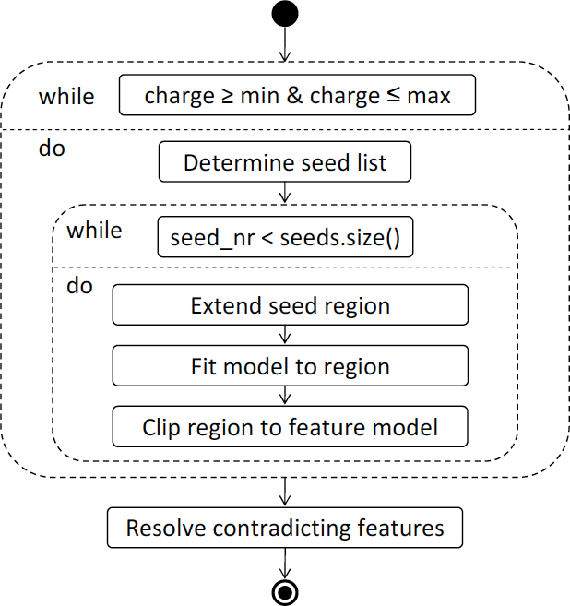
Feature Finding – Overview
Sturm, OpenMS – A Framework for Computational
Mass Spectrometry, Dissertation, Tübingen, 2010

Slide 29
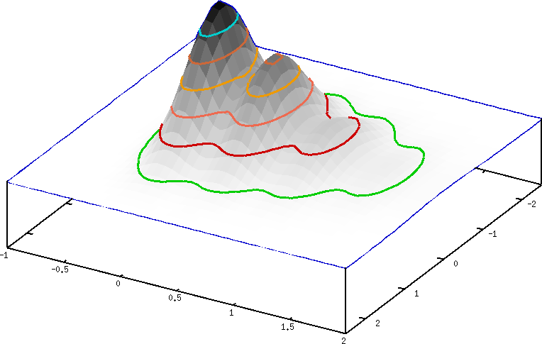
Algorithm: Extension
Explore the peaks around the seed
Add them to a set of relevant peaks
Abort if the peaks are getting too small or too far away
m/z up
rt down
rt up
m/z down

Slide 30
Algorithm: Refinement
Remove peaks that are not consistent with the model
Determine optimal model for the reduced set of peaks
Iterate this until no further improvement can be achieved
Remove all peaks of this feature from potential seeds

Slide 31
Feature Finding
Identify all peaks belonging to one peptide
Key idea:
  identify suspicious regions
  Fit a model to that region and identify peaks are explained by it

Slide 32
Feature Finding
Extension: collect all data points close to the seed
Refinement: remove peaks that are not consistent with the model
Fit an optimal model for the reduced set of peaks
Iterate this until no further improvement can be achieved

Slide 33
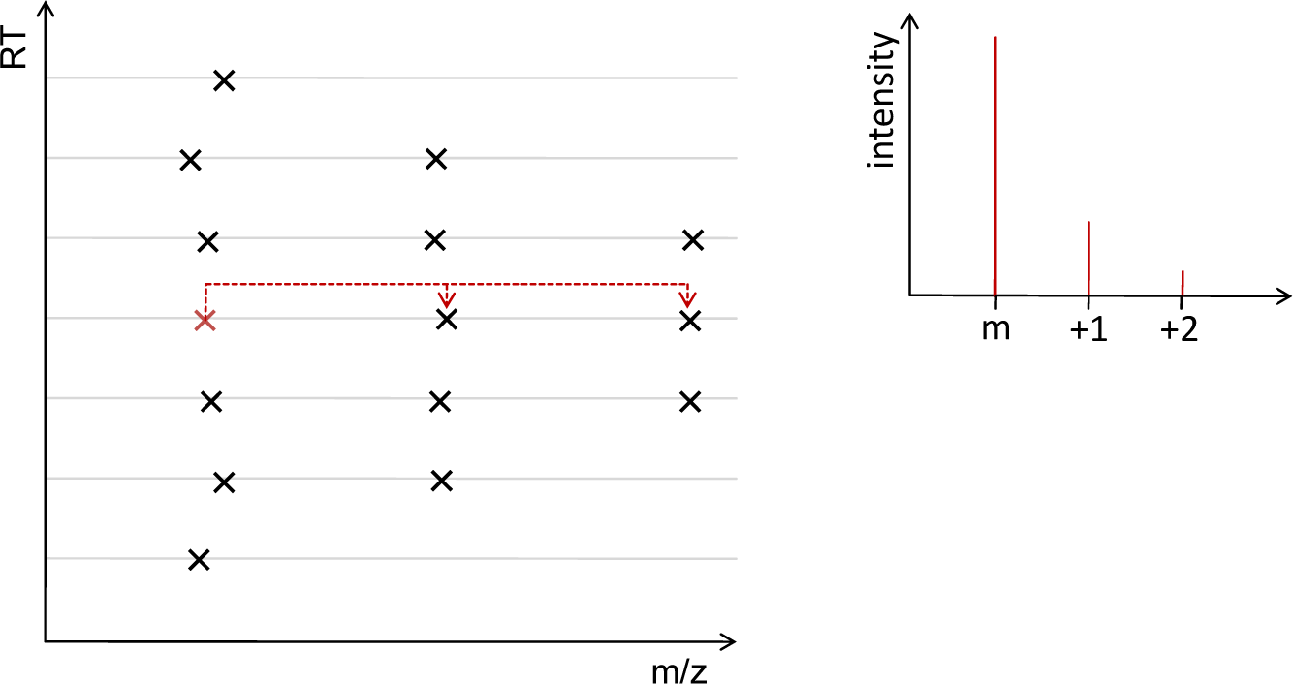
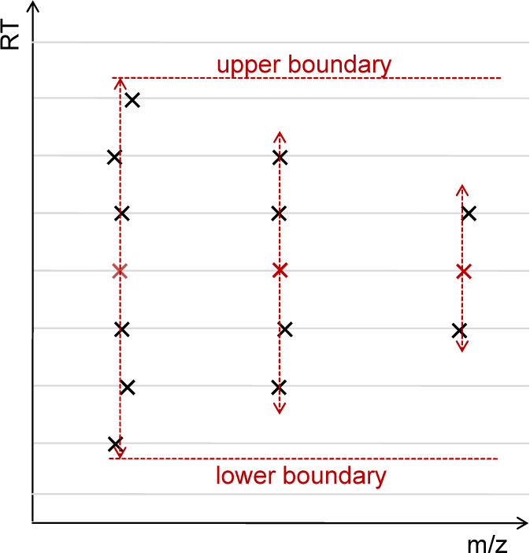
Collecting Mass Traces
A mass trace is a series of peaks along the RT dimension with little variation in the m/z dimension
Mass traces are found with a simple heuristic aborting the search if the peak intensity hits the local noise level
Search for mass traces in the correct m/z distance
Limit length of mass trace to the length of the most intense mass trace
Sturm, OpenMS – A Framework for Computational
Mass Spectrometry, Dissertation, Tübingen, 2010

Slide 34
Feature Deconvolution
Features can overlap in various ways
  Mass traces can contain more than one chromatographic peak (features not baseline-separated in RT dimension)
  Mass traces can be interleaved between features in the m/z dimension
  Co-eluting features can be sharing mass traces
Resolving these conflicts is done in a feature deconvolution step by statistical testing:
  Test several hypotheses that could explain the features
  The most likely of all hypotheses will be identified through comparison with the data

Slide 35
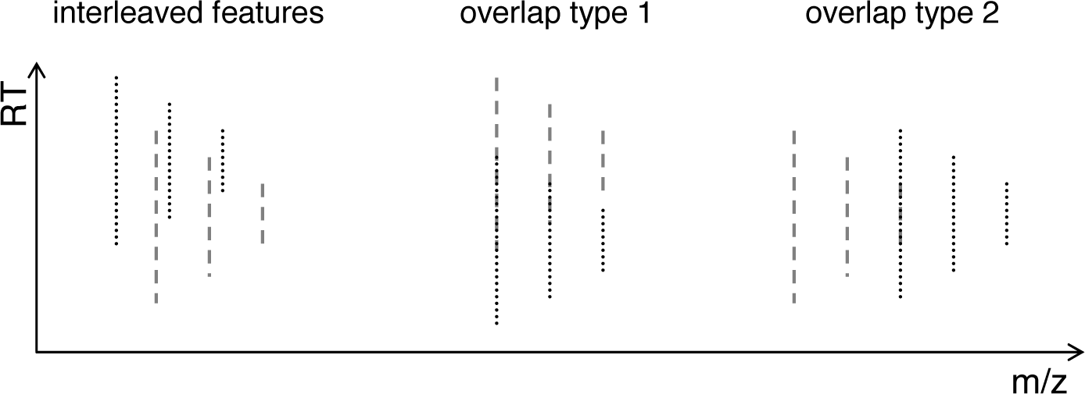
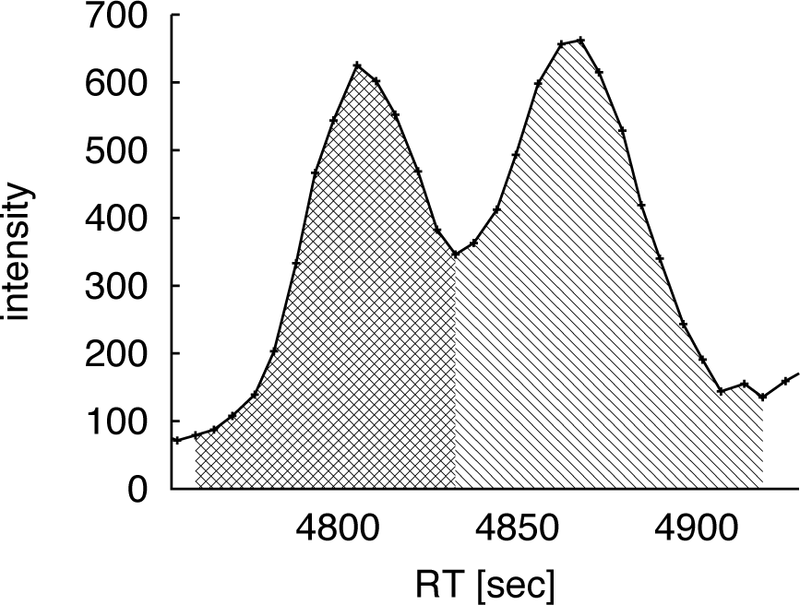
Feature Deconvolution
Sturm, OpenMS – A Framework for Computational
Mass Spectrometry, Dissertation, Tübingen, 2010

Slide 36
Algorithm: Modeling
Test all possible models for different charges states (charge +2, charge +3, …)
Decide on the charge of the features based on the best fit for these models
1
2
3
Notes:
The raw data points are considered empirical samples from the model distribution.

Slide 37
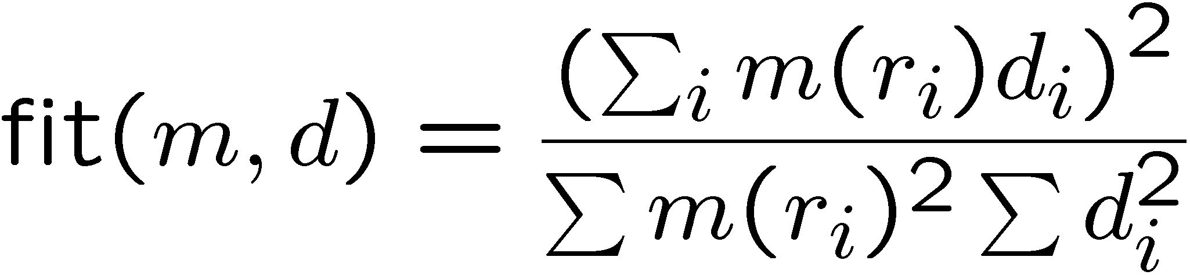
Algorithm: Modeling/Refinement
Estimate quality of fit for model m and data d_{i} at positions r_{i}:
Maximum Likelihood Estimator determines good starting values for model parameters
Further optimization of model parameters in refinement phase (least-squares fit)

Slide 38
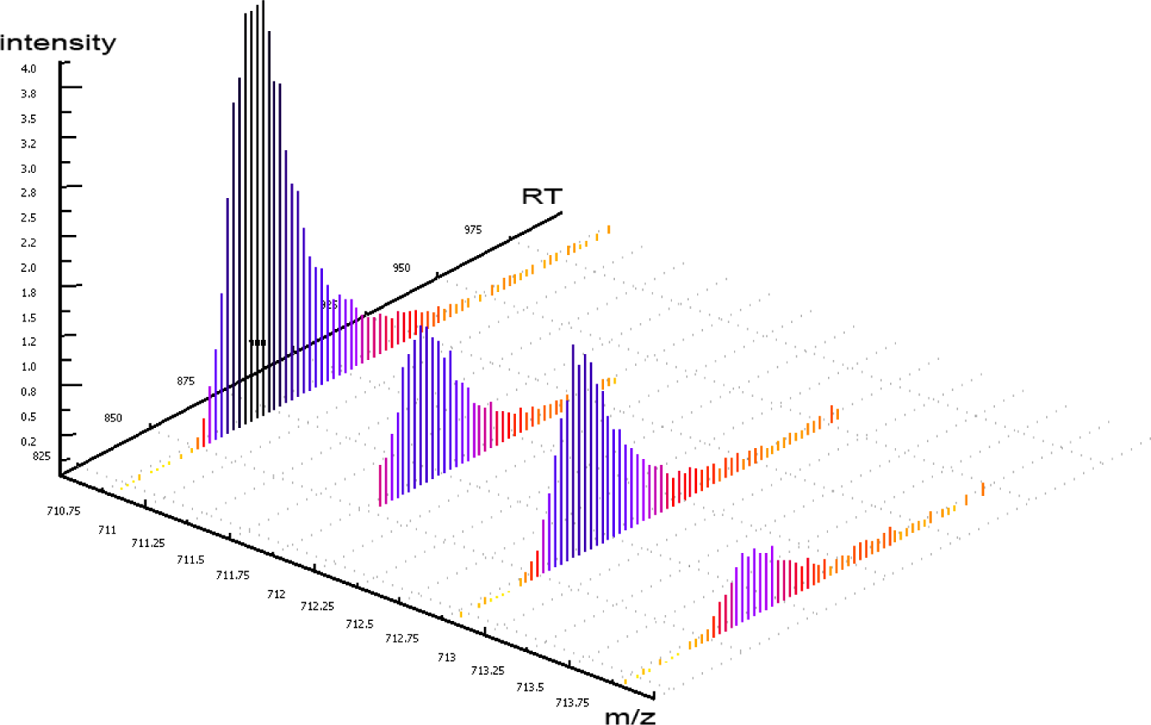
Feature Assembly
Feature resolution is not always possible unambiguously

Slide 39
Feature Finding – Problems
Problems
  Low-resolution instruments might not yield good isotope patterns
  Peptides can overlap, in particular in complex samples
  Fitting of such overlapping patterns can yield bogus results
  Low-intensity features are hard to distinguish from noise peaks
  Isotope labels can skew the distributions or can lead to overlapping pairs

Slide 40
Still Difficult: Low-Intensity Features
Problem:
The algorithm picked up the blue feature,
The red one was not found as it was too
close to the noise peaks (green)

Slide 41
Learning Unit 5B
Map ALignment
Map alignment
Problem definition
Pose-clustering algorithms
Dynamic time-warping techniques
Map alignment and feature linking
Map normalization

Slide 42
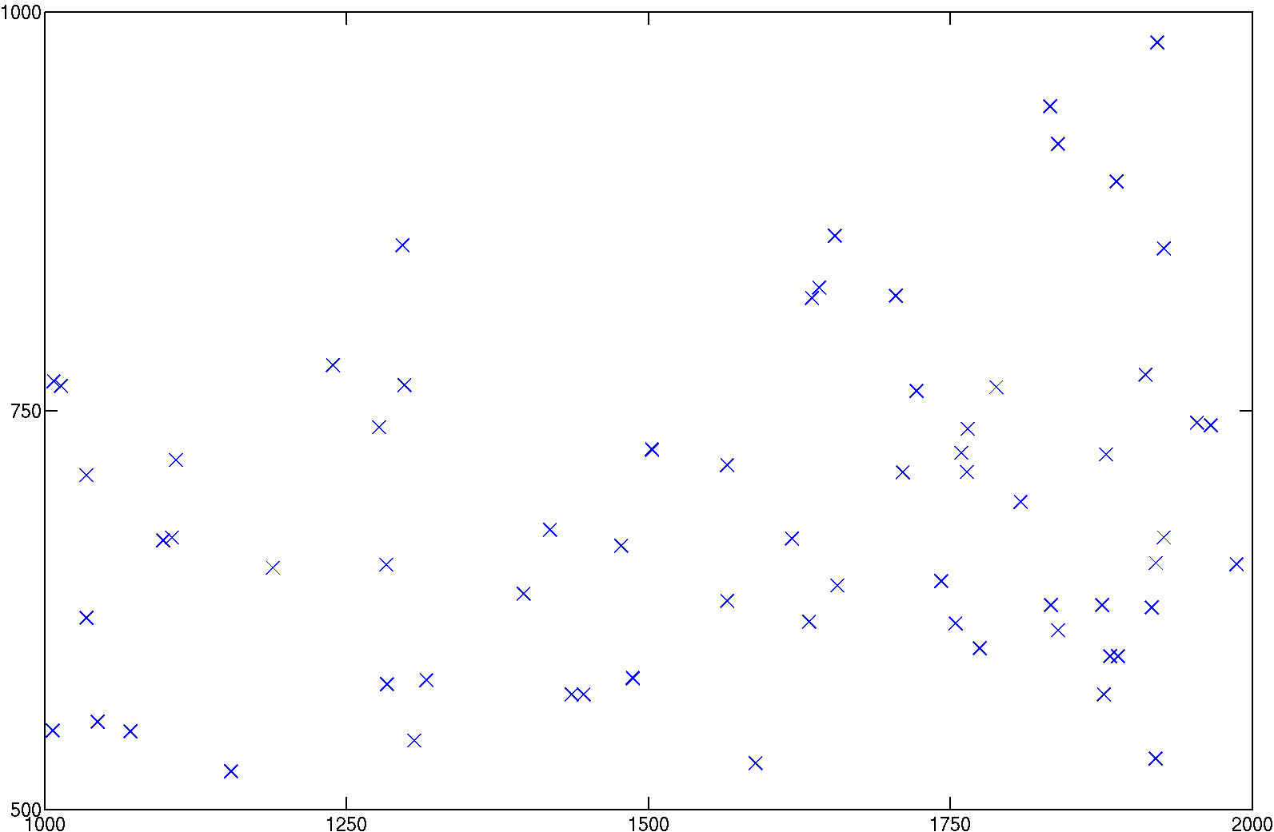
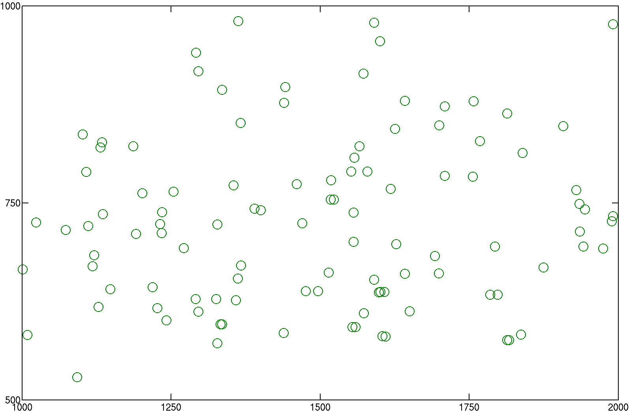
Pairwise Alignment
S
M
T = As +b
t
m/z
rt
The problem is to find the
affine transformation T that
minimizes the distance between T(S) and M.

Slide 43
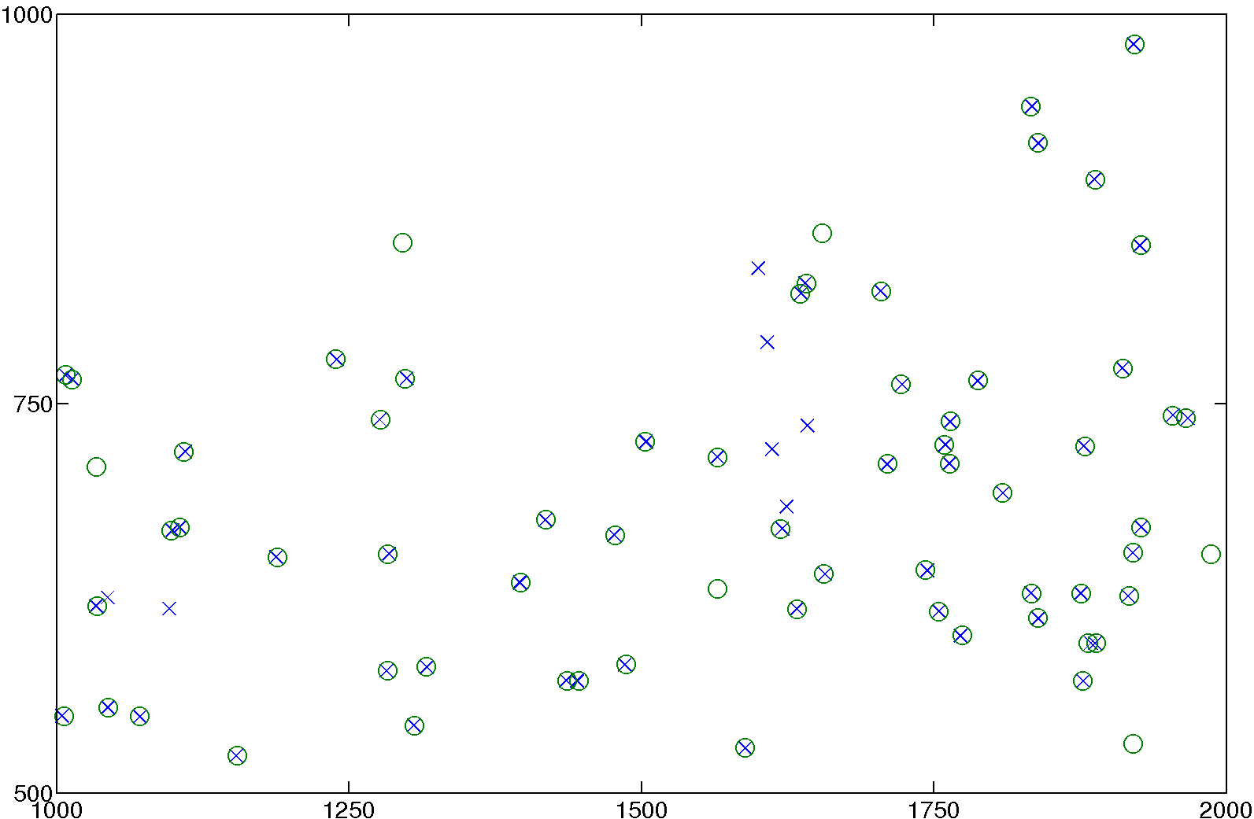
Pairwise Alignment
S
M
T = As +b
t
t
m/z
T(S) and M
rt

Slide 44
Pose Clustering
S
M
m/z
rt
T_{rt}(s_{rt}) = a_{rt}s_{rt} + b_{rt}
T_{m/z}(s_{m/z}) = a_{m/z}s_{m/z} + b_{m/z}

Slide 45
Pose Clustering
S
M
m₁
s₁
s₂
m/z
m₂
rt
m₁ = a_{rt}s₁+b_{rt}
m₂ = a_{rt}s₂+b_{rt}
b_{rt}
a_{rt}

Slide 46
Pose Clustering
S
M
s₁
m₁
s₂
m₂
m/z
rt
m₁ = a_{rt}s₁+b_{rt}
m₂ = a_{rt}s₂+b_{rt}
b_{rt}
a_{rt}

Slide 47
Pose Clustering
S
M
s₁
m₁
s₂
m₂
m/z
rt
m₁ = a_{rt}s₁+b_{rt}
m₂ = a_{rt}s₂+b_{rt}
b_{rt}
a_{rt}

Slide 48
Pose Clustering
S
M
s₁
m₁
s₂
m₂
m/z
rt
m₁ = a_{rt}s₁+b_{rt}
m₂ = a_{rt}s₂+b_{rt}
b_{rt}
a_{rt}

Slide 49
Pose Clustering
S
M
s₁
m₁
s₂
m₂
m/z
rt
Matching of corresponding pairs
will result in the
correct transformation
These are more likely than random matches!
b_{rt}
a_{rt}

Slide 50
Speeding Things Up
S
M
s₁
s₂
m/z
rt
Only consider pairs (s₁,s₂) in S
with s₁ having a small distance
to s₂ in m/z.

Slide 51
Speeding Things Up
S
M
s₁
m₁
s₂
m₂
m/z
rt
Only match
pair (s₁,s₂) onto pair (m₁,m₂)
if s₁ and m₁ as well as s₂ and m₂
lie close together in m/z.

Slide 52
Improve Matching
S
M
s₁
m₁
s₂
m₂
m/z
rt
Normalize intensities in M and S:
weight the vote of each transformation
by the intensity similarities of the
point matches (s₁,m₁) and (s₂,m₂).

Slide 53
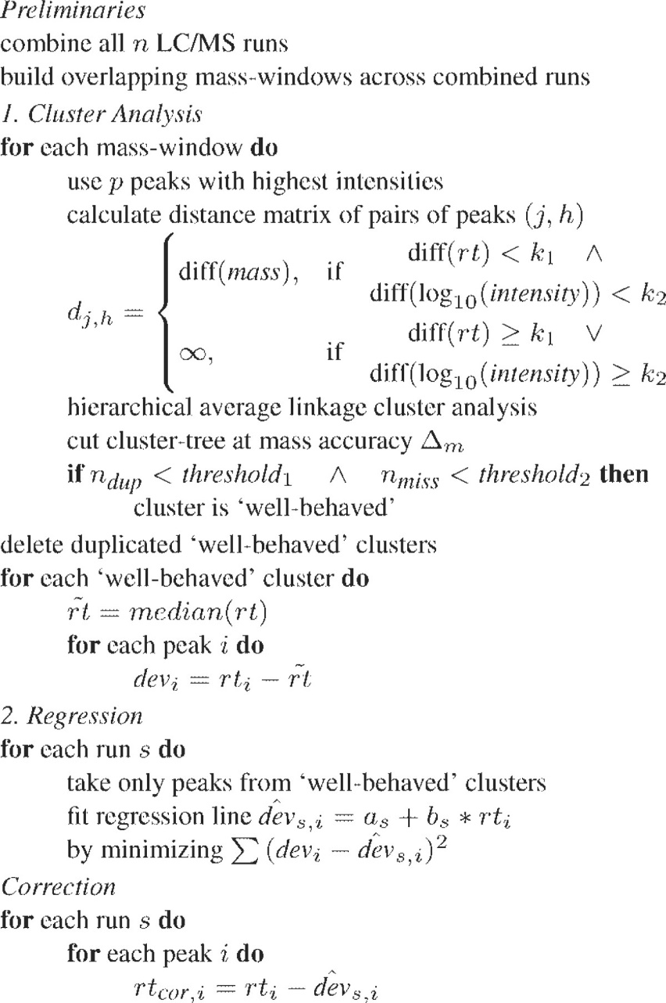
Linear Alignment
Podwojski et al. proposed an alternative linear alignment method and also extended this to a nonlinear alignment
The linear alignment is similar to the algorithm by Lange et al.
It uses a different type of cluster analysis to determine a linear regression
In contrast to the Lange algorithm, it generalizes nicely to multiple map alignment
Podwojski et al., Bioinformatics (2009), 25:758-764.

Slide 54
Nonlinear Alignment
Idea
  Perform linear alignment (using pose clustering)
  Compute a more accurate local alignment using LOESS regression
LOESS regression (often also called LOWESS)
  Locally weighted polynomial regression
  Based on a pre-defined window size
  Points within this window contribute to the local regression
  Perform local regression (linear or quadratic, cubic) around the predicted coordinate

Slide 55

LOESS Regression
Weighting is often performed by tricubic weighting function
Weighting function is applied to coordinates scaled into the chosen window (-1 · 0 · 1)
Local regression (linear quadratic) needs to be recomputed around every point (computationally very expensive)
tricubic function
Cleveland, J. Am. Stat. Soc (1979), 74:829-836

Slide 56
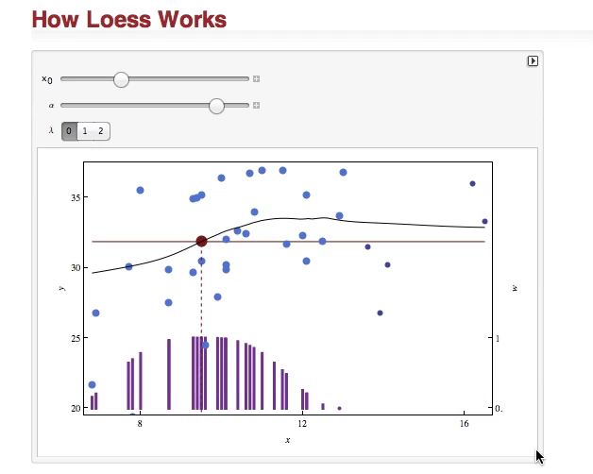

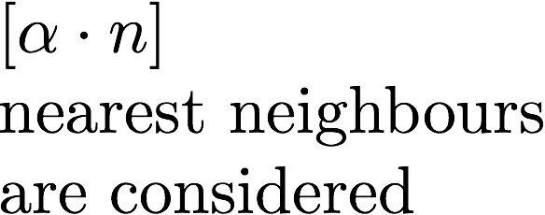
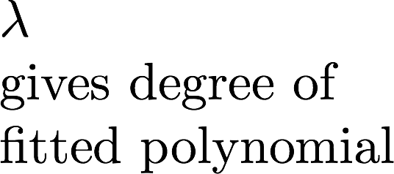
LOESS Regression
http://demonstrations.wolfram.com/HowLoessWorks
Notes:
For $0<\alpha \leq 1$
\noindent $[\alpha\cdot n]$\\
nearest neighbours\\
are considered
\noindent $\lambda$\\
gives degree of\\
fitted polynomial

Slide 57
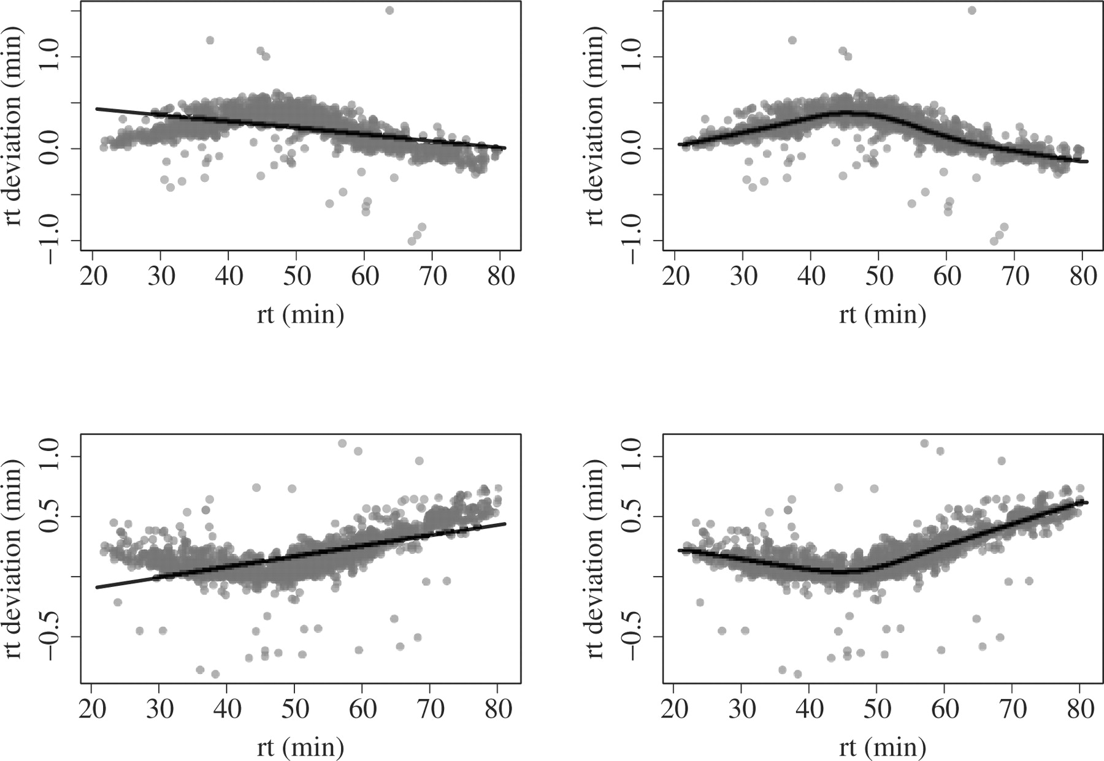
Nonlinear Alignment
Alignment of two different datasets (top/bottom). Left: linear, right: nonlinear.
(around 30 k aligned peaks)
Podwojski et al., Bioinformatics (2009), 25:758-764.

Slide 58
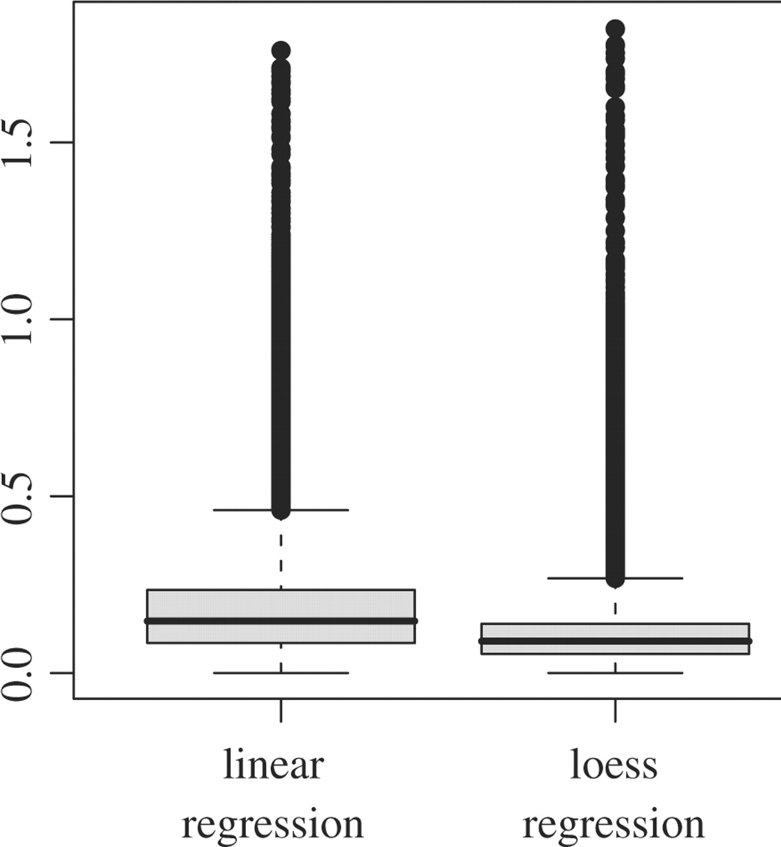
Nonlinear Alignment
RT error [min]
Comparison of median RT error for linear/nonlinear regression
Podwojski et al., Bioinformatics (2009), 25:758-764.

Slide 59
Feature Linking
Map alignment does not yet create a direct correspondence (bijection) between the features!
Feature linking pairs up features
  across maps for label-free quantification
  within maps for arbitrary labeling strategies (e.g., SILAC: link pairs 6 Da apart)
A user-specified mass tolerance and retention time tolerance are required as input
Labeled feature linking also requires the specification of the label distance (mass difference)
The result are consensus features containing the original features as well
Correctness of linked features can also be verified through identifications (if present)

Slide 60
OpenMS/TOPP
OpenMS implements the Lange et al. algorithm
TOPP contains tools for map alignment and for feature linking
  MapAlignerPoseClustering
    Implements the pose clustering algorithm and computes the corresponding transformation
  FeatureLinkerUnlabeledQT
    Uses QT clustering to compute the best assignment of features across several maps
    Result is a consensus map

Slide 61
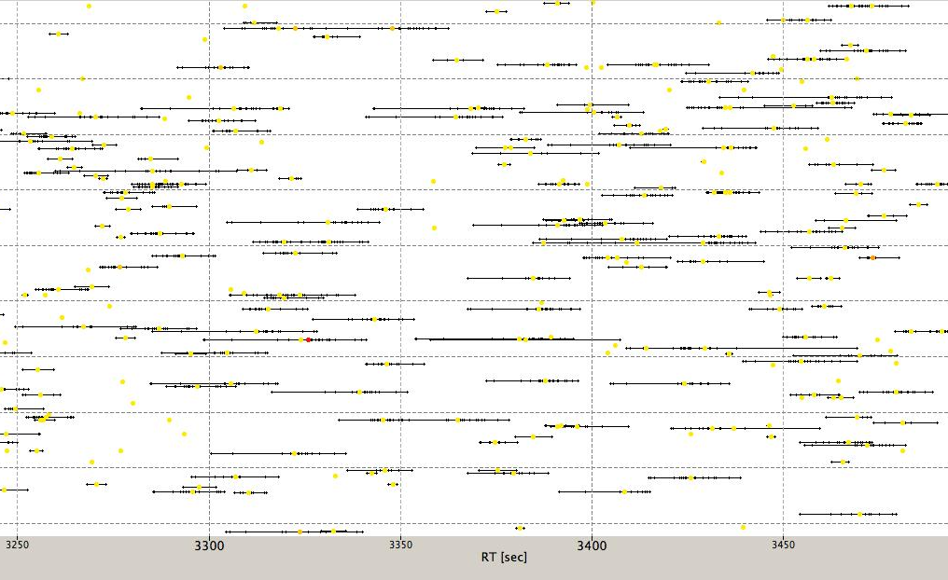
Consensus Features

Slide 62
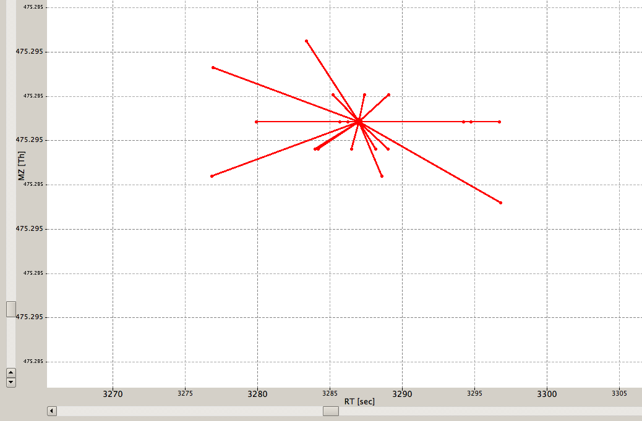
Consensus Features

Slide 63
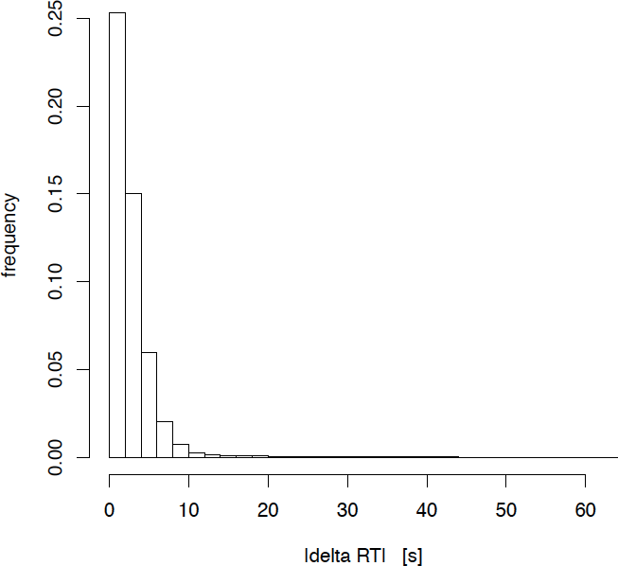
Quality Control
MapStatistics
  Produces some descriptive statistics of a map for QC
    Did feature finding and map alignment work properly?
    Do all maps we aligned have roughly the same amount of features?
    Check instrument calibration and stability of chromatography

Slide 64
Map Normalization
For label-free quantification a normalization of features across maps is often helpful
Strategy 1: internal standards
  Spiked in peptides/proteins are used for normalizing maps
  This is easily done in a statistics package or Excel after the analysis
Strategy 2: background normalization
  For a sufficiently complex background only a small number of features/peptides will be differential
  The background can be used to normalize maps with respect to each other (keeping the ration of unregulated background features at 1:1)
Idea: ‘robust regression’
  Look at all the ratios
  Remove outliers
  Determine the normalization factor from the rest

Slide 65
Effect of Normalization
Label-free quantification in a complex (platelet) background measured with a spiked in peptide
before
normalization
after
normalization

Slide 66
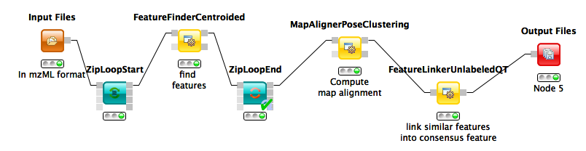
Feature Finding in KNIME
TOPP tool FeatureFinder
(FeatureFinderCentroided in OpenMS 1.11)
Reads a centroided LC-MS map – so if data is available as raw data, it needs to be converted to centroided data using a peak picker
Label-free workflows can get rather complicated and usually require identification steps as well (which we will discuss later in the lecture)

Slide 67
Learning Unit 5C
SILAC Quantification
SILAC Quantification
Experimental techniques
MaxQuant algorithm

Slide 68
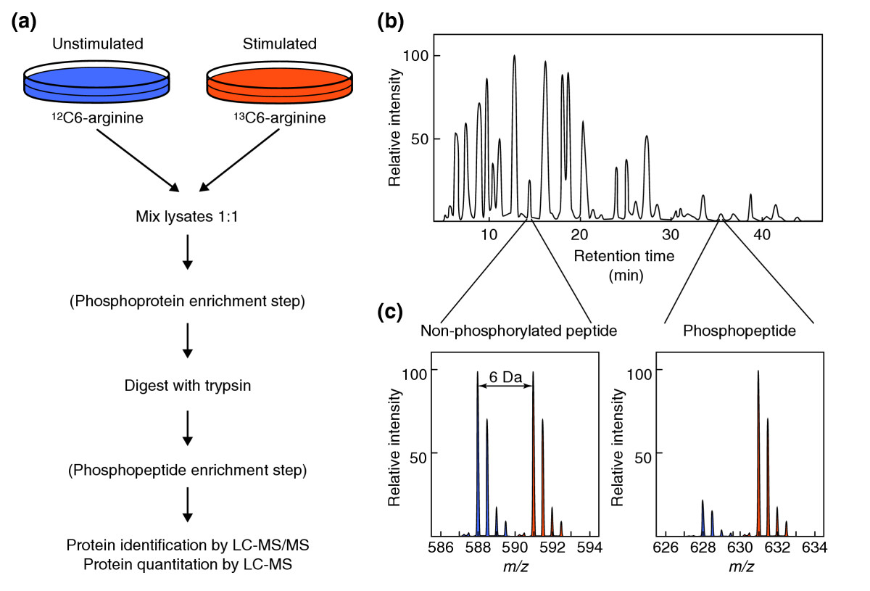
SILAC
Mumby, Brekken, Genome Biol (2005), 6:230

Slide 69
SILAC Analysis
In principle, SILAC pairs are regular features
Note that isotopic labels shift the averagine model
A standard analysis workflow could thus look like:
  Feature finding
  Linking of pairs with the proper distance (4/6/8/10 Da, depending on the experiment)
Specialized SILAC analysis tools can make use of the additional information contained in pairs
  Exact mass differences
  Presence of a second pair can increase confidence in the detection
Inclusion of this knowledge generally improves sensitivity of the feature/pair detection

Slide 70
MaxQuant
Peak detection
  Identify chromatograpic peaks
De-Isotoping
  Construct features from the matching chromatographic peaks
Pair detection
  Identify SILAC pairs among the de-isotoped peaks
Ratio estimation
  Determine the ratio of the SILAC pair
Cox & Mann, Nat. Biotech. (2008), 26:1367-1372.

Slide 71
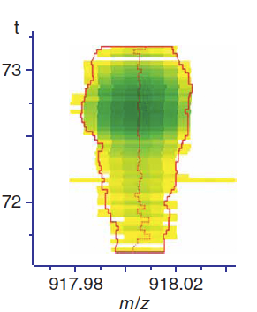
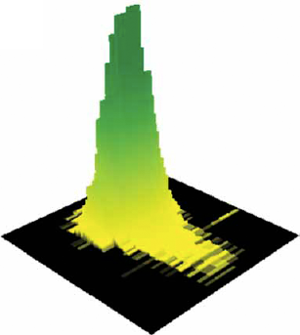
Peak Detection
MaxQuant uses the notion of 3D peaks to describe the mass traces on the raw data (three dimensions: RT, m/z, intensity)
3D peaks can be defined as all the signal caused by one isotopic mass of an analyte – they correspond to mass traces in centroided feature finding
Features are then defined as several of these 3D peaks
3D peak eluting over 1.5 min, m/z around 918 Da in 2D and 3D representation
Cox & Mann, Nat. Biotech. (2008), 26:1367-1372.

Slide 72
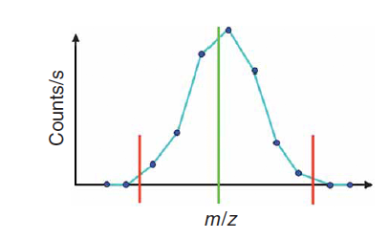
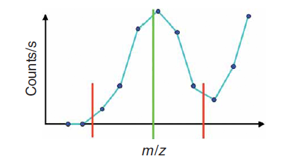
Peak Detection
3D peaks are detected by detecting peaks within individual mass spectra first
For high-resolution MS instruments (e.g., Orbitrap), peak detection is achieved by looking for local maxima
2D peaks are then determined as the range from the maximum until either zero or a local minimum has been reached
Cox & Mann, Nat. Biotech. (2008), 26:1367-1372.

Slide 73
Peak Detection
If there are more than three data points to the peak, then the center of the peak (centroid) is determined as by a Gaussian fit to these three peaks
Special treatment for peaks consisting of only one or two peaks
Intensity of the peak is approximated by the sum of the intensities of all raw data points of the peak
Cox & Mann, Nat. Biotech. (2008), 26:1367-1372.

Slide 74
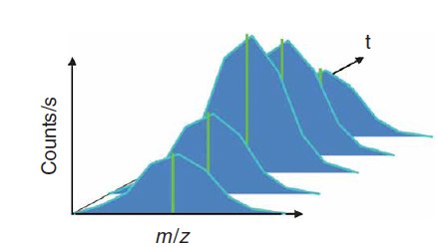
Peak Detection
2D peaks of adjacent scans are assembled into a 3D peak, if their centroid positions differ by less than 7 ppm
2D peaks may be missing in up to one scan (e.g., in case a 2D peak detection did not work well), 3D peak consists of the maximum number of 2D peaks that can be joined in this way
Intensities of 2D peaks are smoothed and the 3D feature is split if there are local minima in the intensity
The 3D peak mass the intensity-weighted average of its 2D peaks’ masses
Cox & Mann, Nat. Biotech. (2008), 26:1367-1372.

Slide 75
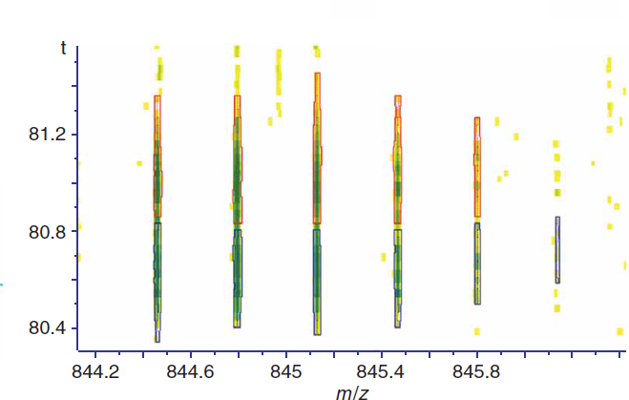
Peak Detection
Two 3D peaks with identical masses, but different RT (~80.6 and ~81.0 min)
Cox & Mann, Nat. Biotech. (2008), 26:1367-1372.

Slide 76
De-Isotoping
3D peaks are aggregated to features
To this end, a compatibility graph is constructed
3D peaks are represented by nodes
An edge is added between two nodes, if
  Their masses match the distance within an isotope profile
  Their elution profiles overlap (normalized inner product [cosine] of the two 3D peaks is greater than 0.6)
Connected components of this graph are potential features, but can still contain 3D peaks from multiple features (overlapping features)

Slide 77
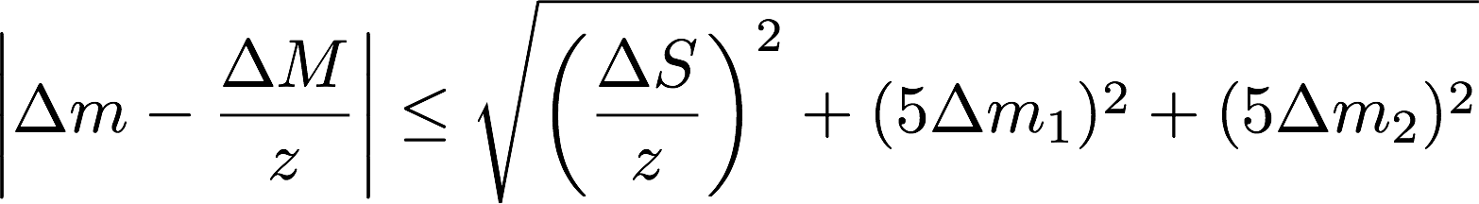

De-Isotoping
The mass criterion for an edge between the nodes representing two 3D peaks is fulfilled if the following holds:
Where m is the mass difference between the peaks and M is the mass difference between the monoisotopic and the ¹³C satellite for an averagine of mass 1,500 Da (1.00286864 Da), z the charge.
m₁ and m₂ are the bootstrapped standard deviations of the two exact peak masses and
S = 2 m(¹³C) – 2 m(¹²C) – m(³⁴S) – m(³²S) = 0.0109135 Da
Is the maximum mass shift caused by the incorporation of one sulphur atom.
Notes:
\begin{equation*}
\left|\Delta m - \frac{\Delta M}{z}\right|\leq \sqrt{\left(\frac{\Delta S}{z}\right)^2 + (5\Delta m_1)^2 + (5\Delta m_2)^2}
\end{equation*}

Slide 78
De-Isotoping
Connected components of this graph correspond to sets of overlapping features and individual (noise) 3D peaks
They are resolved by iteratively removing the largest set of 3D peaks that are consistent
Consistency is defined by
  Mutual consistency of all pairs of peaks with respect to their mass distances (similar to the above definition for an edge, but also between more distant peaks)
  Correlation of 0.6 or better between all elution profiles
  Correlation of 0.6 or better of the 3D peak distances with the isotope distribution of an averagine at mass 1,500 Da

Slide 79
Pair Detection and Ratio Estimation
SILAC pairs are found through their distances by searching for pairs in the correct distance (for up to three labeled K or R in all possible combinations)
Intensities of the two features have to have a correlation of 0.5 or better
For each pair, the intensity ratios are determined as the slope of a regression line through the itensities of corresponding 3D peaks in the light and heavy feature

Slide 80
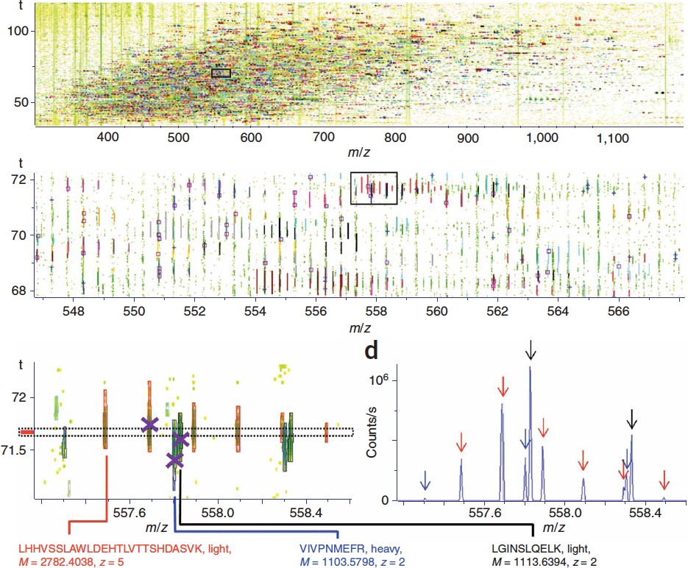
Result
SILAC pairs identified in a large-scale study of human HeLa cells.
Over 5,000 SILAC pairs were found in one run.
Cox & Mann, Nat. Biotech. (2008), 26:1367-1372.

Slide 81
MaxQuant
MaxQuant implements the SILAC pair detection algorithm sketched here
Later versions of MaxQuant can also be applied to label-free quantification
MaxQuant is unfortunately restricted to a specific vendor format (ThermoFischer RAW format) and platform (Windows)
The output consists of a text file, that can then be parsed and analyzed statistically with other tools

Slide 82
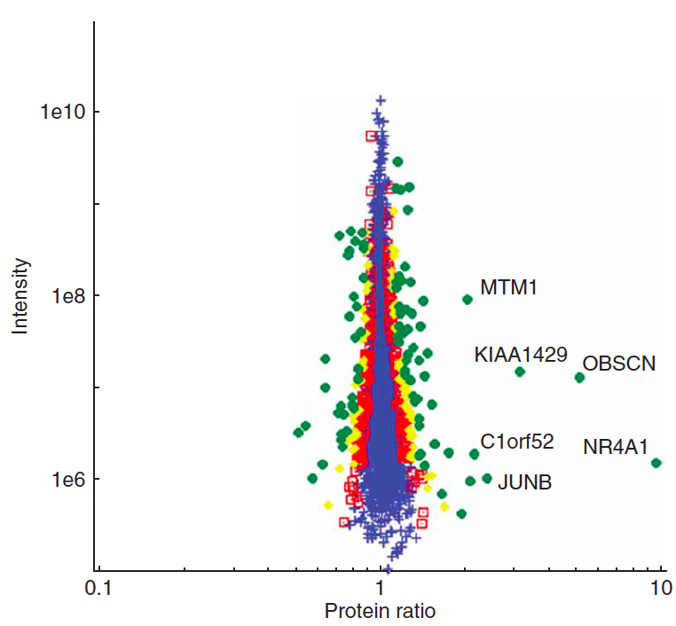
MaxQuant
Differential quantification of protein ratios of HeLA cells after 2 h of EGF stimulation
99.3% of all proteins have a ratio of 1.0 (+/- 50%) and are thus not significantly regulated
Transcription factor JunB and orphan nuclear receptor NR4A1 are both significantly upregulated
Their upregulation by EGF has been found through other methods and described in literature as well
‘christmas tree plot’:
pair intensity as a function of the pair ratio (double logarithmic plot) reveals the distribution of ratios, accuracy, LOD, LOQ, LOL
Cox & Mann, Nat. Biotech. (2008), 26:1367-1372.

Slide 83
Original Papers
Label-free feature finding (OpenMS feature finder)
  Clemens Gröpl, Eva Lange, Knut Reinert, Oliver Kohlbacher, Marc Sturm, Christian G. Huber, Bettina M. Mayr, Christoph L. Klein: Algorithms for the Automated Absolute Quantification of Diagnostic Markers in Complex Proteomics Samples. CompLife 2005: 151-162.
  Online: http://www.springerlink.com/content/81lk5vjtxqwbflce/
  Sturm, Marc: OpenMS – A framework for computational mass spectrometry, Dissertation, Tübingen (2010)
  Online: http://nbn-resolving.de/urn:nbn:de:bsz:21-opus-51146
  Website: http://openms.de
SILAC feature finding (MaxQuant)
  Cox, J. and Mann, M. (2008) MaxQuant enables high peptide identification rates, individualized p.p.b.-range mass accuracies and proteome-wide protein quantification. Nat Biotechnol 26, 1367-72.
  (algorithm: see Supplementary Material at http://www.nature.com/nbt/journal/v26/n12/extref/nbt.1511-S1.pdf)
Website: http://maxquant.org

Slide 84
Materials
Online Materials
  Learning Unit 5[A,B,C],
  Learning Unit 1C

