Slide 1


René Rahn
Algorithmische Bioinformatik, FB Mathematik und Informatik
Journaled String Tree A scalable data structure for analyzing thousands of similar genomes on your laptop
René Rahn, Freie Universität Berlin

Slide 2
Sequential Algorithms
Online pattern matching
k-order Markov chain
PSSM
Read mapping
qGram-Filter
Verifier (Hamming/ Edit distance)

Slide 3
Sequential Algorithms
start
start
initialize
initialize
at end?
yes
stop
stop
State
State
Context
no
counter
position
bit mask
…
counter
position
bit mask
…
process
context
read
update
process
context
s¹:
at pos 350
success?
yes
report
report
no
move forward
move forward
Notes:
CDFGDC
CDEFGAHGC

Slide 4
Multiple sequences
s⁰:
s¹:
s²:
s³:
…
Notes:
CDFGDC
CDEFGAHGC

Slide 5
Multiple similar sequences
s¹:
1: 531
2: 545
3: 531
4: 545
s²:
2: 245
4: 245
s³:
s⁴:
Notes:
CDFGDC
CDEFGAHGC

Slide 6
Referential Compression
src:
TAGCGTAGCAGCTATGAGGAGG-ACCGAGTT
|||||||||||| |||||| ||||||||
tar^{Δ}:
tar:
TAGCGTAGCAGC---GAGGAGCGACCGAGTT
TAGCGTAGCAGC---GAGGAGCGACCGAGTT
Journaled String
ref: *
(19,1,1,1)
G
Virtual Position
ib: CG
Physical Position
3
Journal Entry
1
(12,15,6,0)
GAGGAG
4
(20,22,8,0)
ACCGAGTT
Length
Source
0
(0,0,12,0)
TAGCGTAGCAGC
2
(18,0,1,1)
C
Notes:
ViewToSourcePosition of Row1
toSourcePosition(row,pos)
SourceToViewPosition of Row1
toViewPosition(row,pos)

Slide 7
Journaled String Tree (JST)
6
12
21
22
ref: TAGCGTAGCAGCTATGAGGAGGACCGAGTT
ref: TAGCGTAGCAGCTATGAGGAGG-ACCGAGTT
s¹: TAGCGTAGCAGC---GAGGAGCGACCGAGTT
s²: TAGCGTGGCAGC---GAGGAGC-ACCGAGTT
s³: TAGCGTGGCAGCTATGAGGAGC-ACCGAGTT
Delta Map
r-pos Delta a
6 ⬅ R-( ‘G’,{2,3})
12 ⬅ D-(‘TAT’,{1,2})
21 ⬅ R-( ‘C’,{1,2,3})
22 ⬅ I-( ‘G’,{1})
Journaled String Set
j¹: TAGCGTAGCAGC---GAGGAGCGACCGAGTT
j²: TAGCGTGGCAGC---GAGGAGC-ACCGAGTT
j³: TAGCGTGGCAGCTATGAGGAGC-ACCGAGTT
Notes:
- Can be used like strings
- Modifieres can be nested, e.g reverse complement

Slide 8
JST-Traversal
Traversal
start
Sequential Algorithm
initialize
setState(state s)
state : getState()
at end?
yes
stop
State
State Stack
int : execute(…)
no
counter
position
bit mask
…
process
context
read
update
it : getContext(…)
success?
yes
report
Journaled String Tree
no
vec : getPositions(…)
move forward

Slide 9
Reduce Memory Footprint
Process in blocks
Block 1
Block 2
Block 3
Block 4
--- GA
G C
G GA
-
A C
C T
-- T
-- G
G T
CA T
A

Slide 10
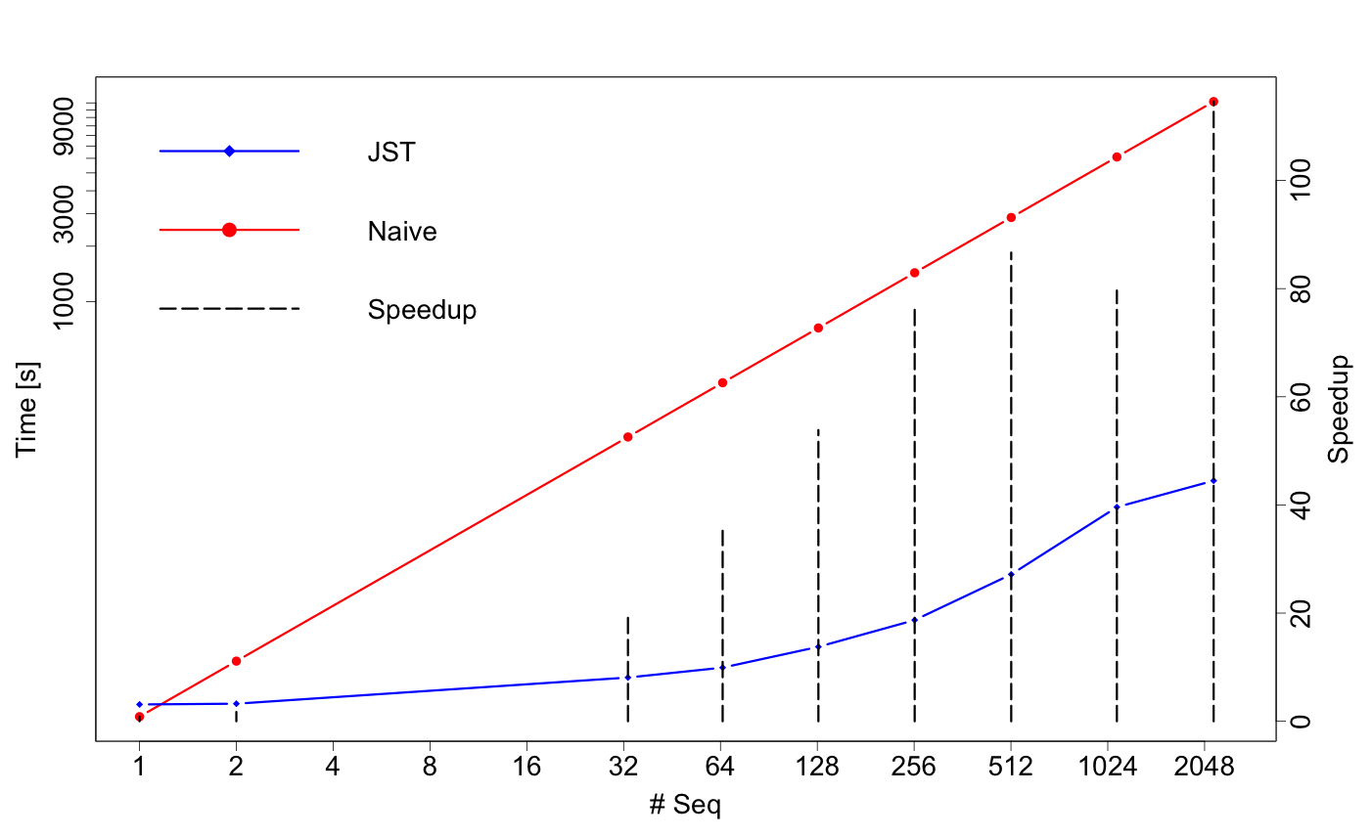
Result: Approx. Search
Total runtime on hs_chr1 + block size 100K + pattern length 64

Slide 11
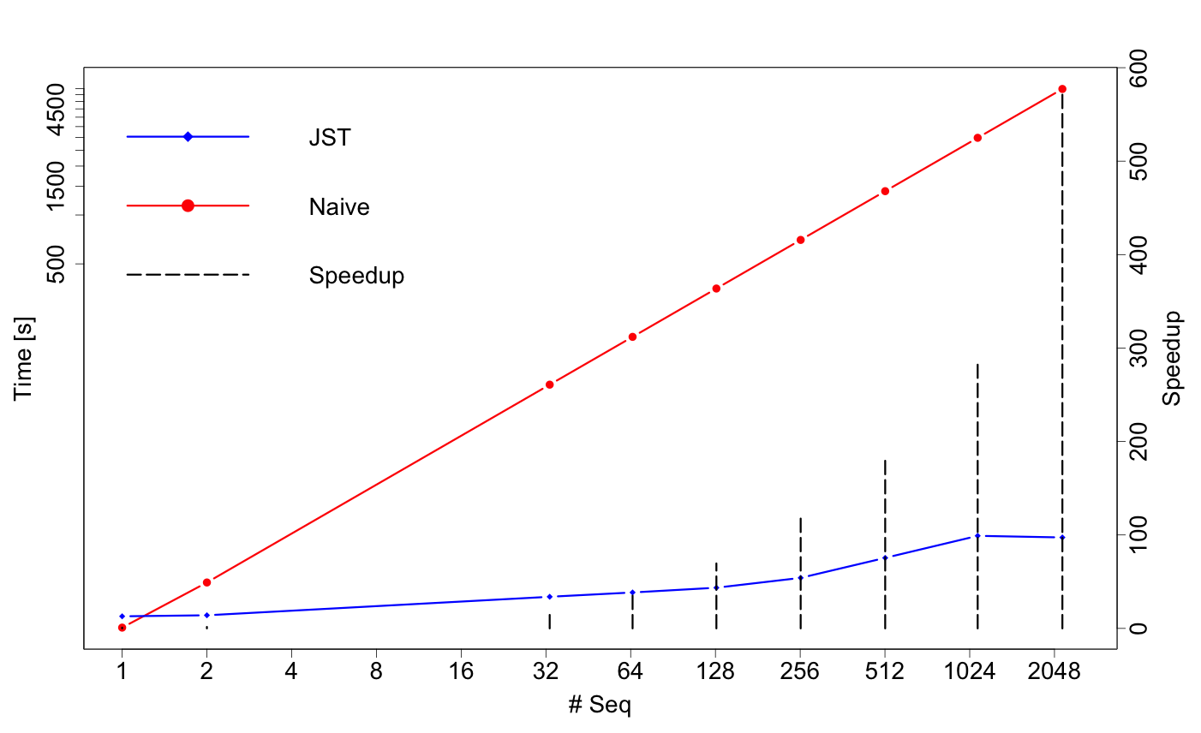
Result: Approx. Search
Solely search time on hs_chr1 + block size 100K + pattern length 64

Slide 12
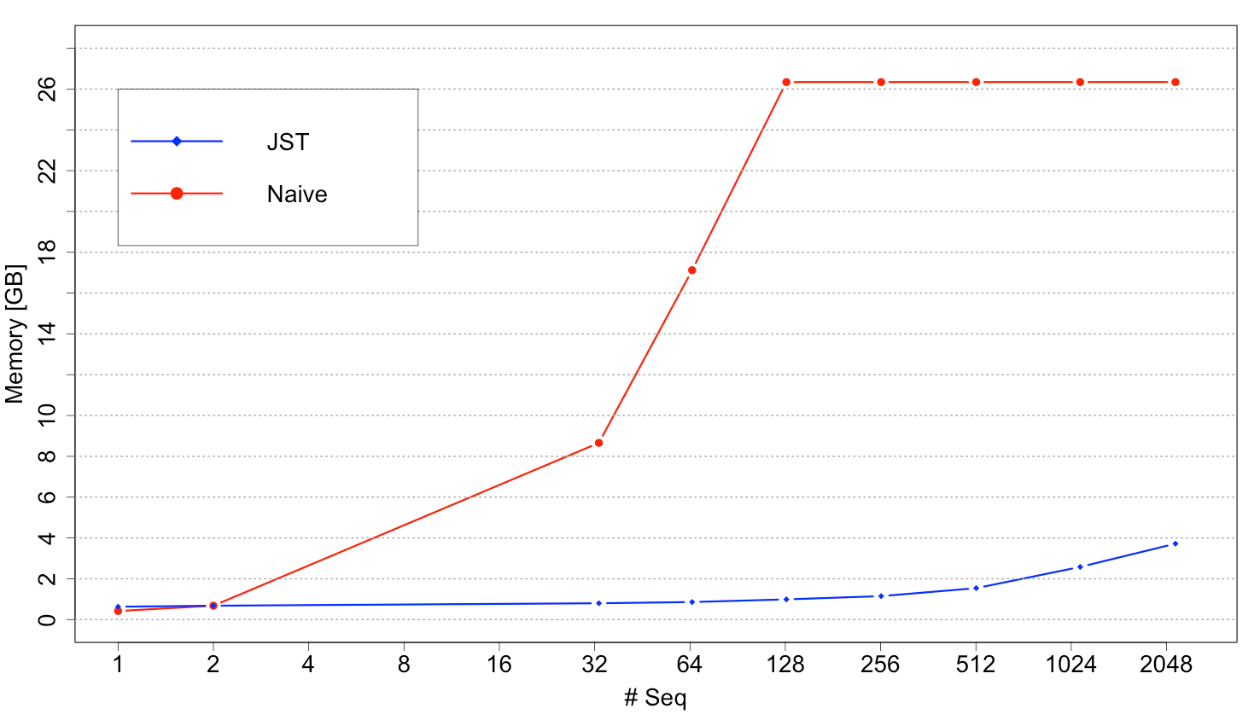
Result: Memory footprint
hs_chr1 + block size 100K

Slide 13
Outlook
Indexing JST - random access
Parallelizing JST Search
Index-based filter working on JST

Slide 14

Questions?
Acknowledgements
Prof. Dr. Knut Reinert
Dr. David Weese
Thank you for your attention!

Slide 15





Background
Notes:
- Can be used like strings
- Modifieres can be nested, e.g reverse complement

Slide 16
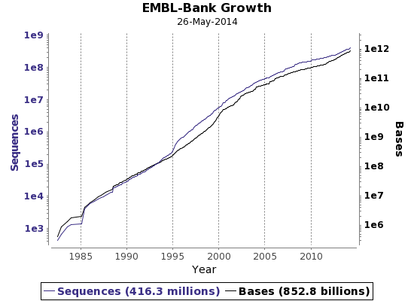
Background
http://www.ebi.ac.uk/ena/about/statistics; Accessed 01.06.2014

Slide 17
Journaled String Tree
Traversal
getPositions
start
initialize
Sequential Algorithm
process
reference segment
shift size
no
next
segment?
yes
stop
success?
yes
yes
no
process
context
no
report
at end?
push state
compute shift
yes
stack
empty?
yes
no
no
at end?
getState
State
split?
yes
no
counter
position
bit mask
…
read
update
pop state
process
branch
segment
push state
shift size
setState

Slide 18
Core Parallelization
T1
Concurrent
Queue
T2
T3
Master

Slide 19
JST Traversal
Delta-Map
Horspool:
r-pos Delta a
6 ⬅ R-( ‘G’,{2,3})
12 ⬅ D-(‘TAT’,{1,2})
21 ⬅ R-( ‘C’,{1,2,3})
22 ⬅ I-( ‘G’,{1})
Pattern: AGCG
A: 3 C: 1 G: 2 T: 4
Context size: 4
{2*,3}
A G C A C C
{2*,3}
{1*,2}
{1*,2,3}
A G C G A G
A G C
G A C
{1*}
C G T G G C A
{1*}
G A C C G
T A G C G T A G C A G C T A T G A G G A G G A C C G A G T T
0 1 2 3 4 5 6 7 8 9 0 1 2 3 4 5 6 7 8 9 0 1 2 3 4 5 6 7 8 9
0 1 2
s¹ : 1
s² : 1
s³ : 1
s¹ : 9
s² : 9
s¹ : 16

Slide 20
Journaled String Interface
template <typename TValue, typename THostSpec, typename TJournalSpec,
typename TBuffSpec>
class String<TValue, Journaled<THostSpec, TJournalSpec, TBuffSpec>>
{
… };
typedef String<Dna, Journaled<>> TJournalString;
typedef typename Iterator<TJournalString, Standard>::Type TIter;
DnaString ref = ”ACGTACGT”;
TJournalString jString(ref);
insert(jString, 5, ”CCC”);
erase(jString, 2, 4);
jString[8] = ’A’;
for(TIter it = begin(jString); it != end(jString); ++it)
std::cout << *it << std::flush;
std::cout << std::endl; // ACACCCCGA
std::cout << host(jString) << std::endl; // ACGTACGT
Can be used as any other String<> in SeqAn

Slide 21
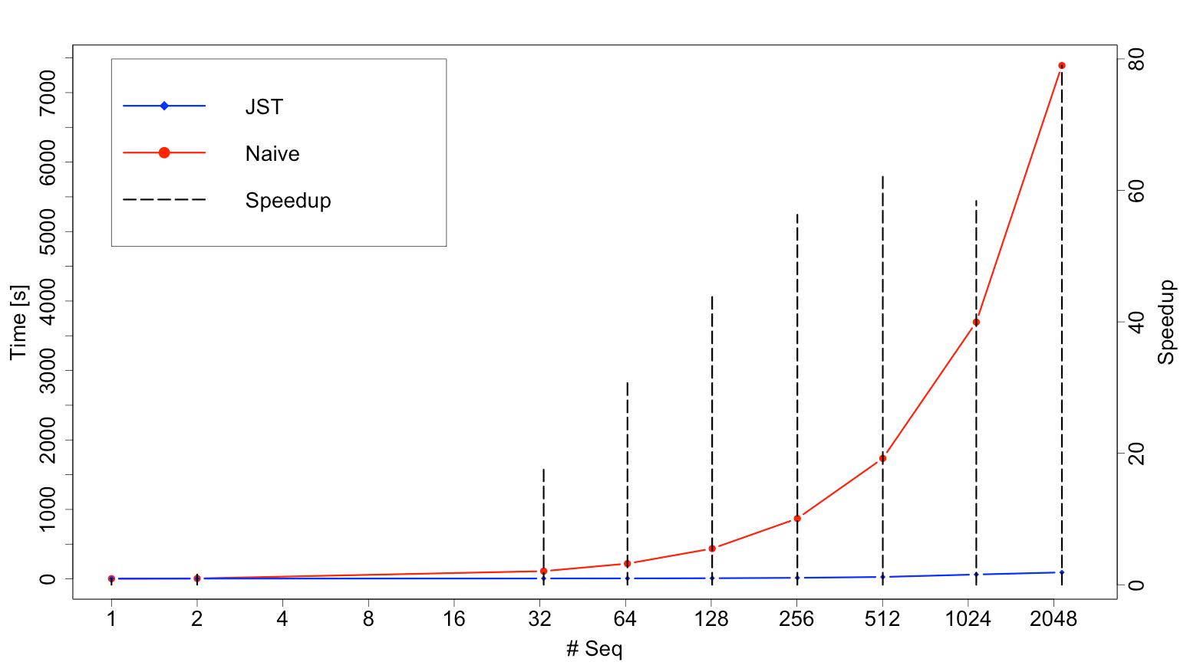
Results
Total times Horspool on hs_chr1 + block size 100K + pattern length 64

Slide 22
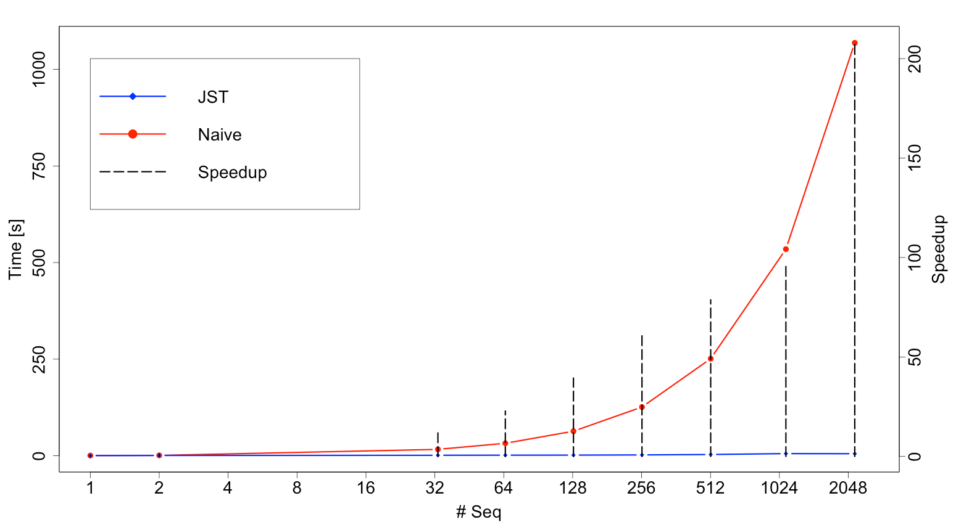
Results
Search times Horspool on hs_chr1 + block size 100K + pattern length 64

