Slide 1
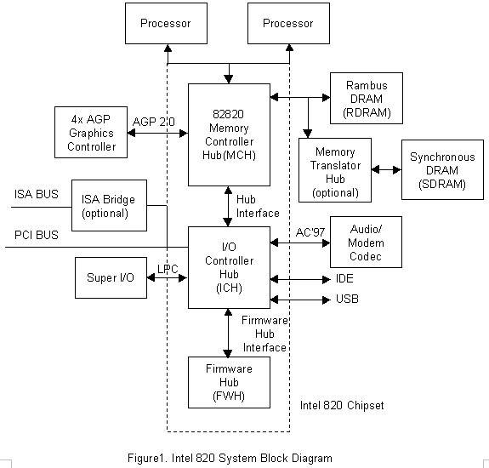
TI II: Computer Architecture
Prof. Dr.-Ing. Jochen Schiller
Computer Systems & Telematics
Freie Universität Berlin, Germany

Slide 2
Structure/content of CST-Lectures
Modeling and Simulation
Modeling, Simulation and Evaluation of Systems
SW/HW-Lab mobile, embedded Systems
SDR, security architectures, IoT, localization, bring your own topic…
Embedded Internet and the IoT
Wireless sensor networks, wireless mesh networks, Internet of Things, etc.
Microprocessor Lab
Programming of embedded systems, IoT, mobile/wireless devices
Seminar Computer Systems
Presentation & discussion of current topics from all lectures
Mobile Communications
Wireless transmission, media access, GSM, 3G, LTE, WLAN, mobile IP, ad-hoc networks
Telematics / Advanced Computer Networks
Protocols, services, standards, LAN, Internet, TCP/IP, WWW, security, quality of service, DNS, routing, applications, IPv6, MPLS
Master
Bachelor
Computer Systems Lab (TI IV)
Embedded systems, interfaces, drivers, operating systems, networking, integration
Module
Computer Architecture,
Operating Systems and Computer Networks
You are here!
Operating Systems and Computer Networks (TI III)
Input/output, DMA/PIO, interrupts, buffer, process/thread, UNIX/Windows, networks, media access, protocols, TCP/IP, Internet
Computer Architecture (TI II)
Harvard/v. Neumann, micro architecture, RISC/CISC, branch prediction, pipelining, cache, memory hierarchy, assembler, multi-processor systems
Basics of Computer Systems (TI I)
Boolean algebra, circuits, minimization, gates, memory, semiconductors, transistors, CMOS, AD/DA conversion

Slide 3
Content
Introduction
Single Processor Systems
Historical overview
Six-level computer architecture
Data representation and Computer arithmetic
Data and number representation
Basic arithmetic
Microarchitecture
Microprocessor architecture
Microprogramming
Pipelining
Instruction Set Architecture
CISC vs. RISC
Data types, Addressing, Instructions
Assembler
Memories
Hierarchy, Types
Physical & Virtual Memory
Segmentation & Paging
Caches
Programming in assembler as part of the exercises

Slide 4
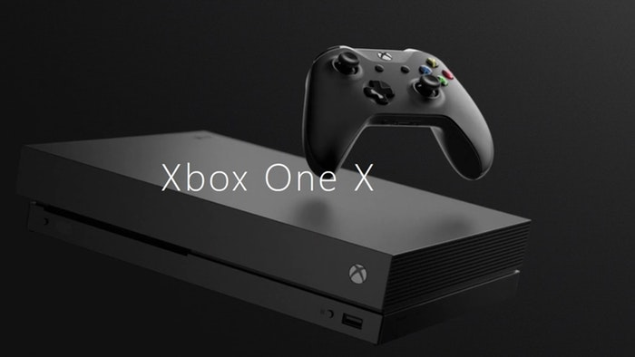
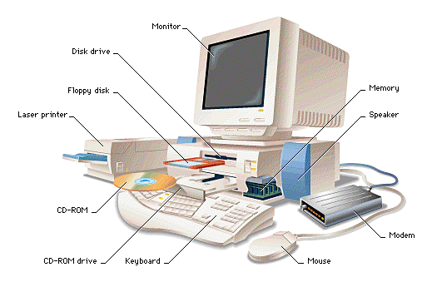
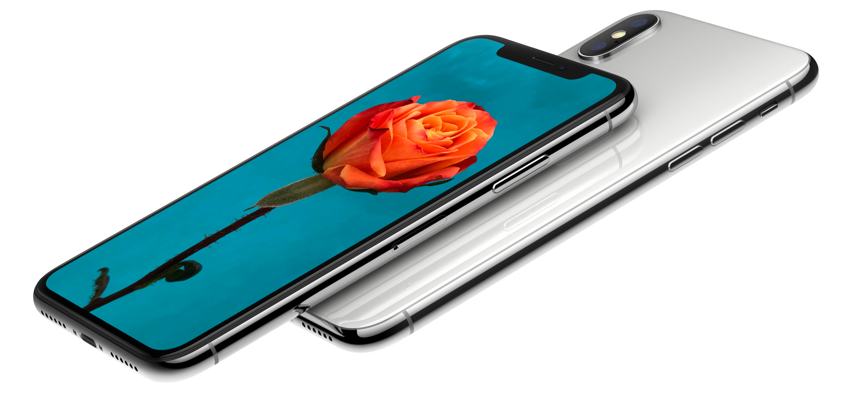
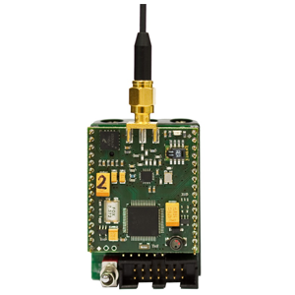
Topics of this Course
Have you ever …
opened the case of a computer?
assembled a computer from components?
written a program in Java/Python/Rust/JavaScript?
written a program in C?
written a program in Assembler?

Slide 5
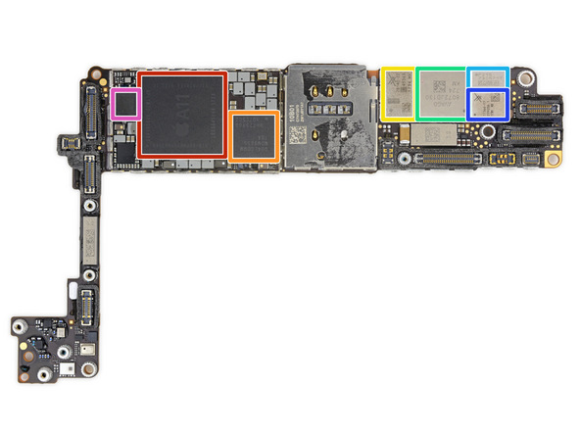
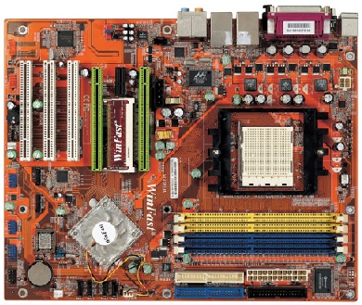
Topics of this Course
At the end of this course, you should …
know the different components of a computer system
know the internals of a computer
know how a computer stores data, i.e., text, audio, video
know how a program is executed
be able to write small assembler programs
understand basic arithmetic
This should help you to
understand computers in general
understand how high-level programming languages are translated into machine language
improve your programming skills
optimize the performance of your programs
https://de.ifixit.com/Teardown/iPhone+8+Teardown/97481

Slide 6
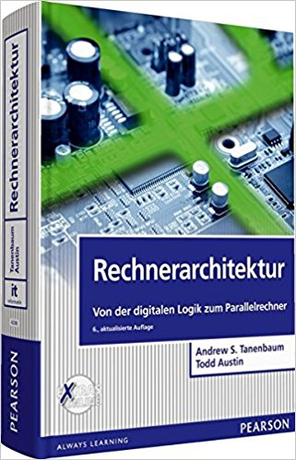
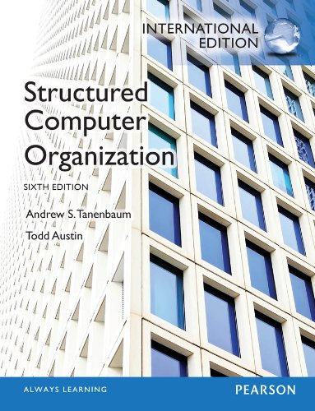
Literature
The course follows (roughly) the books:
A. S. Tanenbaum, T. Austin: Structured Computer Organization, 6. edition, Pearson, 2013 Rechnerarchitektur, 6. Auflage, Pearson Studium, 2014
D. A. Patterson, J. L. Hennesy: Computer Organization and Design, 5. edition, Morgan Kaufmann, 2013 Rechnerorganisation und -entwurf, 5. Auflage, De Gruyter, 2016

Slide 7
Course Organization
Q&A virtual via Webex meetings – tutorials in real life!
General:
Lecture
Available online
Flipped-classroom: Q&A, discussions, Friday, 10-12h c.t., via Webex/HS Taku 9 (hybrid/invitations see whiteboard)
Office Hours
Jochen Schiller: via email or https://fu-berlin.webex.com/meet/jochen.schiller
Tutors: during tutorials
News and Updates
Whiteboard course site (via announcements)
Tutorials
Groups of approx. 25-30 students
Time depends on group
Registration via KVV
Assignments:
New assignments each week
Available in KVV
Discussion
During the tutorials
Practical assignments
@home and in the labs, should work on all platforms
More during Q&A/tutorials
Handing in
Right on time!
Complete electronic workflow!
Solutions handed in too late will be ignored!

Slide 8
Assignments
Exercises: Available on Fridays in KVV after Q&A
Submission: Two weeks later until start of class (Fri, 8:30)
Discussion: Three weeks later in tutorials
Publishing
Questions
Submit
Discussion
Lecture
Tutorials
Lecture
Tutorials
Lecture
Tutorials
Lecture
This week
… next week
… third week
… fourth week

Slide 9
Criteria for Successful Participation
DO NOT FORGET to register in campus management (grading/exam) and whiteboard (course organisation)
Active participation in the tutorials is essential!
Minimum n-2 times present
Hand in your assignments on time
Teamwork is required with 2 students per team
Successful submission of at least n-2 assignments
Each student with a correct answer must be able to present the assignment during the tutorials
At least one presentation during the tutorials
At least 50% of the max. number of points in the exam are required
Only the exam counts for grading!
Exam: to be announced

Slide 10
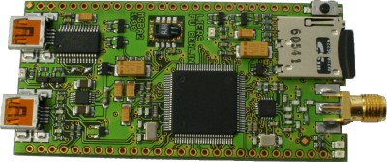
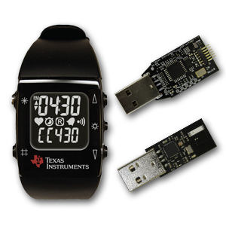
RIOT-OS
The friendly Operating System for the Internet of Things.
http://riot-os.org/

