Slide 1
TI II: Computer Architecture ISA and Assembly
CISC vs. RISC
Data Types
Addressing
Instructions
Assembler

Slide 2
Content
Introduction
Single Processor Systems
Historical overview
Six-level computer architecture
Data representation and Computer arithmetic
Data and number representation
Basic arithmetic
Microarchitecture
Microprocessor architecture
Microprogramming
Pipelining
Instruction Set Architecture
CISC vs. RISC
Data types, Addressing, Instructions
Assembler
Memories
Hierarchy, Types
Physical & Virtual Memory
Segmentation & Paging
Caches

Slide 3
Where are we now?
Level 5
Problem-oriented language level
Java, C#, C++, C, Haskell, Cobol, …
Translation (Compiler)
Javac, VS .NET
Level 4
Assembly language level
Java Byte Code, MSIL/CIL
Translation (Assembler)
JVM, CLR; JIT/Interpreter
Level 3
Operating system machine level
Unix, Windows, iOS
Partial interpretation (operating system)
JVM, CLR; JIT/Interpreter
Level 2
ISA (Instruction Set Architecture) level
x86, PPC, ARM, …
Interpretation (microprogram) or direct execution
microprogram/ none
Level 1
Microarchitecture level
Netburst, ISSE, ASX, <none>, …
Hardware
hardware
Level 0
Digital logic level
Core i7, ARM9, PPC620, …

Slide 4
Information
This chapter is mainly for some background information about ISAs, assembler etc.
The assignments plus tutorials teach you how to program with assembler
We skip the operation system part as this is covered in the course “Operating Systems and Computer Networks”
Subsystems, Interrupts and System Calls
Processes
Memory
Scheduling
I/O and File System
Booting, Services, and Security

Slide 5
The classical SW/HW boundary
What is visible to the user?

Slide 6
Execution of operations
Interpretation or compilation of instructions from the ISA-layer
High-level languages translated into instructions from the ISA
Pure RISC processors can directly execute ISA instructions
i.e. the hardware (HW) can execute these instructions
More complex processors use microprogramming, flexibility and compatibility reasons:
hardware changes leave ISA unchanged
reprogramming to circumvent hardware problems
more powerful ISA – simpler compilers

Slide 7
Example: A selection of the Pentium II integer instructions
Moves |  |  | Transfer of control |  |  | Condition codes
MOV DST,SRC | Move SRC to DST |  | JMP ADDR | Jump to ADDR |  | STC | Set carry bit in EFLAGS register
PUSH SRC | Push SRC onto the stack |  | Jxx ADDR | Conditional jumps based on flags |  | CLC | Clear carry bit in EFLAGS register
POP DST | Pop a word from the stack to DST |  | CALL ADDR | Call procedure at ADDR |  | CMC | Complement carry bit in EFLAGS
XCHG DS1,DS2 | Exchange DS1 and DS2 |  | RET | Return from procedure |  | STD | Set direction bit in EFLAGS register
LEA DST,SRC | Load effective addr of SRC into DST |  | IRET | Return from interrupt |  | CLD | Clear direction bit in EFLAGS reg
CMOV DST,SRC | Conditional move |  | LOOPxx | Loop until condition met |  | STI | Set interrupt bit in EFLAGS register
Arithmetic |  |  | INT ADDR | Initiate a software interrupt |  | CLI | Clear interrupt bit in EFLAGS reg
ADD DST,SRC | Add SRC to DST |  | INTO | Interrupt if overflow bit is set |  | PUSHFD | Push EFLAGS register onto stack
SUB DST,SRC | Subtract DST from SRC |  | Boolean |  |  | POPFD | Pop EFLAGS register from stack
MUL SRC | Multiply EAX by SRC (unsigned) |  | AND DST,SRC | Boolean AND SRC into DST |  | LAHF | Load AH from EFLAGS register
IMUL SRC | Multiply EAX by SRC (signed) |  | OR DST,SRC | Boolean OR SRC into DST |  | SAHF | Store AH in EFLAGS register
DIV SRC | Divide EDX:EAX by SRC (unsigned) |  | XOR DST,SRC | Boolean Exclusive OR SRC to DST |  | Miscellaneous
IDIV SRC | Divide EDX:EAX by SRC (signed) |  | NOT DST | Replace DST with 1 s complement |  | SWAP DST | Change endianness of DST
ADC DST,SRC | Add SRC to DST, then add carry bit |  | Shift/rotate |  |  | CWQ | Extend EAX to EDX:EAX for division
SBB DST,SRC | Subtract DST & carry from SRC |  | SAL/SAR DST,# | Shift DST left/right # bits |  | CWDE | Extend 16-bit number in AX to EAX
INC DST | Add 1 to DST |  | SHL/SHR DST,# | Logical shift DST left/right # bits |  | ENTER SIZE,LV | Create stack frame with SIZE bytes
DEC DST | Subtract 1 from DST |  | ROL/ROR DST,# | Rotate DST left/right # bits |  | LEAVE | Undo stack frame built by ENTER
NEG DST | Negate DST (subtract it from 0) |  | RCL/RCR DST,# | Rotate DST through carry # bits |  | NOP | No operation
Binary coded decimal |  |  | Test/compare |  |  | HLT | Halt
DAA | Decimal adjust |  | TST SRC1,SRC2 | Boolean AND operands, set flags |  | IN AL,PORT | Input a byte from PORT to AL
DAS | Decimal adjust for subtraction |  | CMP SRC1,SRC2 | Set flags based on SRC1 - SRC2 |  | OUT PORT,AL | Output a byte from AL to PORT
AAA | ASCII adjust for addition |  | Strings |  |  | WAIT | Wait for an interrupt
AAS | ASCII adjust for subtraction |  | LODS | Load string |  | SRC = source | # = shift/rotate count
AAM | ASCII adjust for multiplication |  | STOS | Store string |  | DST = destination | LV = # locals
AAD | ASCII adjust for division |  | MOVS | Move string
 |  |  | CMPS | Compare two strings
 |  |  | SCAS | Scan Strings

Slide 8
Complex Instruction Set Computer (CISC)
Some call it
“complete”…

Slide 9
Complex Instruction Set Computer (CISC) 1
Reasons for CISC
Execution of complex instructions faster than execution of equivalent programs with the same function
Micro programming allows for more complex instructions
More complex instructions lead to shorter programs thus faster loading (transfer-rate gap between CPU internally and CPU-main memory)
Bigger is better – more instructions sound more powerful…it’s marketing!
Direct support of programming constructs of higher languages using more complex instructions (e.g. string compare)
Support of specialized powerful compilers
Compatibility (we can do everything like before plus xyz)
Support of special purpose applications (e.g. matrix operations)
➔ more transistors/chip, higher programming languages and special purpose applications favor “complex” instructions

Slide 10
Complex Instruction Set Computer (CISC) 2
Reasons against CISC
Much faster main memories (argument of the 80’s, today again a problem) and the use of cache memory speed-up program execution
Micro programs are more and more complex (so where is the difference between programming and micro programming…)
Replacement of complex instructions using several simpler (much faster) instructions
Longer development cycles
Very complex control units
Large micro programs with (potentially with errors)
Real programs use only a small fraction of the large instruction set frequently!

Slide 11
CISC – really needed?
System programs in XPL on IBM/360:
90% of all instructions used: 10 different instructions
95% of all instructions used: 21 different instructions
99% of all instructions used: 30 different instructions
COBOL programs on IBM/370:
90% of all instructions used: 26 different instructions
99% of all instructions used: 48 different instructions
Only 84 different instructions used at all

Slide 12
The 10 most used instructions in SPECint92 for Intel x86
Instruction | Percentage [%]
load | 22
conditional branch | 20
compare | 16
store | 12
add | 8
and | 6
sub | 5
move register-register | 4
call | 1
return | 1
Total | 95

Slide 13
Limitations of CISC architectures
Usage of instructions (80/20 rule)
Only 20% of the instructions used frequently
Many powerful instructions (rarely used)
Complex instruction format(s)
Micro programming
Critical problem: number of cycles per instruction (CPI)
Many classical CISC architectures have CPI >> 2
Motorola MC68030: CPI = 4-6
Intel 80386: CPI = 4-5
BUT: optimized code for Pentium/Itanium/… – typical CPI ≈ 1
Superscalar processors e.g. issuing 4 instructions in parallel could theoretically go down to 0.25, but: floating-point, SIMD, branch mis-predictions, memory latency …

Slide 14
Reduced Instruction Set Computer (RISC)

Slide 15
Reduced Instruction Set Computer (RISC)
The instruction set consists of
a few, absolutely necessary instructions (≤ 128) and
instruction formats (≤ 4) with a
fixed instruction length of 32 bit and only some
addressing modes (≤ 4).
This allows a much simpler implementation of the control unit and saves space on the chip for additional units.
Many general-purpose registers, at least 32, are needed.
Memory access is only possible via special load and store instructions.

Slide 16
Register/register architecture
Memory access is via load and store operations only.
All other instructions work on the CPU registers only, e.g., arithmetic operations load operands from registers and store results in registers only.
This basic principle is called
register/register architecture or
load/store architecture and is typical for many (original) RISC computers.

Slide 17
Additional features of RISC computers
If possible, all instructions should be implemented in a way that they finish within a single processor cycle.
Consequence: pure RISC processors do not use micro programming
RISC processors introduced enhanced pipelining mechanisms (today, many processors use pipelining for the micro instructions, e.g., Pentium 4 and up).
Furthermore, the early RISC processors had a software-controlled pipeline (compilers inserted delay NOPs, introduced delayed jumps etc.) instead of special hardware.
Aside
PC processors like the Pentium 4 (and up) use micro programming, the internal micro architecture (netburst) is rather RISC, the ISA is CISC.

Slide 18
RISC
Reasons for
Single-chip implementation (yes, today “everything” fits on a single chip)
Shorter development cycles
Higher clock rates, pipelining
Re-use of saved chip space for, e.g., cache
Reasons against
Bottleneck in the memory interface, today again main memory is much slower compared to internal registers/cache
Space on a chip is not that critical anymore

Slide 19
Early RISC processors
IBM 801 project
Already 1975, Cocke, IBM research, Yorktown Heights
MIPS project
Started 1981, Hennessy at the University of Stanford
The first fully functioning chip was finished in 1983 (NMOS VLSI)
This project was the starting point of the MIPS corporation.
Berkeley RISC project
Started 1980, Patterson at UC Berkeley
Origin of the SPARC processor
Basic principle of overlapping register windows
The instruction set contained only 31 instructions with a fixed length of 32 bit and only 2 instruction formats
Only 3 addressing modes

Slide 20
RISC from today’s perspective
What is left from the early ideas of RISC (in many controllers, RISC processors, RISC cores), e.g.:
Instruction pipelining
Load/Store architecture
Large register file, e.g.,
32 general-purpose and
32 floating point register
A unified instruction format, e.g., 32 bit
Few addressing modes
No micro programming
Good example: RISC-V, https://en.wikipedia.org/wiki/RISC-V - RISC with some extras
SIMD/vector processing
Hypervisor/virtualization support
Different versions depending on use (embedded, 32/64/128 bit, …)
Compressed instructions
…

Slide 21
Differences between RISC and CISC processors 1
Pure RISC prefer the Harvard architecture
Separate memory for instructions and data (operands) and, thus, two address and two data busses
parallel fetching of instruction(s) and operand(s) possible
Simplified versions
Two separate bus systems up to the L1 caches, but only one main memory/unified L2/L3 cache (cheaper, standard with today’s systems)
Only a single, multiplexed bus system

Slide 22
Differences between RISC and CISC processors 2
Control unit
Hard-wired
Instruction register is a simple FIFO queue
Each pipeline stage has its own register
A simple combinational circuit can “interpret” the OpCodes in each stage directly
Register file
Consists of a large number of (general purpose) registers
Supports the simultaneous selection of several registers
E.g. 4 port register file: simultaneous write in R0, R1 and read from R2, R3

Slide 23
Differences between RISC and CISC processors 3
Execution unit
Uses a load/store architecture, loads the operands in parallel via 2 operand busses from the register file and writes back the result within the same clock cycle into the register file.
No direct connection between ALU and external bus, all data transfer done via load/store via the register file.
Exception
Register bypass to avoid pipeline hazards (forwarding techniques)

Slide 24
The future of RISC?
Today
Again, processors much faster than RAM/interconnection
Frequent load/stores as bottleneck
Integration of > 5 billion transistors on a single chip feasible
Thus
Development of VLIW (Very Large Instruction Word) processors
HP/Intel Itanium, very short pipeline, compiler does most of the work, powerful ISA (IA-64), less memory accesses
Commercial Failure! But still some use: https://en.wikipedia.org/wiki/Very_long_instruction_word
The future?
RISC considered harmful? Not in embedded systems…
Will legacy stay there forever…
seems so with x86-64 and similar…
New opportunities with open architectures like RISC-V

Slide 25
Questions & Tasks
Check the instruction set of current processors (Intel, ARM, AMD, …) – is it RISC or CISC?
Which of the initial RISC ideas survived?
There is a trade-off between RISC and CISC – when to favor RISC? Why using CISC?

Slide 26
CISC, RISC, VM & Addressing
Examples of ISAs

Slide 27
Typical processors: Pentium, SPARC, JVM
The following processors serve as examples for different ISAs
Pentium, Core i3/5/7/9
Originates from the classical x86 CISC architectures, today 64 bit
Still CISC to the outside, but many RISC features inside
Other CISC examples: Athlon, …, Ryzen, many classical ancestors (VAX, IBM, ...)
UltraSPARC (Ultra Scalable Processor Architecture)
Originates from the early RISC projects (like the MIPS processor)
Still RISC, although extended in many ways
Can be found in, e.g., SUN computers, industry control systems
Other RISC examples: Alpha, MIPS, Power, PowerPC, RISC-V
JVM (Java Virtual Machine)
Either seen as virtual processor or real HW (e.g., picoJava)
Stack machine (operations take place on a stack)
Heavily biased by Java
Other virtual machine examples: CLR, P-Code, WebAssembly

Slide 28
Instruction formats
Example: C:= A + B
Zero-address instruction
stack architectures: push A; push B; ADD; pop C
One-address instruction
Accumulator implicitly operand and result: load A; ADD B; st C
Two-address instruction
One operand becomes result: ADD B,A; move A,C
Three-address format
ADD C,A,B

Slide 29
Addressing modes
Addressing mode
Different possibilities to calculate the address of an operand or the branch target address in the memory
Classical
Address of operands or branch target address directly given in the instruction (absolute address)
Disadvantages
Absolute addresses are fixed during programming and, thus, the compiled program determines its location in memory
Accessing, e.g., dynamic tables require a change in the absolute address for each instruction – ROMs cannot be used as instruction memory!

Slide 30
Addressing modes
Solution
Calculation of the address during runtime (dynamic address calculation)
Address in program
dynamic address calculation (instruction triggers calculation)
Logical Address
Memory management unit (virtual memory management)
Physical Address

Slide 31
Addressing modes – some examples
Be aware:
Naming may differ depending on the architecture
Not all processors support all modes
Absolute/direct: jmpa address ➔ PC := address
PC relative: jmpo offset ➔ PC := PC’ + offset
Register indirect: jmpr R ➔ PC := R
Sequential execution: nop ➔ PC := PC’
Register (direct): mul R1,R2,R3 ➔ PC := PC’; R1 := R2*R3
Base plus offset: load R1,R2,val ➔ PC := PC’; R1 := mem(R2 + val)
Immediate: add R1,R2,val ➔ PC := PC’; R1 := R2 + val
Implicit: load x ➔ PC := PC’; accumulator := x
Indexed absolute, base plus index (plus offset), scaled, autoincrement/-decrement, …
See https://en.wikipedia.org/wiki/Addressing_mode

Slide 32
Example: register indirect addressing
Memory
Instruction register
Processor
OpCode
AReg
Register file
Operand
Address
(Stackpointer)
+ / -
Index or base register, (Stackpointer)
Example:
LD R1, (A0) (load)
(Load the register R1 with the content of the memory word the address register A0 points to)

Slide 33
Questions & Tasks
Several or more complex addressing modes vs. load/store architecture – advantages/disadvantages?
What is the advantage of using a virtual machine such as JVM, CLR, etc.?
What is the motivation behind relative / logical or virtual / physical addresses?

Slide 34
Procedures, Traps, Interrupts & Co.

Slide 35
Procedures, Traps, Interrupts & Co.
Many reasons for non-linear program execution
Jumps, branches
Procedure calls, subroutines, method invocation
Multithreading, parallel processes, co-routines
Hardware interrupts (processor external reasons)
Traps, software interrupts (processor internal reasons)
Non linear program execution is the normal case!
And invalidates standard cache content ...
Trace caches can help (more later)

Slide 36
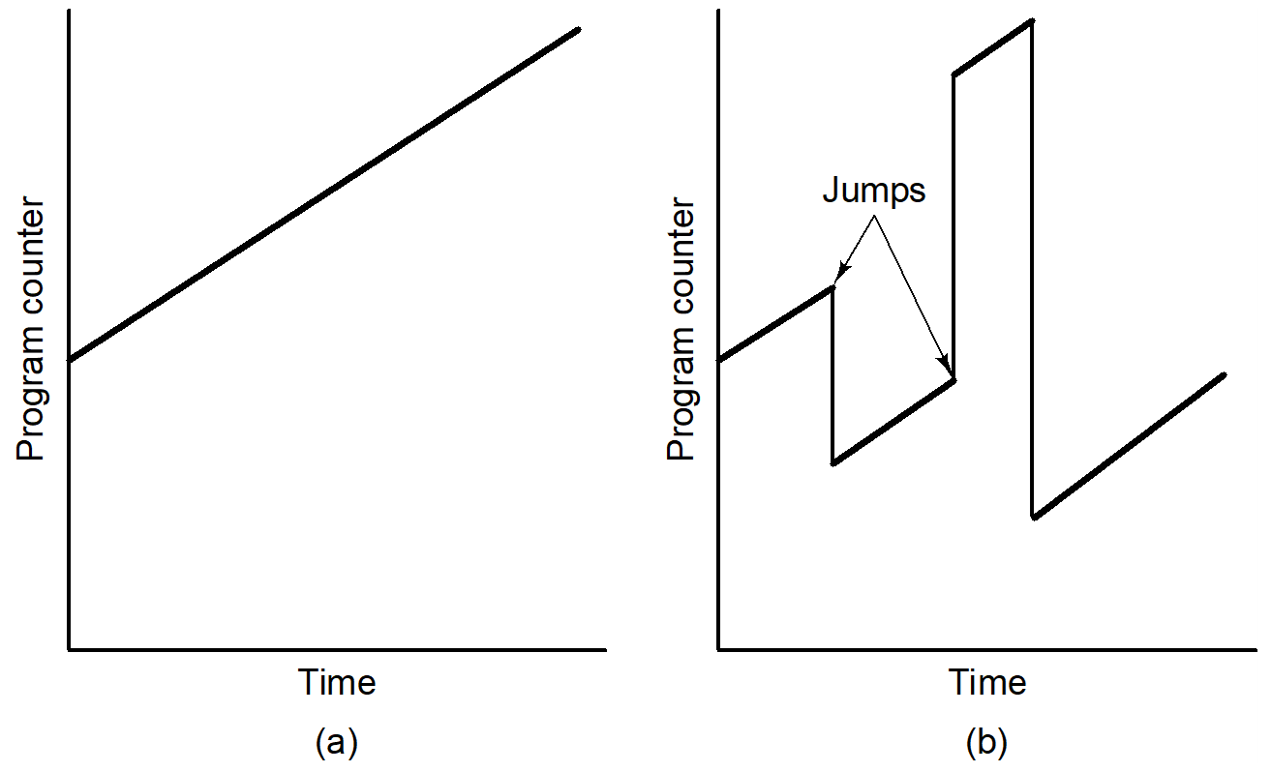
Program execution
Linear, without branches
With branches

Slide 37
Procedure call (subroutine, method, ...)

Slide 38
Co-routine call (parallel process, multithreading,...)

Slide 39
How to handle exceptions?
During runtime exceptions may occur, i.e., interruptions of the programmed flow of instructions
Reasons
Errors in the operating system while executing application programs or errors in the hardware
Requests of external components for attention of the processor
…
Exceptional situations may require the interruption of the currently running program or even its termination
Are exceptions exceptional?

Slide 40
Exception handling
Handling of exceptions requires specialized routines (Interrupt Service Routine, ISR)
A specialized hardware component (interrupt system, interrupt controller) typically supports the selection and activation of an ISR
An ISR has the same structure as a subprogram, but there are also some differences

Slide 41
ISR vs. subprogram/subroutine
Activity | Subroutine/subprogram | ISR
Activation | call subroutine | INT instruction or hardware activation
Return after completion | RET instruction (return from subroutine) | RETI instruction (return from interrupt)
Calculation of starting address | Starting address of called subroutine written in calling program | Starting address of called ISR determined via interrupt table
Saving status | Subroutine call typically saves only PC on a stack | ISR calls save the PC and PSW on a stack

Slide 42
ISR vs. subprogram/subroutine
The processor always executes subroutine calls as programmed.
However, the processor executes ISR only if triggered and the Interrupt Enable bit in the PSW is set.
Reasons for exception handling
External reasons (asynchronous events): incoming data, device ready, mouse movement, …
Internal reasons (synchronous events): system calls, debugging, change of privilege, …

Slide 43
External reasons for exceptions
RESET
Reset of the processor, e.g., triggered by a button, power supply, watch dog timer, …
HALT
Stop the execution of the processor, e.g., to avoid access conflicts on the system bus during DMA (direct memory access)
ERROR
Call of an error handler routine, e.g., due to bus errors
Interrupt
Interrupt request triggered by an external device, e.g., to announce incoming data of an input device
2 types: maskable/non maskable (NMI)

Slide 44
Internal reasons for exceptions
Software Interrupts
INT instruction in the program triggers an interrupt (system calls, debugging, …)
Traps
Exceptions caused by internal events, e.g., overflow, division by zero, stack overflow, …

Slide 45
Example: Calculation of the start address of an Interrupt Service Routine (ISR)
Base Address
Register
ISR
INT
Interrupt
Source
+
INTA
Memory
Int. Vector
Number
x 2, 4, …
Scaling
Interrupt
Vector
Table
Start Address
Address Bus
Data Bus
Base Address

Slide 46
Typical steps of an ISR I
Interrupt activation
Finalize the instruction currently in execution
Check, if software interrupt or internal/external hardware interrupt
Check if Interrupt Enable bit is set ➔ allow interrupt
If it is a hardware interrupt: find source of interrupt, activate INTA (interrupt acknowledge)
Save PSW and PC on stack
Reset Interrupt Enable bit to avoid an additional interrupt in this stage

Slide 47
Typical steps of an ISR II
Calculate start address of ISR (e.g. based on the interrupt vector table) and load it into the PC
Execute the Interrupt Service Routine:
Push the used register on stack
Set the Interrupt Enable bit to allow other interrupts (i.e. interrupts can interrupt interrupts!)
Do the real work of the ISR
Pop the registers from stack
Return from interrupt handling using the IRET instruction
Restore PSW and PC and continue with the interrupted program
Be aware: if the ISR is too large it blocks the computer!

Slide 48
Interrupt vector table
Typically, located at a well-known address, e.g., in ROM (starting at address 0000:0000 for 80X86 processors)
Contains the start addresses of the ISRs
The source of an interrupt creates an interrupt number pointing at the entry in the interrupt vector table
Can be way more complex …

Slide 49
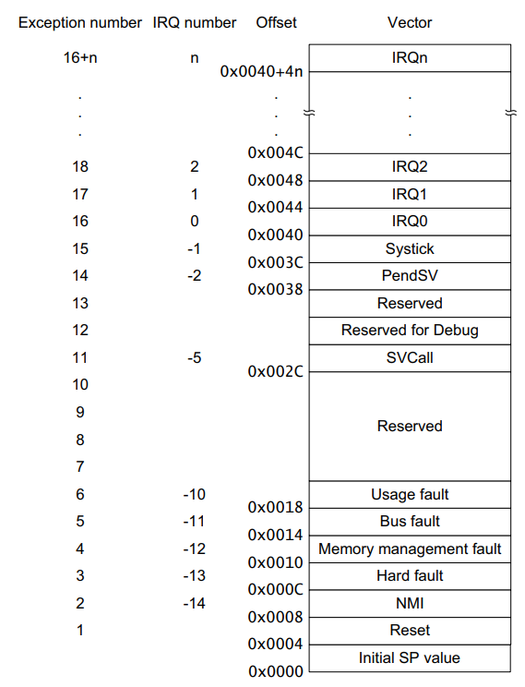
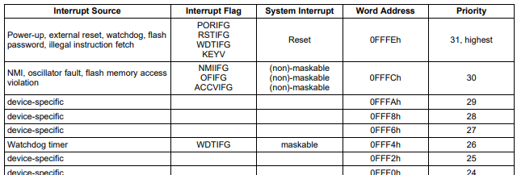
Examples of interrupt vector tables
TI MSP430
https://www.ti.com/
https://www.arm.com/
Espressif ESP32-S2
https://www.espressif.com/
ARM Cortex-M4

Slide 50
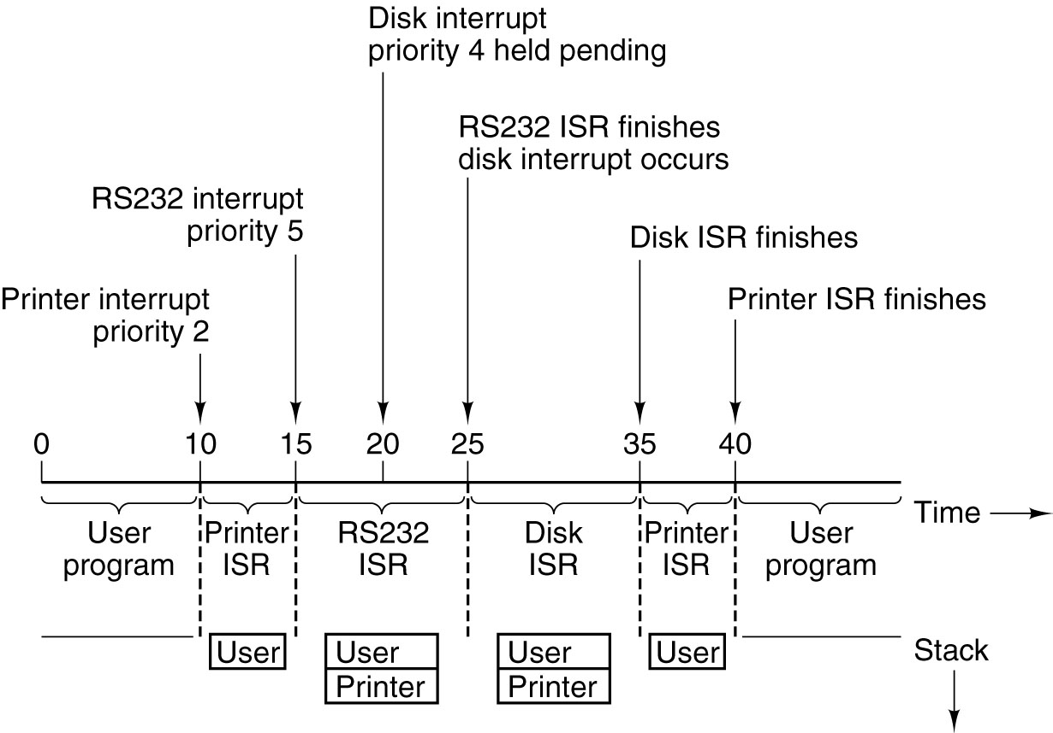
Time sequence of multiple interrupts
Computer with 3 I/O devices
Printer, priority 2
Hard disc, priority 4
RS232, priority 5

Slide 51
Handling of multiple interrupt sources
Cyclic polling of interrupt sources by the interrupt controller (interrupt flag for each source in a status register of the controller).
If the interrupt flag for a component is set
Stop cyclic polling and start ISR for the source.
Several new/additional interrupt requests possible during or after the execution of an ISR.
Two alternative ways of treating new/additional interrupts

Slide 52
Polling: 1. method
Continue cycling polling at the interrupt source following the last served source ➔ all interrupt sources have an equal chance of being served („fair“ processor sharing)
1
1
8
2
8
2
7
CPU
3
7
CPU
3
6
4
6
4
5
5
Interrupt source
currently served
New interrupt requests during serving interrupt source 4

Slide 53
Polling: 2. method
Cyclic polling always starts at a pre-determined first source ➔ Different sources automatically get different priorities. Polling favors components with higher priority.
1
1
8
2
8
2
7
CPU
3
7
CPU
3
6
4
6
4
5
5
Interrupt source
currently served
New interrupt requests during serving interrupt source 4

Slide 54
Polling
Priorities of the old 80286 (and many other x86):
Priority Exception
0 RESET Reset/initialization
1 TRAP Exception during instruction execution
INT Software interrupt
2 TRACE Single step execution
3 NMI Non-maskable interrupt
4 ... Co-processor error
5 IRQ Maskable interrupts
Disadvantage of polling:
Using software for cyclic prioritization and identification of interrupts is too time consuming.

Slide 55
Daisy chaining using hardware
Use specialized hardware for prioritization and identification of interrupts.
Example: Chaining of interrupt sources to a priority chain (Interrupt Daisy Chain).
Each source for an interrupt uses dedicated hardware for connecting with a successor and predecessor (decentralized prioritization)
The first source in the chain has automatically the highest priority.
The priority of the other sources depend on the position in the chain.

Slide 56
Daisy chaining using hardware
Interrupt source 0
Interrupt source 1
IE0
IE1
IACK0
IP0
VNR0
IACK1
IP1
VNR1
IACK2
μP
IACK
IRQ0
IRQ1
Status register
IRQ

Slide 57
Questions & Tasks
Name the key differences between a subprogram and an ISR!
What is the purpose of an ISR?
Could a computer operate without ISRs?
Looking at the typical steps of an ISR – which step(s) should be uninterruptable?
How to handle multiple interrupt sources?

Slide 58
Assembler

Slide 59
Where are we now?
Level 5
Problem-oriented language level
Java, C#, C++, C, Haskell, Cobol, …
Translation (Compiler)
Javac, VS .NET
Level 4
Assembly language level
Java Byte Code, MSIL/CIL
Translation (Assembler)
JVM, CLR; JIT/Interpreter
Level 3
Operating system machine level
Unix, Windows, iOS
Partial interpretation (operating system)
JVM, CLR; JIT/Interpreter
Level 2
ISA (Instruction Set Architecture) level
x86, PPC, ARM, …
Interpretation (microprogram) or direct execution
microprogram/ none
Level 1
Microarchitecture level
Netburst, ISSE, ASX, <none>, …
Hardware
hardware
Level 0
Digital logic level
Core i7, ARM, PPC620, …

Slide 60
Compiler vs. Assembler
Assembler
Source: symbolic representation of a machine language (assembly language)
Destination: numerical representation of the machine language (instructions from ISA)
Examples: inline assembler in Visual Studio, MASM, ilasm, asm (gcc, Linux), MMIXal, nasm, ...
Compiler
Source: high-level language (depends on the definition of „high“ ...), e.g., C, Java, C#, Cobol, Modula, C++, ...
Destination: assembler language or (built-in assembler) numerical representation of the machine language (instructions from ISA)
Examples: C#-Compiler in Visual Studio, gcc, cc, javac, ...
Assembler language
Pure assembler language: 1:1 mapping onto ISA instructions
But additionally: symbolic names, addresses, labels

Slide 61
Reasons for an assembler level
Full access to HW features
(almost) all (visible) registers are exposed to the assembler language, all flags can be read or set, many „hidden“ features can be used
E.g., try accessing the Pentium performance counters from within Java
Performance
Optimized code for special purposes
Real-time: exact number of CPU cycles can be counted, guaranteed access times to registers, deterministic response times of sub-routines (again: try Java and real-time – and see what a garbage collector does...)
Low memory footprint: no useless overhead, optimized loops, etc.
But much harder to program in assembler ....
Thus typically combined with, e.g., C – only performance critical parts of a program will be tuned via (inline) assembler (https://en.wikipedia.org/wiki/Inline_assembler)

Slide 62
Examples for assembler: N = I + J
Pentium
FORMULA:
MOV EAX,I ; register EAX = I
ADD EAX,J ; register EAX = I + J
MOV N,EAX ; N = I + J
I DW 3 ; reserve 4 byte initialized to 3
J DW 4 ; reserve 4 byte initialized to 4
N DW 0 ; reserve 4 byte initialized to 0
SPARC
FORMULA:
SETHI %HI(I),%R1 ! R1 = high-order bits of the address of I
LD [%R1+%LO(I)],%R1 ! R1 = I
SETHI %HI(J),%R2 ! R2 = high-order bits of the address of J
LD [%R2+%LO(J)],%R2 ! R2 = J
NOP ! wait for J to arrive from memory
ADD %R1,%R2,%R2 ! R2 = R1 + R2
SETHI %HI(N),%R1 ! R1 = high-order bits of the address of N
ST %R2,[%R1+%LO(N)] ! N = I + J
I: .WORD 3 ! reserve 4 byte initialized to 3
J: .WORD 4 ! reserve 4 byte initialized to 4
N: .WORD 0 ! reserve 4 byte initialized to 0

Slide 63
Pseudo instructions
Pseudo instructions or assembler directives
Help a lot for assembler programming
Depend on designer of the assembler, not the ISA
Examples (MASM for Pentium)
DB allocate storage for one or more (initialized) bytes
DW allocate storage for one or more (initialized) 32 bit words
PROC start a procedure
MACRO start a macro definition
INCLUDE fetch and include another file
IF start conditional assembly based on a given expression
PUBLIC export a name defined in the module

Slide 64
Macros vs. procedures
Example macro: swap P, Q
SWAP MACRO
MOV EAX,P
MOV EBX,Q
MOV Q,EAX
MOV P,EBX
ENDM
Differences Macro Procedure
When is the call made? During assembly During execution
Is the body inserted into the object program every place the call is made? Yes No
Is a call instruction inserted into the object program and later executed? No Yes
Must a return instruction be used after the call is done? No Yes
How many copies of the body appear in the object program? One per macro call 1
Macros are „textually“ inserted into the assembler program each time a call is made, formal parameters are converted into actual parameters (i.e., the above macro can be used for SWAP A,B as well as SWAP X,Y)

Slide 65
The assembler process
Step-by-step translation does not work
Forward references: symbols used before being defined ...
Solution: two-pass translator or single-pass plus conversion into intermediate format
Pass: reading the source
First step
Check syntax
Create a symbol table, opcode table, literal table
Check instruction length (opcode, operands, ...)
Second step
Generate object code (*.o, *.obj, ...)
Generate information for linker

Slide 66
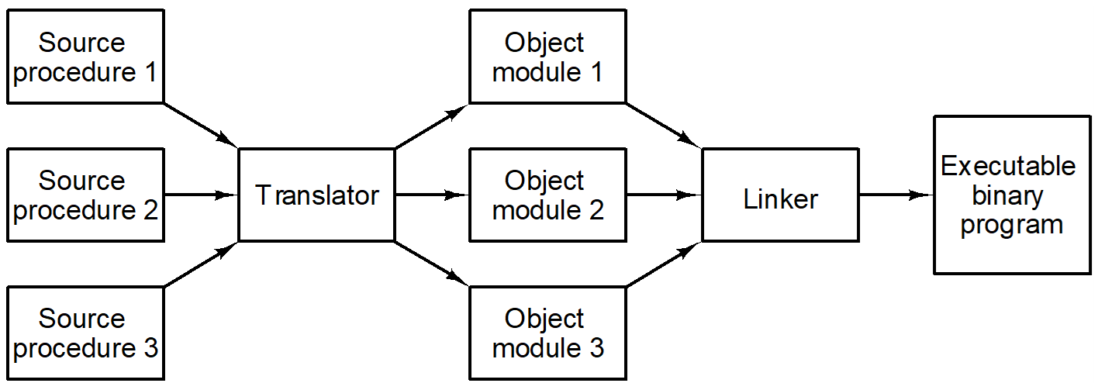
Generation of an executable binary program

Slide 67
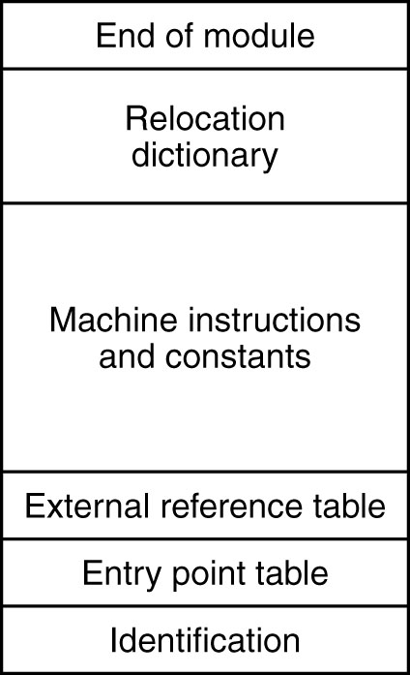
Example Structure of an Object Module / File
Different formats exist (e.g. COFF, ELF)
Relocation often done by MMU (or code is position independent) – but also loader can relocate
https://en.wikipedia.org/wiki/Object_file

Slide 68
Example object modules
Object module A
Object module B
400
600
300
CALL B
500
CALL C
200
400
MOVE P TO X
Each module has its own
address space starting at 0
300
MOVE Q TO X
100
BRANCH TO 200
200
0
100
Object module C
0
BRANCH TO 300
500
400
CALL D
Object module D
300
300
200
MOVE R TO X
200
MOVE S TO X
100
100
0
BRANCH TO 200
0
BRANCH TO 200

Slide 69
Objects before/after linking and relocation
Before
relocation and
linking
After
relocation and
linking

Slide 70
Dynamic linking
A procedure segment
Indirect
The linkage segment
A procedure segment
Indirect
The linkage segment
addressing
Invalid address
addressing
Address of earth
CALL EAR
TH
E
A
R
T
H
Indirect word
CALL EAR
TH
E
A
R
T
H
T
o earth
CALL FIRE
Invalid address
Linkage information
CALL FIRE
Invalid address
A
I
R
f
or the procedure
A
I
R
of AIR
CALL AIR
Invalid address
Name of the
CALL AIR
Invalid address
procedure is
F
I
R
E
stored as a
F
I
R
E
CALL
W
A
TER
character
CALL
W
A
TER
string
CALL EAR
TH
Invalid address
CALL EAR
TH
Invalid address
w
A
T
E
R
W
A
T
E
R
CALL
W
A
TER
CALL
W
A
TER
Before EARTH is called
After EARTH has been called and linked

Slide 71
Shared libraries
DLL (Dynamic Link Library, Windows), shared library (Unix)
Save a lot of memory as they appear only once
Many processes „share“ the same code (instructions)
A lot more info given in OS and compiler courses!

Slide 72
Questions & Tasks
Why using assembler today?
Why using macros? Typically they require more space…
When is the starting address of an object determined? (Many answers possible … When do we really need the address at the latest?)

Slide 73
Summary
Soft-/Hardware boundary
Complex Instruction Set Computer (CISC)
Reduced Instruction Set Computer (RISC)
Examples of ISA
Instructions formats
Addressing formats
Types of instructions
Procedures, Traps, Interrupts & Co.
Assembler

