Slide 1
Mobile Communications
- an Overview
Freie Universität Berlin - Computer Systems & Telematics
Prof. Dr.-Ing. Jochen H. Schiller
www.jochenschiller.de
schiller@computer.org

Slide 2
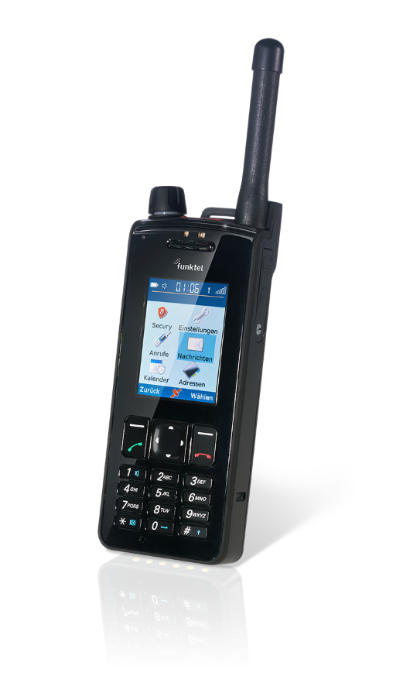
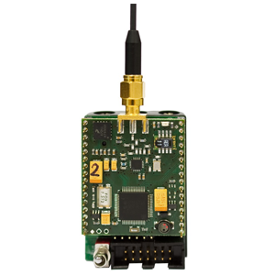
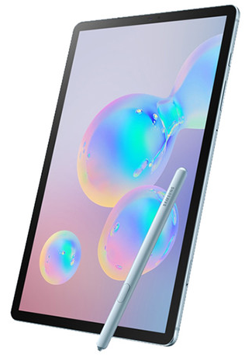
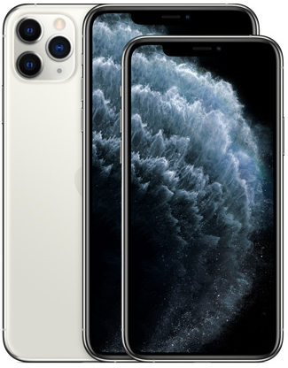
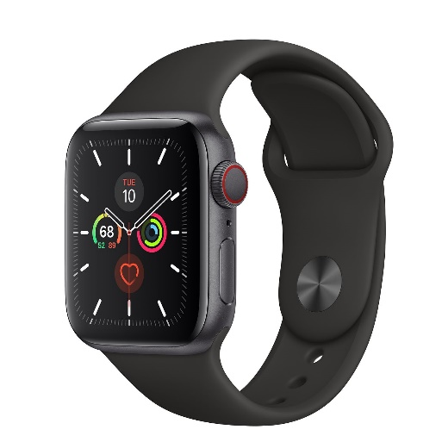
Why Mobile Communications?
Largest SW/HW/networked system
Largest number of subscribers
Mobile devices dominate the Internet
Mobile applications dominate Internet usage
New possibilities, new threats
Technology fully integrated into everybody's life almost 24/7, almost anywhere
Internet of Everything needs mobile/wireless access
Source: https://riot-os.org/
Source: https://www.funktel.international/
Source: https://www.apple.com/
Source: https://www.apple.com/
Source: https://www.samsung.com/

Slide 3
Overview of the lecture
  Introduction
    Use-cases, applications
    Challenges, history
  Wireless Transmission
    Frequencies & regulations, Cognitive Radio
    Signals, antennas, signal propagation, MIMO
    Multiplexing, modulation, spread spectrum, cellular system, SDR
  Medium Access
    SDMA, FDMA, TDMA, CDMA
    CSMA/CA, versions of Aloha, Collision avoidance, polling
  Wireless Telecommunication Systems
    GSM, GPRS, TETRA, UMTS, IMT-2000, LTE
  Wireless LANs/PANs
    Basic Technology
    IEEE 802.11a/b/g/…, .15, Bluetooth, ZigBee
  Internet Protocols
    Mobile IP
    Locator/Identifier split
    Ad-hoc networking
    Routing
    Transport Protocols
    IoT
  Outlook
    Beyond LTE, 5G

Slide 4
Mobile Communications
Chapter 1: Introduction
A case for mobility – many aspects
History of mobile communication
Market
Areas of research

Slide 5
Computers for the next decades?
Computers are integrated (>95% embedded systems!)
  small, cheap, portable, replaceable - no more separate devices (see M. Weiser/invisible computer)
Technology is in the background
  computer are aware of their environment and adapt (“location awareness”)
  computer recognize the location of the user and react appropriately (e.g., call forwarding, message forwarding, “context awareness”)
Advances in technology
  more computing power in smaller devices
  flat, lightweight displays with low power consumption
  new user interfaces due to small dimensions
  more bandwidth per cubic meter
  multiple wireless interfaces: NFC, piconets, wireless LANs, wireless WANs, regional wireless telecommunication networks, VLC etc.

Slide 6
Mobile communication
Two aspects of mobility:
  user mobility: users communicate (wireless) “anytime, anywhere, with anyone”
  device portability: devices can be connected anytime, anywhere to the network
Wireless vs. mobile Examples
✗ ✗ high performance cluster
✗ ✓ notebook in a hotel, on-board networks
✓ ✗ wireless LANs in historic buildings, ad-hoc infrastructure replacement
✓ ✓ Smartphone
The demand for mobile communication created already decades ago the need for integration of wireless networks into existing fixed networks:
  local area networks: standardization of IEEE 802.11
  Internet: Mobile IP extension of the internet protocol IP
  wide area networks: e.g., internetworking of GSM and ISDN, VoIP over WLAN and POTS

Slide 7
Applications I
Vehicles
  transmission of news, road condition, weather, music/video via DAB+/DVB-T2/LTE
  personal communication using GSM/UMTS/LTE
  positioning via GPS/Galileo/Glonass/Beidou
  local ad-hoc network with vehicles close-by to prevent accidents, guidance system, redundancy
  vehicle data (e.g., from busses, high-speed trains) can be transmitted in advance for maintenance
Emergencies
  early transmission of patient data to the hospital, current status, first diagnosis
  replacement of a fixed infrastructure in case of earthquakes, hurricanes, fire etc.
  crisis, war, ...

Slide 8
Typical application: road traffic
UMTS, WLAN,
DAB+, LTE, GSM,
cdma2000, TETRA, ...
ad hoc
Smartphone,
Laptop, Tablet, LTE,
GSM, UMTS, WLAN,
Bluetooth, NFC ...

Slide 9
Mobile and wireless services – Always Best Connected
LTE
10 Mbit/s
LAN
1 Gbit/s,
WLAN
300 Mbit/s
DSL/
WLAN
50 Mbit/s
GSM/GPRS 53 kbit/s
Bluetooth 500 kbit/s
UMTS
2 Mbit/s
GSM/EDGE 384 kbit/s,
DSL/WLAN 6 Mbit/s
UMTS, GSM
384 kbit/s
GSM 115 kbit/s,
WLAN 11 Mbit/s

Slide 10
Applications II
Traveling salesmen
  direct access to customer files stored in a central location
  consistent databases for all agents
  mobile office
Replacement of fixed networks
  remote sensors, e.g., weather, earth activities
  flexibility for trade shows
  LANs in historic buildings
Entertainment, education, ...
  outdoor Internet access
  intelligent travel guide with up-to-date location dependent information
  ad-hoc networks for multi user games
History
Info

Slide 11
Location dependent services
Location aware services
  what services, e.g., printer, phone, server etc. exist in the local environment
Follow-on services
  automatic call-forwarding, transmission of the actual workspace to the current location
Information services
  “push”: e.g., current special offers in the supermarket
  “pull”: e.g., where is the Black Forrest Cheese Cake?
Support services
  caches, intermediate results, state information etc. “follow” the mobile device through the fixed network
Privacy
  who should gain knowledge about the location

Slide 12
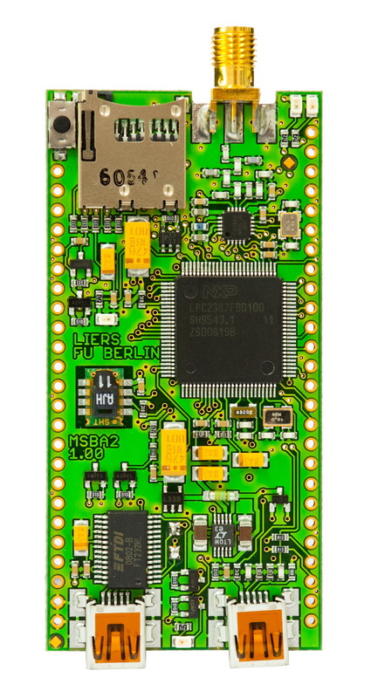
Mobile devices
Specialized PDAs
graphical displays
character recognition
application specific
ruggedized
Laptop/Notebook/Convertible
fully functional
standard applications
Sensors,
embedded
controllers
Smart dust
Smartphone/Tablet
tiny virtual keyboard
voice recognition
simple(r) versions
of standard applications
Classical mobile phones
voice, data
simple graphical displays
robust, water proof
performance
No clear separation between device types possible
(e.g. smart phones, embedded PCs, …)

Slide 13
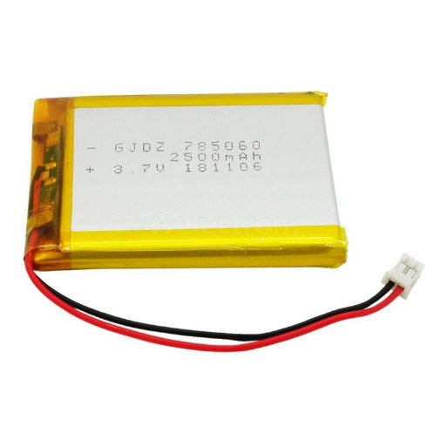
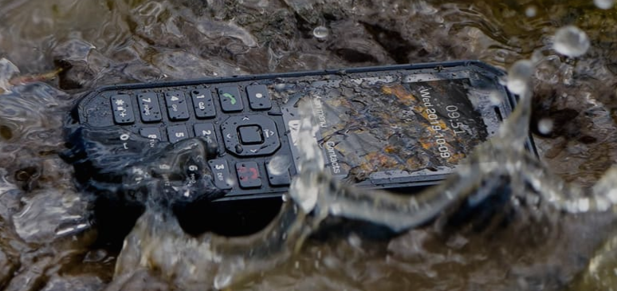
Effects of device portability
Power consumption
  limited computing power, low quality displays, small disks due to limited battery capacity
  CPU: power consumption ~ CV²f
    C: internal capacity, reduced by integration
    V: supply voltage, can be reduced to a certain limit
    f: clock frequency, can be reduced temporally
Loss of data
  higher probability, has to be included in advance into the design (e.g., defects, theft)
Limited user interfaces
  compromise between size of fingers and portability
  integration of character/voice recognition, abstract symbols
Limited fast memory (always in relation to e.g. PCs)
  Limited/no usage of mass memories with moving parts
  flash-memory or ? as alternative
Source: https://www.welectron.com/
Source: https://www.catphones.com/

Slide 14
Wireless networks in comparison to fixed networks
Higher loss-rates due to interference
  emissions of, e.g., engines, lightning
Restrictive regulations of frequencies
  frequencies have to be coordinated, useful frequencies are almost all occupied
Lower transmission rates
  local some Mbit/s, regional sometimes only, e.g., 53kbit/s with GSM/GPRS or about 150 kbit/s using EDGE – some Mbit/s with LTE (shared!) – compare country side vs. downtown
Higher delays, higher jitter
  connection setup time with GSM in the second range, several hundred milliseconds for other wireless systems – in ms range with LTE
Lower security, simpler active attacking
  radio interface accessible for everyone, base station can be simulated, thus attracting calls from mobile phones
Always shared medium
  secure access mechanisms important

Slide 15
Questions & Tasks
  Compare theoretical (and often announced) values for transmission data rates with realistic data rates. What could be reasons for the sometimes big difference?
    How do fixed and wireless systems differ in this context?
  Compare advances in CPU power, displays, batteries, applications, data rates. What are limiting factors of today?
  Go to the web sites of the three big organizations that push forward standardization of mobile and wireless communication (among many other organizations): for LANs http://grouper.ieee.org/groups/802/index.shtml, for the Internet https://www.ietf.org/ and for WANs https://www.3gpp.org/. Find out how they do their standardization!
  What are pros and cons regarding push or pull services?

Slide 16
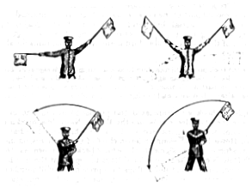
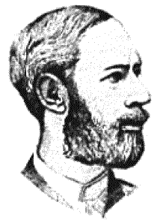
Early history of wireless communication
Many people in history used light for communication
  heliographs, flags (“semaphore”), ...
  150 BC smoke signals for communication;
  (Polybius, Greece)
  1794, optical telegraph, Claude Chappe
Here electromagnetic waves are
of special importance:
  1831 Faraday demonstrates electromagnetic induction
  J. Maxwell (1831-79): theory of electromagnetic Fields, wave equations (1864)
  H. Hertz (1857-94): demonstrates with an experiment the wave character
  of electrical transmission through space (1886, in Karlsruhe, Germany)

Slide 17
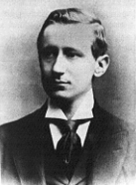
History of wireless communication I
1896 Guglielmo Marconi
  first demonstration of wireless telegraphy (digital!)
  long wave transmission, high transmission power necessary (> 200kW)
1907 Commercial transatlantic connections
  huge base stations (30 100m high antennas)
1915 Wireless voice transmission New York - San Francisco
1920 Discovery of short waves by Marconi
  reflection at the ionosphere
  smaller sender and receiver, possible due to the invention of the vacuum tube (1906, Lee DeForest and Robert von Lieben)
1926 Train-phone on the line Hamburg - Berlin
  wires parallel to the railroad track

Slide 18
History of wireless communication II
1928 many TV broadcast trials (across Atlantic, color TV, news)
1933 Frequency modulation (E. H. Armstrong)
1958 A-Netz in Germany
  analog, 160MHz, connection setup only from the mobile station, no handover, 80% coverage, 1971 11000 customers
1972 B-Netz in Germany
  analog, 160MHz, connection setup from the fixed network too (but location of the mobile station has to be known)
  available also in A, NL and LUX, 1979 13000 customers in D
1979 NMT at 450MHz (Scandinavian countries)
1982 Start of GSM-specification
  goal: pan-European digital mobile phone system with roaming
1983 Start of the American AMPS (Advanced Mobile Phone System, analog)
1984 CT-1 standard (Europe) for cordless telephones

Slide 19
History of wireless communication III
1986 C-Netz in Germany
  analog voice transmission, 450MHz, hand-over possible, digital signaling, automatic location of mobile device
  was in use until 2000, services: FAX, modem, X.25, e-mail, 98% coverage
1991 Specification of DECT
  Digital European Cordless Telephone (today: Digital Enhanced Cordless Telecommunications)
  1880-1900MHz, ~100-500m range, 120 duplex channels, 1.2Mbit/s data transmission, voice encryption, authentication, up to several 10000 user/km2, used in more than 50 countries
1992 Start of GSM
  in D as D1 and D2, fully digital, 900MHz, 124 channels
  automatic location, hand-over, cellular
  roaming in Europe - now worldwide in more than 200 countries
  services: data with 9.6kbit/s, FAX, voice, ...

Slide 20
History of wireless communication IV
1994 E-Netz in Germany
  GSM with 1800MHz, smaller cells
  as Eplus in D (1997 98% coverage of the population)
1996 HiperLAN (High Performance Radio Local Area Network)
  ETSI, standardization of type 1: 5.15 - 5.30GHz, 23.5Mbit/s
  recommendations for type 2 and 3 (both 5GHz) and 4 (17GHz) as wireless ATM-networks (up to 155Mbit/s)
1997 Wireless LAN - IEEE802.11
  IEEE standard, 2.4 - 2.5GHz and infrared, 2Mbit/s
  already many (proprietary) products available in the beginning
1998 Specification of GSM successors
  for UMTS (Universal Mobile Telecommunications System) as European proposals for IMT-2000
  Iridium
    66 satellites (+6 spare), 1.6GHz to the mobile phone

Slide 21
History of wireless communication V
1999 Standardization of additional wireless LANs
  IEEE standard 802.11b, 2.4-2.5GHz, 11Mbit/s
  Bluetooth for piconets, 2.4GHz, <1Mbit/s
  decision about IMT-2000
    several “members” of a “family”: UMTS, cdma2000, DECT, …
  Start of WAP (Wireless Application Protocol) and i-mode
    first step towards a unified Internet/mobile communication system
    access to many services via the mobile phone
2000 GSM with higher data rates
  HSCSD offers up to 57,6kbit/s
  first GPRS trials with up to 50kbit/s (packet oriented!)
  UMTS auctions/beauty contests
    Hype followed by disillusionment (50 B$ paid in Germany for 6 licenses!)
  Iridium goes bankrupt
2001 Start of 3G systems
  Cdma2000 in Korea, UMTS tests in Europe, Foma (almost UMTS) in Japan

Slide 22
History of wireless communication VI
2002
  WLAN hot-spots start to spread
2003
  UMTS starts in Germany
  Start of DVB-T in Germany replacing analog TV
2005
  WiMax starts as DSL alternative (not mobile)
  first ZigBee products
2006
  HSDPA starts in Germany as fast UMTS download version offering > 3 Mbit/s
  WLAN draft for 250 Mbit/s (802.11n) using MIMO
  WPA2 mandatory for Wi-Fi WLAN devices
2007
  over 3.3 billion subscribers for mobile phones (NOT 3 bn people!)
2008
  “real” Internet widely available on mobile phones (standard browsers, decent data rates)
  7.2 Mbit/s HSDPA, 1.4 Mbit/s HSUPA available in Germany, more than 100 operators support HSPA worldwide, first LTE tests (>100 Mbit/s)
2009 – the story continues with netbooks, iPhone, VoIPoWLAN…
2010 – LTE available in some cities, new frequencies allocated
  Reuse of old analog TV bands, LTE as DSL replacement for rural areas
2015 – VoLTE, LTE@700MHz, LTE advanced
2020 – Start of 5G

Slide 23
Questions & Tasks
  The history of wireless and mobile communication is not only a history of successes, but also failures. Iridium, HiperLAN, WAP, WiMax are examples. Find reasons for their failure (or at least limited success)!
  Check the current, newest standards for mobile communications (3gpp), WLAN (IEEE), PANs (Zigbee, Bluetooth)

Slide 24
Worldwide wireless subscribers (old prediction 1998)
700
600
500
Americas
400
Europe
Japan
300
others
total
200
100
0
1996
1997
1998
1999
2000
2001
2014 more than 7 billion subscriptions – be aware: this includes many devices!

Slide 25
Mobile phones per 100 people 1999
Germany
Greece
Spain
Belgium
France
Netherlands
Great Britain
Switzerland
Ireland
Austria
Portugal
Luxemburg
Italy
Denmark
Norway
Sweden
Finland
0
10
20
30
40
50
60
2005: 70-90% penetration in Western Europe, 2009 (ten years later): > 100% – 2016: 96% worldwide!

Slide 26
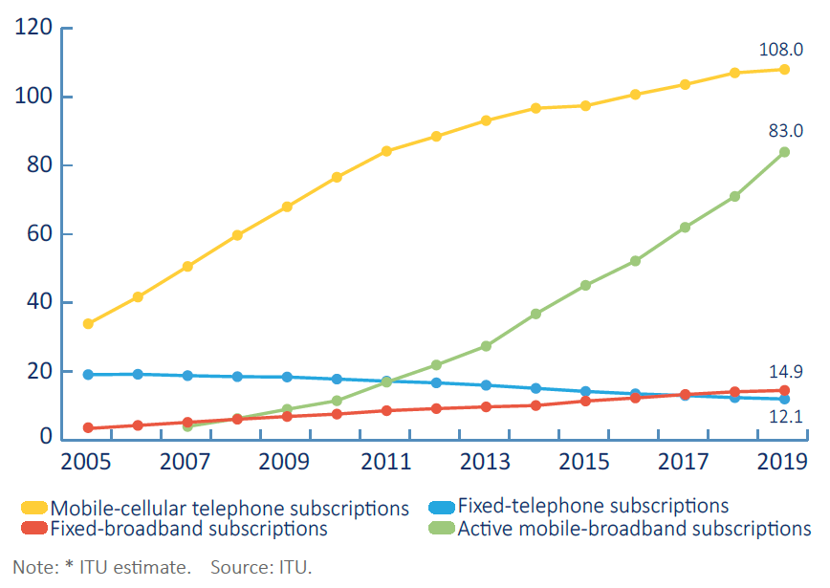
Global ICT developments, 2005-2019

Slide 27
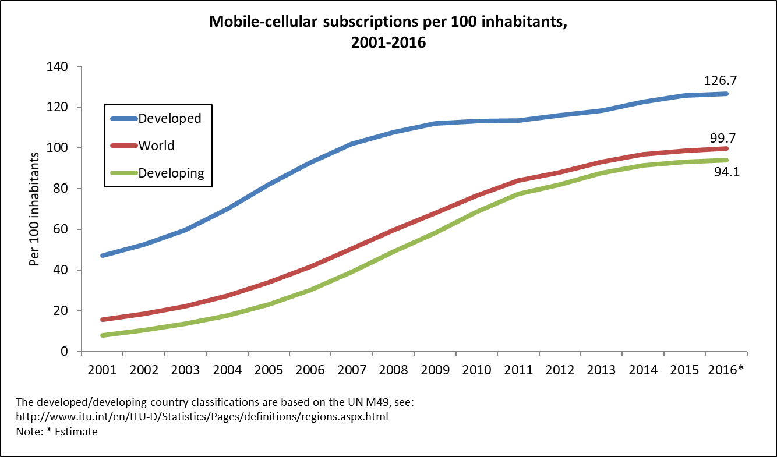
Mobile-cellular subscriptions, 2001-2016

Slide 28
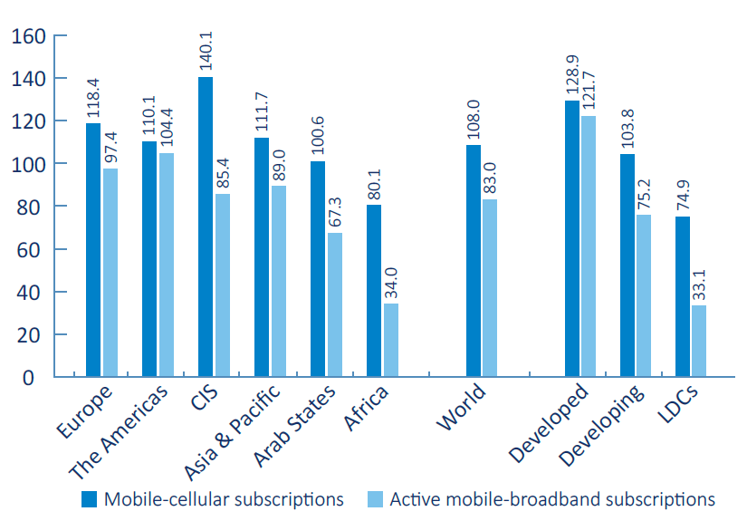
Mobile-cellular subscriptions per region per 100 inhabitants 2019

Slide 29
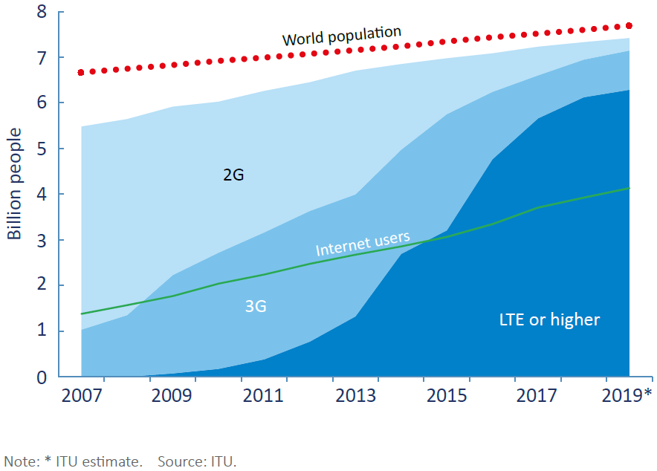
Mobile population coverage by type of network 2007-2019

Slide 30
Questions & Tasks
  Check https://www.itu.int for up-to-date figures
    Additionally, look at https://www.3gpp.org/
  Currently, network operators roll-out 5G technology (covered later in this course). Figure out the strategies of the different network operators while migrating towards 5G systems. Can you find reasons why a single common system is not in sight?
  4G or higher coverage is flattening way before reaching the world population. Give reasons!

Slide 31
Areas of research in mobile and wireless communication
Wireless Communication
  transmission quality (bandwidth, error rate, delay)
  modulation, coding, interference
  medium access, regulations
  ...
Mobility
  location dependent services
  location transparency
  quality of service support (delay, jitter, security)
  ...
Portability
  power consumption
  limited computing power, sizes of display, ...
  usability
  ...
  … and as always: security (privacy, data integrity, tracking, encryption, law enforcement…)!

Slide 32
Simple reference model used here
Application
Application
Transport
Transport
Network
Network
Network
Network
Data Link
Data Link
Data Link
Data Link
Physical
Physical
Physical
Physical
Radio
Medium

Slide 33
Influence of mobile communication to the layer model
service location
new/adaptive applications
multimedia
congestion/flow control
quality of service
addressing, routing
device location
hand-over
authentication
media access/control
multiplexing
encryption
modulation
interference
attenuation
frequency
Application layer
Transport layer
Network layer
Data link layer
Physical layer

Slide 34
Seamless Overlay Networks – (still) the global goal
integration of heterogeneous fixed and
mobile networks with varying
transmission characteristics
regional
vertical
handover
metropolitan area
➔ 5G
campus-based
horizontal
handover
in-house

Slide 35
Questions & Tasks
  This course requires sound knowledge in fixed computer networks, layering, protocols etc. So please refresh your knowledge with our Computer Networks lecture, books, tutorial …
    The principle of layering, the task of the layers, the Internet protocol family should be familiar!
  Where do you use horizontal handover since many years?
  What about vertical handovers? Give examples where they already exist!
    What are problems for vertical handovers?
  The data rate of LTE is already higher than many DSL connections (> 100Mbit/s) – so why doing more research? Can’t we just replace all DSL connections by LTE – problem solved?

