Slide 1
Mobile Communications
Chapter 2: Wireless Transmission
Frequencies
Signals, antennas, signal propagation, MIMO
Multiplexing, Cognitive Radio
Spread spectrum, modulation
Cellular systems

Slide 2

Frequencies for communication
VLF = Very Low Frequency UHF = Ultra High Frequency
LF = Low Frequency SHF = Super High Frequency
MF = Medium Frequency EHF = Extra High Frequency
HF = High Frequency UV = Ultraviolet Light
VHF = Very High Frequency
Frequency and wave length
  λ = c/f
  wave length λ, speed of light c ≅ 3x10⁸m/s, frequency f
twisted pair
coax cable
optical transmission
1 Mm
300 Hz
10 km
30 kHz
100 m
3 MHz
1 m
300 MHz
10 mm
30 GHz
100 μm
3 THz
1 μm
300 THz
VLF
LF
MF
HF
VHF
UHF
SHF
EHF
infrared
visible light
UV

Slide 3
Example frequencies for mobile communication
VHF-/UHF-ranges for mobile radio
  simple, small antenna for cars
  deterministic propagation characteristics, reliable connections
SHF and higher for directed radio links, satellite communication
  small antenna, beam forming
  large bandwidth available
Wireless LANs use frequencies in UHF to SHF range
  some systems planned up to EHF
  limitations due to absorption by, e.g., water (dielectric heating, see microwave oven)
    weather dependent fading, signal loss caused by heavy rainfall etc.

Slide 4
Frequencies and regulations
Examples | Europe | USA | Japan
Cellular networks | GSM 880-915, 925-960, 1710-1785, 1805-1880 UMTS 1920-1980, 2110-2170 LTE 791-821, 832-862, 2500-2690 | AMPS, TDMA, CDMA, GSM 824-849, 869-894 TDMA, CDMA, GSM, UMTS 1850-1910, 1930-1990 | PDC, FOMA 810-888, 893-958 PDC 1429-1453, 1477-1501 FOMA 1920-1980, 2110-2170
Cordless phones | CT1+ 885-887, 930-932 CT2 864-868 DECT 1880-1900 | PACS 1850-1910, 1930-1990 PACS-UB 1910-1930 | PHS 1895-1918 JCT 245-380
Wireless LANs | 802.11b/g 2412-2472 | 802.11b/g 2412-2462 | 802.11b 2412-2484 802.11g 2412-2472
Other RF systems | 27, 128, 418, 433, 868 | 315, 915 | 426, 868
In general: ITU-R holds auctions for new frequencies, manages frequency bands worldwide (WRC, World Radio Conferences); 3GPP specific: see e.g. 3GPP TS 36.101 V16.5.0 (2020-03)

Slide 5
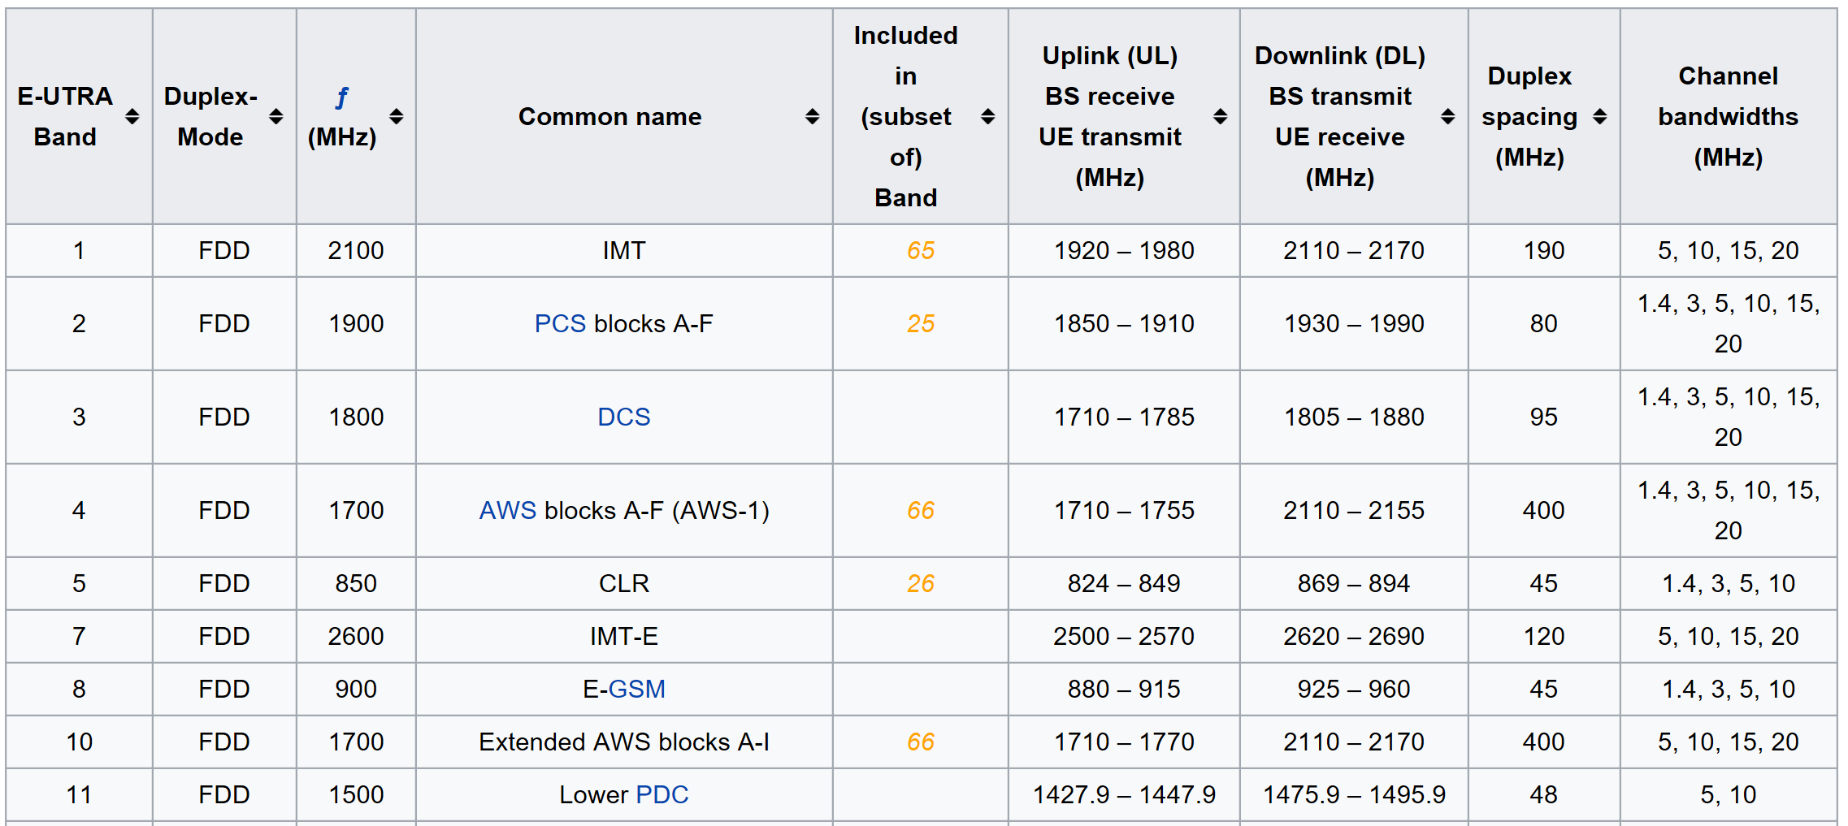
Great flexibility with LTE
See, e.g., en.wikipedia.org/wiki/LTE_frequency_bands or 3GPP TS 36.101 E-UTRA: User Equipment (UE) radio transmission and reception

Slide 6
Signals I
Physical representation of data
Function of time and location
Signal parameters: parameters representing the value of data
Classification
  continuous time/discrete time
  continuous values/discrete values
  analog signal = continuous time and continuous values
  digital signal = discrete time and discrete values
Signal parameters of periodic signals:
  period T, frequency f=1/T, amplitude A, phase shift ϕ
  sine wave as special periodic signal for a carrier:
  s(t) = A_{t} sin(2 π f_{t} t + ϕ_{t})

Slide 7
Fourier representation of periodic signals
1
1
0
0
t
t
ideal periodic signal
real composition
(based on harmonics)

Slide 8
Real technical systems are always bandwidth-limited
attenuation
threshold
0
frequency [Hz]
bandwidth

Slide 9
Signals II
Different representations of signals
  amplitude (amplitude domain)
  frequency spectrum (frequency domain)
  constellation diagram (amplitude M and phase ϕ in polar coordinates)
Composed signals transferred into frequency domain using Fourier transformation
Digital signals need
  infinite frequencies for perfect transmission
  modulation with a carrier frequency for transmission (analog signal!)
A [V]
A [V]
Q = M sin ϕ
t[s]
ϕ
I= M cos ϕ
ϕ
f [Hz]

Slide 10
Antennas: isotropic radiator
Radiation and reception of electromagnetic waves, coupling of wires to space for radio transmission
Isotropic radiator: equal radiation in all directions (three dimensional) - only a theoretical reference antenna
Real antennas always have directive effects (vertically and/or horizontally)
Radiation pattern: measurement of radiation around an antenna
z
y
z
y
x
ideal
isotropic
radiator
x

Slide 11
Antennas: simple dipoles
Real antennas are not isotropic radiators but, e.g., dipoles with lengths λ/4 on car roofs or λ/2 as Hertzian dipole
➔ shape of antenna proportional to wavelength
Example: Radiation pattern of a simple Hertzian dipole
Gain: maximum power in the direction of the main lobe compared to the power of an isotropic radiator (with the same average power)
λ/4
λ/2
y
y
z
simple
dipole
x
z
x
side view (xy-plane)
side view (yz-plane)
top view (xz-plane)

Slide 12
Antennas: directed and sectorized
Often used for microwave connections or base stations for mobile phones (e.g., radio coverage of a valley)
y
y
z
directed
antenna
x
z
x
side view (xy-plane)
side view (yz-plane)
top view (xz-plane)
z
z
sectorized
antenna
x
x
top view, 3 sector
top view, 6 sector

Slide 13
Antennas: diversity
Grouping of 2 or more antennas
  multi-element antenna arrays
Antenna diversity
  switched diversity, selection diversity
    receiver chooses antenna with largest output
  diversity combining
    combine output power to produce gain
    cophasing needed to avoid cancellation
λ/2
λ/2
λ/4
λ/2
λ/4
λ/2
+
+
ground plane

Slide 14
MIMO
Multiple-Input Multiple-Output
  use of several antennas at receiver and transmitter
  increased data rates and transmission range without additional transmit power or bandwidth via higher spectral efficiency, higher link robustness, reduced fading
Examples
  IEEE 802.11n, LTE, HSPA+, …
Functions
  “beamforming”: emit the same signal from all antennas to maximize signal power at receiver antenna
  spatial multiplexing: split high-rate signal into multiple lower rate streams and transmit over different antennas
  diversity coding: transmit single stream over different antennas with (near) orthogonal codes
t₁
t₃
3
1
t₂
Sending time
1: t₀
2: t₀-d₂
3: t₀-d₃
sender
Time of flight
t₂=t₁+d₂
t₃=t₁+d₃
2
receiver

Slide 15
Questions & Tasks
  Frequency regulations may differ between countries. Check out the regulations valid for your country (within Europe CEPT may be able to help you, https://www.cept.org/, for the US try the FCC, www.fcc.gov, for Japan ARIB, www.arib.or.jp).
  Why can waves with a very low frequency follow the earth’s surface? Why are they not used for data transmission in computer networks?
  Why does the ITU-R only regulate ‘lower’ frequencies (up to some hundred GHz) and not higher frequencies (in the THz range)?
  What are the two different approaches in regulation regarding mobile phone systems in Europe and the US? What are the consequences?
  Why is the international availability of the same ISM bands important?
  Is it possible to transmit a digital signal, e.g., coded as square wave as used inside a computer, using radio transmission without any loss? Why?
  Is a directional antenna useful for mobile phones? Why? How can the gain of an antenna be improved?
  If you are unsure about Shannon, Nyquist etc. – go back to our Computer Networks lecture and refresh your knowledge!

Slide 16
Signal propagation ranges
Transmission range
  communication possible
  low error rate
Detection range
  detection of the signal possible
  no communication possible
Interference range
  signal may not be detected
  signal adds to the background noise
Warning: figure misleading – bizarre shaped, time-varying ranges in reality!
sender
transmission
distance
detection
interference

Slide 17
Signal propagation
Propagation in free space always like light (straight line)
Receiving power proportional to 1/d² in vacuum – much more attenuation in real environments, e.g., d^{3.5}…d⁴
(d = distance between sender and receiver)
Receiving power additionally influenced by
  fading (frequency dependent)
  shadowing
  reflection at large obstacles
  refraction depending on the density of a medium
  scattering at small obstacles
  diffraction at edges
shadowing
reflection
refraction
scattering
diffraction

Slide 18
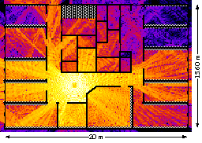
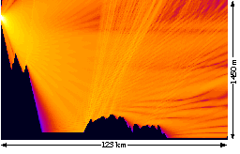
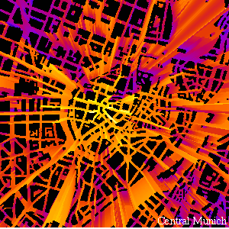
Real world examples
www.ihe.kit.edu/index.php

Slide 19

Multipath propagation
Signal can take many different paths between sender and receiver due to reflection, scattering, diffraction
Time dispersion: signal is dispersed over time
  interference with “neighbor” symbols, Inter Symbol Interference (ISI)
The signal reaches a receiver directly and phase shifted
  distorted signal depending on the phases of the different parts
LOS pulses
multipath
pulses
LOS
(line-of-sight)
signal at sender
signal at receiver

Slide 20
Effects of mobility
Channel characteristics change over time and location
  signal paths change
  different delay variations of different signal parts
  different phases of signal parts
➔ quick changes in the power received (short term/fast fading)
Additional changes in
  distance to sender
  obstacles further away
➔ slow changes in the average power received (long term/slow fading)
power
long term
fading
t
short term fading

Slide 21
Questions & Tasks
  What are the main problems of signal propagation? Why do radio waves not always follow a straight line? Why is reflection both useful and harmful?
  Although the examples shown here reflect real world characteristics they miss several important aspects. What could it be? What else could influence signal propagation in a real world?
  Multipath propagation seems to be harmful, but where could it help? Can a system benefit from multipath propagation? How?
  Name several methods for ISI mitigation. How does ISI depend on the carrier frequency, symbol rate, and motion of sender/receiver? What are the influences of ISI on TDM schemes?
  Remember physics in high school – where did you see certain propagation patterns of waves that can lead to short term fading?
  What could a radio receiver do against fast fading or slow fading, respectively?

Slide 22
Multiplexing
Multiplexing in 5 dimensions
  space (s_{i})
  time (t)
  frequency (f)
  code (c)
  polarization (p)
Goal: multiple use of a shared medium
Important: guard “spaces” needed!
Space-division multiplexing (SDM)
channels k_{i}
c
k₁
k₂
k₃
k₄
k₅
k₆
t
s₁
c
t
f
s₂
c
f
t
s₃
f

Slide 23
Frequency-division multiplexing (FDM)
Separation of the whole spectrum into smaller frequency bands
A channel gets a certain band of the spectrum for the whole time
  Examples: classical analog TV/radio
Advantages
  no dynamic coordination necessary
  works also for analog signals
Disadvantages
  waste of bandwidth if the traffic is
  distributed unevenly
  inflexible
k₁
k₂
k₃
k₄
k₅
k₆
c
f
t

Slide 24
Time-division multiplexing (TDM)
A channel gets the whole spectrum for a certain amount of time
  Example: round-table discussions
Advantages
  only one carrier in the
  medium at any time
  throughput high even
  for many users
Disadvantages
  precise synchronization
  necessary
k₁
k₂
k₃
k₄
k₅
k₆
c
f
t

Slide 25
Time- and frequency-division multiplexing
Combination of both methods
A channel gets a certain frequency band for a certain amount of time
  Examples: GSM, Bluetooth
Advantages
  better protection against tapping
  protection against frequency
  selective interference
but: precise coordination required
k₁
k₂
k₃
k₄
k₅
k₆
c
f
t

Slide 26
Cognitive Radio
Typically in the form of a spectrum sensing CR
  Detect unused spectrum and share with others avoiding interference
  Choose automatically best available spectrum (intelligent form of time/frequency/space multiplexing)
Distinguish
  Primary Users (PU): users assigned to a specific spectrum by e.g. regulation
  Secondary Users (SU): users with a CR to use unused spectrum
Examples
  Reuse of (regionally) unused analog TV spectrum (aka white space)
  Temporary reuse of unused spectrum e.g. of pagers, amateur radio etc.
f
SU
SU
PU
SU
PU
SU
SU
PU
PU
PU
PU
SU
PU
SU
PU
SU
PU
SU
PU
PU
SU
t
space mux
frequency/time mux

Slide 27
Code-division multiplexing (CDM)
Each channel has a unique code
All channels use the same spectrum at the same time
  Example: UMTS
Advantages
  bandwidth efficient
  no coordination and synchronization necessary
  good protection against interference and tapping
Disadvantages
  varying user data rates
  more complex signal regeneration
Implemented using spread spectrum technology
k₁
k₂
k₃
k₄
k₅
k₆
c
f
t

Slide 28
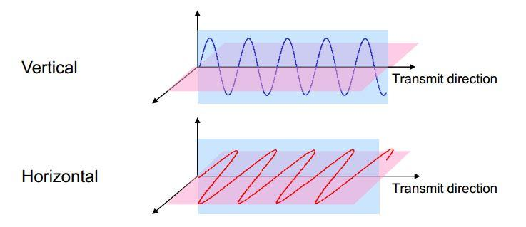
Polarization-division multiplexing (PDM)
Each channel has a unique polarization
  by convention: electric field considered (magnetic field always at right angle to electric field)
  e.g. vertical vs. horizontal, right vs. left circular
Examples: Satellite-TV, microwave links
Advantages
  increased bandwidth (e.g. doubled in satellite dish)
  no coordination and synchronization necessary
Disadvantages
  perfect, ideal polarization not always feasible
  cross-polarization interference (one polarization leaks into another)
Source: https://www.data-alliance.net

Slide 29
Questions & Tasks
  Look at the multiplexing examples. What are the guard “spaces” in each of the technologies?
  Find out in which regions cognitive radios can use free spectrum e.g. from unused analog TV. What do other regions do with the “old” spectrum?
  Do you know polarization from other areas?
  Do you know of other combinations of multiplexing schemes?

Slide 30
Modulation
Digital modulation
  digital data is translated into an analog signal (baseband)
  ASK, FSK, PSK - main focus in this chapter
  differences in spectral efficiency, power efficiency, robustness
Analog modulation
  shifts center frequency of baseband signal up to the radio carrier
  Motivation
    smaller antennas (e.g., λ/4)
    Frequency Division Multiplexing
    medium characteristics
  Basic schemes
    Amplitude Modulation (AM)
    Frequency Modulation (FM)
    Phase Modulation (PM)

Slide 31
Modulation and demodulation
analog
baseband
signal
digital
data
digital
modulation
analog
modulation
101101001
radio transmitter
radio
carrier
analog
baseband
signal
digital
data
analog
demodulation
synchronization
decision
101101001
radio receiver
radio
carrier

Slide 32
Digital modulation
Modulation of digital signals known as Shift Keying
Amplitude Shift Keying (ASK):
  very simple
  low bandwidth requirements
  very susceptible to interference
Frequency Shift Keying (FSK):
  needs larger bandwidth
Phase Shift Keying (PSK):
  more complex
  robust against interference
1
0
1
t
1
0
1
t
1
0
1
t

Slide 33
Advanced Frequency Shift Keying
Bandwidth needed for FSK depends on the distance between the carrier frequencies
Special pre-computation avoids sudden phase shifts ➔ MSK (Minimum Shift Keying)
  bit separated into even and odd bits, the duration of each bit is doubled
  depending on the bit values (even, odd) the higher or lower frequency, original or inverted is chosen
  the frequency of one carrier is twice the frequency of the other
  Equivalent to offset QPSK
Even higher bandwidth efficiency using a Gaussian low-pass filter ➔ GMSK (Gaussian MSK), used in GSM

Slide 34
Example of MSK
1
0
1
1
0
1
0
data
even bits
bit
even 0 1 0 1
odd bits
odd 0 0 1 1
signal h n n h
value - - + +
low
frequency
h: high frequency
n: low frequency
+: original signal
-: inverted signal
high
frequency
MSK
signal
t
No phase shifts!

Slide 35
Advanced Phase Shift Keying
Q
BPSK (Binary Phase Shift Keying):
  bit value 0: sine wave
  bit value 1: inverted sine wave
  very simple PSK
  low spectral efficiency
  robust, used e.g. in satellite systems
QPSK (Quadrature Phase Shift Keying):
  2 bits coded as one symbol
  symbol determines shift of sine wave
  needs less bandwidth compared to BPSK
  more complex
Often also transmission of relative, not absolute phase shift
  DQPSK - Differential QPSK (IS-136, PHS)
I
1
0
10
Q
11
I
00
01
A
t
11
10
00
01

Slide 36
Quadrature Amplitude Modulation
Quadrature Amplitude Modulation (QAM)
  combines amplitude and phase modulation
  it is possible to code n bits using one symbol
  2^{n} discrete levels, n=2 identical to QPSK
Bit error rate increases with n, but less errors compared to comparable PSK schemes
  Example: 16-QAM (4 bits = 1 symbol)
  Symbols 0011 and 0001 have
  the same phase φ, but different
  amplitude a. 0000 and 1000 have
  different phase, but same amplitude.
Q
0010
0001
0011
0000
φ
a
I
1000

Slide 37
Hierarchical Modulation
DVB-T modulates two separate data streams onto a single DVB-T stream
High Priority (HP) embedded within a Low Priority (LP) stream
Multi carrier system, about 2000 or 8000 carriers
QPSK, 16 QAM, 64QAM (the newer DVB-T2 can additionally use 256QAM)
Example: 64QAM
  good reception: resolve the entire
  64QAM constellation
  poor reception, mobile reception:
  resolve only QPSK portion
  6 bit per QAM symbol, 2 most
  significant determine QPSK
  HP service coded in QPSK (2 bit),
  LP uses remaining 4 bit
Q
10
I
00
000010
010101

Slide 38
Questions & Tasks
  Why, typically, is digital modulation not enough for radio transmission? What are general goals for digital modulation? What are typical schemes?
  Think of a phase diagram and the points representing bit patterns for a PSK scheme. How can a receiver decide which bit pattern was originally sent when a received ‘point’ lies somewhere in between other points in the diagram? Why is it, thus, difficult to code more and more bits per phase shift?
  How can a system react in case of higher/lower interference? How does this influence the data rate?

Slide 39
Spread spectrum technology
Problem of radio transmission: frequency dependent fading can wipe out narrow band signals for duration of the interference
Solution: spread the narrow band signal into a broad band signal using a special code
  protection against narrow band interference
Side effects:
  coexistence of several signals without dynamic coordination
  tap-proof
Alternatives: Direct Sequence, Frequency Hopping
power
interference
spread signal
power
signal
spread
interference
detection at
receiver
f
f

Slide 40
Effects of spreading and interference
dP/df
dP/df
user signal
broadband interference
narrowband interference
i)
ii)
f
f
sender
dP/df
dP/df
dP/df
iii)
iv)
v)
f
f
f
receiver

Slide 41
Spreading and frequency selective fading
channel
quality
2
1
5
6
3
narrowband channels
4
frequency
narrow band
signal
guard space
channel
quality
2
2
spread spectrum channels
2
2
2
1
frequency
spread
spectrum

Slide 42
DSSS (Direct Sequence Spread Spectrum) I
XOR of the signal with pseudo-random number (chipping sequence)
  many chips per bit (e.g., 128) result in higher bandwidth of the signal
Advantages
  reduces frequency selective
  fading
  in cellular networks
    base stations can use the
    same frequency range
    several base stations can
    detect and recover the signal
    soft handover
Disadvantages
  precise power control necessary
t_{b}
user data
0
1
XOR
t_{c}
chipping
sequence
0
1
1
0
1
0
1
0
1
1
0
1
0
1
=
resulting
signal
0
1
1
0
1
0
1
1
0
0
1
0
1
0
t_{b}: bit period
t_{c}: chip period

Slide 43
DSSS (Direct Sequence Spread Spectrum) II
spread
spectrum
signal
transmitted
signal
user data
X
modulator
chipping
sequence
radio
carrier
transmitter
correlator
received
signal
lowpass
filtered
signal
sampled
sums
products
data
demodulator
X
integrator
decision
radio
carrier
chipping
sequence
receiver

Slide 44
FHSS (Frequency Hopping Spread Spectrum) I
Discrete changes of carrier frequency
  sequence of frequency changes determined via pseudo random number sequence
Two versions
  Fast Hopping:
  several frequencies per user bit
  Slow Hopping:
  several user bits per frequency
Advantages
  frequency selective fading and interference limited to short period
  simple implementation
  uses only small portion of spectrum at any time
Disadvantages
  not as robust as DSSS
  simpler to detect

Slide 45
FHSS (Frequency Hopping Spread Spectrum) II
t_{b}
user data
0
1
0
1
1
t
f
t_{d}
f₃
slow
hopping
(3 bits/hop)
f₂
f₁
t_{d}
t
f
f₃
fast
hopping
(3 hops/bit)
f₂
f₁
t
t_{b}: bit period t_{d}: dwell time

Slide 46
FHSS (Frequency Hopping Spread Spectrum) III
narrowband
signal
spread
transmit
signal
user data
modulator
modulator
frequency
synthesizer
hopping
sequence
transmitter
received
signal
narrowband
signal
data
demodulator
demodulator
hopping
sequence
frequency
synthesizer
receiver

Slide 47
Software Defined Radio
Basic idea (ideal world)
  Full flexibility wrt. modulation, carrier frequency, coding…
  Simply download a new radio!
  Transmitter: digital signal processor plus very fast D/A-converter
  Receiver: very fast A/D-converter plus digital signal processor
Real world
  Problems due to interference, high accuracy/high data rate, low-noise amplifiers needed, filters etc.
Examples
  Joint Tactical Radio System, GNU Radio, Universal Software Radio Peripheral, …
  see e.g. SDR – 20 Years Later, IEEE Communications Magazine, Sept. 2015 and Jan. 2016
Application
Signal Processor
D/A Converter
Application
Signal Processor
A/D Converter

Slide 48
Questions & Tasks
  What are the means to mitigate narrowband interference? What is the complexity of the different solutions?
  What are the main benefits of a spread spectrum system? How can spreading be achieved?
  What replaces the guard space in FDM when compared to CDM?
  How can DSSS systems benefit from multipath propagation?
  Look-up the developments of SDRs today. What can be done already with low-cost SDRs? (see e.g. GNU radio, https://www.gnuradio.org/)

Slide 49
Cell structure
Implements space division multiplex
  base station covers a certain transmission area (cell)
Mobile stations communicate only via the base station
Advantages of cell structures
  higher capacity, higher number of users
  less transmission power needed
  more robust, decentralized
  base station deals with interference, transmission area etc. locally
Problems
  fixed network needed for the base stations
  handover (changing from one cell to another) necessary
  interference with other cells
Cell sizes from some 100 m in cities to, e.g., 35 km on the country side (GSM) - even less for higher frequencies

Slide 50
Frequency planning I
Frequency reuse only with a certain distance between the base stations
Standard model using 7 frequencies:
Fixed frequency assignment:
  certain frequencies are assigned to a certain cell
  problem: different traffic load in different cells
Dynamic frequency assignment:
  base station chooses frequencies depending on the frequencies already used in neighbor cells
  more capacity in cells with more traffic
  assignment can also be based on interference measurements
f₃
f₅
f₂
f₄
f₆
f₅
f₁
f₄
f₃
f₇
f₁
f₂

Slide 51
Frequency planning II
f₃
f₃
f₃
f₂
f₂
f₁
f₁
f₁
f₂
f₃
f₇
f₃
f₃
3 cell cluster
f₅
f₂
f₂
f₂
f₂
f₄
f₆
f₅
f₁
f₁
f₁
f₄
f₃
f₃
f₃
f₃
f₇
f₁
f₂
f₃
f₆
f₅
f₂
7 cell cluster
f₁
f₂
f₁
f₂
f₁
f₂
f₃
h₁
h₂
f₃
h₁
h₂
f₃
3 cell cluster
with 3 sector antennas
g₁
g₂
h₃
g₁
g₂
h₃
g₁
g₂
g₃
g₃
g₃

Slide 52
Cell breathing
CDM systems: cell size depends on current load
Additional traffic appears as noise to other users
If the noise level is too high users drop out of cells

Slide 53
Questions & Tasks
  What are the main reasons for using cellular systems? How is SDM typically realized and combined with FDM? How does dynamic frequency assignment influence the frequencies available in other cells?
  What limits the number of simultaneous users in a TDM/FDM system compared to a CDM system? What happens to the transmission quality of connections if the load gets higher in a cell, i.e., how does an additional user influence the other users in the cell?

