Slide 1
Mobile Communications
Chapter 5: Wireless LANs
Characteristics
IEEE 802.11 (PHY, MAC, Roaming, .11a, b, g, h, i, n … z, ac, ad, …, ax, ay, az, ba, bb, …)
Bluetooth / BLE / IEEE 802.15.x / ZigBee
IEEE 802.16/.19/.20/.21/.22
Comparison

Slide 2
Mobile Communication Technology according to IEEE (examples)
WiFi
Local wireless networks
WLAN 802.11
802.11a
802.11h
802.11i/e/…/n/…/z/az/ba/bb…
802.11b
802.11g
(see: http://www.ieee802.org/11/QuickGuide_IEEE_802_WG_and_Activities.htm)
ZigBee
Personal wireless nw
WPAN 802.15
802.15.4
802.15.4a/b/c/d/e/f/g…y/z
802.15.5, .6 (WBAN), .7, .8, .10… .15
802.15.2
802.15.3
802.15.3b/c/d/e/f
802.15.1
Bluetooth
(see: http://www.ieee802.org/15/)
Wireless distribution networks
WMAN 802.16 (Broadband Wireless Access)
WiMAX
+ Mobility
[hist.: 802.20 (Mobile Broadband Wireless Access)]
802.16e (addition to .16 for mobile devices)

Slide 3
Characteristics of wireless LANs
Advantages
  very flexible within the transmission area
  ad-hoc networks without previous planning possible
  (almost) no wiring difficulties (e.g. historic buildings, firewalls)
  more robust against disasters like, e.g., earthquakes, fires - or users pulling a plug...
Disadvantages
  typically lower user data rates/higher delays and delay jitter compared to wired networks due to shared medium, lots of interference (it depends on your neighbors!)
  different/proprietary solutions, especially for higher bit-rates or low-power, standards take their time, devices have to fall back to older/standard solutions
  products have to follow many national restrictions if working wireless, it takes longer time to establish global solutions

Slide 4
Design goals for wireless LANs
global, seamless operation
low power for battery use
no special permissions or licenses needed to use the LAN
robust transmission technology
simplified spontaneous cooperation at meetings
easy to use for everyone, simple management
protection of investment in wired networks
security (no one should be able to read my data), privacy (no one should be able to collect user profiles), safety (low radiation)
transparency concerning applications and higher layer protocols, but also location awareness if necessary
…

Slide 5
Comparison: infrastructure vs. ad-hoc vs. mesh networks
infrastructure
network
mesh network
AP: Access Point
AP
AP
wired network
AP
ad-hoc network

Slide 6
802.11 – Classical architecture of an infrastructure network
802.11 LAN
802.x LAN
Station (STA)
  terminal with access mechanisms to the wireless medium and radio contact to the access point
Basic Service Set (BSS)
  group of stations using the same radio frequency
Access Point
  station integrated into the wireless LAN and the distribution system
Portal
  bridge to other (wired) networks
Distribution System
  interconnection network to form one logical network (EES: Extended Service Set) based
  on several BSS
STA₁
BSS₁
Access
Point
Portal
Distribution System
ESS
Access
Point
BSS₂
STA₂
802.11 LAN
STA₃
Notes:
9

Slide 7
802.11 - Architecture of an ad-hoc network
802.11 LAN
Direct communication within a limited range
  Station (STA):
  terminal with access mechanisms to the wireless medium
  Independent Basic Service Set (IBSS):
  group of stations using the same radio frequency
STA₁
IBSS₁
STA₃
STA₂
IBSS₂
STA₅
STA₄
802.11 LAN

Slide 8
802.11 - Architecture of a mesh network
802.11 LAN
802.x LAN
STA₁
Mesh BSS forming a meshed network with possibly redundant paths using the Hybrid Wireless Mesh Protocol (HWMP)
Mesh Gate, AP and
DS can be
co-located in
one device
BSS
Access
Point
Portal
Distribution
System
Mesh
Gate
802.11 LAN
Mesh BSS
STA₂
BSS
Access
Point
Distribution
System
Mesh
Gate
Mesh STA₂
Mesh STA₁
Mesh STA₃
Mesh STA₅
Mesh STA₄

Slide 9
IEEE standard 802.11
fixed
terminal
mobile terminal
infrastructure
network
access point
application
application
TCP
TCP
IP
IP
LLC
LLC
LLC
802.11 MAC
802.11 MAC
802.3 MAC
802.3 MAC
802.11 PHY
802.11 PHY
802.3 PHY
802.3 PHY

Slide 10
802.11 - Layers and functions
MAC
  access mechanisms, fragmentation, encryption
MAC Management
  synchronization, roaming, MIB, power management
PHY
  clear channel assessment (carrier sense)
  modulation, coding
PHY Management
  channel selection, MIB
Station Management
  coordination of all management functions
Station Management
LLC
DLC
MAC
MAC Management
PHY
PHY Management
PHY

Slide 11
Questions & Tasks
  Check the relevant web pages – it is a very dynamic field!
  How is mobility restricted using WLANs? What additional elements are needed for roaming between networks, how and where can WLANs support roaming? In your answer, think of the capabilities of layer 2 where WLANs reside.
  What are the basic differences between wireless WANs and WLANs, and what are the common features? Consider mode of operation, administration, frequencies, capabilities of nodes, services, national/international regulations.

Slide 12
802.11 - Physical layer (historical – not in standard any longer)
3 versions: 2 radio (typ. 2.4 GHz), 1 IR
  data rates 1 or 2 Mbit/s
FHSS (Frequency Hopping Spread Spectrum) - obsolete
  spreading, despreading, signal strength, typ. 1 Mbit/s
  min. 2.5 frequency hops/s (USA), two-level GFSK modulation
DSSS (Direct Sequence Spread Spectrum) – many products
  DBPSK modulation for 1 Mbit/s (Differential Binary Phase Shift Keying), DQPSK for 2 Mbit/s (Differential Quadrature PSK)
  preamble and header of a frame is always transmitted with 1 Mbit/s, rest of transmission 1 or 2 Mbit/s
  chipping sequence: +1, -1, +1, +1, -1, +1, +1, +1, -1, -1, -1 (Barker code)
  max. radiated power 1 W (USA), 100 mW (EU), min. 1mW
Infrared - obsolete
  850-950 nm, diffuse light, typ. 10 m range
  carrier detection, energy detection, synchronization

Slide 13
DSSS PHY packet format (legacy)
Synchronization
  synch., gain setting, energy detection, frequency offset compensation
SFD (Start Frame Delimiter)
  1111001110100000
Signal
  data rate of the payload (0A: 1 Mbit/s DBPSK; 14: 2 Mbit/s DQPSK)
Service
  future use, 00: 802.11 compliant
Length
  length of the payload
HEC (Header Error Check)
  protection of signal, service and length, x¹⁶+x¹²+x⁵+1
128
16
8
8
16
16
variable
bits
synchronization
SFD
signal
service
length
HEC
payload
PLCP preamble
PLCP header

Slide 14
IEEE 802.11 HR/DSSS – PHY frame formats (was 802.11b)
Long PLCP PPDU format
High Rate Direct Sequence Spread Spectrum @ 2.4GHz
Data rate
  1, 2, 5.5, 11 Mbit/s, depending on SNR
  User data rate max. approx. 6 Mbit/s
128
16
8
8
16
16
variable
bits
synchronization
SFD
signal
service
length
HEC
payload
PLCP preamble
PLCP header
192 µs at 1 Mbit/s DBPSK
1, 2, 5.5 or 11 Mbit/s
Short PLCP PPDU format (optional)
56
16
8
8
16
16
variable
bits
short synch.
SFD
signal
service
length
HEC
payload
PLCP preamble
(1 Mbit/s, DBPSK)
PLCP header
(2 Mbit/s, DQPSK)
96 µs
2, 5.5 or 11 Mbit/s

Slide 15
Channel selection (non-overlapping)
Europe (ETSI)
channel 1
channel 7
channel 13
2400
2412
2442
2472
2483.5
22 MHz
[MHz]
US (FCC)/Canada (IC)
channel 1
channel 6
channel 11
2400
2412
2437
2462
2483.5
22 MHz
[MHz]

Slide 16
IEEE 802.11 OFDM – PHY frame format (was 802.11a)
Orthogonal Frequency Division Multiplexing @ 5GHz
Data rates
  E.g. 6, 9, 12, 18, 24, 36, 48, 54 Mbit/s, depending on SNR and channel width
  User throughput (1500 byte packets): 5.3 (6), 18 (24), 24 (36), 32 (54)
  6, 12, 24 Mbit/s mandatory
Transmission range
  100m outdoor, 10m indoor
    E.g., 54 Mbit/s up to 5 m, 48 up to 12 m, 36 up to 25 m, 24 up to 30m, 18 up to 40 m, 12 up to 60 m
Frequency
  Free 5.15-5.25, 5.25-5.35, 5.725-5.825 GHz ISM-band
4
1
12
1
6
16
variable
6
variable
bits
rate
reserved
length
parity
tail
service
payload
tail
pad
PLCP header
PLCP preamble
signal
data
12
1
variable
symbols
6 Mbit/s
6, 9, 12, 18, 24, 36, 48, 54 Mbit/s

Slide 17
Operating channels of 802.11a in Europe (examples)
36
40
44
48
52
56
60
64
channel
5150
5180
5200
5220
5240
5260
5280
5300
5320
5350
[MHz]
16.6 MHz
100
104
108
112
116
120
124
128
132
136
140
channel
5470
5500
5520
5540
5560
5580
5600
5620
5640
5660
5680
5700
5725
16.6 MHz
[MHz]
center frequency =
5000 + 5*channel number [MHz]

Slide 18
Operating channels for 802.11a / US U-NII (examples)
36
40
44
48
52
56
60
64
channel
5150
5180
5200
5220
5240
5260
5280
5300
5320
5350
[MHz]
16.6 MHz
center frequency =
5000 + 5*channel number [MHz]
149
153
157
161
channel
5725
5745
5765
5785
5805
5825
[MHz]
16.6 MHz

Slide 19
OFDM in IEEE 802.11
OFDM with 52 used subcarriers (64 in total)
  48 data + 4 pilot
    (plus 12 virtual subcarriers)
  312.5 kHz spacing
pilot
312.5 kHz
-26
-21
-7
-1
1
7
21
26
subcarrier
number
channel center frequency

Slide 20
IEEE 802.11 ERP – PHY frame formats (was 802.11g)
Extended Rate PHY @ 2.4GHz
Data rates
  Builds on classical 1, 2 Mbit/s (DSSS) and 1, 2, 5.5, 11 Mbit/s (HR DSSS)
  Uses additionally OFDM for 6, 9, 12, 18, 24, 36, 48, and 54 Mbit/s (thus check 802.11 OFDM for frame formats)
Many more options and modulation modes standardized but obsolete or deprecated.
Basically, it applies the old 802.11a @ 2.4 GHz.

Slide 21
IEEE 802.11 HT – PHY frame formats (was 802.11n) – marketed as WiFi 4
High Throughput (HT) Orthogonal Frequency Division Multiplexing (OFDM) system @ 2.4 and 5 GHz
Based on the OFDM system, but now using up to 4 spatial stream operating in 20 MHz bandwidth (additionally, 40 MHz bandwidth specified offering up to 600 Mbit/s)

Slide 22
IEEE 802.11 HT – PHY frame formats (was 802.11n)

Slide 23
Very High Throughput (VHT) PHY – uses OFDM (was 802.11ac)
Source: IEEE Std 802.11-2016

Slide 24
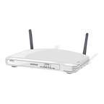


IEEE 802.11 VHT – High-speed for WLANs at 5 GHz – marketed as WiFi 5
Single link throughput > 500Mbit/s, multi-station > 1 Gbit/s
Bandwidth up to 160 MHz (80 MHz mandatory), up to 8x MIMO, up to 256 QAM, beamforming, SDMA via MIMO
Example home configuration:
  8-antenna access point, 160 MHz
  bandwidth, 6.77 Gbit/s
  4-antenna digital TV, 3.39 Gbit/s
  2-antenna tablet, 1.69 Gbit/s
  Two 1-antenna smartphones,
  867 Mbit/s each
Redefinition of many protocol fields and procedures!

Slide 25
Questions & Tasks
  Why is the number of non-overlapping channels important?
  Why is the user throughput much lower than the max. available data rate at PHY?
  What are advantages of higher frequency bands? Disadvantages?
  How are higher data rates achieved?

Slide 26
802.11 - MAC layer architecture
Source: IEEE Std 802.11-2016

Slide 27
How to access the medium in 802.11
Distributed Coordination Function (DCF)
Fundamental access method in 802.11, mandatory
Also known as CSMA/CA (Carrier Sense Multiple Access with Collision Avoidance)
Random backoff, certain fairness, refinement with RTS/CTS possible
Point Coordination Function (not really used, will be kicked out of the standard in the future)
Contention free access, reservation of the medium
Hybrid Coordination Function (HCF)
QoS support by combining DCF and PCF
Contention-based channel access (Enhanced Distributed Channel Access, EDCA) and controlled channel access (HCF Controlled Channel Access, HCCA)
Support of different priorities for, e.g., background, best effort, video, voice traffic (WiFi WMM Designations)
Mesh Coordination Function (MCF)
Only in a MBSS, EDCA for contention-based access, MCCA (MCS Controlled Channel Access) for contention-free access

Slide 28
802.11 - MAC Inter Frame Space
Priorities of packets defined through different inter frame spaces (not always guaranteed)
  RIFS (Reduced IFS)
    shortest IFS, reduced overhead, only if no SIFS expected, for higher throughput
  SIFS (Short IFS)
    for ACK, CTS, polling response
  PIFS (PCF IFS)
    used to gain priority access (PCF, TIM, …)
  DIFS (DCF IFS)
    for “normal” asynchronous data service
  AIFS (Arbitration IFS)
    variable depending on QoS
  EIFS (Extended IFS)
    IFS e.g. after an incorrect FCS
  Additional “beamforming” IFSs
EIFS
AIFS_{i}
…
AIFS_{i}
RIFS
DIFS
DIFS
PIFS
medium busy
SIFS
contention
next frame
t
direct access if
medium is free ≥ DIFS

Slide 29
802.11 - CSMA/CA access method I
station ready to send starts sensing the medium (Carrier Sense based on CCA, Clear Channel Assessment)
if the medium is free for the duration of an Inter-Frame Space (IFS), the station can start sending (IFS depends on service type)
if the medium is busy, the station has to wait for a free IFS, then the station must additionally wait a random back-off time (collision avoidance, multiple of slot-time)
if another station occupies the medium during the back-off time of the station, the back-off timer stops (fairness)
DIFS
DIFS
contention window
(randomized back-off
mechanism)
medium busy
next frame
direct access if
medium is free ≥ DIFS
t
slot time (20µs)
Notes:
12

Slide 30
802.11 - Competing stations - simple version
DIFS
DIFS
DIFS
DIFS
bo_{e}
bo_{r}
bo_{e}
bo_{r}
bo_{e}
busy
station₁
bo_{e}
busy
station₂
busy
station₃
bo_{e}
busy
bo_{e}
bo_{r}
station₄
bo_{e}
bo_{r}
bo_{e}
busy
bo_{e}
bo_{r}
station₅
t
busy
medium not idle (frame, ack etc.)
bo_{e}
elapsed backoff time
packet arrival at MAC
bo_{r}
residual backoff time

Slide 31
802.11 - CSMA/CA access method II
Sending unicast packets
  station has to wait for DIFS before sending data
  receivers acknowledge at once (after waiting for SIFS) if the packet was received correctly (FCS)
  automatic retransmission of data packets in case of transmission errors, but exponential increase of contention window
DIFS
data
sender
SIFS
ACK
receiver
DIFS
other
stations
data
t
waiting time
contention

Slide 32
802.11 – DCF with RTS/CTS
Sending unicast packets
  station can send RTS with reservation parameter after waiting for DIFS (reservation determines amount of time the data packet needs the medium)
  acknowledgement via CTS after SIFS by receiver (if ready to receive)
  sender can now send data at once, acknowledgement via ACK
  other stations store medium reservations distributed via RTS and CTS
DIFS
RTS
data
sender
SIFS
SIFS
SIFS
CTS
ACK
receiver
NAV (RTS)
DIFS
other
stations
data
NAV (CTS)
t
defer access
contention

Slide 33
Fragmentation
DIFS
RTS
frag₁
frag₂
sender
SIFS
SIFS
SIFS
SIFS
SIFS
CTS
ACK₁
ACK₂
receiver
NAV (RTS)
NAV (CTS)
NAV (frag₁)
DIFS
other
stations
data
NAV (ACK₁)
t
contention

Slide 34
802.11 – MAC Frame format
Types
  control frames, management frames, data frames
Sequence numbers
  important against duplicated frames due to lost ACKs
Addresses
  receiver, transmitter (physical), BSS identifier, sender (logical)
Miscellaneous
  sending time, checksum, frame control, data
Only the first three and the last field are present in all frames!
bytes
2
2
6
6
6
2
6
2
4
0-7951
4
Frame
Control
Duration/
ID
Address
1
Address
2
Address
3
Sequence
Control
Address
4
QoS
Control
HT
Control
Frame
Body
FCS
bits
2
2
4
1
1
1
1
1
1
1
1
Protocol
version
Type
Subtype
To
DS
From
DS
More
Frag
Retry
Power
Mgmt
More
Data
Protec-
ted
Frame
+HTC/
Order

Slide 35
MAC address format (examples)
AP: Access Point
DA: Destination Address
SA: Source Address
BSSID: Basic Service Set Identifier
RA: Receiver Address
TA: Transmitter Address

Slide 36
Special Frames: ACK, RTS, CTS
bytes
2
2
6
4
Acknowledgement
Request To Send
Clear To Send
ACK
Frame
Control
Duration
Receiver
Address
FCS
bytes
2
2
6
6
4
RTS
Frame
Control
Duration
Receiver
Address
Transmitter
Address
FCS
bytes
2
2
6
4
CTS
Frame
Control
Duration
Receiver
Address
FCS

Slide 37
Questions & Tasks
  Why is it difficult to guarantee QoS at MAC layer?
  How does 802.11 prioritize different packets?
  What is the behavior of the basic access method under no/light/heavy load?
  How is fairness implemented?
  Why is the contention window mechanism unfair?
  What is the idea of the NAV?
  How is the problem with hidden/exposed stations solved?

Slide 38
802.11 - MAC management
Synchronization
  try to find a LAN, try to stay within a LAN
  timer etc.
Power management
  sleep-mode without missing a message
  periodic sleep, frame buffering, traffic measurements
Association/Reassociation
  integration into a LAN
  roaming, i.e. change networks by changing access points
  scanning, i.e. active search for a network
MIB - Management Information Base
  managing, read, write

Slide 39
Synchronization using a Beacon (infrastructure)
beacon interval
(20ms – 1s)
B
B
B
B
access
point
busy
busy
busy
busy
medium
t
value of the timestamp
B
beacon frame

Slide 40
Synchronization using a Beacon (ad-hoc)
beacon interval
B₁
B₁
station₁
B₂
B₂
station₂
busy
busy
busy
busy
medium
t
value of the timestamp
B
beacon frame
random delay

Slide 41
Power management
Idea: switch the transceiver off if not needed
  States of a station: sleep and awake
Timing Synchronization Function (TSF)
  stations wake up at the same time
Infrastructure
  Traffic Indication Map (TIM)
    list of unicast receivers transmitted by AP
  Delivery Traffic Indication Map (DTIM)
    list of broadcast/multicast receivers transmitted by AP
Ad-hoc
  Ad-hoc Traffic Indication Map (ATIM)
    announcement of receivers by stations buffering frames
    more complicated - no central AP
    collision of ATIMs possible (scalability?)
APSD (Automatic Power Save Delivery)
  more efficient method in 802.11e replacing above schemes offering scheduled (S-APSD) and unscheduled service periods (U-APSD)

Slide 42
Power saving with wake-up patterns (infrastructure)
TIM interval
DTIM interval
D
B
T
T
d
D
B
access
point
busy
busy
busy
busy
medium
p
d
station
t
T
TIM
D
DTIM
awake
B
p
d
data transmission
to/from the station
broadcast/multicast
PS poll

Slide 43
U-APSD – WMM Power Save
Procedure for unicast data delivered to a STA in PS mode
STA triggers release of buffered data from AP
WMM Power Save based on legacy procedures plus optional U-APSD
Advantages:
  No more polling needed
  Downlink data frames sent together in a fast sequence
  Trigger frame may already contain data – ideal e.g. for VoIP
  Applications specify PS behavior, i.e. sleep period
no more than max. service period length
ACK
data / null
data / null
AP
data / null
ACK
ACK
STA
awake

Slide 44
802.11 - Roaming
No or bad connection? Then perform:
Scanning
  scan the environment, i.e., listen into the medium for beacon signals or send probes into the medium and wait for an answer
Reassociation Request
  station sends a request to one or several AP(s)
Reassociation Response
  success: AP has answered, station can now participate
  failure: continue scanning
AP accepts Reassociation Request
  signal the new station to the distribution system
  the distribution system updates its data base (i.e., location information)
  typically, the distribution system now informs the old AP so it can release resources
May take a long time …

Slide 45
Faster roaming using 802.11k, .11r and .11v
Classical roaming is too slow, e.g., for VoIP over WLAN ➔ service interruption
  802.11 authentication message exchange
  Reassociation messages exchange
  EAP-request/response identity exchange
  Access request and challenge packet exchange
  EAP request/response
  RADIUS access request/accept exchange
  Success message to Client
  Nonce-value exchange
  Temporal key, acknowledgement exchange
In this example 17 steps (all but 7. are exchanges)!
  See 802.1X for more details about authentication
802.11k: Optimized channel list
  Collect potential roaming networks prior to roaming
802.11r: Fast BSS Transition - only 4 steps left
  Client and AP exchange 802.11 authentication messages and nonce-values
  Client and AP exchange reassociation messages and temporal key/acknowledgment
802.11v: BSS Transition Management
  Manage information about alternative access points
  Disassociation Imminent can force client to roam

Slide 46
WLAN: IEEE 802.11 – some developments
802.11c: Bridge Support
  Definition of MAC procedures to support bridges as extension to 802.1D
802.11d: Regulatory Domain Update
  Support of additional regulations related to channel selection, hopping sequences
802.11e: MAC Enhancements – QoS
  Enhance the current 802.11 MAC to expand support for applications with Quality of Service requirements, and in the capabilities and efficiency of the protocol
  Definition of a data flow (“connection”) with parameters like rate, burst, period… supported by HCCA (HCF (Hybrid Coordinator Function) Controlled Channel Access, optional)
  Additional energy saving mechanisms and more efficient retransmission
  EDCA (Enhanced Distributed Channel Access): high priority traffic waits less for channel access
802.11F: Inter-Access Point Protocol (withdrawn)
  Establish an Inter-Access Point Protocol for data exchange via the distribution system
802.11g: Data Rates > 20 Mbit/s at 2.4 GHz; 54 Mbit/s, OFDM
  Successful successor of 802.11b, performance loss during mixed operation with .11b
802.11h: Spectrum Managed 802.11a
  Extension for operation of 802.11a in Europe by mechanisms like channel measurement for dynamic channel selection (DFS, Dynamic Frequency Selection) and power control (TPC, Transmit Power Control)
802.11i: Enhanced Security Mechanisms
  Enhance the current 802.11 MAC to provide improvements in security.
  TKIP enhances the insecure WEP, but remains compatible to older WEP systems
  AES provides a secure encryption method and is based on new hardware

Slide 47
WLAN: IEEE 802.11 – some developments
802.11j: Extensions for operations in Japan
  Changes of 802.11a for operation at 5GHz in Japan using only half the channel width at larger range
802.11k: Methods for channel measurements
  Devices and access points should be able to estimate channel quality in order to be able to choose a better access point of channel
802.11m: Updates of the 802.11-2007 standard
802.11n: Higher data rates above 100Mbit/s
  Changes of PHY and MAC with the goal of 100Mbit/s at MAC SAP
  MIMO antennas (Multiple Input Multiple Output), up to 600Mbit/s are currently feasible
  However, still a large overhead due to protocol headers and inefficient mechanisms
802.11p: Inter car communications
  Communication between cars/road side and cars/cars
  Planned for relative speeds of min. 200km/h and ranges over 1000m
  Usage of 5.850-5.925GHz band in North America
802.11r: Faster Handover between BSS (“roaming”)
  Secure, fast handover of a station from one AP to another within an ESS
  Current mechanisms (even newer standards like 802.11i) plus incompatible devices from different vendors are massive problems for the use of, e.g., VoIP in WLANs
  Handover should be feasible within 50ms in order to support multimedia applications efficiently
802.11s: Mesh Networking
  Design of a self-configuring Wireless Distribution System (WDS) based on 802.11
  Support of point-to-point and broadcast communication across several hops

Slide 48
WLAN: IEEE 802.11 – some developments
802.11T: Performance evaluation of 802.11 networks
  Standardization of performance measurement schemes
802.11u: Interworking with additional external networks
802.11v: Network management
  Extensions of current management functions, channel measurements
  Definition of a unified interface
802.11w: Securing of network control
  Classical standards like 802.11, but also 802.11i protect only data frames, not the control frames. Thus, this standard should extend 802.11i in a way that, e.g., no control frames can be forged.
802.11y: Extensions for the 3650-3700 MHz band in the USA
802.11z: Extension to direct link setup
802.11aa: Robust audio/video stream transport
802.11ac: Very High Throughput <6Ghz – up to almost 7 Gbit/s @ 5GHz using 8x8 MIMO
802.11ad: Very High Throughput in 60 GHz
802.11af: TV white space, ah: sub 1GHz, ai: fast initial link set-up; … aq: pre-association discovery,
802.11ax: High Efficiency Wireless LAN (HEW)
802.11ay: Next Generation 60 GHz (NG60), az: Next Generation Positioning (NGP), ba: Wake-up radio, bb: light, …
802.11-2016: Current “complete” standard - 3534 pages!
  Comprises many amendments
Note: Not all “standards” will end in products, many ideas get stuck at working group level
Info: www.ieee802.org/11/; dig into Task Group Meetings

Slide 49
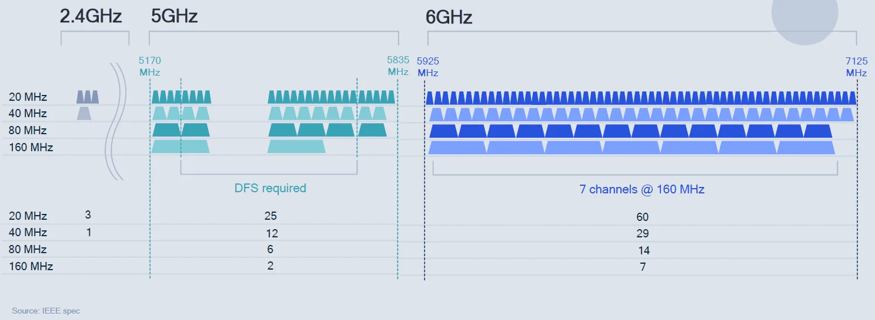
Current top standard IEEE 802.11ax – High Efficiency WLAN – marketed as WiFi 6(E)
Increased number of non-overlapping channels at 6 GHz

Slide 50
Improvements of 802.11ax over 802.11ac
  Centrally (AP) controlled MAC with dynamic bandwidth assignment using OFDMA via Resource Units (RU, time-frequency resources, see LTE!)
  Multi-user MIMO in up- and downlink, AP sends trigger with scheduling information (modulation, coding, RUs)
  Mix of assigned and random access RUs for uplinks
  Spatial frequency reuse via “coloring” of signals (distinguishes own/neighboring network) plus adaptive power/sensitivity thresholds
  Two NAVs: own network and overlapping network to avoid misbehavior
  Dynamic fragmentation helps reducing overhead (fill available RUs)
  Longer guard intervals for better protection against signal delay spread (outdoor conditions)

Slide 51
Data rates for 802.11ax
  Values are for a single spatial stream
  Depending on number of streams devices with > 10 Gbit/s available
MCS | Modulation | Coding rate | Data rate in Mbit/s per spatial stream
 |  |  | 20 MHz channels |  | 40 MHz channels |  | 80 MHz channels |  | 160 MHz channels
 |  |  | 1600 ns GI | 800 ns GI | 1600 ns GI | 800 ns GI | 1600 ns GI | 800 ns GI | 1600 ns GI | 800 ns GI
0 | BPSK | 1/2 | 8 | 8.6 | 16 | 17.2 | 34 | 36.0 | 68 | 72
1 | QPSK | 1/2 | 16 | 17.2 | 33 | 34.4 | 68 | 72.1 | 136 | 144
2 | QPSK | 3/4 | 24 | 25.8 | 49 | 51.6 | 102 | 108.1 | 204 | 216
3 | 16-QAM | 1/2 | 33 | 34.4 | 65 | 68.8 | 136 | 144.1 | 272 | 282
4 | 16-QAM | 3/4 | 49 | 51.6 | 98 | 103.2 | 204 | 216.2 | 408 | 432
5 | 64-QAM | 2/3 | 65 | 68.8 | 130 | 137.6 | 272 | 288.2 | 544 | 576
6 | 64-QAM | 3/4 | 73 | 77.4 | 146 | 154.9 | 306 | 324.4 | 613 | 649
7 | 64-QAM | 5/6 | 81 | 86.0 | 163 | 172.1 | 340 | 360.3 | 681 | 721
8 | 256-QAM | 3/4 | 98 | 103.2 | 195 | 206.5 | 408 | 432.4 | 817 | 865
9 | 256-QAM | 5/6 | 108 | 114.7 | 217 | 229.4 | 453 | 480.4 | 907 | 961
10 | 1024-QAM | 3/4 | 122 | 129.0 | 244 | 258.1 | 510 | 540.4 | 1021 | 1081
11 | 1024-QAM | 5/6 | 135 | 143.4 | 271 | 286.8 | 567 | 600.5 | 1134 | 1201

Slide 52
Questions & Tasks
  Check the differences between WiFi, WMM, … and the 802.11 standard!
  Why is synchronization needed?
  What are the negative effects of the power saving mechanisms, what are the trade-offs between power consumption and transmission QoS? What is the advantage of U-APSD?
  Why can roaming consume a lot of time? How to speed-up the process?
  What is left from the distributed WLAN mechanisms when looking at the most current standards?

Slide 53
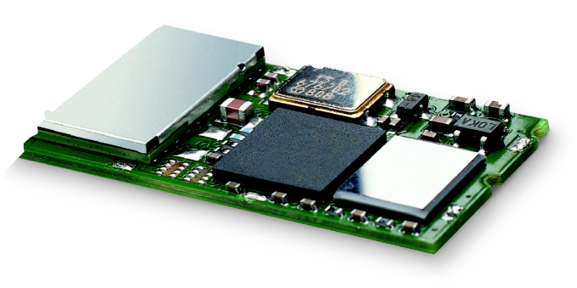
Bluetooth
Basic idea long time ago
  Universal radio interface for ad-hoc wireless connectivity
  Interconnecting computer and peripherals, handheld devices, PDAs, cell phones – replacement of IrDA
  Embedded in other devices, goal: 5€/device (pretty soon < 1€)
  Short range (10 m), low power consumption, license-free 2.45 GHz ISM band
  Voice and data transmission, approx. 1 Mbit/s gross data rate
One of the first modules (Ericsson).

Slide 54


Bluetooth
(was: )
History
  1994: Ericsson (Mattison/Haartsen), “MC-link” project
  Renaming of the project: Bluetooth according to Harald “Blåtand” Gormsen [son of Gorm], King of Denmark in the 10th century
  1998: foundation of Bluetooth SIG, www.bluetooth.org
  1999: erection of a rune stone at Ercisson/Lund ;-)
  2001: first consumer products for mass market, spec. version 1.1 released
  2005: 5 million chips/week
Special Interest Group
  Original founding members: Ericsson, Intel, IBM, Nokia, Toshiba
  Added promoters: 3Com, Agere (was: Lucent), Microsoft, Motorola
  > 10000 members
  Common specification and certification of products
  2020: core specification 5.2 comprises 3256 pages!

Slide 55


History and hi-tech…
1999:
Ericsson mobile communications AB reste denna sten till minne av Harald Blåtand, som fick ge sitt namn åt en ny teknologi för trådlös, mobil kommunikation.

Slide 56


…and the real rune stone
Located in Jelling, Denmark,
erected by King Harald “Blåtand”
in memory of his parents.
The stone has three sides – one side
showing a picture of Christ.
Inscription:
"Harald king executes these sepulchral monuments after Gorm, his father and Thyra, his mother. The Harald who won the whole of Denmark and Norway and turned the Danes to Christianity."
This could be the “original” colors of the stone.
Inscription:
“auk tani karthi kristna” (and made the Danes Christians)
Btw: Blåtand has nothing to do
with a blue tooth…

Slide 57
Bluetooth today - Overview
Basic Rate (BR) – up to 723.2 kbit/s
  Optional EDR (Enhanced Data Rate, 2.1 Mbit/s ), AMP (Alternate MAC and PHY, 54 Mbit/s)
  Headsets, keyboards, …
Low Energy (LE) – up to 2 Mbit/s
  Lower power, cost, complexity, duty cycles
  Smart beacons, home automation, …
Source: www.Bluetooth.org, BT_Core, v5.2

Slide 58
Characteristics of the classical system – Bluetooth BR
2.4 GHz ISM band, 79 RF channels, 1 MHz carrier spacing
  Channel 0: 2402 MHz … channel 78: 2480 MHz
  GFSK modulation, 1-100 mW transmit power
FHSS and TDD
  Frequency hopping with 1600 hops/s
  Hopping sequence in a pseudo random fashion, determined by a master
  Time division duplex for send/receive separation
Voice link – SCO (Synchronous Connection Oriented)
  FEC (forward error correction), no retransmission, 64 kbit/s duplex, point-to-point, circuit switched
Data link – ACL (Asynchronous ConnectionLess)
  Asynchronous, fast acknowledge, point-to-multipoint, up to 433.9 kbit/s symmetric or 723.2/57.6 kbit/s asymmetric, packet switched
Topology
  Overlapping piconets (stars) forming a scatternet

Slide 59
Piconet
Collection of devices connected in an ad hoc fashion
One unit acts as master and the others as slaves for the lifetime of the piconet
Master determines hopping pattern, slaves have to synchronize
Each piconet has a unique hopping pattern
Participation in a piconet = synchronization to hopping sequence
Each piconet has one master and up to 7 simultaneous slaves
S
S
M
SB
S
SB
M=Master
S=Slave
SB=Standby

Slide 60
Forming a piconet
All devices in a piconet hop together
  Master gives slaves its clock and device ID
    Hopping pattern: determined by device ID (48 bit, unique worldwide)
    Phase in hopping pattern determined by clock
Addressing
  Logical Transport Address (LT_ADDR, 3 bit)
•

SB
•
S


SB
SB
S



M
SB
SB




SB
SB
SB
S




SB
SB
SB
SB


SB
SB

Slide 61
Scatternet
Linking of multiple co-located piconets through the sharing of common master or slave devices
  Devices can be slave in one piconet and master of another
Communication between piconets
  Devices jumping back and forth between the piconets
Piconets
(each with a
capacity of
720 kbit/s)
S
S
S
M
M
SB
S
M=Master
S=Slave
SB=Standby
SB
SB
S

Slide 62
Bluetooth protocol stack – classical view
audio apps.
NW apps.
vCal/vCard
telephony apps.
mgmnt. apps.
TCP/UDP
OBEX
AT modem
commands
TCS BIN
SDP
Control
IP
BNEP
PPP
Audio
RFCOMM (serial line interface)
Logical Link Control and Adaptation Protocol (L2CAP)
Host
Controller
Interface
Link Manager
Baseband
Radio
AT: attention sequence
OBEX: object exchange
TCS BIN: telephony control protocol specification – binary
BNEP: Bluetooth network encapsulation protocol
SDP: service discovery protocol
RFCOMM: radio frequency comm.

Slide 63
Frequency selection during data transmission
625 µs
f_{k}
f_{k+1}
f_{k+2}
f_{k+3}
f_{k+4}
f_{k+5}
f_{k+6}
M
S
M
S
M
S
M
t
f_{k}
f_{k+3}
f_{k+4}
f_{k+5}
f_{k+6}
M
S
M
S
M
t
f_{k}
f_{k+1}
f_{k+6}
M
S
M
t

Slide 64
Baseband
Piconet/channel definition
Low-level packet definition
  Access code
    Channel, device access, e.g., derived from master
  Packet header
    1/3-FEC, Logical Transport Address (broadcast + 7 slaves), link type, alternating bit ARQ/SEQ, checksum
Logical transport identifier
EDR PHY mode change (GFSK to DPSK)
PHY channel access
68(72)
54
0-2745
bits
access code
packet header
Guard/sync
(EDR only)
payload
4
64
(4)
3
4
1
1
1
8
bits
preamble
sync.
(trailer)
LT_ADDR
type
flow
ARQN
SEQN
HEC

Slide 65
Classical SCO payload types
payload (30)
HV1
audio (10)
FEC (20)
HV2
audio (20)
FEC (10)
HV3
audio (30)
DV
audio (10)
header (1)
payload (0-9)
2/3 FEC
CRC (2)
(bytes)

Slide 66
Classical ACL Payload types
payload (0-343)
header (1/2)
payload (0-339)
CRC (2)
DM1
header (1)
payload (0-17)
2/3 FEC
CRC (2)
DH1
header (1)
payload (0-27)
CRC (2)
(bytes)
DM3
header (2)
payload (0-121)
2/3 FEC
CRC (2)
DH3
header (2)
payload (0-183)
CRC (2)
DM5
header (2)
payload (0-224)
2/3 FEC
CRC (2)
DH5
header (2)
payload (0-339)
CRC (2)
AUX1
header (1)
payload (0-29)

Slide 67
Baseband data rates (examples)
ACL packets
SCO packets
Source: www.Bluetooth.org, BT_Core

Slide 68
Questions & Tasks
  What were in the beginning, what are today the goals of Bluetooth?
  What are basic differences between WLAN and Bluetooth BR/EDR?
  What is a piconet?
  Why is there no collision in a piconet? How can collisions occur?
  How does EDR achieve higher data rates?

Slide 69
Baseband link types
Polling-based TDD packet transmission
  625µs slots, master polls slaves
SCO (Synchronous Connection Oriented) – Voice
  Periodic single slot packet assignment, 64 kbit/s full-duplex, point-to-point
ACL (Asynchronous ConnectionLess) – Data
  Variable packet size (1, 3, 5 slots), asymmetric bandwidth, point-to-multipoint
SCO
ACL
SCO
ACL
SCO
ACL
SCO
ACL
MASTER
f₀
f₄
f₆
f₈
f₁₂
f₁₄
f₁₈
f₂₀
SLAVE 1
f₁
f₇
f₉
f₁₃
f₁₉
SLAVE 2
f₅
f₁₇
f₂₁

Slide 70
Robustness
Slow frequency hopping with hopping patterns determined by a master
  Protection from interference on certain frequencies
  Separation from other piconets (FH-CDMA)
Retransmission
  ACL only, very fast
Forward Error Correction
  SCO and ACL
Error in payload
(not header!)
NAK
ACK
MASTER
A
C
C
F
H
SLAVE 1
B
D
E
SLAVE 2
G
G

Slide 71
Baseband states of a Bluetooth device
standby
unconnected
detach
inquiry
page
connecting
transmit
connected
active
hold
sniff
low power
Standby: do nothing
Inquire: search for other devices
Page: connect to a specific device
Connected: participate in a piconet
Sniff: listen periodically, not each slot
Hold: stop ACL, SCO still possible, possibly
participate in another piconet
Some more defined: role swapping, EDR, …

Slide 72
Classical Example: Power consumption/CSR BlueCore2
Typical Average Current Consumption¹
  VDD=1.8V Temperature = 20°C
  Mode
    SCO connection HV3 (1s interval Sniff Mode) (Slave) 26.0 mA
    SCO connection HV3 (1s interval Sniff Mode) (Master) 26.0 mA
    SCO connection HV1 (Slave) 53.0 mA
    SCO connection HV1 (Master) 53.0 mA
    ACL data transfer 115.2kbps UART (Master) 15.5 mA
    ACL data transfer 720kbps USB (Slave) 53.0 mA
    ACL data transfer 720kbps USB (Master) 53.0 mA
    ACL connection, Sniff Mode 40ms interval, 38.4kbps UART 4.0 mA
    ACL connection, Sniff Mode 1.28s interval, 38.4kbps UART 0.5 mA
    Parked Slave, 1.28s beacon interval, 38.4kbps UART 0.6 mA
    Standby Mode (Connected to host, no RF activity) 47.0 µA
    Deep Sleep Mode² 20.0 µA
Notes:
  ¹ Current consumption is the sum of both BC212015A and the flash.
  ² Current consumption is for the BC212015A device only.

Slide 73
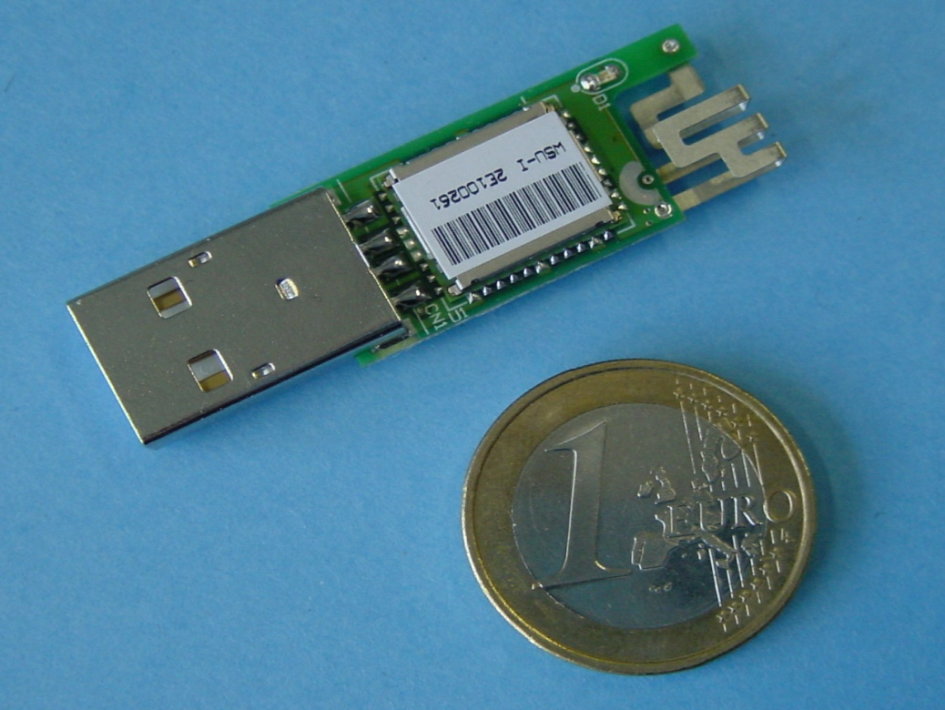
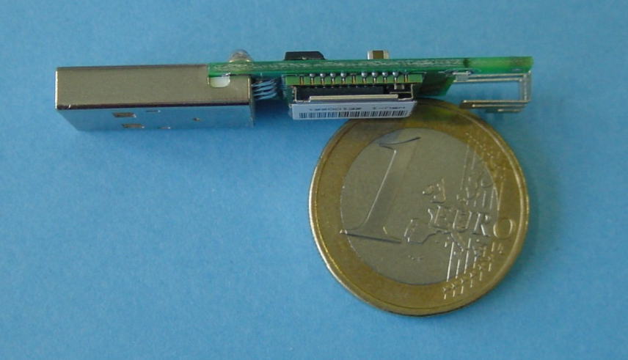
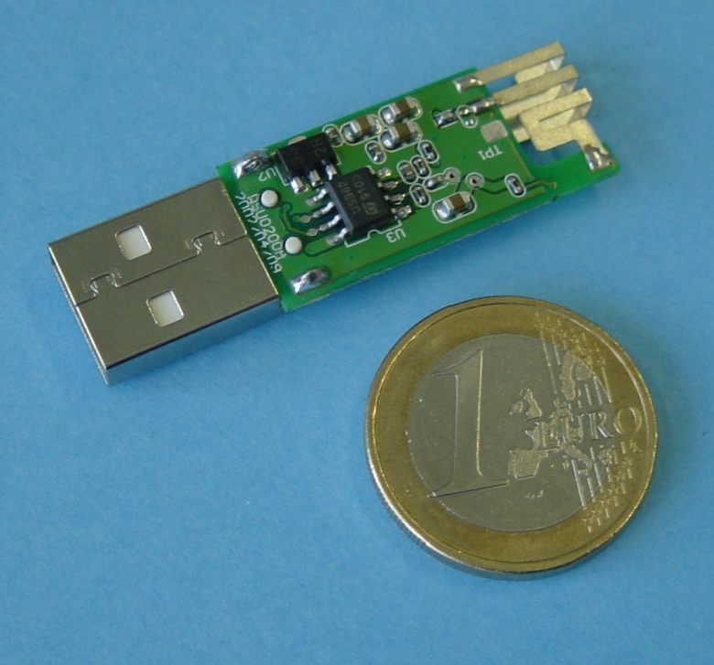
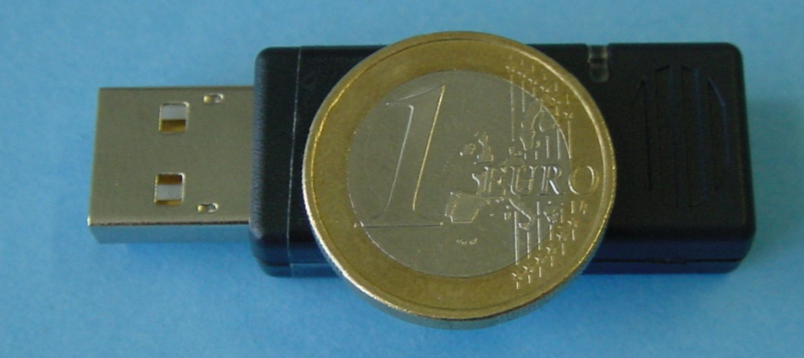
Example: Bluetooth/USB adapter (2002: 50€, today: some cents if integrated)

Slide 74
L2CAP - Logical Link Control and Adaptation Protocol
Simple data link protocol on top of baseband
Connection oriented, connectionless, and signaling channels
Protocol multiplexing
  RFCOMM, SDP, telephony control
Segmentation & reassembly
  Up to 64kbyte user data, 16 bit CRC used from baseband
QoS flow specification per channel
  Follows RFC 1363, specifies delay, jitter, bursts, bandwidth
Group abstraction
  Create/close group, add/remove member

Slide 75
L2CAP logical channels
Slave
Master
Slave
L2CAP
L2CAP
L2CAP
2
d
1
1
d
d
d
d
1
1
d
d
2
baseband
baseband
baseband
signalling
ACL
connectionless
connection-oriented

Slide 76
L2CAP packet formats
Connectionless PDU
2
2
≥2
0-65533
bytes
length
CID=2
PSM
payload
Connection-oriented PDU
2
2
0-65535
bytes
length
CID
payload
Signalling command PDU
2
2
bytes
length
CID=1
One or more commands
1
1
2
≥0
code
ID
length
data

Slide 77
Security - simplified
User input (initialization)
newer:
numeric comparison
just works
out-of-band
passkey entry
PIN (1-16 byte)
Pairing
PIN (1-16 byte)
E₂
Authentication key generation
(possibly permanent storage)
E₂
link key (128 bit)
Authentication
link key (128 bit)
E₃
Encryption key generation
(temporary storage)
E₃
encryption key (128 bit)
Encryption
encryption key (128 bit)
Keystream generator
Keystream generator
payload key
Ciphering
payload key
Cipher data
Data
Data

Slide 78
SDP – Service Discovery Protocol
Inquiry/response protocol for discovering services
  Searching for and browsing services in radio proximity
  Adapted to the highly dynamic environment
  Can be complemented by others like SLP, Jini, Salutation, …
  Defines discovery only, not the usage of services
  Caching of discovered services
  Gradual discovery
Service record format
  Information about services provided by attributes
  Attributes are composed of an 16 bit ID (name) and a value
  values may be derived from 128 bit Universally Unique Identifiers (UUID)

Slide 79
Additional protocols to support legacy protocols/apps.
RFCOMM
  Emulation of a serial port (supports a large base of legacy applications)
  Allows multiple ports over a single physical channel
Telephony Control Protocol Specification (TCS)
  Call control (setup, release)
  Group management
OBEX
  Exchange of objects, IrDA replacement
WAP
  Interacting with applications on cellular phones

Slide 80
Profiles
Represent default solutions for a certain usage model
  Vertical slice through the protocol stack
  Basis for interoperability
  Defines options and parameters
Examples
  A2DP: Advanced Audio Distribution Profile
  BIP: Basic Imaging Profile
  CTN: Calendar Tasks and Notes Profile
  FTP: File Transfer Profile
  GNSS: Global Navigation Satellite System Profile
  HDP: Health Device Profile
  HID: Human Interface Device Profile
  PBAP: Phone Book Access Profile
  SPP: Serial Port Profile
  … see https://www.bluetooth.com/specifications/profiles-overview/
Applications
Protocols
Profiles

Slide 81
Questions & Tasks
  How does Bluetooth guarantee certain data rates and delays?
  Can slaves send on their own?
  How can the sniff mode help reducing power consumption?
  If interested in the current security features – please do have a look at the Core Spec!
  Many protocols, options, parameters – quite complex! What is one offered solution to guarantee compatibility?

Slide 82
Bluetooth versions
Bluetooth 1.1
  also IEEE Standard 802.15.1-2002
  initial stable commercial standard
Bluetooth 1.2
  also IEEE Standard 802.15.1-2005
  eSCO (extended SCO): higher, variable bitrates, retransmission for SCO
  AFH (adaptive frequency hopping) to avoid interference
Bluetooth 2.0 + EDR (2004, no more IEEE)
  EDR (enhanced date rate) of 3.0 Mbit/s for ACL and eSCO
  lower power consumption due to shorter duty cycle
Bluetooth 2.1 + EDR (2007)
  better pairing support, e.g. using NFC
  improved security
Bluetooth 3.0 + HS (2009)
  Bluetooth 2.1 + EDR + IEEE 802.11a/g = 54 Mbit/s
Bluetooth 4.0 (2010), 4.1 (2013), 4.2 (2014)
  Low Energy, much faster connection setup
Bluetooth 5 (2016)
  Longer range (100m) or higher data rate (2 Mbit/s without EDR), localization, no more park state

Slide 83
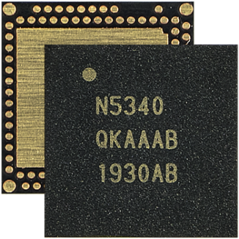
Bluetooth Low Energy – this is not classical BT anymore!
Also at 2.4 GHz, FHSS, mandatory 1 Mbit/s, 500 kbit/s, 125 kbit/s as well as optional 2 Mbit/s
Special mesh networking for many-to-many communication between thousands of devices
Two MAC schemes
  FDMA
    40 channels, 2 MHz spacing, 3 channels for advertising, 37 general purpose (advertising, data)
  TDMA
    Polling scheme with predetermined intervals
Physical channel sub-divided into “events”
  Advertising, extended advertising, periodic advertising, connection, isochronous
Radio supports direction finding (angle of arrival / departure) useful for RTLS
Source: www.nordicsemi.com, nRF5340

Slide 84
BLE Physical Channels
Source: www.Bluetooth.org, BT_Core, v5.2

Slide 85
BLE Packet Format – Example: Uncoded PHY LE 1M and LE 2M)
Preamble
  Synchronization, gain control,
  symbol timing
  1 byte for LE 1M, 2 byte for LE 2M
Access Address
  Determined by the link layer
Constant Tone Extension
  Optional for AoA/AoD estimation
Source: www.Bluetooth.org, BT_Core, v5.2

Slide 86
BLE Advertisements
  Communication can happen in advertising events
  Each advertising event starts at the first advertising channel k
  Advertisers send advertisements, scanners receive and may make a request answered by the advertiser
  Advertisements can be used to set-up bidirectional communication, periodic broadcasts, isochronous streams
Source: www.Bluetooth.org, BT_Core, v5.2

Slide 87
BLE setting up ACL connections
  Devices (called initiator) may listen for connectable advertising packets
  After reception the initiator may make a connection request on the same channel
  Start of connecting event if advertiser accepts connection request
  Initiator becomes master in the piconet, advertising device the slave
  Channel hopping at each connection event based on hopping pattern determined by connection request
    Pseudo-random pattern using 37 frequencies incl. interference prevention via exclusion of channels
  Using an ACL connection the master can establish one or more isochronous connections
Source: www.Bluetooth.org, BT_Core, v5.2

Slide 88
Example Roles and Topologies
Piconet A
  A is master
  B is slave
  C is slave
  BUT: slaves do NOT share same frequencies!
Group D
  D is advertiser
  A is initiator
  A could add D to piconet A
Group C
  C is advertiser
  E is scanner
Advertisements may happen on different advertising channels to avoid collisions
Piconet A
Group D
A
D
B
C
E
Group C

Slide 89
Link Layer State Diagram
Source: www.Bluetooth.org, BT_Core, v5.2

Slide 90
Questions & Tasks
  What are major changes when going from Bluetooth BR/EDR to Bluetooth LE?
  How do devices “find” each other?
  What are differences of BT BR/EDR piconets and BT LE piconets?
  Why can BT LE devices react/transmit faster?
  Where can collisions happen during data transmission?

Slide 91
WPAN: IEEE 802.15 – additional developments 1
802.15.2: Coexistance
  Coexistence of Wireless Personal Area Networks (802.15) and Wireless Local Area Networks (802.11), quantify the mutual interference
802.15.3: High-Rate
  Standard for high-rate (20Mbit/s or greater) WPANs, while still low-power/low-cost
  Data Rates: 11, 22, 33, 44, 55 Mbit/s
  Quality of Service isochronous protocol
  Ad hoc peer-to-peer networking
  Security
  Low power consumption
  Low cost
  Designed to meet the demanding requirements of portable consumer imaging and multimedia applications

Slide 92
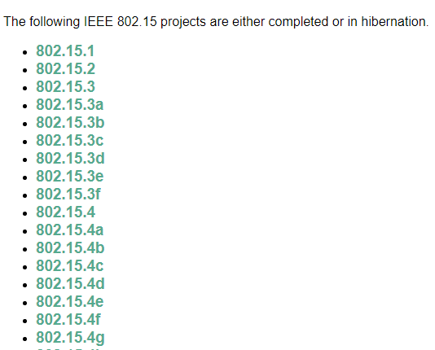
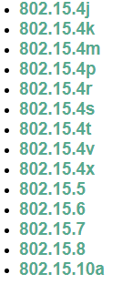
WPAN: IEEE 802.15 – additional developments 2
Several working groups extend the 802.15.3 standard
802.15.3a: - withdrawn -
  Alternative PHY with higher data rate as extension to 802.15.3
  Applications: multimedia, picture transmission
802.15.3b:
  Enhanced interoperability of MAC
  Correction of errors and ambiguities in the standard
802.15.3c:
  Alternative PHY at 57-64 GHz
  Goal: data rates above 2 Gbit/s
Not all these working groups really create a standard, not all standards will be found in products later …

Slide 93
WPAN: IEEE 802.15 – additional developments 3
802.15.4: Low-Rate, Very Low-Power
  Low data rate solution with multi-month to multi-year battery life and very low complexity
  Potential applications are sensors, interactive toys, smart badges, remote controls, and home automation
  Data rates of 20-250 kbit/s, latency down to 15 ms
  Master-Slave or Peer-to-Peer operation
  Up to 254 devices or 64516 simpler nodes
  Support for critical latency devices, such as joysticks
  CSMA/CA channel access (data centric), slotted (beacon) or unslotted
  Automatic network establishment by the PAN coordinator
  Dynamic device addressing, flexible addressing format
  Fully handshaked protocol for transfer reliability
  Power management to ensure low power consumption
  16 channels in the 2.4 GHz ISM band, 10 channels in the 915 MHz US ISM band and one channel in the European 868 MHz band
Base of the ZigBee technology – www.zigbee.org

Slide 94


Zigbee
Relation to 802.15.4 similar to Bluetooth / 802.15.1
Pushed by Chipcon (now TI), ember, freescale (Motorola), Honeywell, Mitsubishi, Motorola, Philips, Samsung…
More than 260 members – see www.zigbee.org
  about 19 promoters, 133 participants, 162 adopters
  must be member to commercially use ZigBee spec
ZigBee platforms comprise
  IEEE 802.15.4 for layers 1 and 2
  ZigBee protocol stack up to the applications

Slide 95
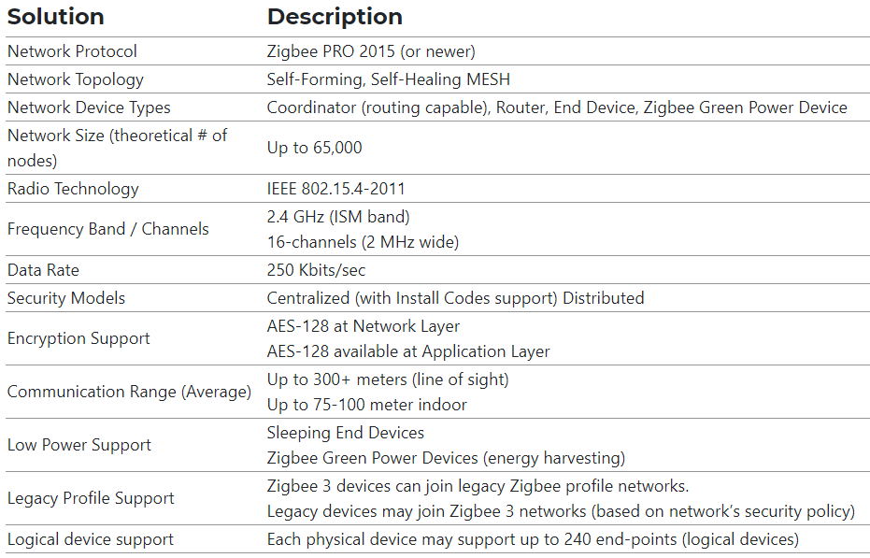
Zigbee Technical Specifications
Source: www.zigbeealliance.org

Slide 96
Zigbee Network Topology Example – Centralized Security
  Mesh, self-organizing, self-healing topology scalable to thousands of nodes
  Interference tolerance via clear channel assessments, retries, etc.
  Point to Point communication gives range > 100 m; full mesh deployment can have several kilometer range
  End device
    Single parent, no routing
    Often battery powered
  Router
  Coordinator
    Owns the network
  FFD (Full Function Device)
    Mains powered, can route,
    always on
  RFD (Reduced Function Device)
    Talks only to parent, can sleep
Zigbee Coordinator (FFD)
Zigbee Router (FFD)
Zigbee End Device (RFD or FFD)
Bi-directional Mesh Link
Source: www.zigbeealliance.org

Slide 97
WPAN: IEEE 802.15 – additional developments 4
802.15.4a:
  Alternative PHY with lower data rate as extension to 802.15.4
  Properties: precise localization (< 1m precision), extremely low power consumption, longer range
  Two PHY alternatives
    UWB (Ultra Wideband): ultra short pulses, communication and localization
    CSS (Chirp Spread Spectrum): communication only
802.15.4b, c, d, e, f, g, … r, s:
  Extensions, corrections, and clarifications regarding 802.15.4
  Usage of new bands, more flexible security mechanisms
  RFID, smart utility neighborhood (high scalability)
802.15.5: Mesh Networking
  Partial meshes, full meshes
  Range extension, more robustness, longer battery live
802.15.6: Body Area Networks
  Low power networks e.g. for medical or entertainment use
802.15.7: Visible Light Communication ……………. and many, many more!
Not all these working groups really create a standard, not all standards will be found in products later … see http://www.ieee802.org/15/

Slide 98
Some more IEEE standards for mobile communications
IEEE 802.16: Broadband Wireless Access / WirelessMAN / WiMax – hibernating (dead due to LTE…)
  Wireless distribution system, e.g., for the last mile, alternative to DSL
  75 Mbit/s up to 50 km LOS, up to 10 km NLOS; 2-66 GHz band
  Initial standards without roaming or mobility support
  802.16e adds mobility support, allows for roaming at 150 km/h
IEEE 802.19: Wireless Coexistence Working Group
  Standards for the coexistence between wireless standards of unlicensed devices
IEEE 802.20: Mobile Broadband Wireless Access (MBWA) Working Group - disbanded
IEEE 802.21: Media Independent Handover Interoperability - hibernating
  Standardize handover between different 802.x and/or non 802 networks
IEEE 802.22: Wireless Regional Area Networks (WRAN) - hibernating
  Radio-based PHY/MAC for use by license-exempt devices on a non-interfering basis in spectrum that is allocated to the TV Broadcast Service

Slide 99
RF Controllers – ISM bands
Data rate
  Typ. up to 115 kbit/s (serial interface)
Transmission range
  5-100 m, depending on power (typ. 10-500 mW)
Frequency
  Typ. 27 (EU, US), 315 (US), 418 (EU), 426 (Japan), 433 (EU), 868 (EU), 915 (US) MHz (depending on regulations)
Security
  Some products with added processors
Cost
  Cheap: 10€-50€
Availability
  Many products, many vendors
Connection set-up time
  N/A
Quality of Service
  none
Manageability
  Very simple, same as serial interface
Special Advantages/Disadvantages
  Advantage: very low cost, large experience, high volume available
  Disadvantage: no QoS, crowded ISM bands (particularly 27 and 433 MHz), typ. no Medium Access Control, 418 MHz experiences interference with TETRA

Slide 100
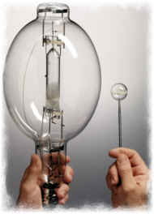
ISM band interference
OLD
Many sources of interference
  Microwave ovens, microwave lighting
  802.11, 802.11b, 802.11g, 802.15, …
  Even old analog TV transmission, surveillance
  Unlicensed metropolitan area networks
  …
Levels of interference
  Physical layer: interference acts like noise
    Spread spectrum tries to minimize this
    FEC/interleaving tries to correct
  MAC layer: algorithms not harmonized
    E.g., Bluetooth might confuse 802.11
NEW
© Fusion Lighting, Inc., now used by LG as Plasma Lighting System

Slide 101
802.11 vs.(?) 802.15/Bluetooth – a problem from the beginning?
Bluetooth may act like a rogue member of the 802.11 network
  Does not know anything about gaps, inter frame spacing etc.
IEEE 802.15-2 discusses these problems
  Proposal: Adaptive Frequency Hopping
    a non-collaborative Coexistence Mechanism
Real effects? Many different opinions, publications, tests, formulae, …
  Results from complete breakdown to almost no effect
  Bluetooth (FHSS) seems more robust than 802.11b (DSSS)
f [MHz]
2480
802.11b
3 channels
(separated by installation)
1000 byte
ACK
DIFS
SIFS
DIFS
500 byte
ACK
500 byte
ACK
500 byte
DIFS
SIFS
DIFS
SIFS
DIFS
802.15.1
79 channels
(separated by hopping pattern)
100
byte
ACK
100
byte
ACK
100
byte
ACK
100
byte
ACK
100
byte
ACK
DIFS
SIFS
DIFS
SIFS
DIFS
SIFS
DIFS
SIFS
DIFS
SIFS
2402
t

Slide 102
Overview – who is where?
Bluetooth BR/EDR
Bluetooth LE
ZigBee 802.15.4
WLAN 802.11
Source: S. Raza

Slide 103
Mechanisms for Interference avoidance in the ISM band – Example Bluetooth
Adaptive Frequency Hopping
  Reduce the number of channels used in a piconet (min. 20 out of 79)
HCI Set Host Channel Classification
  Host informs BT controller of the occupied channels by e.g. WLAN
Enhanced SCO
  Added retransmissions to SCO
Piconet Clock Adjust
  Align clock with external technology
Slot Availability Mask
  Exchange available time slot
…

Slide 104
Questions & Tasks
  Check the additional developments yourself – several “overlapping” goals and competing standards!
  What is the main purpose of Zigbee?
  What are key characteristics of Zigbee networks? Differences to Bluetooth (LE)?
  How can wireless systems avoid interference? What does Bluetooth offer?

