Slide 1
Mobile Communications
Chapter 7 : Outlook
The future of mobile and wireless networks – Is it 5G/6G/…?
All IP? Licensed? Public? Private? Micro-operators? Trillions of devices?
Tbit/s connections with sub ms latency? AI everywhere? Wireless tactile Internet?

Slide 2
Mobile and wireless services – Remember: Always Best Connected
LTE, UMTS
2 Mbit/s
LAN
100 Mbit/s,
WLAN
54 Mbit/s
LAN, WLAN
100 Mbit/s
GSM 53 kbit/s
Bluetooth 500 kbit/s
UMTS
2 Mbit/s
GSM/EDGE 384 kbit/s,
WLAN 5 Mbit/s
LTE
10 Mbit/s
GSM 115 kbit/s,
WLAN 11 Mbit/s

Slide 3
Wireless systems: overview of the (historical) development
cellular phones
satellites
cordless
phones
wireless LAN
1980:
CT0
1981:
NMT 450
1982:
Inmarsat-A
1983:
AMPS
1984:
CT1
1986:
NMT 900
1987:
CT1+
1988:
Inmarsat-C
1989:
CT 2
1991:
CDMA
1991:
D-AMPS
1991:
DECT
1992:
GSM
1992:
Inmarsat-B
Inmarsat-M
199x:
proprietary
1993:
PDC
1994:
DCS 1800
1997:
IEEE 802.11
1998:
Iridium
1999:
802.11b, Bluetooth
analogue
2000:
GPRS
2000:
IEEE 802.11a
2001:
IMT-2000
digital
2014:
Fourth Generation
(Internet based)

Slide 4
New: Convergence with new applications
Mobile networks
„Classical“
Internet
Internet of things
Fixed networks
GSM
FTP
Industrial control systems
Cable networks
GPRS
WWW
UMTS
Web2
Power grid
PSTN
LTE
P2P
Broadcast
Company networks
ISDN
VoD
Home networks
DSL
iTV
Medical devices
UMS
Content
Sharing
3/4/5G
VoIP
IPTV
Autonomous vehicles
WiFi
proprietary
Common technology
(everything over IP)
Communities
…

Slide 5
Overlay Networks - the global goal
integration of heterogeneous fixed and
mobile networks with varying
transmission characteristics
regional
vertical
handover
metropolitan area
campus-based
horizontal
handover
in-car,
in-house,
personal area

Slide 6
Wireless access technologies
500
DAB
New radios
physical/
economic border
250
GSM, TETRA
5G
100
EDGE
UMTS
LTE
relative speed [km/h]
50
5
DECT
802.11b
802.11a/g/n/ac/ax
Bluetooth
0
Point-to-multipoint distribution systems
10 kbit/s
2 Mbit/s
20 Mbit/s
bandwidth
>1 Gbit/s

Slide 7
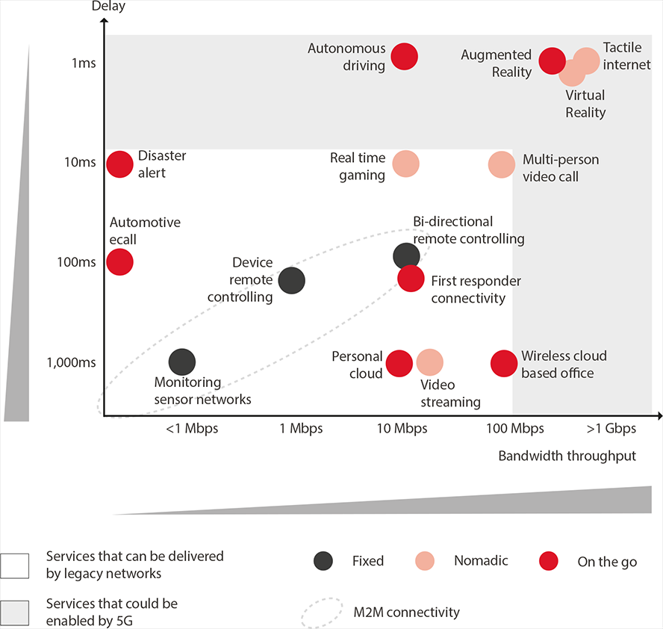
New applications
Source: GSMA Intelligence

Slide 8
Software Defined Mobile Networking
  Apply SDN to mobile networks
    Dynamic, efficient network configuration
    Improved performance
    Separation of data (forwarding) and control (“brain”) plane
  Can be complemented by NFV
    Network Function Virtualization
    Virtualized network functions (SW implementations of network functions)
    Services can be built by chaining VNFs
    SDN could orchestrate and manage NFV
Source: Rost et. Al, Mobile Network Architecture Evolution toward 5G, IEEE Communications Magazine, vol. 54, no. 5, 2016

Slide 9
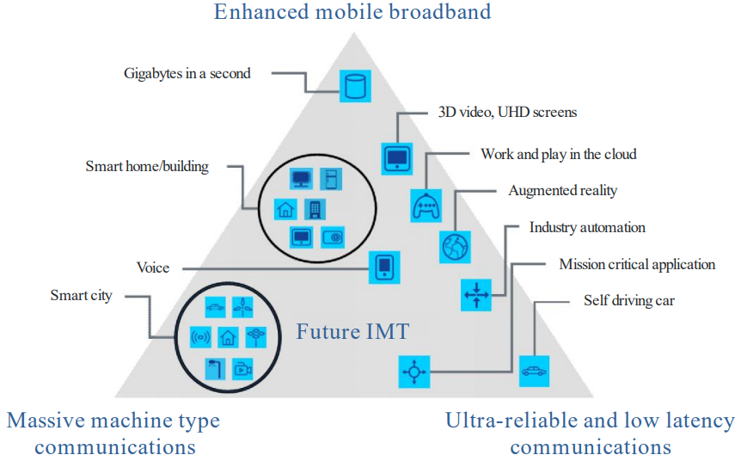
ITU IMT-2020 – Applications for 5G
eMBB
mMTC
URLL
Source: ITU, M.2083

Slide 10
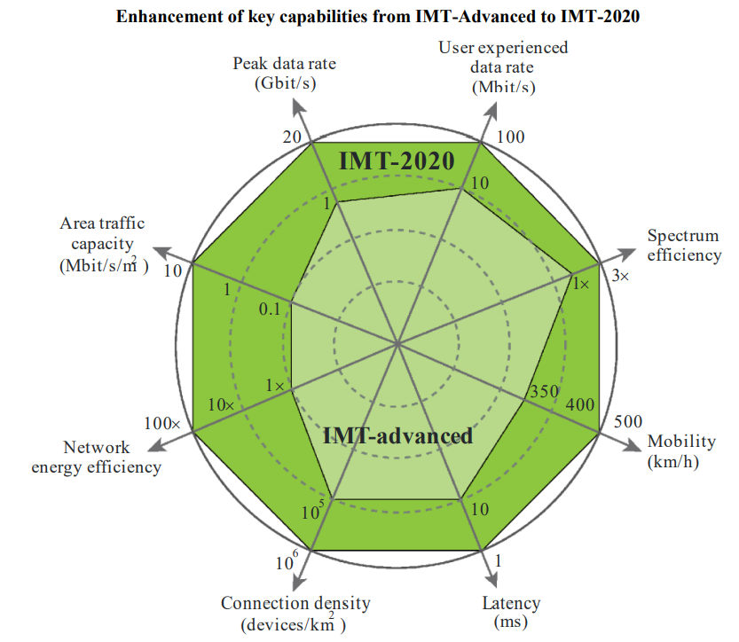
ITU IMT-2020 – Performance Requirements
Source: ITU, M.2083

Slide 11
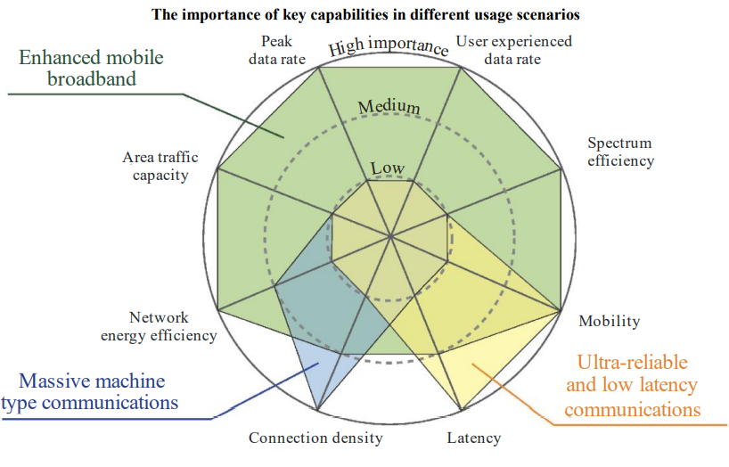
ITU IMT-2020 – 3 main usage scenarios: eMBB, eMTC, URLL
Source: ITU, M.2083

Slide 12
3GPP LTE standardization roadmap toward 5G
Source: Rost et. Al, Mobile Network Architecture Evolution toward 5G, IEEE Communications Magazine, vol. 54, no. 5, 2016

Slide 13
Some new 5G features
Using higher frequencies
  mmWave, operating bands up to 52.6 GHz, channel bandwidth up to 400 MHz, 30 bit/s/Hz down, 15 bit/s/Hz up
Variety of use cases
  scaling data rates from kbit/s up to Gbit/s
Mini-slots
  low latency response for, e.g., autonomous cars, factory automation
eMBB: 500 km/h mobility, 10-20 Gbit/s peak, all data all the time available
URLL: < 1ms air interface latency, 5 ms end-to-end latency (well, not around the globe, rather edge computing), 99.9999% reliability, 50 kbit/s-10 Mbit/s
mMTC: billions of things connected, ultra low cost, low energy, 10⁵ to 10⁶ devices per km², 1-100 kbit/s per device, 10 years battery life
Next Generation Core: uses SDN, NFV, SON – virtualization of network architecture

Slide 14
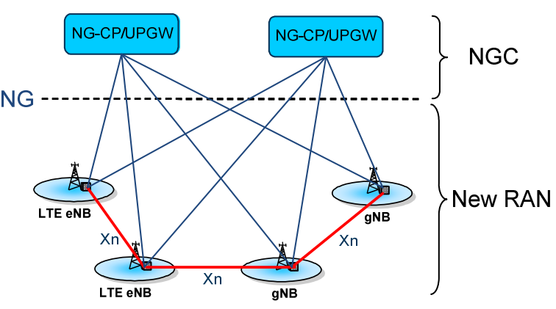
New RAN architecture for 5G (3GPP TR 38.912)
gNodeB (gNB, next generation Node B)
  providing the New RAN U-plane and C-plane protocol terminations towards the UE
LTE eNode B (eNB)
  providing the E-UTRA U-plane and C-plane protocol terminations towards the UE.
Xn interface
  interconnection of nodes in New RAN with each other
NG interface
  connections of nodes in New RAN to the NGC
  supporting a many-to-many relation between NG-CP (Control Plane)/UPGWs (User Plane Gateways) and the nodes in New RAN
Source: ETSI TR 138 912

Slide 15
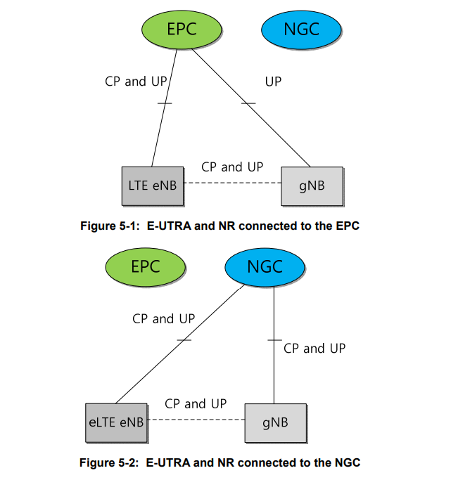
LTE – New Radio co-existence (ETSI TR 138 912)
Source: ETSI TR 138 912

Slide 16

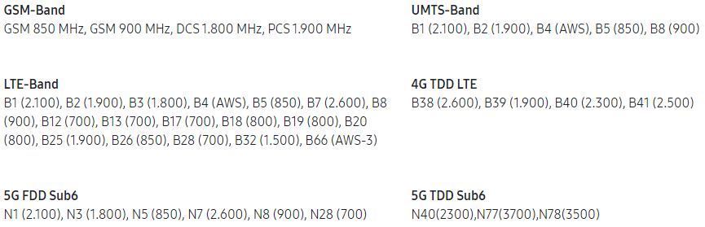
5G gets real in many places 2017/2018
At least some test installations, first devices – smooth transition
More realistic expectations in industry: „no fundamental difference between 4G and 5G“, „natural evolution“ – investment in 5G, but not big hype
Products that integrate 2G, 3G, 4G and 5G are available; smartphones available since 2019
Examples:
Berlin, 70 basestations operating at 3.7 GHz (5G New Radio), 64 antenna massive MIMO, beamforming, > 2 Gbit/s per client, RTT 7-9 ms
https://5g-ppp.eu/ for many more 5G trials
Source: Samsung

Slide 17
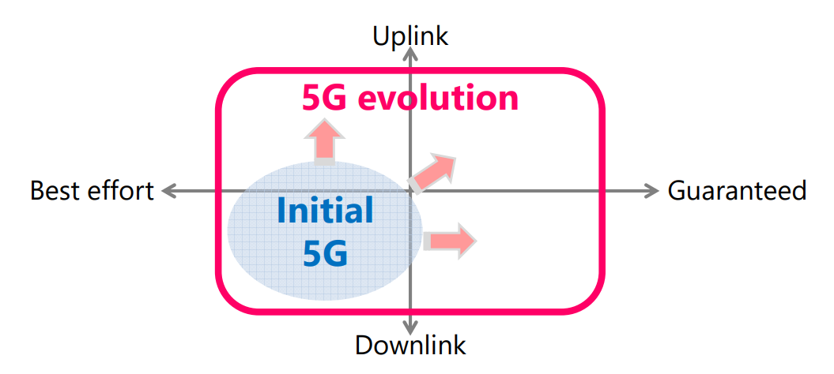
5G Evolution continues
Source: www.nttdocomo.co.jp, 6G Whitepaper

Slide 18
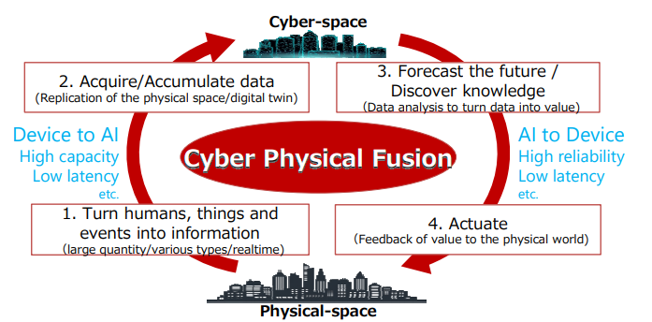
Why needing more than 5G?
Source: www.nttdocomo.co.jp, 6G Whitepaper

Slide 19
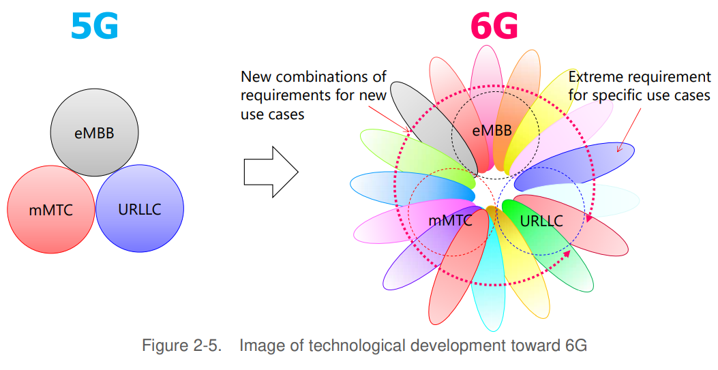
Extreme requirements for specific scenarios
Source: www.nttdocomo.co.jp, 6G Whitepaper

Slide 20
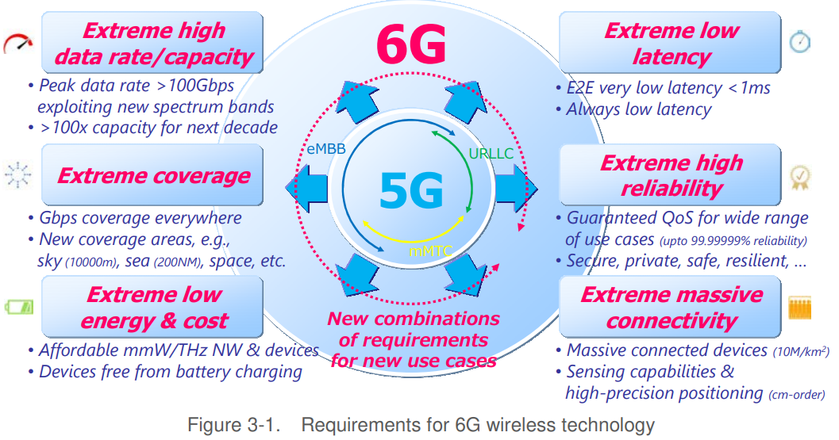
6G – The next step for 2030 and beyond - IMT-2030
Source: www.nttdocomo.co.jp, 6G Whitepaper

Slide 21
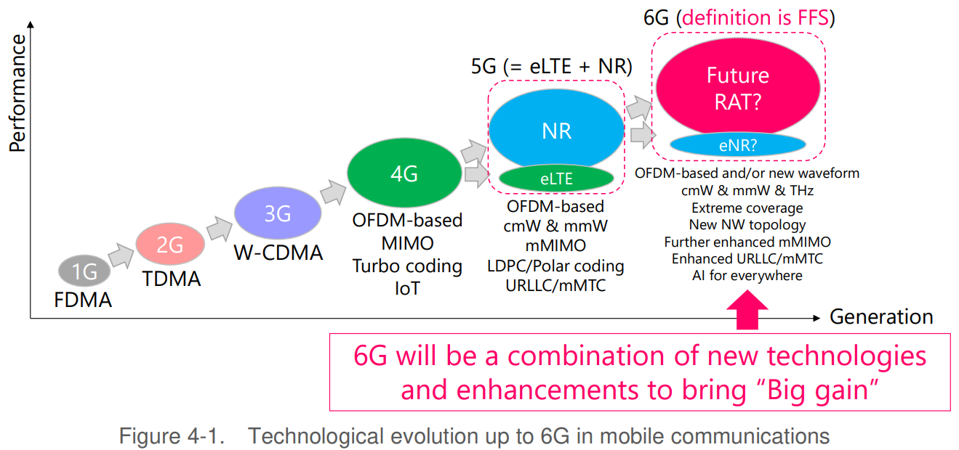
Roadmap through the generations
Source: www.nttdocomo.co.jp, 6G Whitepaper

Slide 22

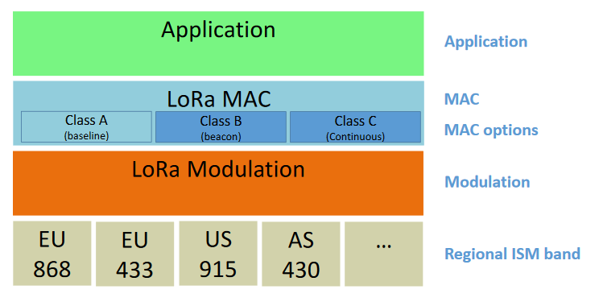
LoRaWAN – a wireless technology for IoT I
LoRaWAN
Max. 250 mW, max. 1% duty cycle, ISM/SRD band (e.g. 433, 868 MHz)
Open specification, based on proprietary chirp spread spectrum technology (LoRa, Semtech Corp.)
Asymmetric, > 10km range, up to 50 kbit/s, star topology
LoRaAlliance
500+ member companies, solutions, products,
services based on LoRaWAN
https://www.lora-alliance.org/
Open issues
LoRa closed, no open documentation
Doubts regarding scalability: “Do LoRa Low-Power Wide-Area Networks Scale?” (Bor et. Al, MSWiM’16)
  Typical smart city deployment supports only 3-4 nodes per 1000m² (20 byte packet every 16 min)
No hard guarantees for QoS

Slide 23
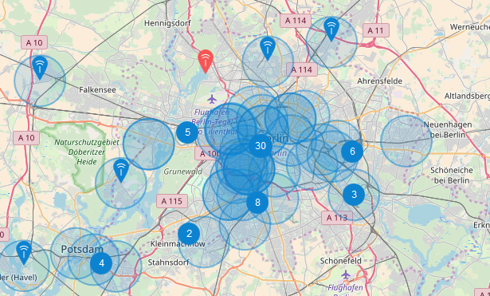
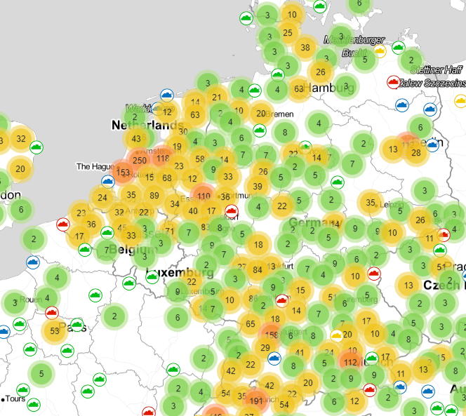

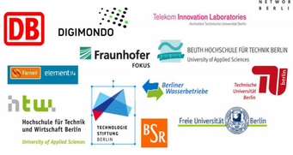
LoRaWAN – a wireless technology for IoT II
LoRaWAN
https://www.thethingsnetwork.org/
https://www.ttnmapper.org/

Slide 24
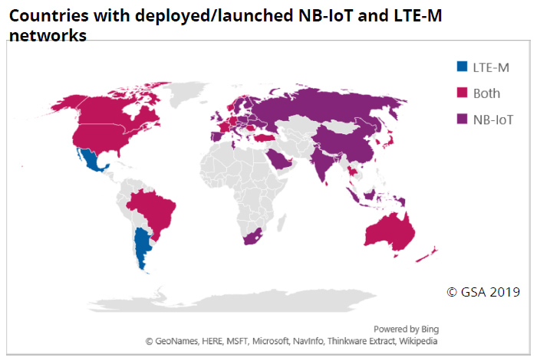
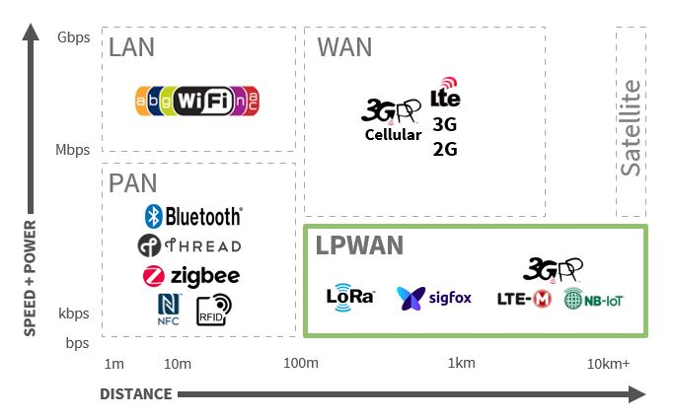
Many more wireless networks for IoT are evolving – who will make it?
www.electronicspecifier.com

Slide 25
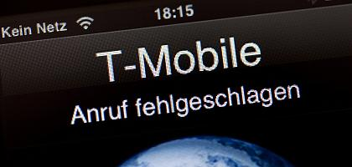
…and what about security? Availability?
„The Internet of Things (IoT) will present new attack surfaces as most of the IoT devices do not offer integrated security and, furthermore, it is often not possible to update security mechanisms later on. If compromised, these devices may serve as a backdoor for hackers to enter clinical IT systems – undiscovered for months.“ (DarkReading, www.informationweek.com, 22.12.16)
  Large variety of systems (hardware, interfaces, operating systems), typically “weak”
  Real interaction with the environment (CPS)
  Longer (but also much shorter!) life cycles, deeply embedded
  Complete unclear patching/updating strategy, responsibility
  How to integrate today the security needed in 30 years?
Software bugs do happen
  Even using the best software engineering principles
  Quite often due to unforeseeable interdependencies, new features,
  short innovation cycles
Often only one/very few vendors
  Even simple bugs may affect many networked systems
Result: very simple to affect millions of users
  System update @ German Telekom banned 40 million users from the network
  Simple misconfiguration at Internet routers cut off many autonomous systems
Classical high availability? Emergency calls? Redundancy?
Source: www.heise.de

Slide 26
Questions & Tasks
  Is 5G all about higher data rates? What else do applications in the future need?
  What are the three main application domains of 5G?
  Why is even more than 5G needed? What could be applications?
  Check for LoRaWAN at your place. What else could be used for IoT? Pros and cons?
  This is not a security lecture – but think of vulnerabilities of mobile and wireless systems, think of the many systems depending on these networks…

Slide 27

Thanks, take care – and have fun with Mobile Communications!
Source: Ed Jones/AFP, Seoul, South Korea,, 22.06.2016

