Slide 1
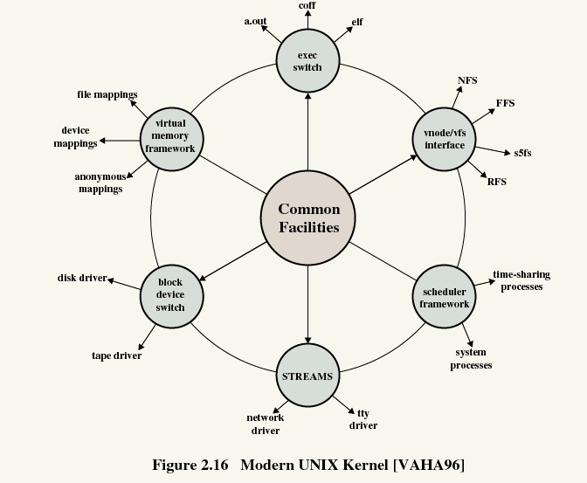
TI III: Operating Systems & Computer Networks
Organization
Prof. Dr.-Ing. Jochen H. Schiller
Computer Systems & Telematics
Freie Universität Berlin, Germany

Slide 2
Structure/content of CST-Lectures
Modeling and Simulation
Modeling, Simulation and Evaluation of Systems
SW/HW-Lab mobile, embedded Systems
SDR, security architectures, IoT, localization, bring your own topic…
Embedded Internet and the IoT
Wireless sensor networks, wireless mesh networks, Internet of Things, etc.
Microprocessor Lab
Programming of embedded systems, IoT, mobile/wireless devices
Seminar Computer Systems
Presentation & discussion of current topics from all lectures
Mobile Communications
Wireless transmission, media access, GSM, 3G, LTE, WLAN, mobile IP, ad-hoc networks
Telematics / Advanced Computer Networks
Protocols, services, standards, LAN, Internet, TCP/IP, WWW, security, quality of service, DNS, routing, applications, IPv6, MPLS
Master
Bachelor
Computer Systems Lab (TI IV)
Embedded systems, interfaces, drivers, operating systems, networking, integration
You are here!
Operating Systems and Computer Networks (TI III)
Input/output, DMA/PIO, interrupts, buffer, process/thread, UNIX/Windows, networks, media access, protocols, TCP/IP, Internet
Computer Architecture (TI II)
Harvard/v. Neumann, micro architecture, RISC/CISC, branch prediction, pipelining, cache, memory hierarchy, assembler, multi-processor systems
Basics of Computer Systems (TI I)
Boolean algebra, circuits, minimization, gates, memory, semiconductors, transistors, CMOS, AD/DA conversion

Slide 3
Content
TI 3
Operating Systems
Betriebssysteme
Computer Networks
Kommunikationssysteme

Slide 4
Content
Introduction and Motivation
  Tasks
  Services
  Virtual Resources
  Historical Perspective
  Examples
  Tools
Subsystems, Interrupts and System Calls
  System Structure
  Flow of Control
  System Library
  POSIX
Processes
  Definition
  Implementation
  State Model
Memory
  Paging & Segmentation
  Virtual Memory
  Swap Policies
Scheduling
  Types of Scheduling
  Decision Modes
  Process Priorities
  Scheduling Policies
I/O and File System
  Devices
  Buffering and Caching
  Files and Directories
Booting, Services, and Security
  System Startup
  System Services
  Security Issues

Slide 5
Content
Networked Computer & Internet
  Sockets
  Internet
  Layers
  Protocols
Host-to-Network I
  Physical Layer
  Media
  Signals
  Modems
Host-to-Network II
  Data Link Layer
  Framing, Flow Control
  Error Detection / Correction
  Point-to-Point Protocol
Host-to-Network III
  Topologies
  Medium Access
  Local Area Networks
        Ethernet, WLAN
Internetworking
  Switches, Routers
  Routing
  Internet Protocol
  Addressing
Transport Layer
  Protocol Mechanisms
  TCP, UDP
  Addressing, Ports

Slide 6
Content
Applications
  Domain Name System
  Email
  World Wide Web
Network Security
  Basic Concepts & Terms
  Cryptology
  Examples
        Firewalls
        Virtual Private Networks (VPNs)
        IP Security
        Email Security with PGP
Example
  Under the Hood of Surfing the Web
Programming in C as part of the exercises

Slide 7
Course Organization
Everything virtual via Webex meetings/events!
General:
Lecture
  Available online
  Flipped-classroom: Q&A, discussions, Friday, 10-12h, via Webex (invitations see KVV)
Office Hours
  Jochen Schiller: Tue 14:00-15:00,
  https://fu-berlin.webex.com/meet/jochen.schiller or via email
  Tutors: during tutorials
News and Updates
  KVV course site (via announcements)
Tutorials
  Groups of approx. 25-30 students
  Time depends on group
  Registration via KVV
Assignments:
New assignments each week
  Available in KVV
Discussion
  During the tutorials
Practical assignments
  @home, should work on all platforms
  More during Q&A/tutorials
Handing in
  Right on time!
  Complete electronic workflow!
  Solutions handed in too late will be ignored!

Slide 8
Assignments
Übungsblätter: Available on Fridays in KVV after Q&A
Submission: Two weeks later until start of class (Fri, 10:15)
Discussion: Three weeks later in tutorials
Publishing
Questions
Submit
Discussion
Lecture
Tutorials
Lecture
Tutorials
Lecture
Tutorials
Lecture
This week
… next week
… third week
… fourth week

Slide 9
Criteria for Successful Participation
Active participation in the tutorials is essential!
  Minimum n-2 times present
Hand in your assignments on time
  Teamwork is required with 2 students per team
Successful submission of at least n-2 assignments
Each student with a correct answer must be able to present the assignment during the tutorials
  At least one presentation during the tutorials
At least 50% of the max. number of points in the exam are required
Only the exam counts for grading!
Exam: to be announced

Slide 10
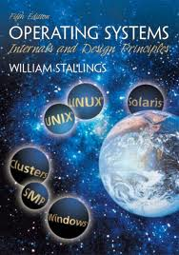
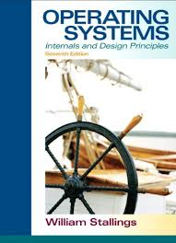
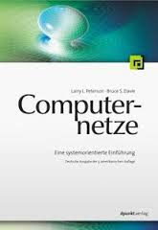
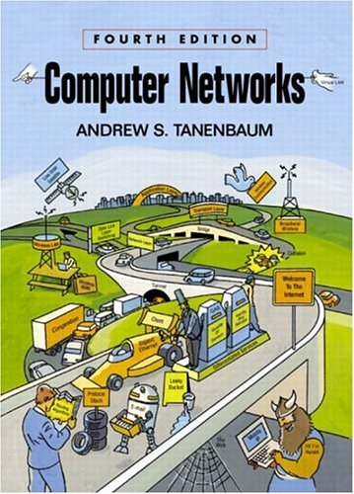
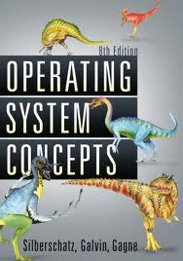
Literature
Archive of the lectures! – see KVV for links
  Prepare yourself! Follow the lecture BEFORE Q&A
  Prepare a list of questions & discuss during Q&A
The course is based on:
  William Stallings, Operating Systems: Internals
  and Design Principles, Prentice Hall International
  Larry L. Peterson, Bruce S. Davie, Computernetze –
  Eine systemorientierte Einführung, dpunkt Verlag
Additional literature:
  Andrew S. Tanenbaum, Modern Operating Systems,
  Prentice Hall
  Abraham Silberschatz, Peter B. Galvin, Greg Gagne,
  Operating System Concepts, John Wiley & Sons

Slide 11

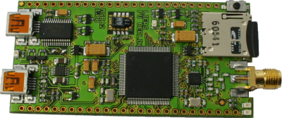
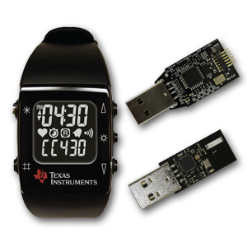
RIOT-OS
The friendly Operating System for the Internet of Things.
http://riot-os.org/

Slide 12
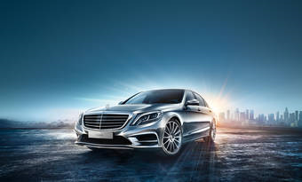
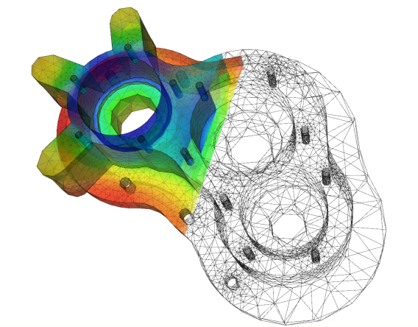
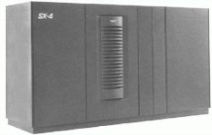
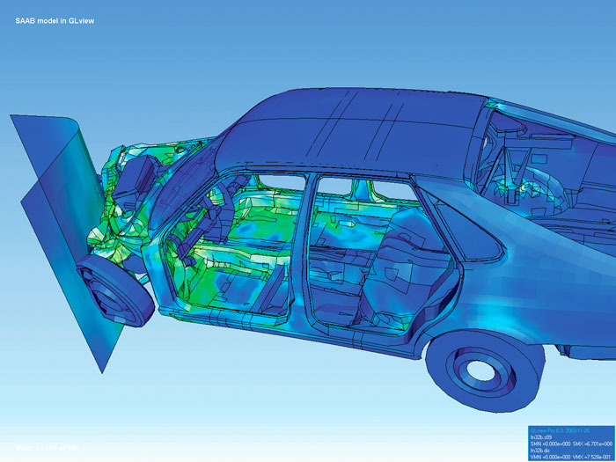
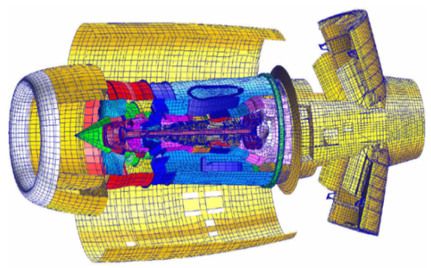
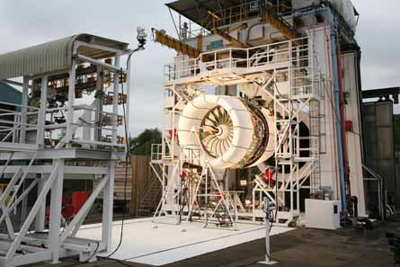

OS-support for HPC (Grids)

