Slide 1
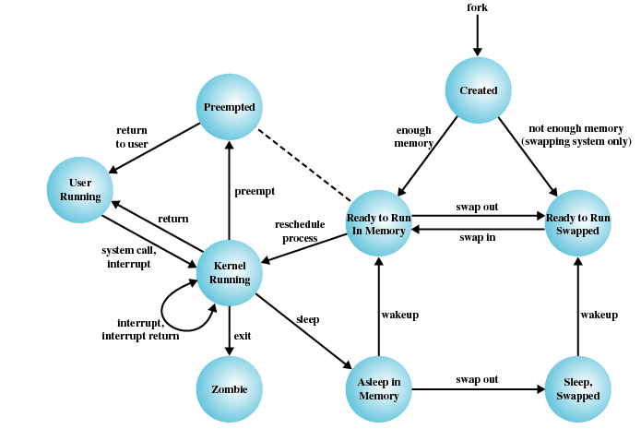
TI III: Operating Systems & Computer Networks
Subsystems, Interrupts, and System Calls
Prof. Dr.-Ing. Jochen Schiller
Computer Systems & Telematics
Freie Universität Berlin, Germany

Slide 2
Content
Introduction and Motivation
Subsystems, Interrupts and System Calls
Processes
Memory
Scheduling
I/O and File System
Booting, Services, and Security

Slide 3
Hierarchical System View
13 | Shell | Shared and distributed resources
12 | User processes
11 | Directories
10 | Devices
9 | File system
8 | Communications
7 | Virtual memory | Pre-processor resources
6 | Local secondary storage
5 | Primitive processes
4 | Interrupts | Hardware support
3 | Procedures
2 | Instruction set
1 | Electronic circuits
4. Interrupts
  Objects: interrupt service routines (ISRs)
  Operations: call, mask, unmask
3. Procedures
  Objects: subroutines, call stack
  Operations: stack pointer, call, return
2. Instruction Set
  Objects: stack, microcode compiler, scalar and vector data
  Operations: add, subtract, load, store, branch, …
1. Electronic Circuits
  Objects: registers, memory cells, logic gates
  Operations: register or memory access

Slide 4
Hierarchical System View
13 | Shell | Shared and distributed resources
12 | User processes
11 | Directories
10 | Devices
9 | File system
8 | Communications
7 | Virtual memory | Pre-processor resources
6 | Local secondary storage
5 | Primitive processes
4 | Interrupts | Hardware support
3 | Procedures
2 | Instruction set
1 | Electronic circuits
7. Virtual Memory
  Objects: segments, pages
  Operations: read, write, load
6. Secondary Storage
  Objects: blocks of data, device channels
  Operations: read, write, lock, unlock
5. Primitive processes (program being executed)
  Objects: simple processes, semaphore, ready lists
  Operations: suspend, resume, wait, signal

Slide 5
Hierarchical System View
13 | Shell | Shared and distributed resources
12 | User processes
11 | Directories
10 | Devices
9 | File system
8 | Communications
7 | Virtual memory | Pre-processor resources
6 | Local secondary storage
5 | Primitive processes
4 | Interrupts | Hardware support
3 | Procedures
2 | Instruction set
1 | Electronic circuits
13. Shell
  Objects: user programming interface
  Operations: operations in shell command language
12. User Processes (incl. data on used resources)
  Objects: user processes
  Operations: create, terminate, suspend, resume
11. Directories
  Objects: directories
  Operations: create, delete, append, remove, search, list
10. Devices
  Objects: external devices, e.g., printer, display, and keyboard
  Operations: open, close, read, write
9. File System
  Objects: named files
  Operations: create, delete, open, close, read, write
8. Inter-process Communication (IPC)
  Objects: channels, shared memory
  Operations: create, delete, open, close, read, write

Slide 6
Questions & Tasks
  Compare this system view with the layered structure from Computer Architecture – which parts do you recognize?
  Compare this system view with the memory hierarchy from Computer Architecture – how can you map the different types of memory to this system view?
  Take your computer, your OS and try to find out the different components of this system view – can you find or identify them all?
  For those used to window-based user interfaces, touch screens, voice interfaces, gesture-controlled gadgets etc. – try to find a shell and play with it! (yes, those were the old days, but you can learn a lot going back to the roots!)

Slide 7
Content
Introduction and Motivation
Subsystems, Interrupts and System Calls
Processes
Memory
Scheduling
I/O and File System
Booting, Services, and Security

Slide 8
Interrupts - Motivation
A lot of devices are connected to a computer, e.g.,
  Keyboard, hard disk, network interface
These devices occasionally need CPU service:
  Keyboard: a key is pressed
  Hard disk: a task is completed
  Network interface: a packet has arrived
BUT: it is not predictable when these devices need to be serviced
How does the CPU find out that a device needs attention?
  Two options: Interrupts and Polling

Slide 9
Interrupts versus Polling
Interrupts | Polling
Give each device a wire that it can use to signal the CPU. | Ask the devices periodically if an event has occured.
Like a phone that rings when a call comes in. | Like a phone without a bell: You have to pick it up every few seconds to see if you have a call.
No overhead when no requests pending, efficient use of CPU time. | Takes CPU time even when no requests pending.
Devices are serviced as soon as possible - low latency. | Response time depends on polling rate.

Slide 10
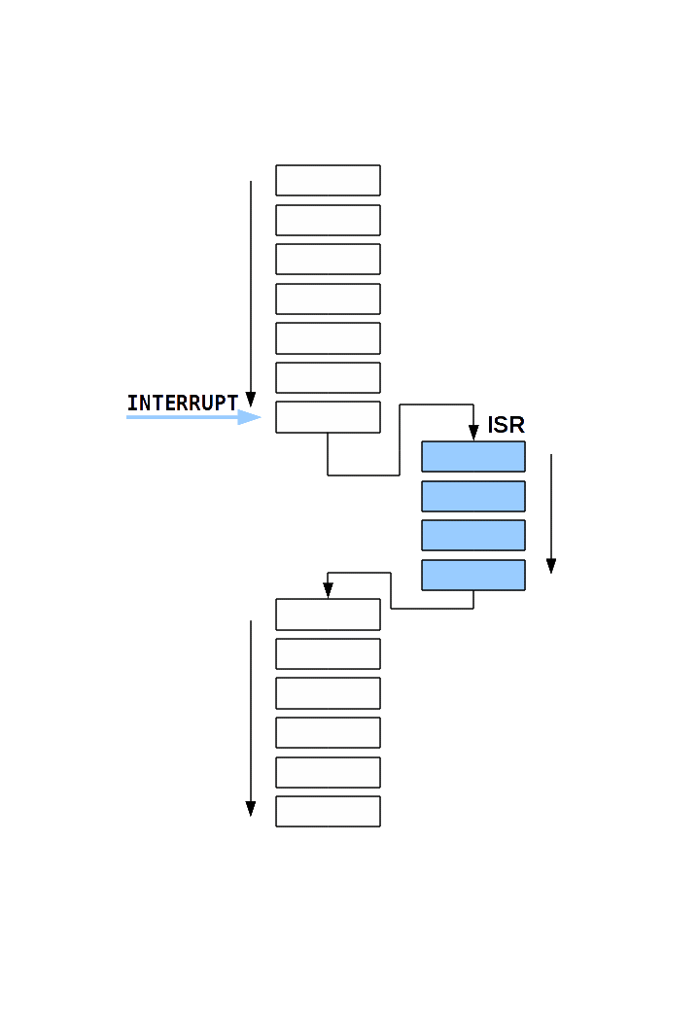
Interrupt Service Routines
Interrupt handling is performed by the operating system (device drivers) in interrupt service routines (ISRs).
Interrupts temporarily discontinue the currently executing application.

Slide 11
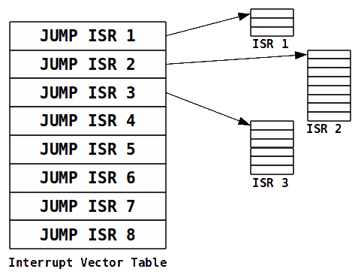
Interrupt Vector Table
Interrupt vector table maps interrupts to service routines that handle them
Table has one entry for each interrupt
Each entry contains the address of the ISR
(interrupt vector)
Table resides in main memory at a constant address (interrupt base address)
Interrupt number provides index into the table

Slide 12
Detecting Interrupts

Slide 13
Detecting Interrupts

Slide 14
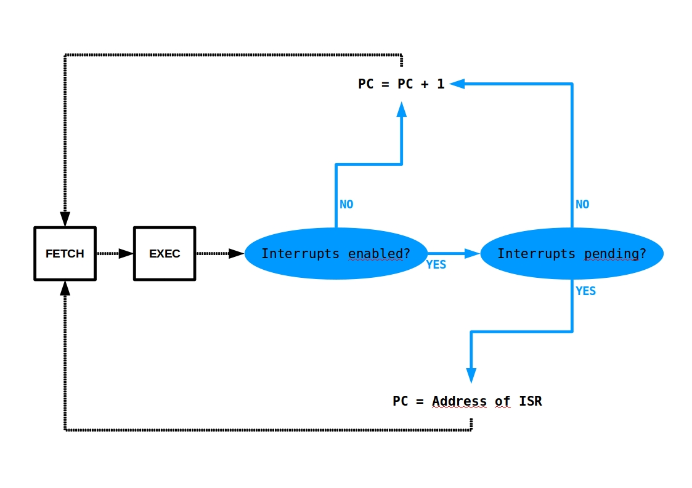
Detecting Interrupts

Slide 15
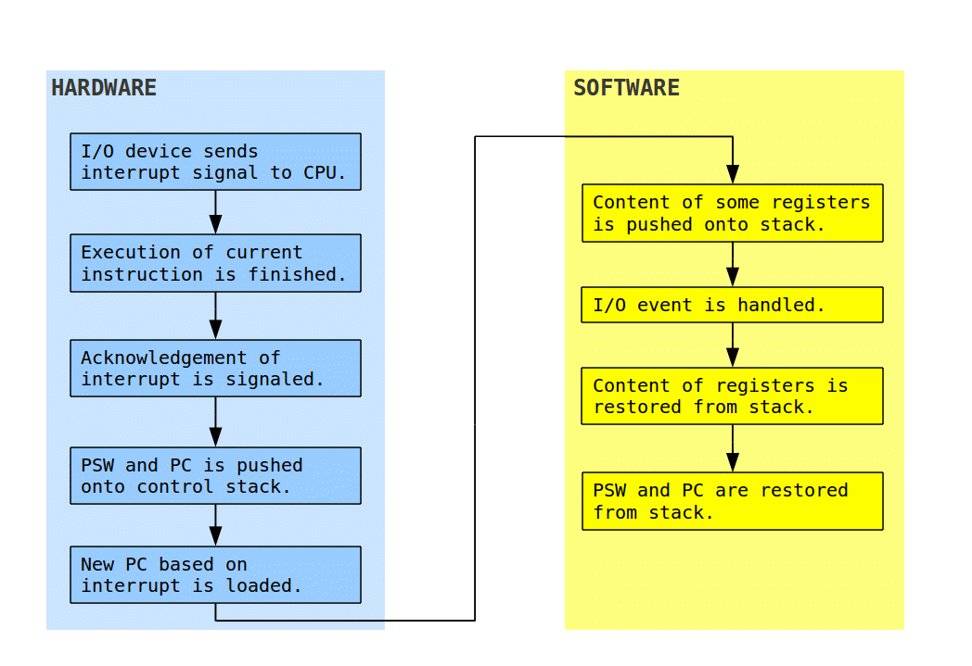
Steps of Interrupt Handling
Example: Handling of an I/O event

Slide 16
Types of Interrupts
Hardware interrupts (asynchronous)
  Triggered by hardware devices, e.g.,
    Timer
    I/O device
    Printer
Software interrupts (synchronous)
  Triggered within a processor by executing an instruction
  Often used to implement system calls
Exceptions, e.g.,
  Arithmetic overflow, division by zero
  Illegal instruction
  Illegal memory access

Slide 17
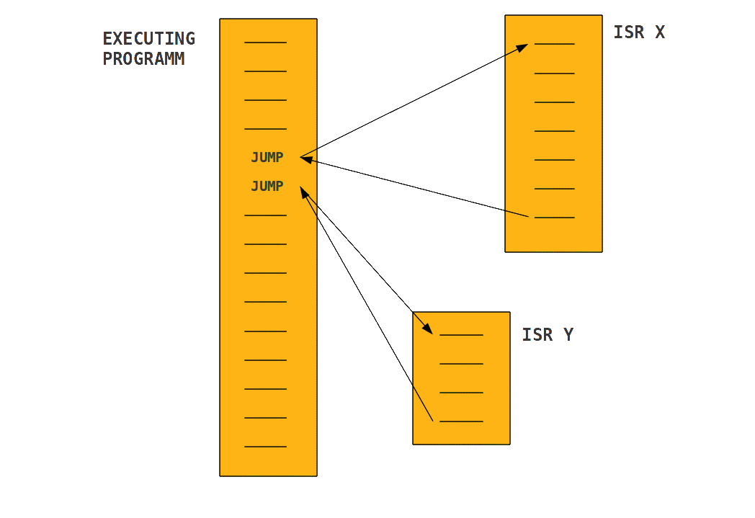
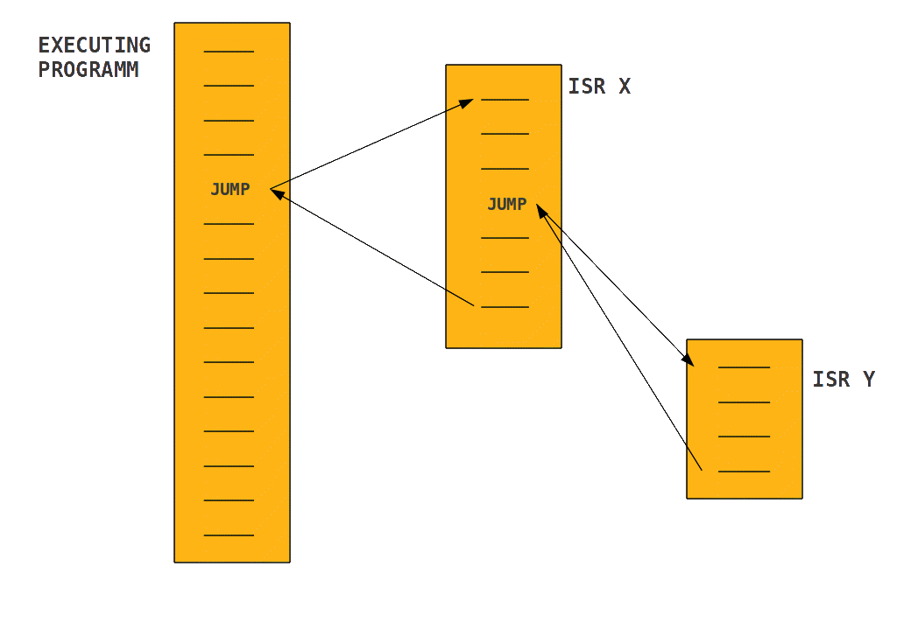
Multiple Interrupts
Sequential interrupt processing:
Delay of interrupt handling unpredictable under load
Nested interrupt processing:
Delay depends on interrupt priority level
Highest priority guarantees constant delay
Required for real-time applications

Slide 18
Questions & Tasks
  Go back to Computer Architecture if you want to learn more about interrupts!
    Remember the issues with pipelining, branch prediction etc.
  Polling seems to be a bad idea – come up with scenarios where polling could make sense!
  What should be considered when programming an ISR?
    Think of timing and registers
  Figure out the interrupts (type, frequency, priority etc.) on your system – are interrupts frequent?

Slide 19
Content
Introduction and Motivation
Subsystems, Interrupts and System Calls
Processes
Memory
Scheduling
I/O and File System
Booting, Services, and Security

Slide 20
System Calls
User applications access system services by calling system calls that are part of the system interface.
Typical modes of execution:
  User mode (ring 3):
    Typical mode for user processes
    Limited access to hardware features
    May request privileged services via system calls
  Kernel/privileged/system/control mode (ring 0):
    Typical mode for kernel of operating system
    Full access to hardware features
    Memory access beyond own address space
    Required for implementation of device drivers (low-level), scheduling, virtual memory
Handling a user request within the kernel implies switching from user to kernel mode.
Ring 0
Ring 1
Ring 2
Ring 3

Slide 21
Context / Mode / Process Switch
“Context switch” may refer to:
Mode switch between user and kernel mode
  Short interruption of current process (e.g. while handling system call)
  No modification of process state required
Process switch between different (user) processes
  May occur (depending on scheduler) when flow of control moves from user process to operating system:
    Interrupt: Response to external asynchronous event
      Timer interrupt: periodic process switch
      I/O interrupt: possibly event a process is waiting for
      Memory fault: Loading of a swapped memory segment with interleaved execution of another process
    Trap: Response to error caused by process
    System call: Process requests OS service
  More expensive than mode switch due to process state, processor caches, ...

Slide 22
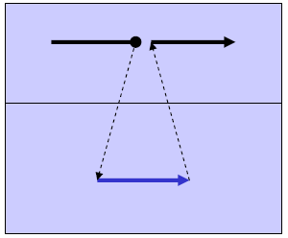
Implementation of Syscalls (1)
Subroutine call into operating system
  Used in very simple operating systems without separate address spaces
    No hardware-enforced security
    User processes run with full access to hardware (ring 0)
  Compiler / linker / loader insert call addresses into program
  Interrupt handling terminates with a simple jump back into program (“RETI”)
Example:
  MS-DOS & Embedded Systems

Slide 23
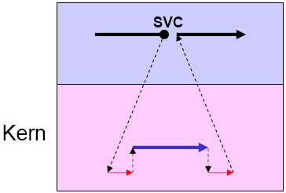
Implementation of Syscalls (2)
Machine-level instruction “system call” (supervisor call, SVC)
  Raises trap / exception / software interrupt
  Interrupt service routine detects cause and branches into corresponding service routine
    Possibly within same address space, so no process switch
  Compiler inserts parameters for system calls
  Terminates with return
Example: most UNIX kernels
User
mode
Kernel
mode

Slide 24
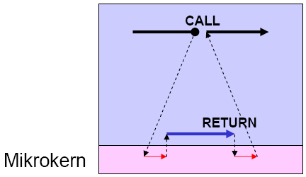
Implementation of Syscalls (3)
Call of system module / object
  Microkernel manages jump into address space of the corresponding system module in response to CALL alarm
    Process switch required
  Return into calling address space with RETURN
User mode
Kernel mode

Slide 25
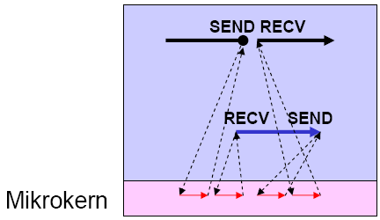
Implementation of Syscalls (4)
Dispatching a task to a system process
  Microkernel dispatches task to corresponding system process in response to SEND alarm
  System process receives task with RECV
    Process switch required
  Same method used for delivering result
Example: Mach, Minix
User mode
Kernel mode

Slide 26
Questions & Tasks
  Why having such a “complicated” system like syscalls at all?
  (Real) Micro kernels seem to be a smart idea – think of draw-backs!
  The “simple” implementation of syscalls (version 1) looks pretty unsecure – where could still use this method without headaches?
  The following section gives you some examples – use a disassembler to find such examples, read man pages to find out more about syscalls, follow the link to POSIX resources!

Slide 27
System Calls and System Library
System library hides system calls from programmers
Example write():
Value -1 in register EAX on error

Slide 28
System Calls and System Library
Example: Linux system calls
%eax | Name | Source | %ebx | %ecx | %edx | %esx | %edi
1 | sys_exit | kernel/exit.c | int | - | - | - | -
2 | sys_fork | arch/i386/kernel/process.c | struct pt_regs | - | - | - | -
3 | sys_read | fs/read_write.c | unsigned int | char * | size_t | - | -
4 | sys_write | fs/read_write.c | unsigned int | const char * | size_t | - | -
5 | sys_open | fs/open.c | const char * | int | int | - | -
6 | sys_close | fs/open.c | unsigned int | - | - | - | -
7 | sys_waitpid | kernel/exit.c | pid_t | unsigned int * | int | - | -
8 | sys_creat | fs/open.c | const char * | int | - | - | -
...
http://man7.org/linux/man-pages/man2/syscalls.2.html

Slide 29
System Calls and System Library
WRITE(2) Linux Programmer's Manual WRITE(2)
NAME
write - write to a file descriptor
SYNOPSIS
#include <unistd.h>
ssize_t write(int fd, const void *buf, size_t count);
DESCRIPTION
write() writes up to count bytes from the buffer pointed buf to the
file referred to by the file descriptor fd.
The number of bytes written may be less than count if, for example,
there is insufficient space on the underlying physical medium, or the
RLIMIT_FSIZE resource limit is encountered (see setrlimit(2)), or the
call was interrupted by a signal handler after having written less
than count bytes. (See also pipe(7).)
…

Slide 30
POSIX
Portable Operating System Interface (POSIX)
Standard for operating system API
  IEEE 1003, ISO/IEC 9945
Three main parts:
  POSIX Kernel APIs (system call interface)
  POSIX Commands and Utilities
  POSIX Conformance Testing
Operating system, that implement POSIX:
  INTEGRITY, Linux, BSD/OS, A/UX, LynxOS, Mac OS X, MINIX, RTEMS, SkyOS, > Windows NT

Slide 31
POSIX Versions
See: http://pubs.opengroup.org/onlinepubs/9699919799/
POSIX.1, Core Services
  (includes Standard ANSI C)
  Process Creation and Control
  Signals (IPC)
  Floating Point Exceptions
  Segmentation Violations (VMM)
  Illegal Instructions
  Bus Errors
  Timers
  File and Directory Operations
  Pipes
  C Library (Standard C)
  I/O Port Interface Control
POSIX.1b, Real-time extensions
  Priority Scheduling
  Real-Time Signals
  Clocks and Timers
  Semaphores
  Message Passing
  Shared Memory
  Asynch and Synch I/O
  Memory Locking
POSIX.1c, Threads extensions
  Thread Creation, Control, and Cleanup
  Thread Scheduling
  Thread Synchronization
  Signal Handling

Slide 32
Content
Introduction and Motivation
Subsystems, Interrupts and System Calls
Processes
Memory
Scheduling
I/O and File System
Booting, Services, and Security

