Slide 1
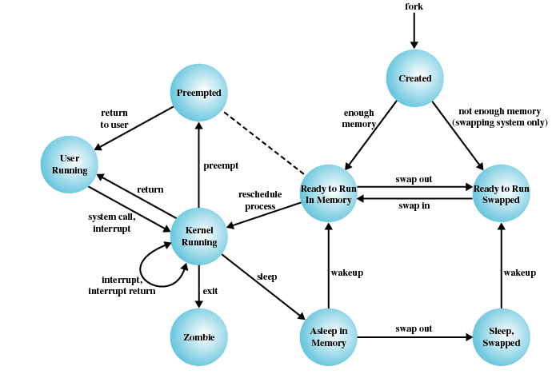
TI III: Operating Systems & Computer Networks
Memory
Prof. Dr.-Ing. Jochen Schiller
Computer Systems & Telematics
Freie Universität Berlin, Germany

Slide 2
Content
Introduction and Motivation
Subsystems, Interrupts and System Calls
Processes
Memory
Scheduling
I/O and File System
Booting, Services, and Security

Slide 3
Motivation
Memory
To which location in memory should the process image be loaded?
What happens to all the addresses contained in the process image?
How does the OS know that no other process is using that memory?
How can the OS prevent a process from accessing memory that it doesn’t “own”?
What’s the best method to efficiently manage memory requests?
Operating System
0010101110100110101010101010110110101010100...

Slide 4
Motivation
See course Computer Architecture!
Here many pointers to this course
Lecture does not cover all slides

Slide 5
Memory Management
Memory
Closely related to processes
  Memory management isolates processes from each other
Goals
  Subdividing memory to accommodate multiple processes
  Memory needs to be allocated to ensure a reasonable supply of
  ready processes to consume available processor time
Requirements
  Relocation: Location in (physical) memory unknown or may change
  Protection: Disallow access to memory of other processes
  Sharing: Data for communication (IPC), program copy for memory reduction
Operating System

Slide 6
Addressing
Physical Address
  The absolute address or actual location in main memory
  Used by the kernel (to implement logical addresses)
Relative Address
  Address expressed as a location relative to some known point
  Also commonly found in application programming (arrays)
Logical/Virtual Address
  Reference to memory location independent of current assignment of data to memory
  Translation must be made to physical address
  Requires hardware support
Address space
  Range of addresses that are (within the address space) unambiguously addressable

Slide 7
Addressing

Slide 8
Memory Access

Slide 9
Questions & Tasks
  Can you imagine a computer system without memory management?
  What are pros and cons of having many/few processes in memory?
  Repeat relevant sections of Computer Architecture if you have to refresh your knowledge about caches, memory access, memory hierarchy etc.

Slide 10
Fixed and Dynamic Partitioning

Slide 11
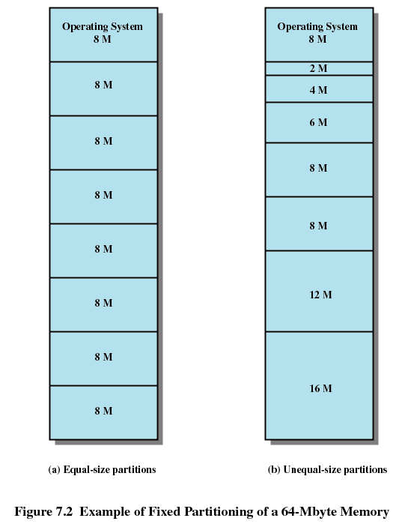
Fixed Partitioning

Slide 12
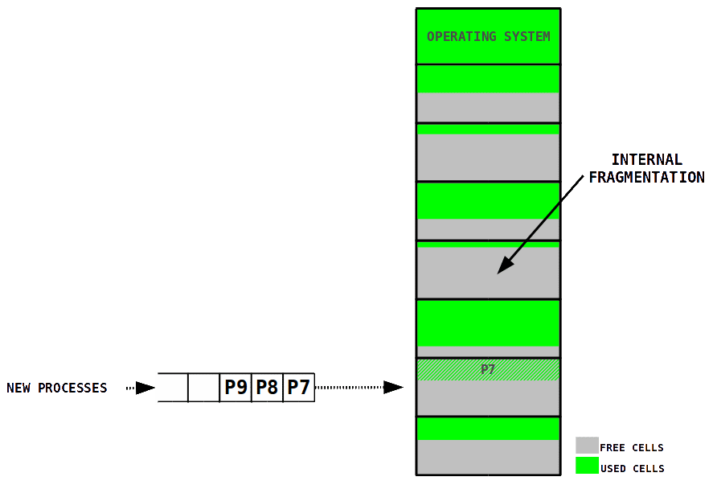
Fixed Partitions
Memory partitioned into fixed pieces, each partition can hold one process
Amount of processes in main memory is bounded by the number of partitions
Internal fragmentation

Slide 13
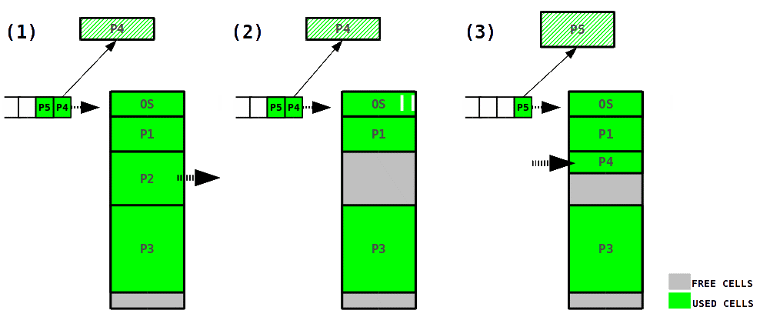
Dynamic Partitions
Memory is divided into variable sized partitions on demand
Although there is enough space left for P5 it can not be allocated to the process because it is not continuous
External fragmentation

Slide 14
Dynamic Partitioning

Slide 15
Implementation

Slide 16
Dynamic Placement Algorithms
First-fit algorithm:
  Scans memory from the beginning
  Chooses first available block that is large enough
Next-fit algorithm:
  Scans memory from the location of the last placement
  Tends to allocate block of memory at end of memory (where largest block is commonly found)

Slide 17
Buddy System
Combines advantages of fixed and dynamic allocation
Entire available space is treated as single block of size 2^{U} bytes
  U := number of bits in address
If memory of size s is requested (2^{U-1} < s <= 2^{U}), entire block is allocated
  Otherwise block is split into two equal buddies
  Process continues until smallest block greater than or equal to s is
  generated
Free blocks can easily be merged into bigger blocks
Compactification eased by regularly sized blocks

Slide 18
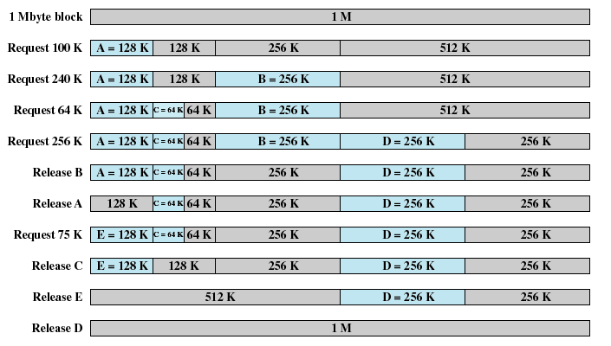
Buddy System: Example

Slide 19
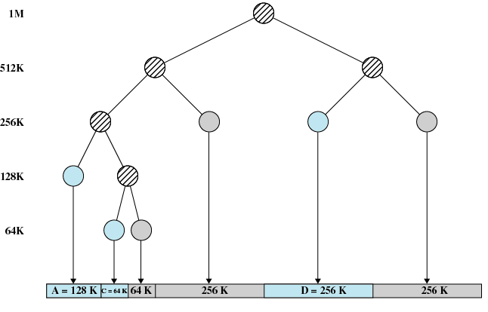
Buddy System: Example

Slide 20
Fragmentation of main memory
Fragmentation: free cells in main memory are unusable because of the allocation scheme
  memory space is wasted
Internal fragmentation: the free memory cells are within the area allocated to a process
  occurs using fixed partitions
External fragmentation: the free memory cells are not in the area allocated to any process
  occurs using dynamic partitions

Slide 21
Questions & Tasks
  What are the advantages and disadvantages of fixed and dynamic partitions, respectively?
  What happens if there is not enough memory available for placing a new block of memory?
  How does the size of partitions influence internal and external fragmentation, respectively?
  And how does this influence the management overhead?

Slide 22
Paging

Slide 23
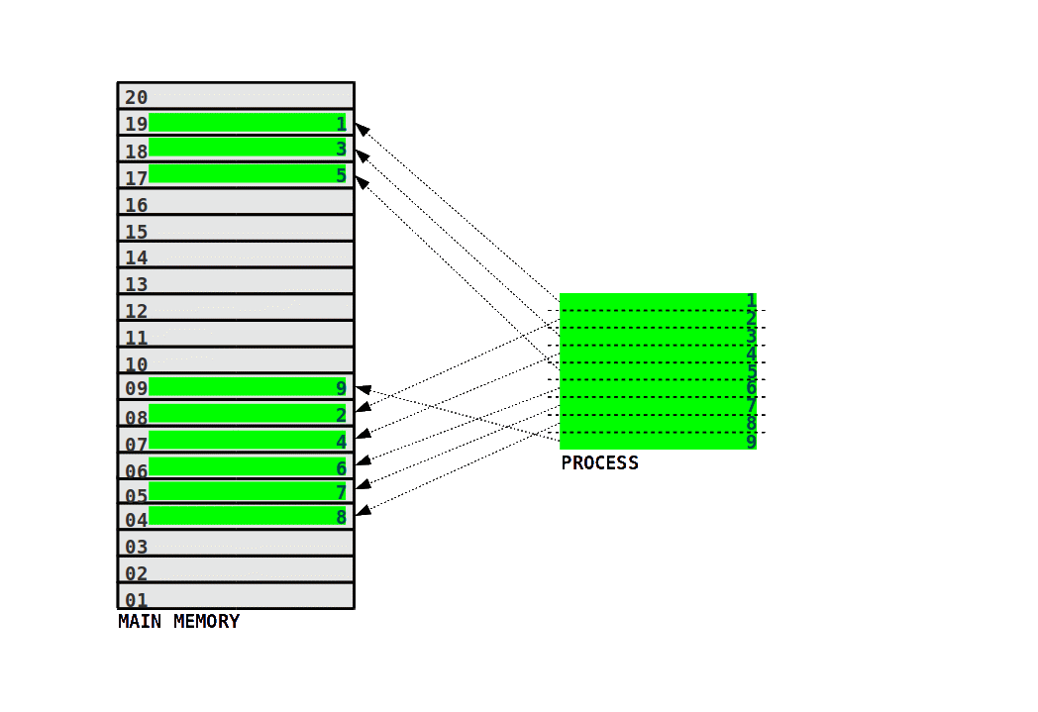
Paging
Memory divided into small fixed-sized pieces, called (page-)frames
Process images divided into pieces of the same size, called pages
One frame of the main memory is allocated to one page of a process

Slide 24
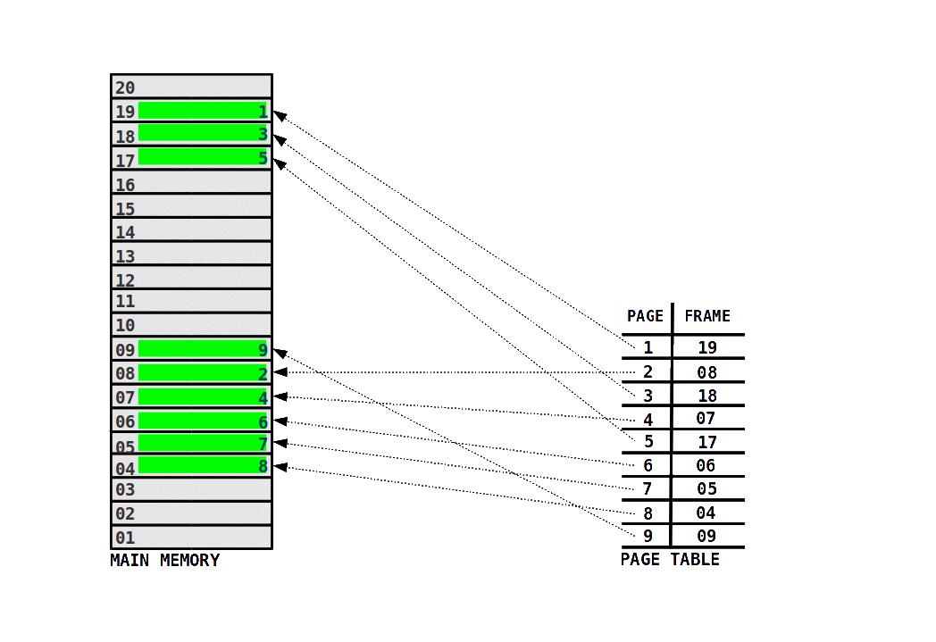
Page Table
Operating system maintains page table for each process
  Pages are mapped to frames

Slide 25
Size of Frames/Pages
Paging creates no external fragmentation
  Since size of frames/pages is fixed
Internal fragmentation depends on frame size
  The smaller the frames the lower the internal fragmentation
  BUT: the smaller the frames the bigger the page tables

Slide 26
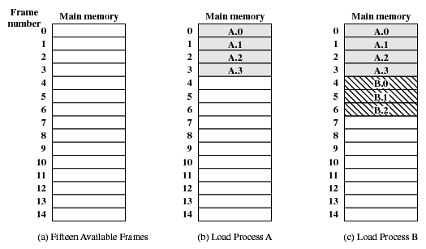
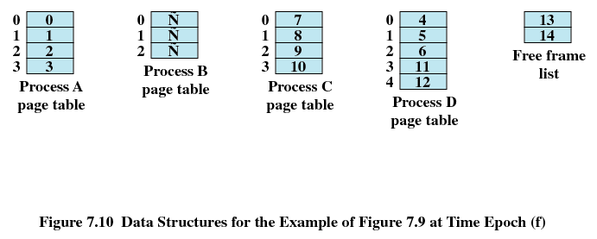
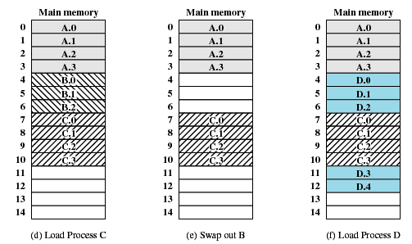
Assignment of Pages to Frames
Example:
(a) – (d) Load processes A, B, and C
(e) Swap out process B
(f) Load process D
Page Tables

Slide 27
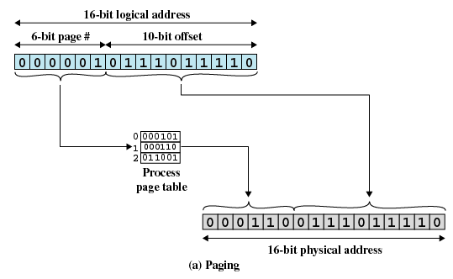
Addresses
Memory address consists of a page number and offset within the page

Slide 28
Translation of virtual to real addresses
Notes:
Xxxxxxxxxxxxxxxxxxxxxxxxxxxxxxxxxxxxxx
Beginn Vorlesung 4
Xxxxxxxxxxxxxxxxxxxxxxxxxxxxxxxxxxxxxx
Gestern kam ja schon die Frage auf, ob in er Page Table logische oder physikalische Adressen gespeichert sind
Das wiederholen wir hier nochmal
→ funktioniert so, wie wir es auch schon in RA beim virtuellen Speicher besprochen haben
Diese Folie habe ich aus dem RA Memory-Kapitel geklaut, die kennen Sie schon
Damals lag der Fokus auf der Abbildung virtuelle Adresse auf reale Adresse
→ stellen Sie sich jetzt so eine Page Table für jeden einzelnen Prozess vor
Xxxxxxxxxxxxxxxxxxxxxxxxxxxxxxxxxxxxxxxxxxx
Wie funktioniert jetzt das Umrechnen der Adressen?
Unten: virtuelle Adresse
Hier mal 32 Bit Adressen
Oben: physikalische Adresse
Hier mal 15 Bit Adressen
→ mehr echten Hauptspeicher gibt es einfach gar nicht
Die konkrete Aufteilung der Bits in der virtuellen Adresse sind wie immer Implementierungsfrage
Hier sind jetzt die unteren 12 Bits der Offset und geben 1:1 die unteren 12 Bits der physikalischen Adresse an
Was passiert mit den übrigen vorderen 20 Bit der Virtuellen Adresse?
→ hier kommt jetzt die Page Table zum Einsatz
→ darin stehen alle Abbildungen von virtueller auf physikalische Adresse
Welche Zahl steht in den vorderen 20 Bit der virtuellen Adresse? → 3
→ also gucke ich in der Page Table die Virtuelle Page 3 nach
→ dort stehen dann die 3 für die physikalische Adresse verbliebenen vorderen Bits drin
Wie auch beim Caching kann es hier zu Konkurrenz kommen, zu Seiten Flattern, usw.
→ genau wie beim Caching gibt es auch hier viele Optimierungsmöglichkeiten

Slide 29
Hardware Support (MMU)
Base register (starting address for the process)
Bounds register (ending location of the process)
Registers are set when process is loaded
Bounds register is used for security purpose
MMU
Memory Management Unit

Slide 30
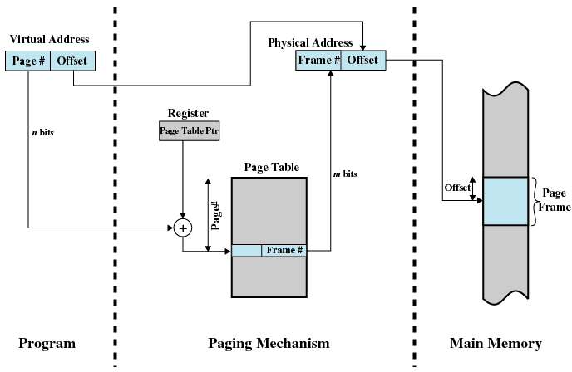
Paging Address Translation

Slide 31
Support Needed for Virtual Memory
Hardware Support
  Present bit: Page/segment is available in main memory
  Modified bit: Content of page/segment has been modified
  Implementation:
    Paging:
OS must be able to manage moving pages between primary and secondary memory
Other control bits:
Write enabled
Executable
Shared between processes
...

Slide 32
Hierarchical Page Table
Page table itself may grow to considerable size
Swap parts of page table to secondary storage
  Problem: One virtual memory reference may cause two physical memory accesses (one to fetch page table, one to fetch data)
  Performance penalty due to disk I/O delays

Slide 33
Translation Lookaside Buffer
Problem: How to know which pages are loaded and up to date?
Translation Lookaside Buffer (TLB)
Built into CPU
Caches most recently used page table entries

Slide 34
Translation Lookaside Buffer
Basic steps:
Given a virtual address, processor examines TLB
  If page table entry is present (TLB hit)
    Retrieve frame number and form physical address
  If page table entry is not found in TLB (TLB miss)
    Fall back to process page table in main memory
      For hierarchical page tables, possibly start recursion
OS checks if page is present in main memory
  If not, issue page fault and fetch page from disk
Update TLB to include new page entry

Slide 35
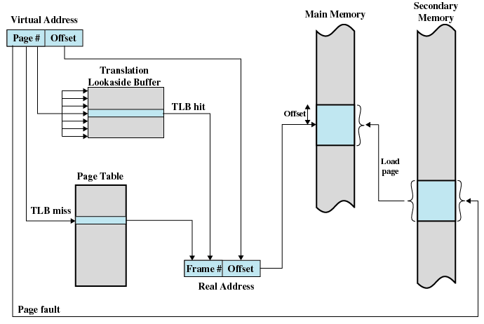
Translation Lookaside Buffer

Slide 36
Translation Lookaside Buffer
Operation of Paging and Translation Lookaside Buffer

Slide 37
Translation Lookaside Buffer

Slide 38
Questions & Tasks
  Does it “hurt” (in terms of performance) if a process is distributed over several non-continuous pages?
    i.e. is memory defragmentation necessary? Explain difference to hard disk!
  Who calls the operating system if a page is not present in main memory? What happens to the process?
  Who “informs” the process if the needed page is available?
  How can the operating system speed-up the page table look-ups?
  What is the role of an MMU?

Slide 39
Page Size
Paging

Slide 40
Page Size
Smaller page size …
  less amount of internal fragmentation
  more pages required per process
  large number of pages will be found in main memory
More pages per process means larger page tables
  large portion of page tables in virtual memory
  secondary memory is designed to efficiently transfer large blocks of data so a large page size is better
With time pages in memory will contain portions of the process near recent references
  Page faults low
Increased page size causes pages to contain locations further from any recent reference
  Page faults rise

Slide 41
Page Size

Slide 42
Example Page Sizes
Architecture | Smallest page size | Larger page sizes
x86 (classical 32 bit) | 4 kbyte | 2 Mbyte, 4 Mbyte
x86-64 (64 bit) | 4 kbyte | 2 Mbyte, 1 Gbyte
IA-64 (Itanium, VLIW) | 4 kbyte | 8 / 64 / 256 kbyte, 1 / 4 / 16 / 256 Mbyte
SPARC v8 | 4 kbyte | 256 kbyte, 16 Mbyte
UltraSPARC | 8 kbyte | 64 / 512 kbyte, 4 / 32 / 256 Mbyte, 2 / 16 Gbyte
ARMv7 | 4 kbyte | 64 kbyte, 1 / 16 Mbyte
Power | 4 kbyte | 64 kbyte, 16 Mbyte, 1 Gbyte

Slide 43
Page Replacement
Paging

Slide 44
Problem: Thrashing
VM Thrashing
Page/segment of process is swapped out just before its needed
  Happens under memory pressure, i.e., too many resource-hungry processes running on too little main memory
Processor spends most of its time swapping pages/segments rather than executing user instructions
  Computer stalls with heavy disk I/O
Solution: “Good” page replacement policies
  Principle of Locality:
    Program and data references within a process tend to cluster
    Possible to make intelligent guesses about which pieces will be needed in the future

Slide 45
Algorithms / Policies
Fetch Policy
Which page should be swapped in? When?
Alternatives
  Demand paging:
    only brings pages into main memory when reference is made to address on page
  Prepaging:
    brings in more pages than needed
    anticipates future requests
Replacement Policy
Which page should be swapped out / replaced?
Approaches
  Remove page that is least likely to be referenced in near future
  Most policies predict future behavior on basis of past behavior, e.g.
    First-In, First Out (FIFO)
    Not Recently Used (NRU)
    Least Recently Used (LRU)
    ...

Slide 46
Some Basic Replacement Algorithms
Optimal policy (for reference only)
  Selects page for which time to next reference is longest
  Impossible to have perfect knowledge of future events
Least Recently Used (LRU)
  Replaces page that has not been referenced for longest time
  By principle of locality, least likely to be referenced in near future
First-in, First-out (FIFO)
  Treats page frames allocated to a process as circular buffer
  Pages are removed in round-robin style
  Page that has been in memory the longest is replaced (but may be needed soon)
Clock Policy
  When a page is first loaded in memory, use bit is set to 1
  When page is referenced, use bit is set to 1
  During search for replacement, each use bit is changed to 0
  When replacing pages, first frame with use bit set to 0 is replaced

Slide 47
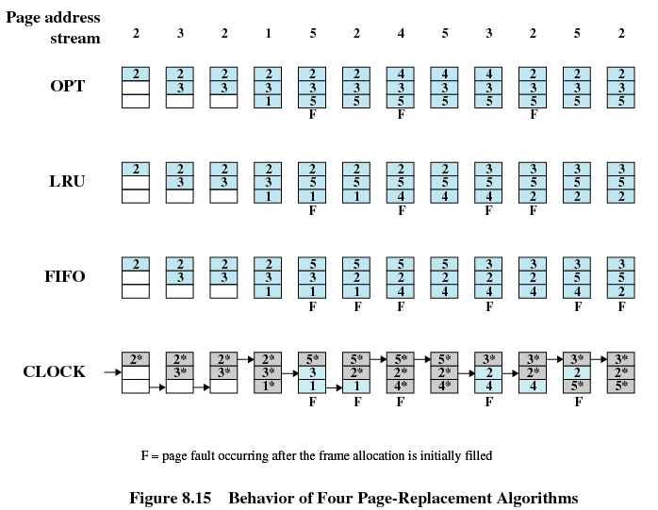
Page Replacement Example

Slide 48
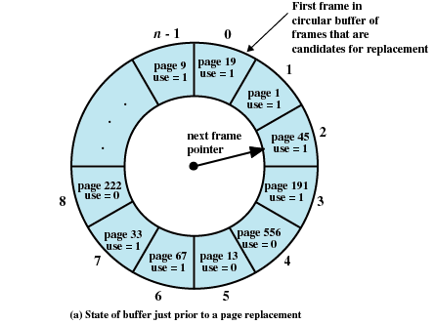
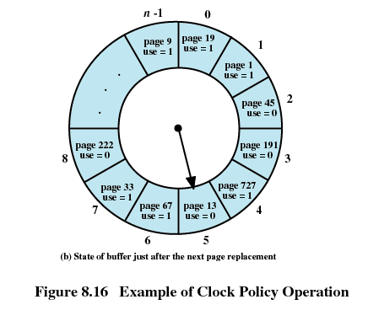
Page Replacement Example

Slide 49
Comparison of Placement Algorithms

Slide 50
Resident Size
Paging

Slide 51
Resident Set Size
Fixed-allocation
  Gives a process a fixed number of pages
  When a page fault occurs, one of the pages of that process must be replaced
Variable-allocation
  Number of pages varies over the lifetime of the process

Slide 52
Resident Set Size
Decide ahead of time the amount of allocation to give a process
If allocation is too small, there will be a high page fault rate
If allocation is too large there will be too few programs in main memory

Slide 53
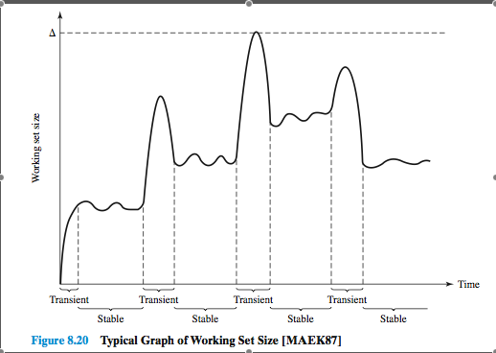
Resident Set Size
Working Set of a process: set of pages of the process that have been referenced in the last t time units

Slide 54
Working Set

Slide 55
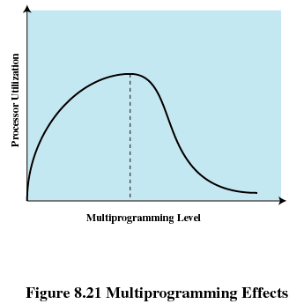
Load Control
Determines the number of processes that will be resident in main memory
Too few processes, many occasions when all processes will be blocked and much time will be spent in swapping
Too many processes will lead to thrashing

Slide 56
Segmentation
All segments of all programs do not have to be of the same length
There is a maximum segment length
Addressing consist of two parts - a segment number and an offset
Since segments are not equal, segmentation is similar to dynamic partitioning

Slide 57
Questions & Tasks
  Where else do you know the “Principle of Locality” from? Which elements of a computer do also benefit from this principle?
  How do you as a user recognize VM thrashing?
  Can the OS swap out all pages?
  Is the replacement algorithm relevant for larger number of allocated frames in memory processes? Why?

Slide 58
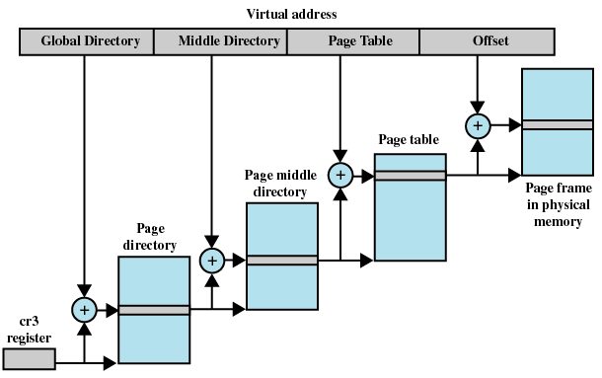
Example: Linux VM Implementation
4 kB
Fixed in
main memory
Possibly swapped to disk

Slide 59
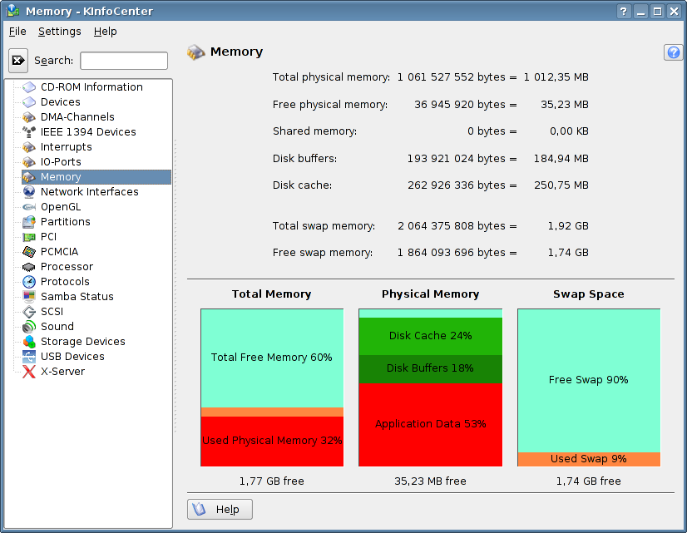
Example: Linux Memory Utilization

Slide 60
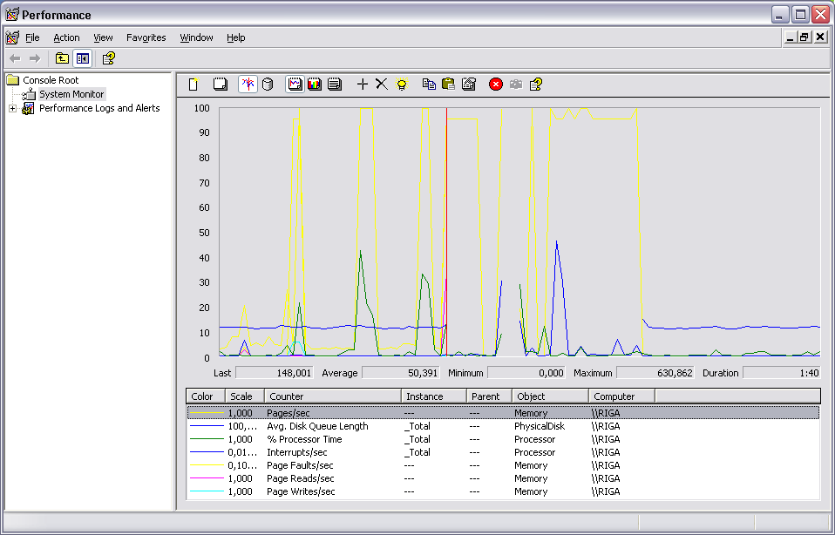
Example: Windows Paging (perfmon)

Slide 61
Related System Calls (Linux)
int brk(void *end_data_segment)
  Sets end of data segment of process to end_data_segment
void *sbrk(intptr_t increment)
  Increments the program’s data space by increment bytes
void *mmap(void *start, size_t length, int
prot, int flags, int fd, off_t offset)
  Maps length bytes of file descriptor fd to address start
  With flag MAP_ANONYMOUS no actual file is needed
int munmap(void *start, size_t length)
  Deletes mapping to specified address

Slide 62
Related Library Wrappers
void *malloc(size_t size)
  Allocates size bytes and returns pointer
  Returns NULL if no memory is available
void free(void *ptr)
  Frees memory pointed to by ptr
void *calloc(size_t nmemb, size_t size)
  Allocates and zeroes memory for nmemb elements of size size bytes
void *realloc(void *ptr, size_t size)
  Changes size of previously allocated memory at ptr to size bytes

Slide 63
Content
Introduction and Motivation
Subsystems, Interrupts and System Calls
Processes
Memory
Scheduling
I/O and File System
Booting, Services, and Security

