Slide 1
TI III: Operating Systems & Computer Networks
Transport Layer
7
7
6
6
5
5
4
4
Prof. Dr.-Ing. Jochen Schiller
Computer Systems & Telematics
Freie Universität Berlin, Germany
3
3
2
2
1
1

Slide 2
Content
Networked Computer & Internet
Host-to-Network
Internetworking
Transport Layer
Applications
Network Security
Example

Slide 3
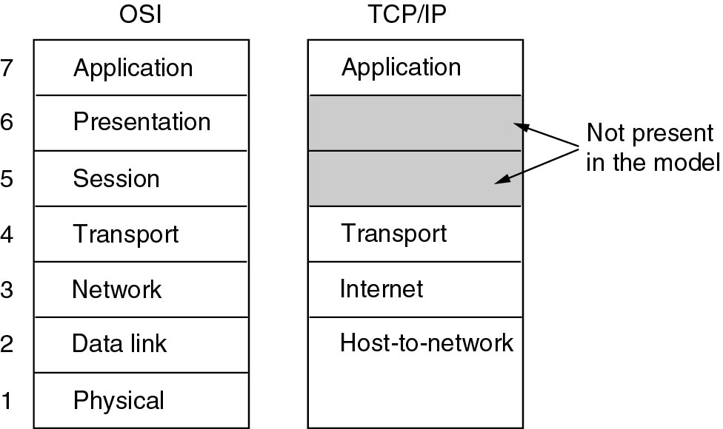
Transport Layer

Slide 4
Tasks of Transport Layer
End-to-end connection: From process to process (not node-to-node)
Insulation of higher layers from technology, structure and impairments of lower layers, e.g., packet loss
Transparent transmission of user data
Support of Quality of Service (QoS)
  Not widely deployed in the classical Internet
Independent addressing of processes, i.e., independent of Layer 3
  Exception: The Internet Socket (IP-address + port)
Host
Host
End-to-end connection
4
3
2
1
4
3
2
1
Medium
Medium

Slide 5
Services of Transport Protocols
Services provided to upper layers:
  Connection-less and connection-oriented transport service
    Connection management (setup and teardown) necessary as auxiliary service
  Reliable or unreliable transport
    In-order delivery
    Reliability, i.e., all packets
  Congestion control – be a good citizen in the network
  Demultiplexing, i.e., support of several transport endpoints in a single host
  Support different interaction models
    Byte stream, messages
    Remote Procedure Calls (RPC)

Slide 6
Example: User Datagram Protocol (UDP)
Unreliable, datagram protocol
(De)multiplex several data flows onto IP layer and back to applications
Ensures packet’s correctness
  Checksum of pseudoheader (IP source/destination, protocol ID and length of data), UDP header and data
UDP
header

Slide 7
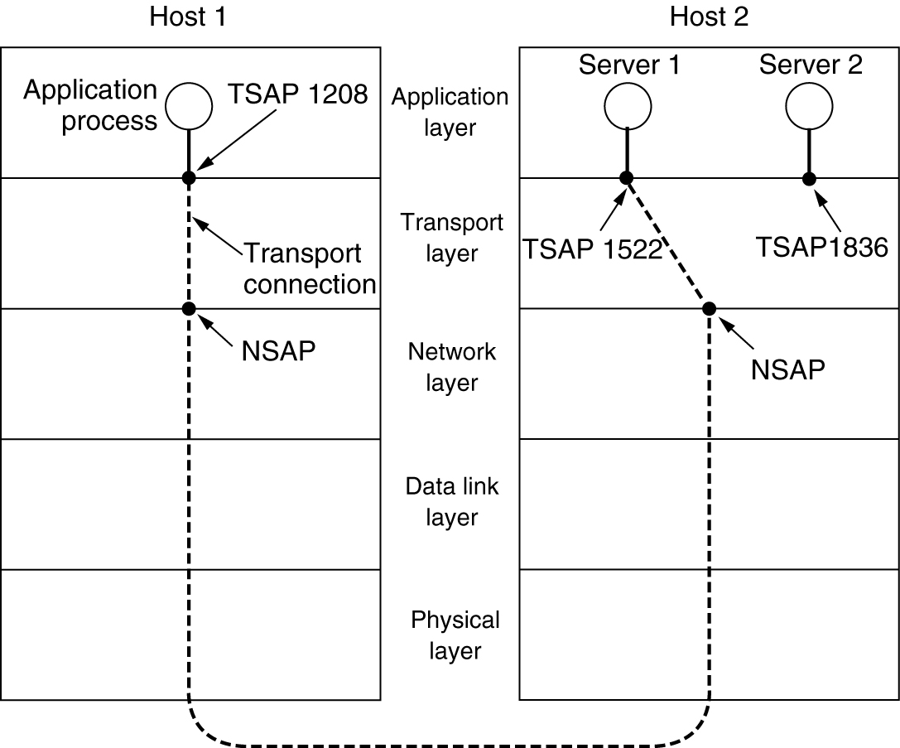
Addressing / Demultiplexing
Provide multiple service access points (SAPs) to multiplex several applications
  SAPs can identify connections or data flows
Example: Port numbers as Transport SAP identifiers in TCP/UDP
  Dynamically allocated
  Predefined for “well-known” services, e.g., port 80 for HTTP/Web server
  Privileges required to bind to certain ports
TCP/UDP connection is thus identified by four tuple (known as socket pair):
  [Source Port, Source IP Address, Destination Port, Dest. IP Address]

Slide 8
TCP – Some Well-known Ports
Many applications choose TCP/UDP as transport protocol
Correct port must be used to communicate with respective application on server side:
  13: Day time
  20: FTP data
  25: SMTP
  (Simple Mail Transfer Protocol)
  53: DNS
  (Domain Name Server)
  80: HTTP
  (Hyper Text Transfer Protocol)
  119: NNTP
  (Network News Transfer
  Protocol)
> telnet walapai 13
Trying 129.13.3.121...
Connected to walapai.
Escape character is '^]'.
Sun Jan 21 16:57:19 2007
Connection closed by foreign host
> telnet mailhost 25
Trying 129.13.3.161...
Connected to mailhost .
Escape character is '^]'.
220 mailhost ESMTP Sendmail 8.8.5/8.8.5; Sun,
21 Jan 2007 17:02:51 +0200
HELP
214-This is Sendmail version 8.8.5
214-Topics:
214- HELO EHLO MAIL RCPT DATA
214- RSET NOOP QUIT HELP VRFY
214- EXPN VERB ETRN DSN
214-For more info use "HELP <topic>".
...
214 End of HELP info
Notes:
Der Nummerraum der Ports ist wie folgt unterteilt:
Well known ports: 0 – 1023
Registered ports: 1024 – 49151
z.B. 3074/tcp Xbox game port
Dynamic/private ports: 49152 – 65535
werden auf Anforderung vom Betriebssystem vergeben
Siehe auch www.iana.org/assignments/portnumbers

Slide 9
Questions & Tasks
  What does the transport layer see from the underlying technology, media, intermediate systems?
  Why is it difficult to offer QoS at the transport layer?
  How can congestions happen in the underlying network?
  Why having UDP – it is as unreliable as IP…?

Slide 10
Connection Establishment
How to establish a joint context and a connection between sender and receiver?
  Only relevant in end-systems (not for routers), network layer (IP) assumed to be connection-less
Naïve solution:
  Sender sends
    CONNECTION REQUEST
  Receiver answers with
    CONNECTION ACCEPTED
  Sender proceeds once that
    message is received
CONNECTION
REQUEST
CONN
ACCEPTED
DATA

Slide 11
Failure of Naïve Solution
Transfer
money
CONNECTION
REQUEST
Naïve solution fails in realistic networks
  In which packets can be lost, stored/reordered, and duplicated
Example failure scenario: All packets are duplicated and delayed
  Due to congestion, errors, re-routing, ...
Result: Two independent transactions performed, while only one was intended
  Similar to replay attack
Problematic are delayed duplicates!
CONN
ACCEPTED
TRANSFER
OK
OK
CONN
ACCEPTED
???
DROP
OK
OK
???
DROP

Slide 12
More Sophisticated Solution
Idea: Add additional handshake
  Sender has to re-confirm to receiver that it actually wants to set up this connection
Add third message to connection setup phase:
Three-way handshake
  This third message can already carry data for efficiency (piggy backing)
CONNECTION
REQUEST
CONN
ACCEPTED
CONN
CONFIRMED

Slide 13
Connection Setup – Further Issues
Terminology for TCP:
  SYN (synchronize) packet – connection setup
  SYN/ACK packet – Connection accepted
    Previous sequence number is acknowledged; new sequence number from receiver is proposed
  ACK packet – Connection confirmation
    Combined with DATA
Sequence numbers used for:
  Identification of duplicate connection setup messages
  Acknowledgement of following data packets
Crashing or malicious nodes may leave connections half open, i.e., not reply to SYN/ACK
  Tie up some resources (kernel-space memory)
  Resources need to be freed after timeout
  Possible attack: SYN-Flooding

Slide 14
Connection Release
Goal: Release connection when both peers have agreed that they have received all data and have nothing more to say
  Both sides must have invoked a “Close”-like service primitive
Problem:
  Given that packets may be lost, how to acknowledge reliably that no further communication is required
  ACKs would require to be ACKed, which would require to be ACKed...
Analogy: Two army problem (coordinated attack)
  Two armies form up for an attack against each other
  One army is split into two parts that must attack together
  Communication via messengers who can be captured
Which rules shall commanders use to agree on attack date?
Provably unsolvable if messages can be lost
How to coordinate?

Slide 15
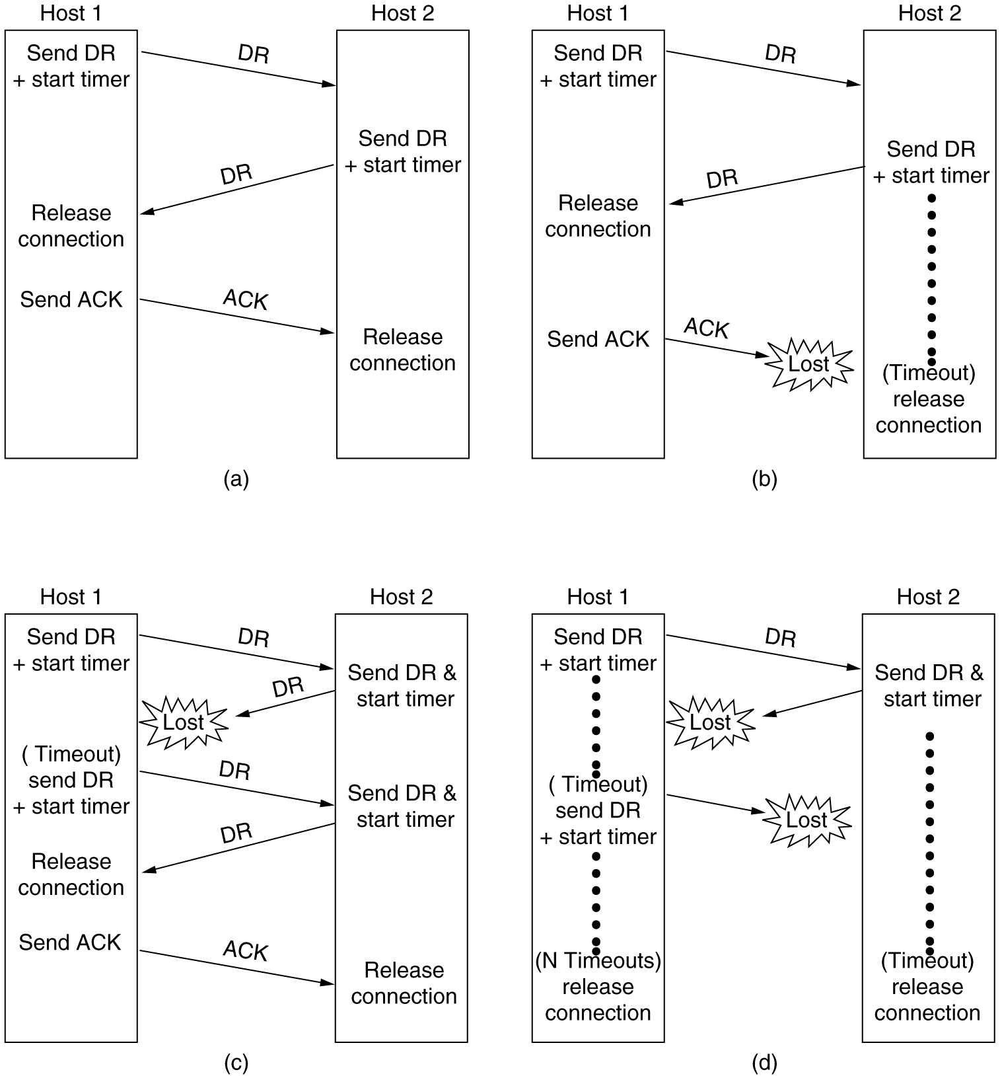
Connection Release in Practice
Take some risks when releasing a connection
Usual approach: Three-way handshake again
  Send disconnect request (DR)
  Set timer
  Wait for DR from peer
  Acknowledge DR
  Possibly retry
  Possibly time out

Slide 16
Problems for Connection Release
Problem cases for connection release with three-way handshake:
Lost ACK solved by
(optimistic) timer in Host 2
Timer solves (optimistically) case when 2nd DR and ACK are lost
Lost second DR solved by retransmission of first DR
Notes:
In welchem Fall scheitert das Protokoll, also gibt eine Verbindung unkorrekt auf?

Slide 17
Example: TCP Setup, Transmission, Release
Client
Server
[SYN, seq=17]
Connection setup:
  Three-way handshake
  Negotiation of window size, sequence numbers, TCP options
Data transfer:
  Piggybacked acknowledgements
Connection release:
  Confirmed
  Resources on client-side released after time-wait (frozen reference)
    E.g. 30 s, 1 min, 2 min
[SYN, seq=39, ACK=18]
Connection
Setup
[seq=18, ACK=40]
[seq=53, ACK=78, data=‚hi‘]
Data
Transfer
[seq=78, ACK=55, data=‚ho‘]
[FIN]
[ACK]
[FIN]
Connection
release
[ACK]
Time wait
Notes:
Verbindungsaufbau:
Der Initiator sendet ein TCP-Paket mit gesetztem SYN-Flag und einer frei gewählten initialen Sequenznummer.
Daraufhin antwortet der Gerufene mit einem TCP-Paket, bei dem das SYN-Flag ebenso wie das ACK-Flag gesetzt ist (oft auch als SYNACK bezeichnet), und bestätigt das empfangene Paket. Zudem wird ebenfalls eine Sequenznummer gewählt.
Schließlich wird mit dem dritten Paket vom Initiator der Verbindungsaufbau abgeschlossen. Hier ist das SYN-Flag nicht gesetzt, nur das ACK-Flag.
Datenübertragung:
BEIDE Partner können nun Daten vollduplex senden, hierbei bestätigt ein Paket mit gesetztem ACK-Flag immer den vollständigen Empfang aller Daten (byteorientiert!) bis zur angegebenen Sequenznummer-1.
Verbindungsabbau:
Auch der Verbindungsabbau ist bestätigt, der Initiator des Abbaus (was beide Partner sein können) startet mit einem TCP-Paket mit gesetztem FIN-Flag, dieses wird bestätigt. Ist der andere Partner ebenfalls zum Schließen bereit, so sendet auch er ein TCP-Paket mit gesetztem FIN-Flag, welches vom Initiator bestätigt wird. Damit ist die Verbindung für den Partner beendet. Der Initiator muss noch eine gewisse Zeit warten, bis die Verbindung endgültig beendet ist.

Slide 18
TCP State Transition Diagram
event/action
(e.g. receive/send)
CLOSED
Active open
/SYN
Passive open
Close
Close
LISTEN
SYN/SYN + ACK
Send/
SYN
SYN_RCVD
SYN/SYN + ACK
SYN_SENT
ACK
SYN + ACK/ACK
Close
/FIN
ESTABLISHED
Close
/FIN
FIN/ACK
FIN_WAIT_1
CLOSE_WAIT
FIN/ACK
ACK
Close
/FIN
ACK + FIN/ACK
FIN_WAIT_2
CLOSING
LAST_ACK
ACK
Timeout after two
ACK
FIN/ACK
segment lifetimes
TIME_WAIT
CLOSED
Notes:
Der in der vorigen Folie gezeigte Ablauf würde nacheinander die folgenden Zustände beim Initiator durchlaufen:
CLOSED – SYN_SENT – ESTABLISHED – FIN_WAIT_1 – FIN_WAIT_2 – TIME_WAIT – CLOSED
Bei der gerufenen Station müsste zunächst der LISTEN-Zustand eingenommen werden, damit überhaupt auf einen Verbindungsaufbauwunsch reagiert werden kann (typisch für z.B. Server). Die zugehörige Abfolge der Zustände wäre dann:
CLOSED – LISTEN – SYN_RCVD – ESTABLISHED – CLOSE_WAIT – LAST_ACK – CLOSED

Slide 19
Example
PS Z:\> Get-NetTCPConnection -LocalAddress 160.45.114.36
LocalAddress LocalPort RemoteAddress RemotePort State AppliedSetting OwningProcess
------------ --------- ------------- ---------- ----- -------------- -------------
160.45.114.36 61291 130.133.170.130 59531 Established Internet 7776
160.45.114.36 61289 130.133.170.200 59531 Established Internet 7776
160.45.114.36 58783 130.133.170.200 59532 Established Internet 7776
160.45.114.36 58500 160.45.41.101 49159 Established Internet 2012
160.45.114.36 58424 160.45.41.36 8194 Established Internet 2232
160.45.114.36 58366 91.190.217.52 12350 Established Internet 8768
160.45.114.36 58363 64.4.23.168 40048 Established Internet 8768
160.45.114.36 58362 160.45.41.142 445 Established Internet 4
160.45.114.36 58329 160.45.41.91 445 Established Internet 4
160.45.114.36 56972 130.133.170.200 59531 Established Internet 7776
160.45.114.36 53168 13.107.3.128 443 Established Internet 8768
160.45.114.36 53166 160.45.114.28 139 TimeWait 0
160.45.114.36 53157 160.45.41.90 80 TimeWait 0
160.45.114.36 53155 52.109.120.20 443 TimeWait 0
160.45.114.36 52582 65.52.108.74 443 Established Internet 8768
160.45.114.36 51739 65.52.139.168 443 Established Internet 8768
160.45.114.36 51507 160.45.41.90 10123 Established Internet 3500
160.45.114.36 51345 13.92.210.230 443 Established Internet 7596
160.45.114.36 50956 160.45.41.17 49687 Established Internet 2012
160.45.114.36 49740 160.45.114.36 8194 Established Internet 2192
160.45.114.36 49704 160.45.114.36 8194 Established Internet 2192
160.45.114.36 8194 160.45.114.36 49704 Established Internet 2232
160.45.114.36 8194 160.45.114.36 49740 Established Internet 2232
160.45.114.36 3985 0.0.0.0 0 Listen 8768
160.45.114.36 443 0.0.0.0 0 Listen 8768
160.45.114.36 139 0.0.0.0 0 Listen 4
160.45.114.36 80 0.0.0.0 0 Listen 8768

Slide 20
Questions & Tasks
  Why using a three-way handshake?
  What is piggy backing?
  Why does TCP use sequence numbers? What do these numbers count?
  Why can’t we guarantee the release of a connection? How is the problem “solved” in real systems?
  What can happen if the system freezes the resources too long or too short?

Slide 21
Flow Control in TCP
Recall: Flow control serves to prevent a fast sender from overrunning a slow receiver
Similar issue in link and transport layer
Additional problems in transport layer flow control:
  Many connections, need to adapt the amount of buffer per connection dynamically
    Instead of simply allocating fixed amount of buffer space per outgoing link
  Unlike link layer frames, transport layer PDUs can differ widely in size
  Network’s packet buffering capability clouds the picture
    Need to estimate how many packets are currently in transit

Slide 22
Flow Control Buffer Allocation
To support outstanding packets, sender either has to
  ... rely on receiver to process packets as they come in
    Out-of-order delivery, no applicable to all protocols, e.g. TCP
  ... assume that receiver has sufficient buffer space available
More buffer allows for more outstanding packets
  Necessary to obtain highly efficient transmission
    See bandwidth-delay product
How does sender have buffer assurance?
  Sender can request buffer space
  Receiver can tell sender about available buffer space
    For sliding window protocols: Set size of sender’s send window
Notes:
Flow con

Slide 23
Flow Control Permits and Acknowledgements
Two separate mechanisms:
  Permits
    “Receiver has buffer space, go ahead and send more data”
    Flow control
  Acknowledgements
    “Receiver has received certain packets”
    Error control
Can be combined with dynamically changing buffer space at receiver
  Due to different speed with which application actually retrieves received data from transport layer
  Example: TCP combines ACKs with sequence numbers
Combination of mechanisms has implications:
  TCP cannot distinguish between packet loss at receiver and in transit

Slide 24
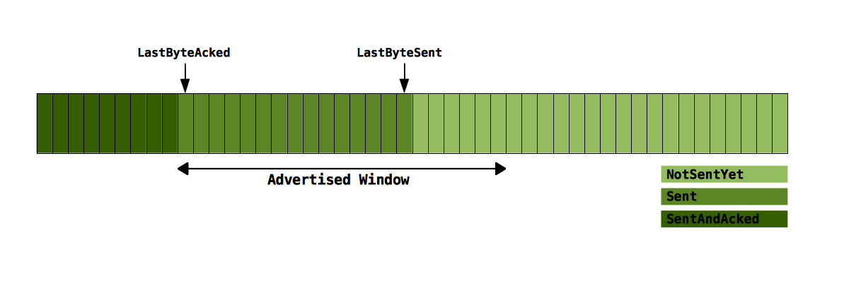
TCP Sender
Sent bytes need to be saved until they are acked
  When timer expires before a byte has been acked it is resent
Each time a packet is acked a new window size is advertised
  The window is moved to the right
Notes:
Note: check the sliding window explanation in the link layer chapter

Slide 25
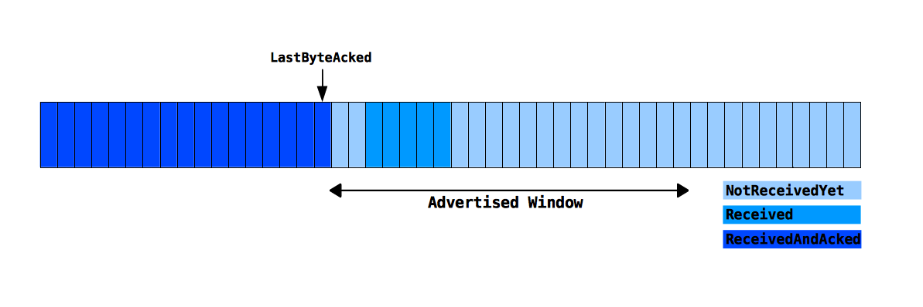
TCP Receiver
Application expects the data it receives to be in the correct order
  When bytes arrive out of order, the receiver must keep space in the buffer free (gaps)
Notes:
Note: check the sliding window explanation in the link layer chapter

Slide 26
Timeout Computations
Timeouts protect against lost packets
Timeouts should reflect round-trip time (RTT) between sender and receiver
  Problem: RTTs can be highly variable
    Range over several orders of magnitude
  Dynamic measurements/adaptation of RTTs
Simple approach: Keep a running average of RTTs
  Computed by an autoregressive model:
  EstimatedRTT_{n} = α EstimatedRTT_{n-1} + (1-α) RTTSample_{n}
    Parameter α smoothes estimation (α = 0.8, …, 0.9)
  (Conservative) timeout choice: 2 * EstimatedRTT

Slide 27
Problems with Timeout Computations
Simple algorithm cannot obtain correct RTT samples if packets have been retransmitted
  ACKs refer to data/sequence numbers, not to individual packets
Two examples:
Solutions:
  Karn/Partridge algorithm: Do not take RTT samples for retransmitted packets
  Jacobsen/Karels algorithm: Also consider variance of RTT
Sender
Receiver
Sender
Receiver
Original transmission
Original transmission
TT
TT
Retransmission
ACK
SampleR
SampleR
Retransmission
ACK

Slide 28
Timer and Packet Loss
Reaction to packet loss:
After packet loss is detected by timeout, transmission speed needs to slow down
Basic idea: Use successively larger timeout values
Exponential backoff: Double timeout value for each additional retransmission
  Multiplicative factor for exponential backoff is reset upon ACK arrival
  Reset connections if maximal timeout value (given by number of retries) is exceeded

Slide 29
TCP Fairness & TCP Friendliness
TCP Fairness:
  Adjust dynamically to available bandwidth
  Fairly share bandwidth among all connections
    If n connections share a given bottleneck link, each connection obtains 1/n of its bandwidth (in the long run)
Interaction with other protocols:
  Bottleneck bandwidth also depends on load of other protocols
    Example: UDP, which is has no built-in congestion control
  UDP traffic can potentially squeeze out TCP traffic
Other transport protocols should be TCP friendly:
  They should not consume more bandwidth than a TCP connection in a comparable situation
  UDP is not TCP friendly
    Workarounds using queuing and dropping techniques in routers
    Alternatives are available but little used up to now, e.g. Datagram Congestion Control Protocol (DCCP)

Slide 30
TCP Packet Header
0
16
31
Source Port
Destination Port
Sequence Number
Piggyback Acknowledgement
4 bit TCP
header
length
6 bit
unused
(= 0)
U
R
G
A
C
K
E
O
M
R
S
T
S
Y
N
F
I
N
Advertised Window
Packet
Header
Checksum
Urgent Pointer
Options (0 or more 32 bit words
Data…
Sometimes also called
PSH (Push-Bit) in literature.
Notes:
- Source- und Destinationport identifizieren die Endpunkte der Verbindung. Wie die Hosts ihre Ports zuweisen, bleibt ihnen überlassen (bis auf die standardisierten bis Nummer 1023)
- Sequence number enthält die Byte-Folgenummer
- Piggyback acknowledgement: Huckepackverschickung von Quittungen. Die nächste erwartete Folgenummer
- TCP header length: Anzahl der 32-bit-Wörter im Paketkopf
- URG: Wird auf 1 gesetzt, falls der Urgent Pointer verwendet wird
- SYN: Wird beim Verbindungsaufbau verwendet, um CONNECT.Req/Ind anzuzeigen
- ACK: Unterscheidet bei gesetztem SYN-Bit eine CR-PDU von einer CC-PDU.
Signalisiert die Gültigkeit des Acknowledgement-Feldes
- FIN: Gibt an, dass der Sender keine Daten mehr senden möchte
- RST: Wird benutzt, um eine Verbindung zurückzusetzen
- EOM (bzw. PSH): Dieses Bit zeigt das Ende einer Nachricht an
- Window: Dient zur Flusskontrolle. Anzahl der Bytes, die nach dem höchsten bestätigten Byte gesendet werden dürfen
- Checksum: Enthält die Prüfsumme über Paketkopf und Daten
- Urgent Pointer: Relativer Zeiger auf wichtige Daten
- Das Options-Feld kann Optionen variabler Länge aufnehmen

Slide 31
TCP – Summary
TCP provides a reliable byte stream using
  Connection management – three-way
  handshake for setup and teardown
  Error control via Go-Back-N or Selective Repeat (depending on version)
  Flow control using advertised receiver window
  Congestion control using exponential backoff, AIMD, slow start, congestion threshold (see literature)
TCP semantics/parameters are quite subtle
  Non-trivial step from unreliable datagram service to efficient reliable byte stream
  Interaction of TCP with other layers is more complicated than it looks because of hidden, implicit assumptions
    Example: Packet loss is not an indication of congestion in wireless networks
  Many little details and extensions are not discussed here

Slide 32
Conclusion
Transport protocols can be anything from trivial to highly complex, depending on the purpose they serve
They determine to a large degree the dynamics of a network and – in particular – its stability
  It is trivial to build TCP protocols “faster”, but they (or the network) are less stable
Interdependencies of various mechanisms in a transport protocols can be very subtle with big consequences
  Examples: Fairness, coexistence of different TCP flavors, ...
More in Telematics
  SCTP, DCCP, MP-TCP… still ongoing research!

Slide 33
Content
Networked Computer & Internet
Host-to-Network
Internetworking
Transport Layer
Applications
Network Security
Example

Slide 34
Questions & Tasks
  What is the difference between flow, error, and congestion control?
  Why is it problematic to combine the mechanisms e.g. in TCP?
  What is the impact of the bandwidth-delay product on flow control?
  What contributes to the RTT? Why is it not that simple to calculate a correct time-out?
  TCP fairness sounds fine. But what happens in case of short-lived connections (e.g. web requests)?
  Why should protocols be “TCP friendly”? What happens if they are not?

