Slide 1
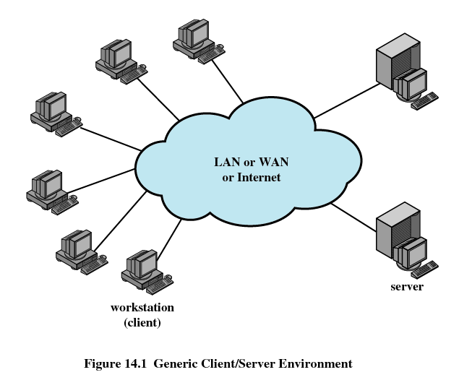
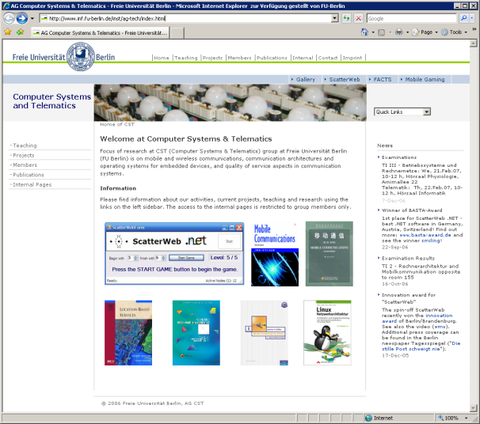
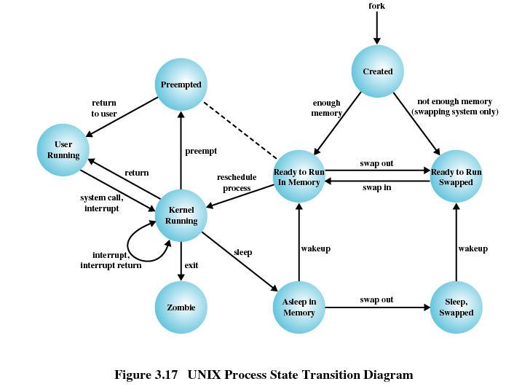
TI III: Operating Systems & Computer Networks
Example
Prof. Dr.-Ing. Jochen Schiller
Computer Systems & Telematics
Freie Universität Berlin, Germany

Slide 2
Content
Networked Computer & Internet
Host-to-Network
Internetworking
Transport Layer
Applications
Network Security
Example

Slide 3
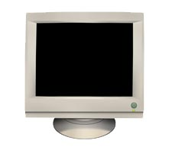

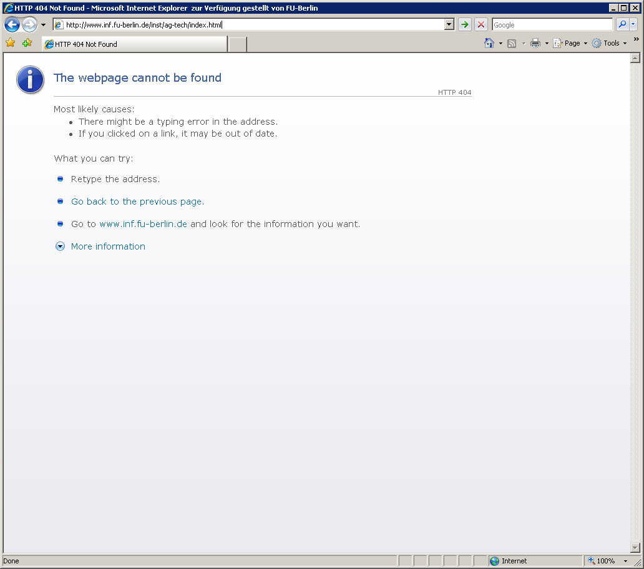
A Comprehensive Example
What happens if one presses a key on the computer?
What if that key causes an web page to be displayed?
?
?

Slide 4
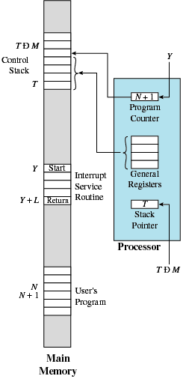
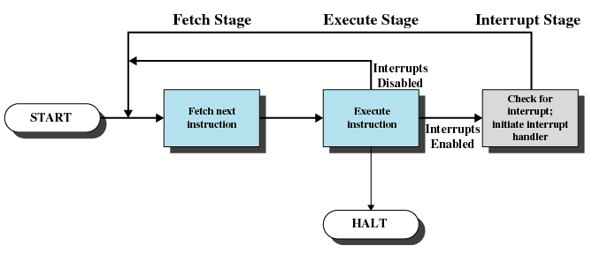
Keyboard Interrupt
Keyboard controller raises interrupt flag
CPU interrupts execution of current process and starts Interrupt Service Routine (ISR)
  Unconditional jump

Slide 5
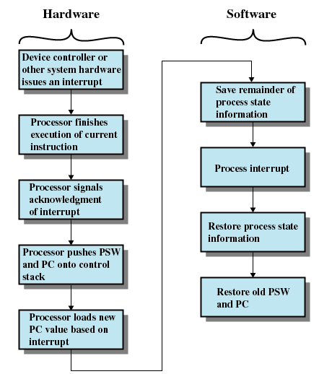
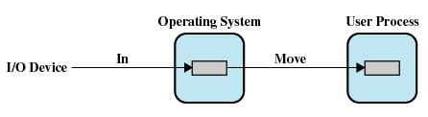
Keyboard Interrupt Handling
ISR processes input from keyboard
  Clears interrupt flag
  Transfers data from device into buffer
  Establishes owner of device
  Triggers notification of user process

Slide 6
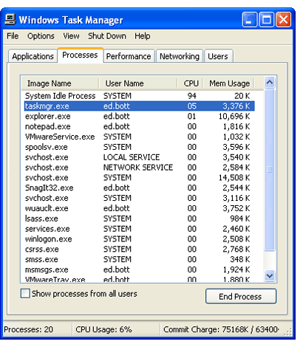
In the Meantime…
Web browser is one of many processes running locally
Other processes include
  Other user processes (possibly of different users)
  System processes implementing system
  services
  Kernel processes

Slide 7
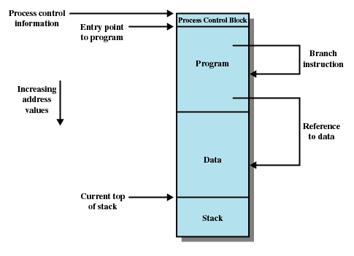
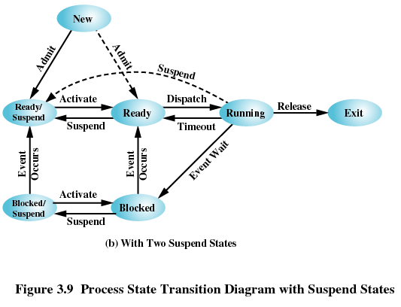
Web Browser Process in Detail
Web browser processes
  Currently waiting for input
    E.g. using select()
  Process state blocked

Slide 8
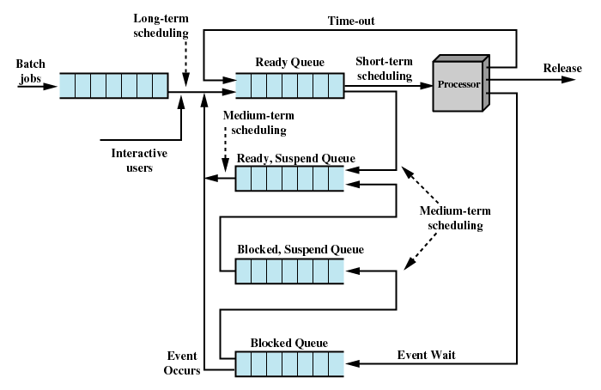
Reaction to External Event
ISR changes process state to ready
Scheduling algorithm eventually changes process state to running
2.
1.
2.
1.

Slide 9
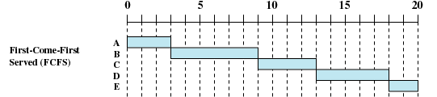




Process Scheduling
A (3)
B (6)
C (4)
D (5)
E (2)
Scheduling is handled by variety of scheduling algorithms
  Non-preemptive / preemptive
  Maximize throughput, responsiveness, etc...
Processes may have priorities
  Priority inversion due to
  lock on shared resources
  Priority inheritance

Slide 10
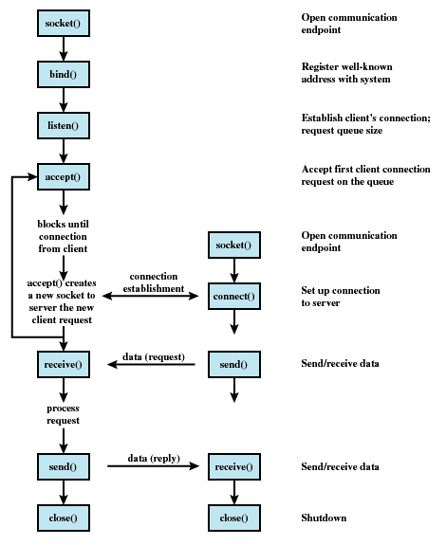
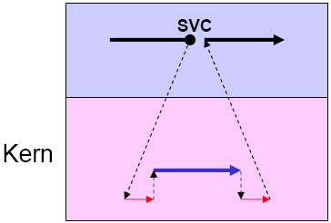
Web Browser Processes Event
Assume input requires web browser to display a web page with a given URL
  String processing (user space)
  Connect to server and retrieve necessary data (system calls)
  Render web page (user space)
  Update user interface (system calls)

Slide 11
Client/Server Communication
GET /inst/ag-tech/index.html HTTP/1.1
Host: www.inf.fu-berlin.de
Pragma: no-cache
....

Slide 12
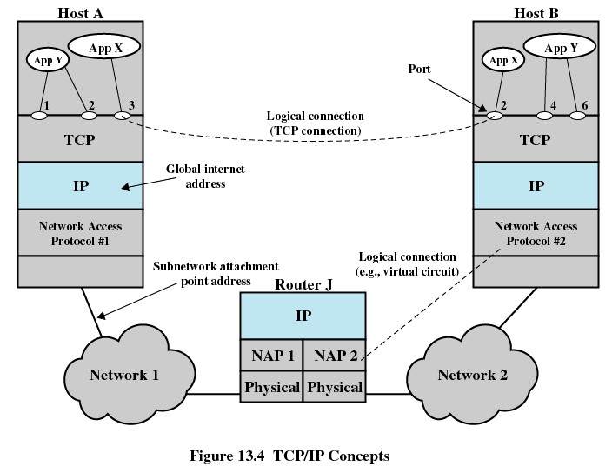
Layered Protocol Stack
Web Browser
Web Server
Host corres-
ponding to URL

Slide 13
Interaction Between Network Layers
TCP
UDP
4
Layered protocol architecture
  Each layer uses only services of layer directly below
  Each layer provides services to layer directly above
  Protocol independence
  Modularity
Data encapsulation
  Lower layers treat upper layer packets as simple data
  Headers contain control information for each layer
  Repeated encapsulation causes overhead
ICMP
ARP
IP
3
Host-to-Network
2
AH Application Header
PH Presentation Header
SH Session Header
TH Transport Header
NH Network Header
DLH Data Link Header
DLT Data Link Trailer
User data
Application layer
AH
data
Application layer
Presentation
layer
sending
Presentation
layer
PH
data
receiving
Session layer
SH
data
Session layer
Transport
layer
TH
data
Transport
layer
Network
layer
NH
data
Network
layer
Data link layer
DLH
data
DLT
Data link layer
Physical layer
bits
Physical layer

Slide 14
Uniform Resource Locator (URL)
http: Hypertext Transfer Protocol (HTTP)
  Protocol for accessing web pages and related content
  Implies communication over port 80 (unless other port given in URL)
cst.mi.fu-berlin.de: Host name
  Resolved to IP address via Domain Name System (DNS)
  cst.mi.fu-berlin.de -> 160.45.117.167
index.html: Local resource name
  Protocol specific parameter
  Handled by web server
http://cst.mi.fu-berlin.de/index.html

Slide 15
Security: HTTP over TLS/SSL
HTTPS authenticates server and
establishes secure connection:
Propose SSL parameters, send random number
Agree to parameters, send random number
Send public key certificate
Conclude handshake negotiation
Send random number encrypted with server’s public key
  Client and server derive session key from all three random numbers
Activate negotiated parameters
Send encrypted hash over previous messages
  Server decrypts and verifies message
Activate negotiated parameters
Send encrypted hash over previous messages
  Client decrypts and verifies message
Proceed to exchange regular HTTP data over secure channel
1
2
3
4
5
6
7
8
9
Source: Cisco Systems. Application Control Engine Module SSL Configuration Guide
Notes:
PGP (Pretty Good Privacy) ist ein Programmpaket, das Verschlüsselung, Authentifizierung und Kompression für E-Mails in einfach zu verwendender Form zur Verfügung stellt und für viele Plattformen frei verfügbar ist (z.B. Windows, Linux, Solaris, MacOS). Der Ablauf beim Versenden einer E-Mail sieht dabei wie folgt aus:
- Zunächst wird anhand der Originalnachricht mithilfe von MD5 ein Hash-Code berechnet. Dieser wird mit dem Private-Key des Absenders verschlüsselt und an die eigentliche Mitteilung angefügt. Entschlüsselt der Empfänger später diesen Hash-Code mit dem Public-Key des Absenders und stimmt der entschlüsselte Wert mit der eigenen MD5-Berechnung überein, so ist zum einen die Authenzität (nur der Sender konnte eine Nachricht erzeugen, die sich mit seinem Public-Key entschlüsseln lässt), zum anderen die Integrität der Mitteilung (MD5 garantiert, dass eine Nachricht mit gleichem Hash-Code nicht in vertretbarer Zeit konstruiert werden kann) sichergestellt.
- Diese Kombination aus verschlüsseltem MD5-Hash-Code und eigentlicher Nachricht wird mithilfe des Ziv-Lempel-Algorithmus („ZIP“) komprimiert.
- Danach wird eine beliebige Eingabe des Benutzers eingesetzt, um einen 128-Bit-Schlüssel für das IDEA (International Data Encryption Algorithm)-Verfahren zu erzeugen. Hierzu wird der Inhalt der Eingabe sowie die Eingabegeschwindigkeit, d.h. die Abstände zwischen den einzelnen Buchstaben, herangezogen. Die Nachricht wird daraufhin verschlüsselt und der mit dem Public-Key des Empfängers verschlüsselte IDEA-Key ebenfalls der Nachricht angefügt.
- Danach wird die Mitteilung mithilfe der base64-Kodierung über eine Kette von MTAs zum Ziel übertragen. Der Empfänger kann mithilfe seines persönlichen Private-Keys den IDEA-Key und so die schließlich gesamte Nachricht entschlüsseln.

Slide 16
Connection Setup / Transport Layer
Client
Server
[SYN, seq=17]
[SYN, seq=39, ACK=18]
Connection
setup
Reliable end-to-end connection between processes
Call to connect() initiates connection setup
  TCP 3-way handshake
  Connection parameters
[seq=18, ACK=40]
[seq=53, ACK=78, data=‚hi‘]
Data
transfer
CLOSED
[seq=78, ACK=55, data=‚ho‘]
Passive open
Close
Active open
/SYN
Close
[FIN]
LISTEN
SYN/SYN + ACK
Send/
SYN
[ACK]
SYN_RCVD
SYN/SYN + ACK
SYN_SENT
ACK
SYN + ACK/ACK
Connection
release
[FIN]
Close
/FIN
ESTABLISHED
[ACK]
FIN_WAIT_1
Close
/FIN
FIN/ACK
CLOSE_WAIT
FIN/ACK
Time wait
ACK
ACK + FIN/ACK
Close
/FIN
FIN_WAIT_2
CLOSING
LAST_ACK
ACK
Timeout after two
ACK
FIN/ACK
TIME_WAIT
segment lifetimes
CLOSED

Slide 17
Structure of Network Layer IP-Packet
Congestion control (Explicit Congestion Notification)
Don‘t Fragment
Reserved
More Fragments
QoS class
DiffServ Codepoint
ECN
0
DF
MF
Bit
0
3
7
15
31
Version
Hdr.Len
DiffServ
Total Length
Identifier
Flags
Fragment Offset
Time to Live
Protocol
Header Checksum
Source Address
IP Header
Destination Address
Options and Padding
Data

Slide 18
Network Layer Routing (Local Scope)
Globally unique per host addressing
Routers maintain tables of known networks
  Optional route to default gateway
Subnetting implements logical structure
  Subnet mask builds hierarchy using host part of IP address
  Limits broadcasts
  More efficient routing
Network topology may be part of security concept
160.45.114
Campus - Institute
Router
160.45.113
Router
160.45
160.45.115
Campus
backbone
Router
160.45.117
Internet

Slide 19
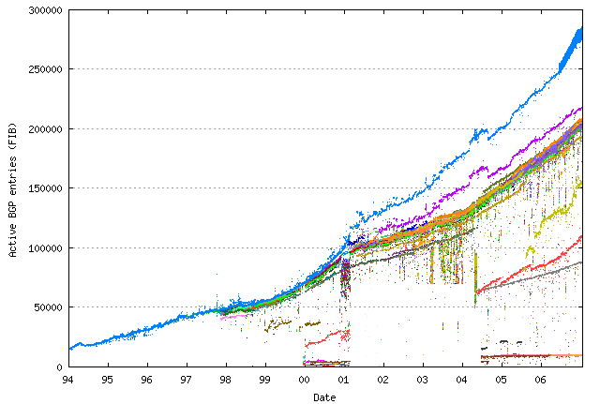
Network Layer Routing (Global Scope)
Internet organized into autonomous systems (AS)
  Commonly, one AS per major organization
  Peering points to exchange data between ASs
Intra-domain routing: OSPF, link state algorithm
Inter-domain routing: BGPv4, distance vector protocol
  May involve non-technical routing choices
Intra Domain Routing
Inter Domain Routing
Large
company
Consumer
ISP 1
Backbone service provider 2
Peering point
Consumer
ISP 2
Small
company 2
Small
company 1

Slide 20
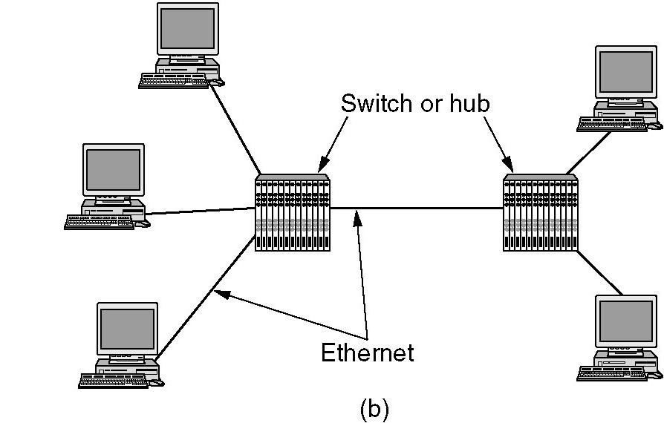
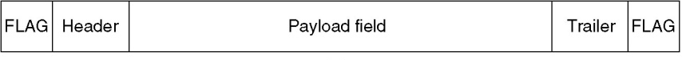
Data Link Layer Communication (Local Scope)
Transparent communication between two directly connected nodes
Services include: framing, error control, connection maintenance, acknowledgements, flow control
Congestion control (Explicit Congestion Notification)
Don‘t Fragment
QoS class
Reserved
More Fragments
DiffServ Codepoint
ECN
0
DF
MF
Bit
0
3
7
15
31
Version
Hdr.Len
DiffServ
Total Length
Identifier
Flags
Fragment Offset
Time to Live
Protocol
Header Checksum
Source Address
IP Header
Destination Address
Options and Padding
Data

Slide 21
Error Detection: Cyclic Redundancy Check (CRC)
Reception of a correct bit sequence:
11 0011 1001 ÷ 1 1001 = 10 0001 (mod 2)
11 001
00 0001 1001
1 1001
0 0000 = remainder
  No remainder, thus the received bits should be error free
Reception of a erroneous bit sequence:
11 1111 1000 ÷ 1 1001 = 10 1001 (mod 2)
11 001
00 1101 1
1100 1
0001 0000
1 1001
0 1001 = remainder ≠ 0
  There is a remainder unequal 0, thus there was definitely a transmission error

Slide 22
Errors During Transmission
Data
0 1 0 1 1 0 0 1 1 0 0 1 0 1 0
Signal
Inter-
ference
Signal with inter-ference
Sampling
Received
0 1 0 1 1 0 1 1 1 0 0 0 0 1
data
Original data
0 1 0 1 1 0 0 1 1 0 0 1 0 1
Error!

Slide 23
Physical Layer
Wired transmission
Twisted pair
Coaxial cable
Wave guide
Optical fibers
Packet / sequence of bits turned into physical signal
Signal propagation depends on physical medium (limited bandwidth, attenuation, dispersion) and background noise
Mapping between bits and (multi-valued) symbols
Baseband transmission vs. modulation (broadband transmission)
Hz
10³
10⁵
10⁷
10⁹
10¹¹
10¹³
10¹⁵
Long wave
Classical radio
Short wave
Micro waves
Infra red
TV
Visible light
Wireless transmission
Twisted pair
Coaxial
Optical fiber
Copper core
Insulation
Copper core
Insulation
Shielding
Insulation and
mechanical protection
LED
Laser diode
Glas core
Protective layers

Slide 24
Client/Server Communication
GET /inst/ag-tech/index.html HTTP/1.1
Host: www.inf.fu-berlin.de
Pragma: no-cache
....

Slide 25
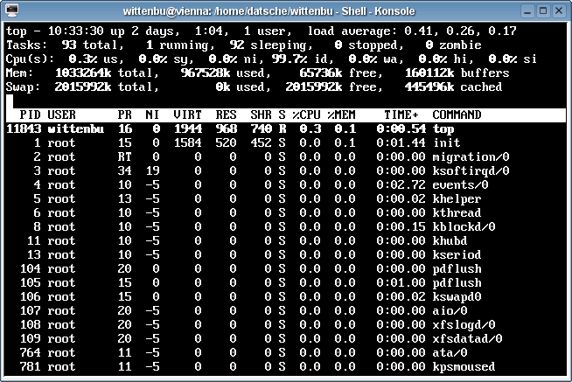
At the Server…
Web server is one of many processes running locally
Upon receiving packet, network interface controller (NIC) will raise interrupt
Kernel will handle the packet and notify the web server process

Slide 26
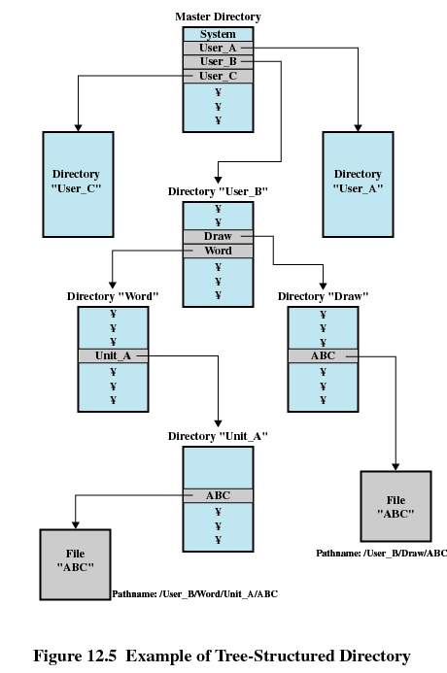
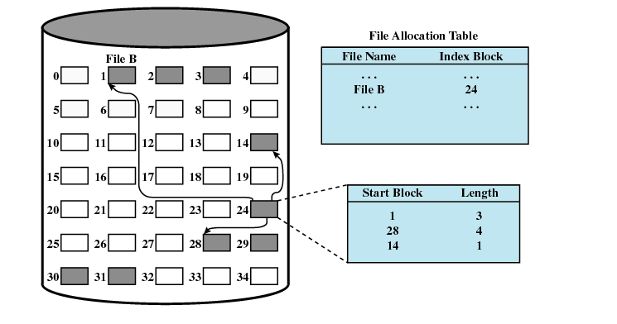
Processing of HTTP-GET Request
Web server retrieves file inst/ag-tech/index.html from local file system
  System calls to access secondary storage
  Kernel maps file name to data layout on disk
Web server sends data to client

Slide 27
Server Replies to Client
HTTP/1.1 200 OK
Date: Fri, 16 Feb 2007 11:40:34 GMT
Server: Apache/1.3.6 (Unix)
Transfer-Encoding: chunked
Content-Type: text/html
<HTML>
Document according to HTML
</HTML>

Slide 28
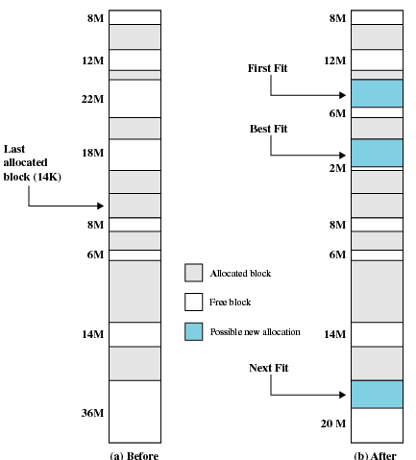

Client Data Processing
Client host receives packet
Kernel hands data to web browser process
Web browser renders page
  May have to allocate memory in the process
Finally, browser updates user interface via system call

Slide 29
A Comprehensive Example
!
!

Slide 30
Content
Introduction and Motivation
Subsystems, Interrupts and System Calls
Processes
Memory
Scheduling
I/O and File System
Booting, Services, and Security
Networked Computer & Internet
Host-to-Network
Internetworking
Transport Layer
Applications
Network Security
Example

Slide 31
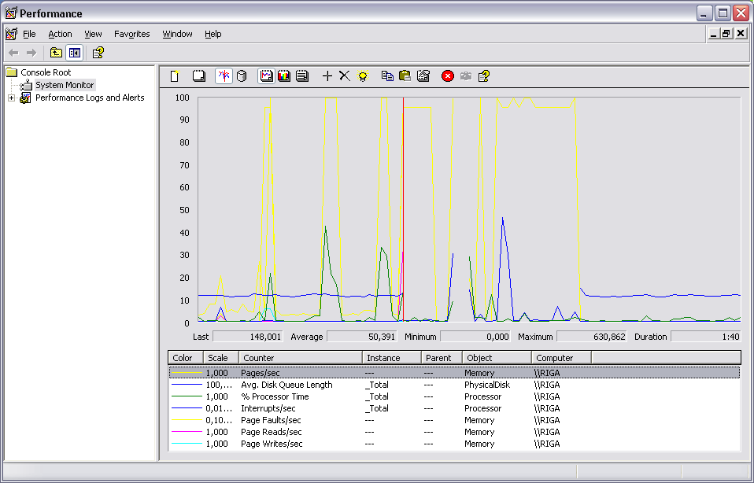
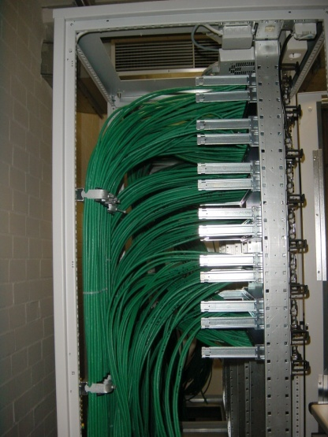
Fin

